Slide 1


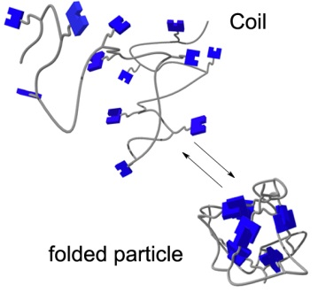
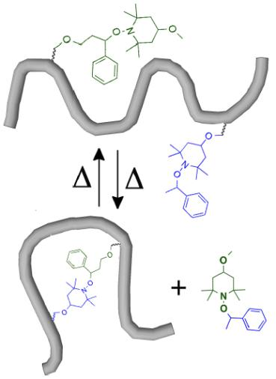
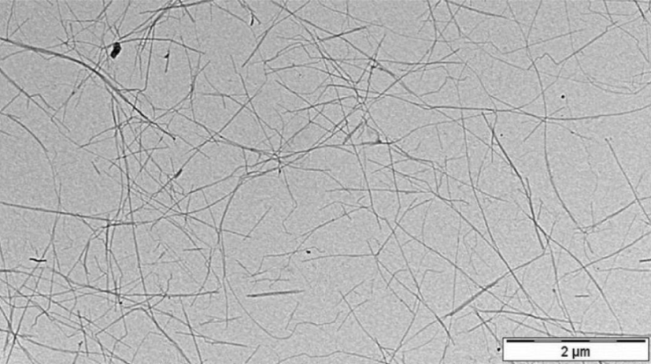
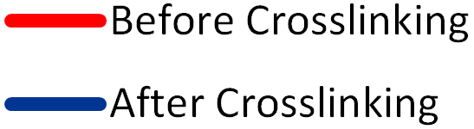
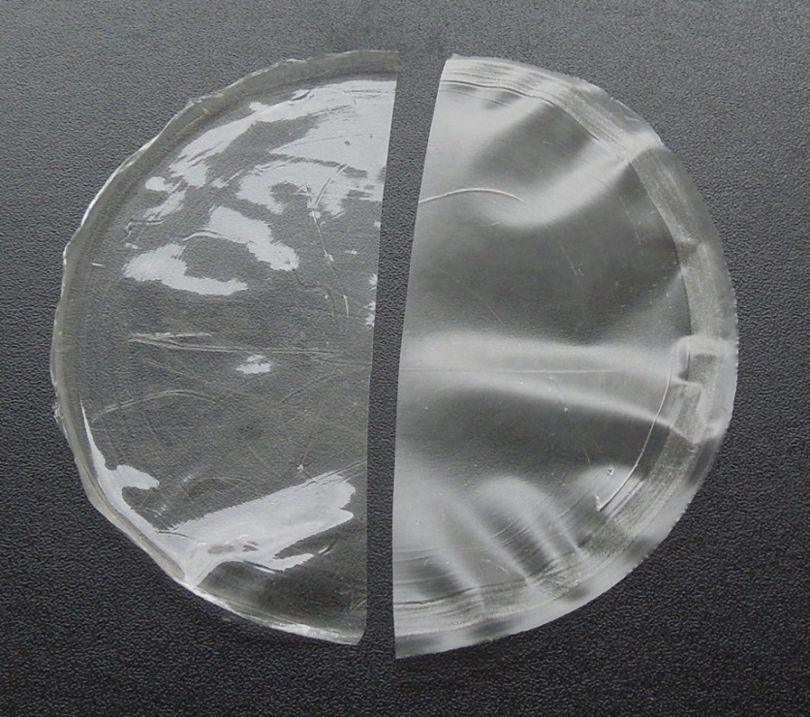
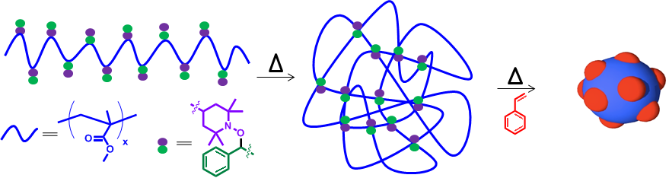
Radically-Exchangeable Alkoxyamines as Heat-Responsive Crosslinkers for Polymeric Nanostructures and Nanocomposites
Odin Achorn, Danming Chao, Erik Berda,* and Johan Foster*
obz2@wildcats.unh.edu; Parsons Hall, 23 Academic Way, Durham NH 03824
Introduction
We report progress toward the synthesis of single-chain polymer nanoparticles (SCNPs) and cellulose-reinforced nanocomposites with the use of radically-exchangeable alkoxyamine crosslinkers. Crosslinking was achieved by complementary interactions between two different alkoxyamines in the materials. Heat was used to cleave the two alkoxyamines homolytically, leaving nitroxide radicals bonded to some points of the material and benzylic radicals to other points. Bonding between these complementary radicals caused the materials to crosslink. Crosslinked nanoparticles were analyzed by size exclusion chromatography (SEC), and crosslinked nanocomposites were analyzed by dynamic mechanical thermal analysis (DMTA).
Alkoxyamines
Hydroxyl-substituted alkoxyamines were synthesized by a published method (1) and by a method provided by Dr. Hideyuki Otsuka (2).¹ Methacrylate monomers were synthesized by reacting the hydroxyl-substituted alkoxyamines with 2-isocyanatoethyl methacrylate.² Alkoxyamines were activated for functionalization of materials with 1,1’-carbonyldiimidazole (CDI).
Scheme 2. Synthesis of alkoxyamine monomers.
Scheme 1. Synthesis of hydroxyl-substituted alkoxyamines.
Scheme 3. Synthesis of CDI-activated alkoxyamines.
Nanoparticles
Atom transfer radical polymerization was used to incorporate alkoxyamine-functionalized monomers into a poly(methyl methacrylate)-based polymer.³ The polymer was heated to homolyze the alkoxyamine C–O bonds, enabling radical exchange and crosslinking.³ Intramolecular crosslinking should cause the polymers to fold into SCNPs.
Crosslinking at 1.0 mg/mL broadened the size distribution, indicating intramolecular and intermolecular crosslinking. The 0.5 mg/mL reaction shows an increase in retention time, which seems to indicate that intramolecular crosslinking and SCNP formation is favored.⁴
Nanocomposites
Nanocomposites are materials with two phases finely dispersed at the nanometer scale. In this project, rigid cellulose nanocrystals (CNCs) were dispersed in a soft poly(vinyl acetate) (PVAc) matrix. The CNCs set up a scaffold to impart their rigidity to the material.⁵ The two materials were functionalized with complementary alkoxyamine crosslinkers.
Heat-induced crosslinking between the scaffold and matrix increased the interaction between the two phases, increasing the temperature at which the material transitions from a strong, glassy state to a weaker, rubbery state (glass transition temperature, T_{g}).
Scheme 4. Copolymerization of the two alkoxyamine monomers with methyl methacrylate.
Table 1. Polymer size data
1.0 mg/mL Reaction | M_{N} (g/mol) | M_{W} (g/mol) | PDI | Rh(n) (nm)
Before Crosslinking | 2.42×10⁴ | 2.65×10⁴ | 1.10 | 3.2
After Crosslinking | 4.76×10⁴ | 7.05×10⁴ | 1.48 | 5.5
Scheme 5. Crosslinking between PVAc and CNCs.
0.5 mg/mL Reaction | M_{N} (g/mol) | M_{W} (g/mol) | PDI | Rh(n) (nm)
Before Crosslinking | 1.29×10⁵ | 1.50×10⁵ | 1.16 | 8.4
After Crosslinking | 2.04×10³ | 3.20×10³ | 1.57 | 1.2
Figure 3. TEM of CNCs.⁵ The CNCs set up a scaffold in the PVAc matrix.
Figure 1. Crosslinking reaction.
1.0 mg/mL Reaction
0.5 mg/mL Reaction
Figure 2. Light Scatter (LS) and Refractive Index (RI) SEC traces of polymers before and after crosslinking at 1.0 and 0.5 mg/mL in toluene.
Figure 4. Plain PVAc on the left and nanocomposite on the right.
Figure 5. Dynamic Mechanical Thermal Analysis of nanocomposite film before and after crosslinking.
Future Work
Once conditions are optimized for making SCNPs, the alkoxyamine crosslinks will be used to polymerize styrene.¹ This may lead to phase-separated nanoparticles with immiscible polystyrene blocks on the surface of the poly(methyl methacrylate) core.
Conclusions
Alkoxyamines have been shown to be effective at making crosslinks in polymeric nanoparticles and nanocomposites. Heating polymers with pendant complementary alkoxyamines resulted in different sized particles due to intramolecular and intermolecular crosslinking. A reaction concentration of 0.5 mg/mL seems to favor the formation of smaller particles. Heating a nanocomposite film of alkoxyamine-functionalized CNCs in an alkoxyamine-functionalized PVAc matrix increased its T_{g}.
Figure 3. Phase-separated nanoparticle formation by polymerization of an immiscible block through SCNP crosslinks.
References
Acknowledgements
We thank the UNH Chemistry Department, the UNH Hamel Center for Undergraduate Research, and the Adolphe Merkle Institute for funding this project. Additional thanks go to Dr. Hideyuki Otsuka for his advice on synthesizing alkoxyamines and to the members of the Berda group and the AMI Polymer Chemistry & Materials group for their help.
Nicolay, R.; Matyjaszewski, K. Macromolecules. 2011, 44, 240-247.
Amamoto, Y.; Higaki, Y.; Matsuda, Y.; Otsuka, H.; Takahara, A. J. Am. Chem. Soc. 2007, 129, 13298-13304.
Su, J.; Amamoto, Y.; Nishihara, M.; Takahara, A.; Otsuka, H. Polym. Chem., 2011, 2, 2021-2026.
Tuten, B. T.; Chao, D.; Lyon, C. K.; Berda, E. B. Polym. Chem., 2012, 3, 3068-3071.
Biyani, M.V.; Foster, E.J.; Weder, C. ACS Macro Lett. 2013, 2, 236−240.

