Slide 1
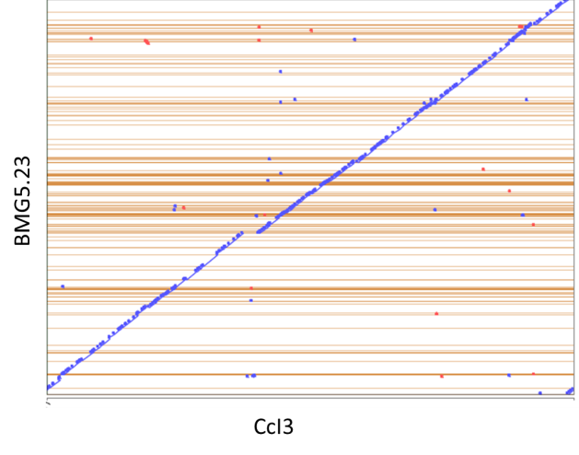
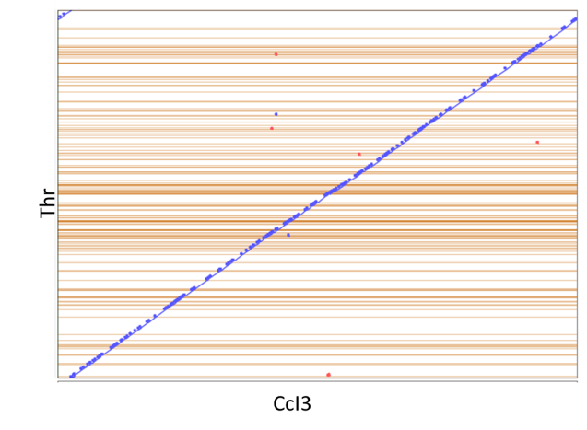
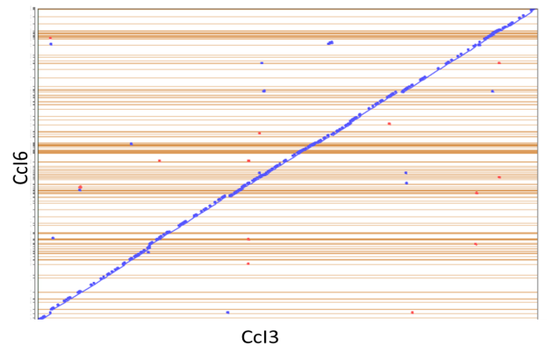
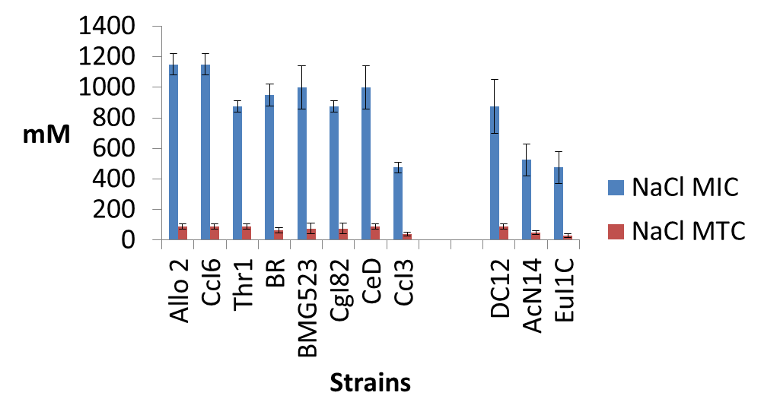
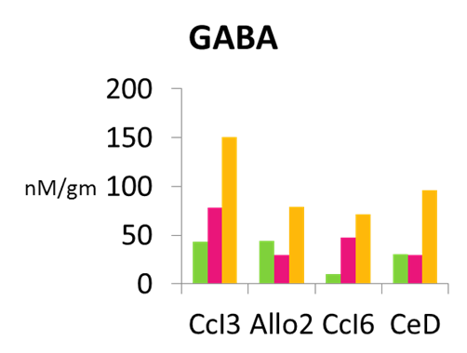
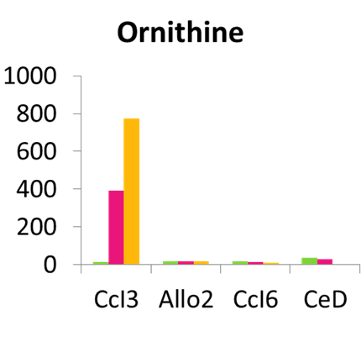
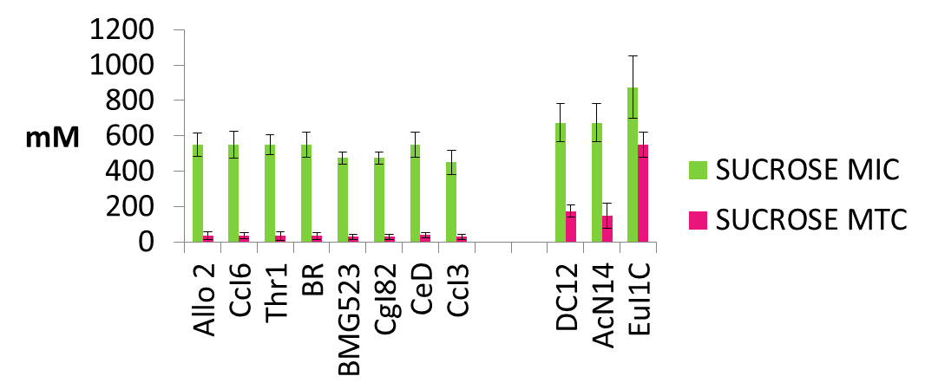
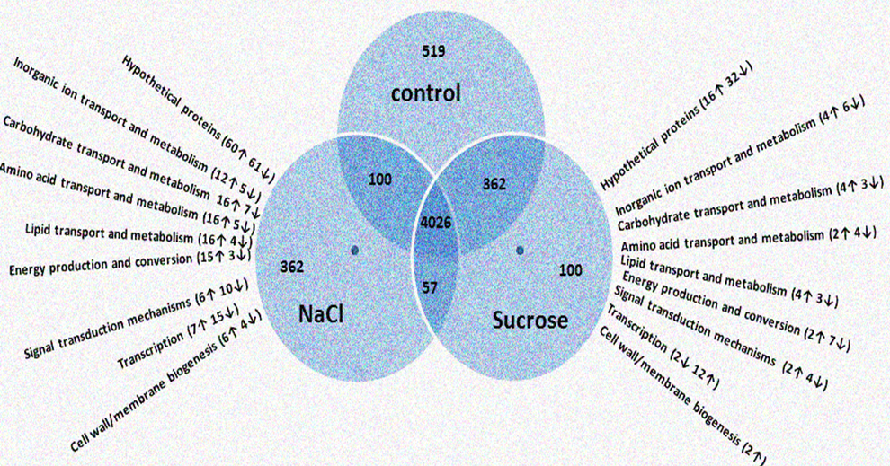
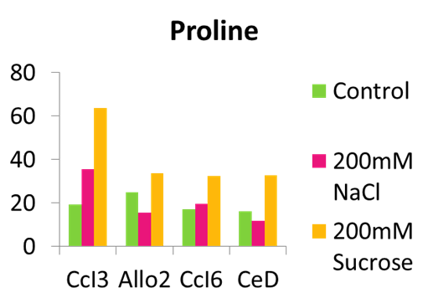
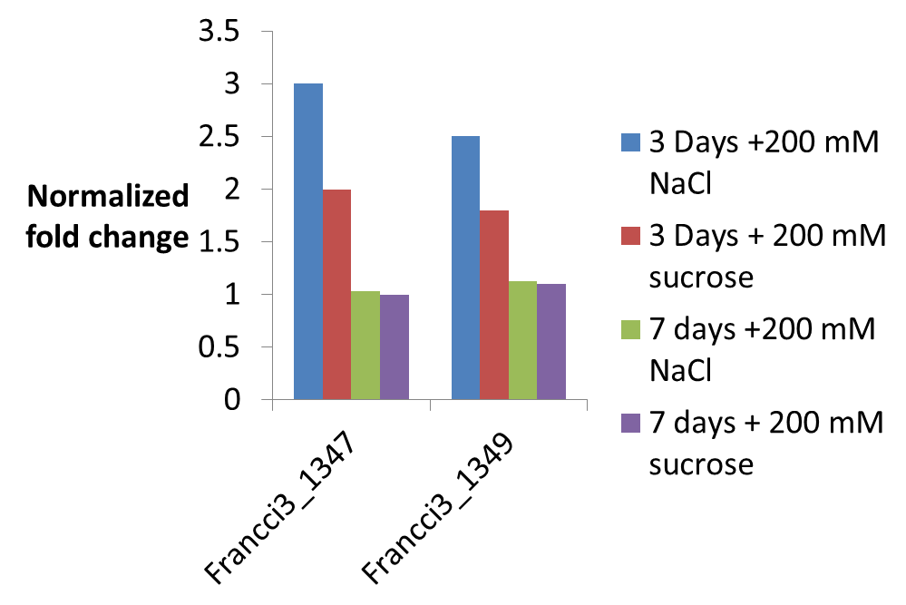
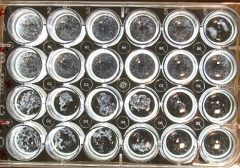
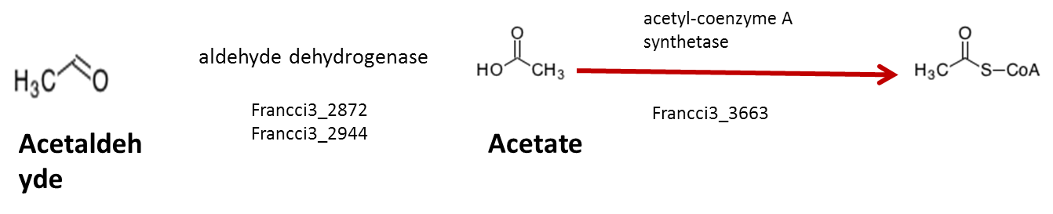
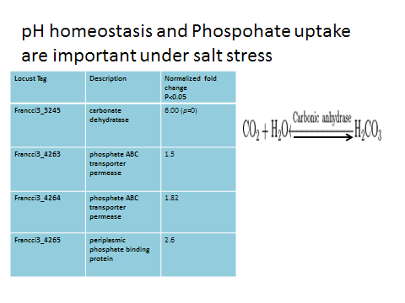
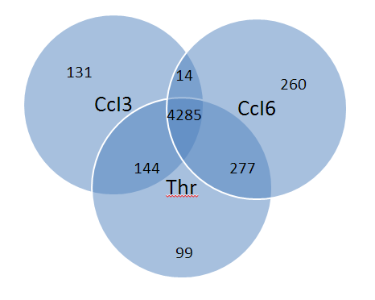
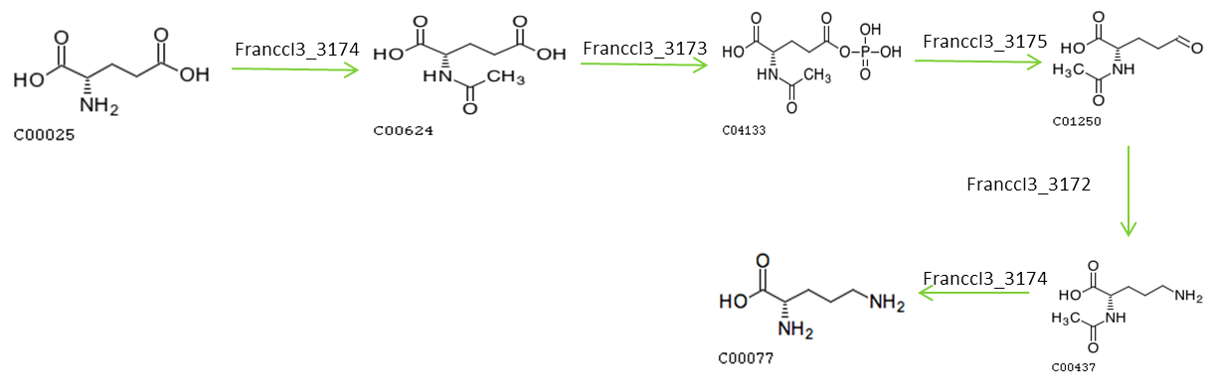
Identification and Molecular Characterization of Salt Stress Tolerance in Frankia Isolates from Casuarina Plants
Rediet OSHONE¹, Mariama NGOM^{2,3,5}, Nathalie DIAGNE^{3,5}, Diegane DIOUF^{3,5}, Valérie HOCHER^{4,5}, Mame Oureye SY^{2,5}, Laurent LAPLAZE^{4,5}, Antony CHAMPION^{3,4,5}, and Louis S. TISA¹
1. University of New Hampshire, USA 2. Laboratoire Campus de Biotechnologie Végétale, Faculté des Sciences & Techniques, Université Cheikh Anta Diop (UCAD), Dakar, Sénégal 3. Laboratoire Commun de Microbiologie IRD/ISRA/UCAD, Dakar, Sénégal 4. Equipe Rhizogenèse, UMR DIADE, IRD, Montpellier, France 5. Laboratoire mixte international Adaptation des Plantes et microorganismes associés aux Stress Environnementaux (LAPSE), Dakar, Sénégal
Introduction
Results
Results
CcI3 identified as the most salt sensitive strain, while Allo2, BMG5.23, CcI6, and CeD are salt tolerant
Genomic synteny of CcI3 to CcI6, Thr, and BMG5.23
Membrane composition changes under salt stress
Salt sensitive strain shows drastic change in amino acid profile under stress
Salinization of soils and groundwater is a serious problem causing drastic reduction in agricultural production. Actinorhizal plants form a symbiotic association with the actinobacteria, Frankia, and are able to tolerate a variety of abiotic stresses including salt stress. Among the actinorhizal plants, some trees of the genus Casuarina have been shown to grow well under these conditions. The bacterial partner, Frankia, of the actinorhizal symbiosis plays a role in the ability of these plants to survive under harsh conditions. The aim of this study was to identify salt-tolerant Frankia strains and to determine the genes responsible for the molecular mechanisms of salt stress tolerance.
RNA sequencing based differential gene expression analysis in CcI3 exposed to salt and osmotic stress
Trehalose biosynthesis is involved in the early response to salinity
Functional category comparison
*
*
*
Conclusion
*
These preliminary results are uncovering the mechanisms of salt stress tolerance in Frankia
Material and Methods
References
A 24-well growth assay was used to determine salt tolerance levels for Frankia strains.
1. Benson DR and Silvester WB 1993 Biology of Frankia strains,actinomycete symbionts of actinorhizal plants
2. Furnholm T et al. 2012. Development of a semi-high-throughput growth assay for filamentous actinobacteria Frankia. Arch. Microbiol. 194 13–20
3. Hurst et al. 2014. Draft genome sequence of Frankia sp. Strain Thr. genomeA
4. Ghodhbane-Gtari F. et al. 2013 Draft Genome Sequence of Frankia sp. strain BMG5.23 genomeA
5. Mansour et al.2014. Draft genome sequence of Frankia sp. Strain CcI6. 2(1): e01205-13
6. Oshone R et al. 2013. Effect of salt stress on the physiology of Frankia sp. strain CcI6. J. Biosci. 38:699–702
7. Rengasamy P 2006 World salinization with emphasis on Australia. J. Exp. Bot. 57 1017–1023
A 24 well plate growth assay ²
Aldehyde detoxification is important in salt stress tolerance
pH homeostasis and Phospohate uptake are important under salt stress
RNA sequencing was performed in triplicate for cells under salt and osmotic stress.
The genomes of salt tolerant strains were sequenced and compared to the genome of the salt sensitive strain.
Quantitative PCR was performed on a sub set of the genes to confirm results of the RNA seq analysis.
Amino acid analysis was used to determine changes in the amino acid profile under salt stress.
Analysis of homologous coding sequences
Ornithine Biosynthesis is up regulated under salt stress
Acknowledgement
This research is supported in part by Hatch NH585, JGI 2012 CSP585, and by the College of Life Sciences and Agriculture at the University of New Hampshire, Durham. Travel support was obtained from the MCBS department, Graduate School, and the Zsigray Fund.

