Slide 1
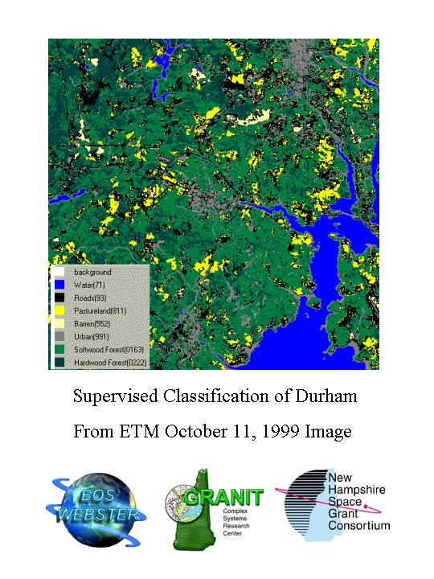


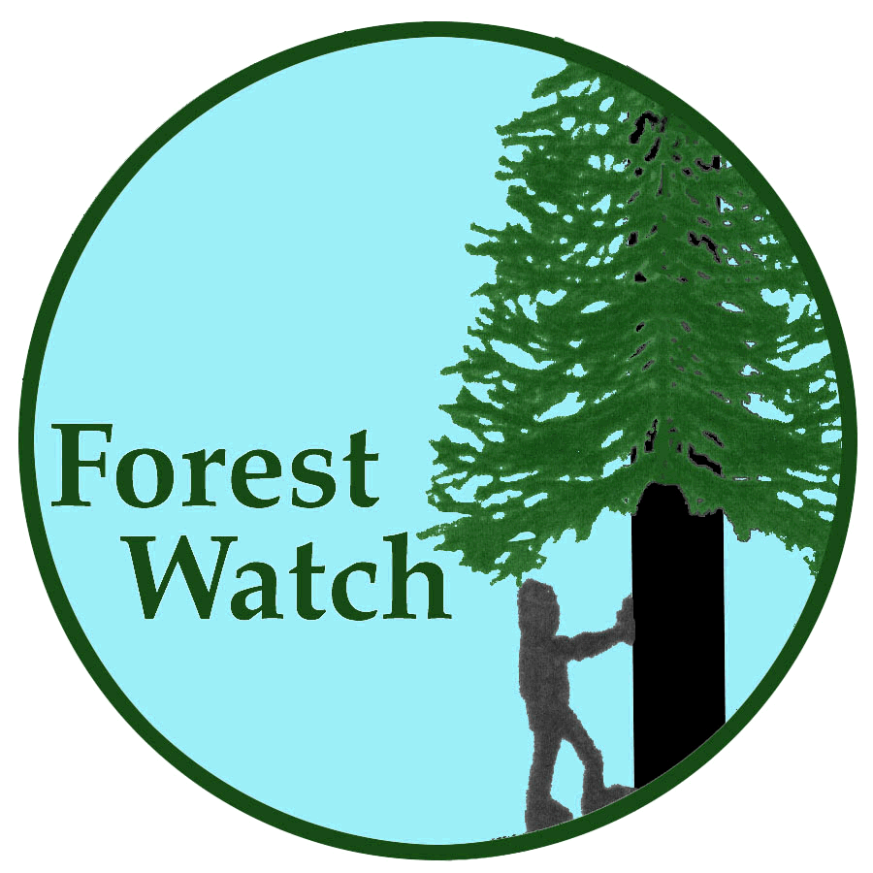

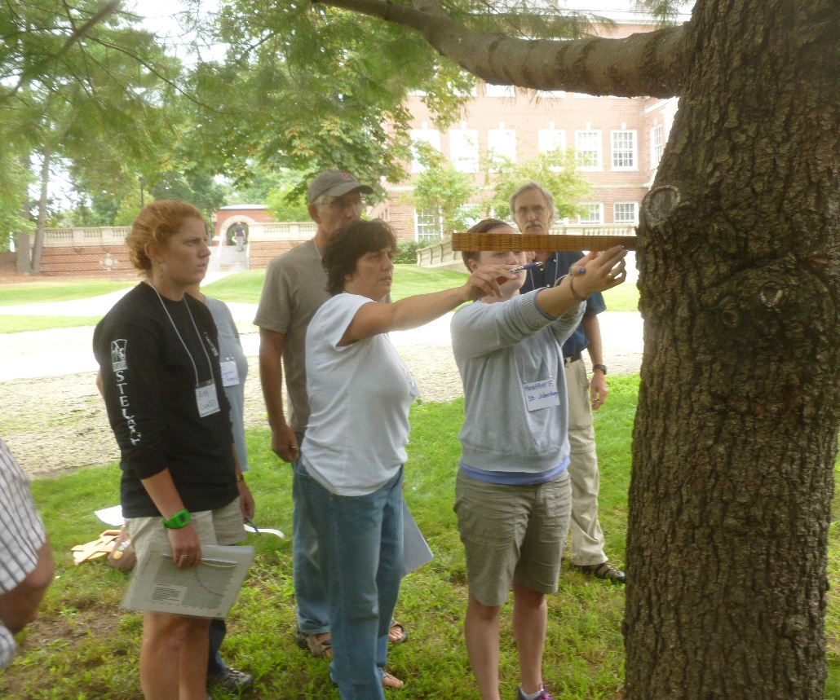
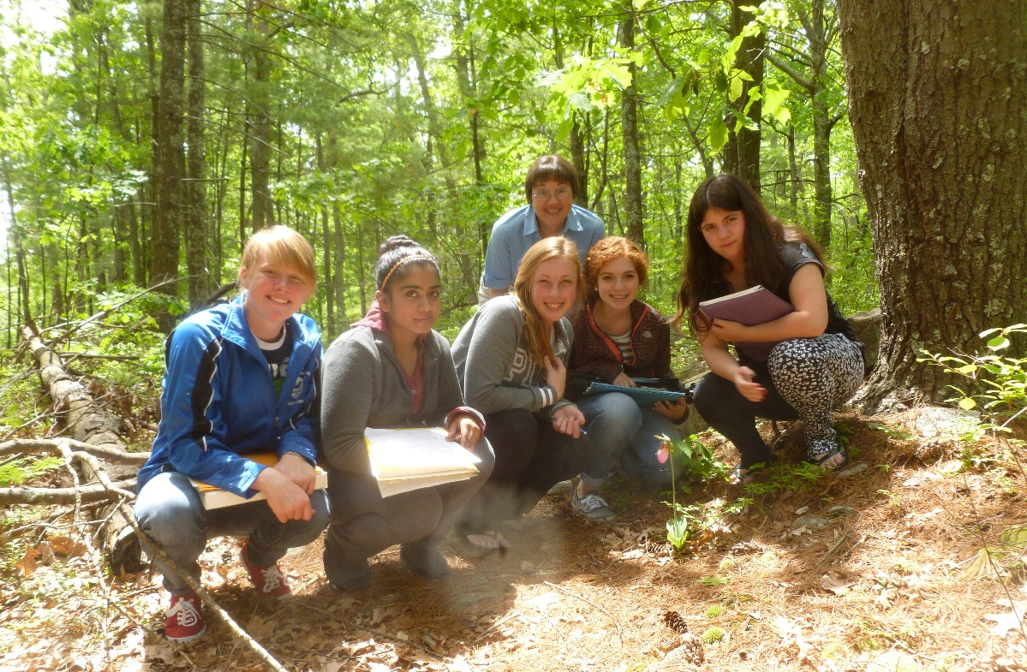

Forest Watch and Public Policy
Ozone Regulations Improve Air Quality---Student Data Tracks the Change
Dr. Barrett N. Rock, Martha Carlson
Students & Scientists Working Together
Determining the Health of New England Forests
Introduction
Air quality across New England is improving. The Ozone Transport Region imposes strict regulations on emissions of pollutants in 11 eastern states. In New Hampshire, the OTR rules have reduced ozone (smog) by 26% since 1996.
Forest Watch research by students, teachers and scientists documents the impact of that public policy. Our long-term monitoring of white pine health correlates closely with air quality standards and state controls: When air quality improves, so does white pine health.
White Pine Research
Since 1992, nearly 400 teachers have participated in Forest Watch with an estimated 28,000 students.
Samples have been taken from 1950 white pine trees in some 3,800 field samples. Students examine at least 60 needles from each of their school’s 5 to 10 trees. They identify and quantify ozone damage.
Conclusions
Forest Watch research and data provides policy makers with valuable information: The impact of improved air quality in New Hampshire and neighboring states. If our trees are healthier, perhaps human beings are too.
Acknowledgements
Forest Watch greatly appreciates the help of Dr. Jeffrey Underhill, Chief Scientist, Air Resources Division, NH Dept. of Environmental Services. The New Hampshire Space Grant Consortium, a NASA program, has funded Forest Watch for 23 years. Winnacunnet posters were printed thanks to NH EPSCOR, a program funded by the National Science Foundation. We also deeply appreciate donors to the Forest Watch Fund including John King, King Forest Industries, Wentworth, NH.
Figures 5. A new group of teachers will join Forest Watch in 2014 to learn how they and their students can monitor white pines. Tools range from simple hand tools (a logger’s Biltmore stick, at left) to the newest Landsat 8 imagery. Below, a 2013 view of Hanson, MA, where middle school students regularly monitor their pines.
Figure 2. Above, reactive nitrogen gases from numerous sources have fallen 60% since New Hampshire imposed strict regulations on automobile exhaust and other hot engines such as the Bow Electric Generating Plant. Below, volatile organics (VOCs) have also dropped with state regulation of industrial cleaners, paints, gases, printing products, auto body shop chemicals and many other chemicals which combine with NOx to form ozone (DES graphs).
Figure 4. The red edge inflection point indicates how much chlorophyll needles contain. The graph shows rapid improvement in needle health in 1998, just two years after the National Ambient Air Quality Standards were imposed and the New England OTR went into effect.
NOx, VOCs and REIPs
Forest Watch students master a vocabulary of atmospheric chemistry and spectral measurements of tree health. They learn that reactive nitrogen gases (NOx), and volatile organics (VOCs) combine in bright sunlight and high heat to form ozone. They learn that ozone can damage white pine. State actions in New England and the Mid-Atlantic have brought down NOx and VOCs in the past 20 years. At the same time, chlorophyll levels, as measured in Forest Watch white pines have jumped to healthy levels.
Long-Term Monitoring
Forest Watch samples and measurements document annual changes in white pine health. In the past year, students found record lengths in needles and a record lack of ozone damage. The health of the pines may reflect the tree’s resilience after major loss of needles in 2010. Students continue to monitor fungal infestations.
Figure 1. Honors biology students from Salem High School with veteran Forest Watch teacher Norma Bursaw regularly monitor the health of a county park near their school. Forest Watch reaches children K-12.
Figures 3. NH Governor Maggie Hassan and other Eastern governors have asked the EPA to expand the Ozone Transport Region to Midwest and Southern states.
The Ozone Transport Region
Winds from states just west of us bring ozone and its primary pollutants to New England. Students in St. Johnsbury, Vermont, are lobbying their representatives to get on board with New England governors to help their pines and expand the OTR.

