Slide 1
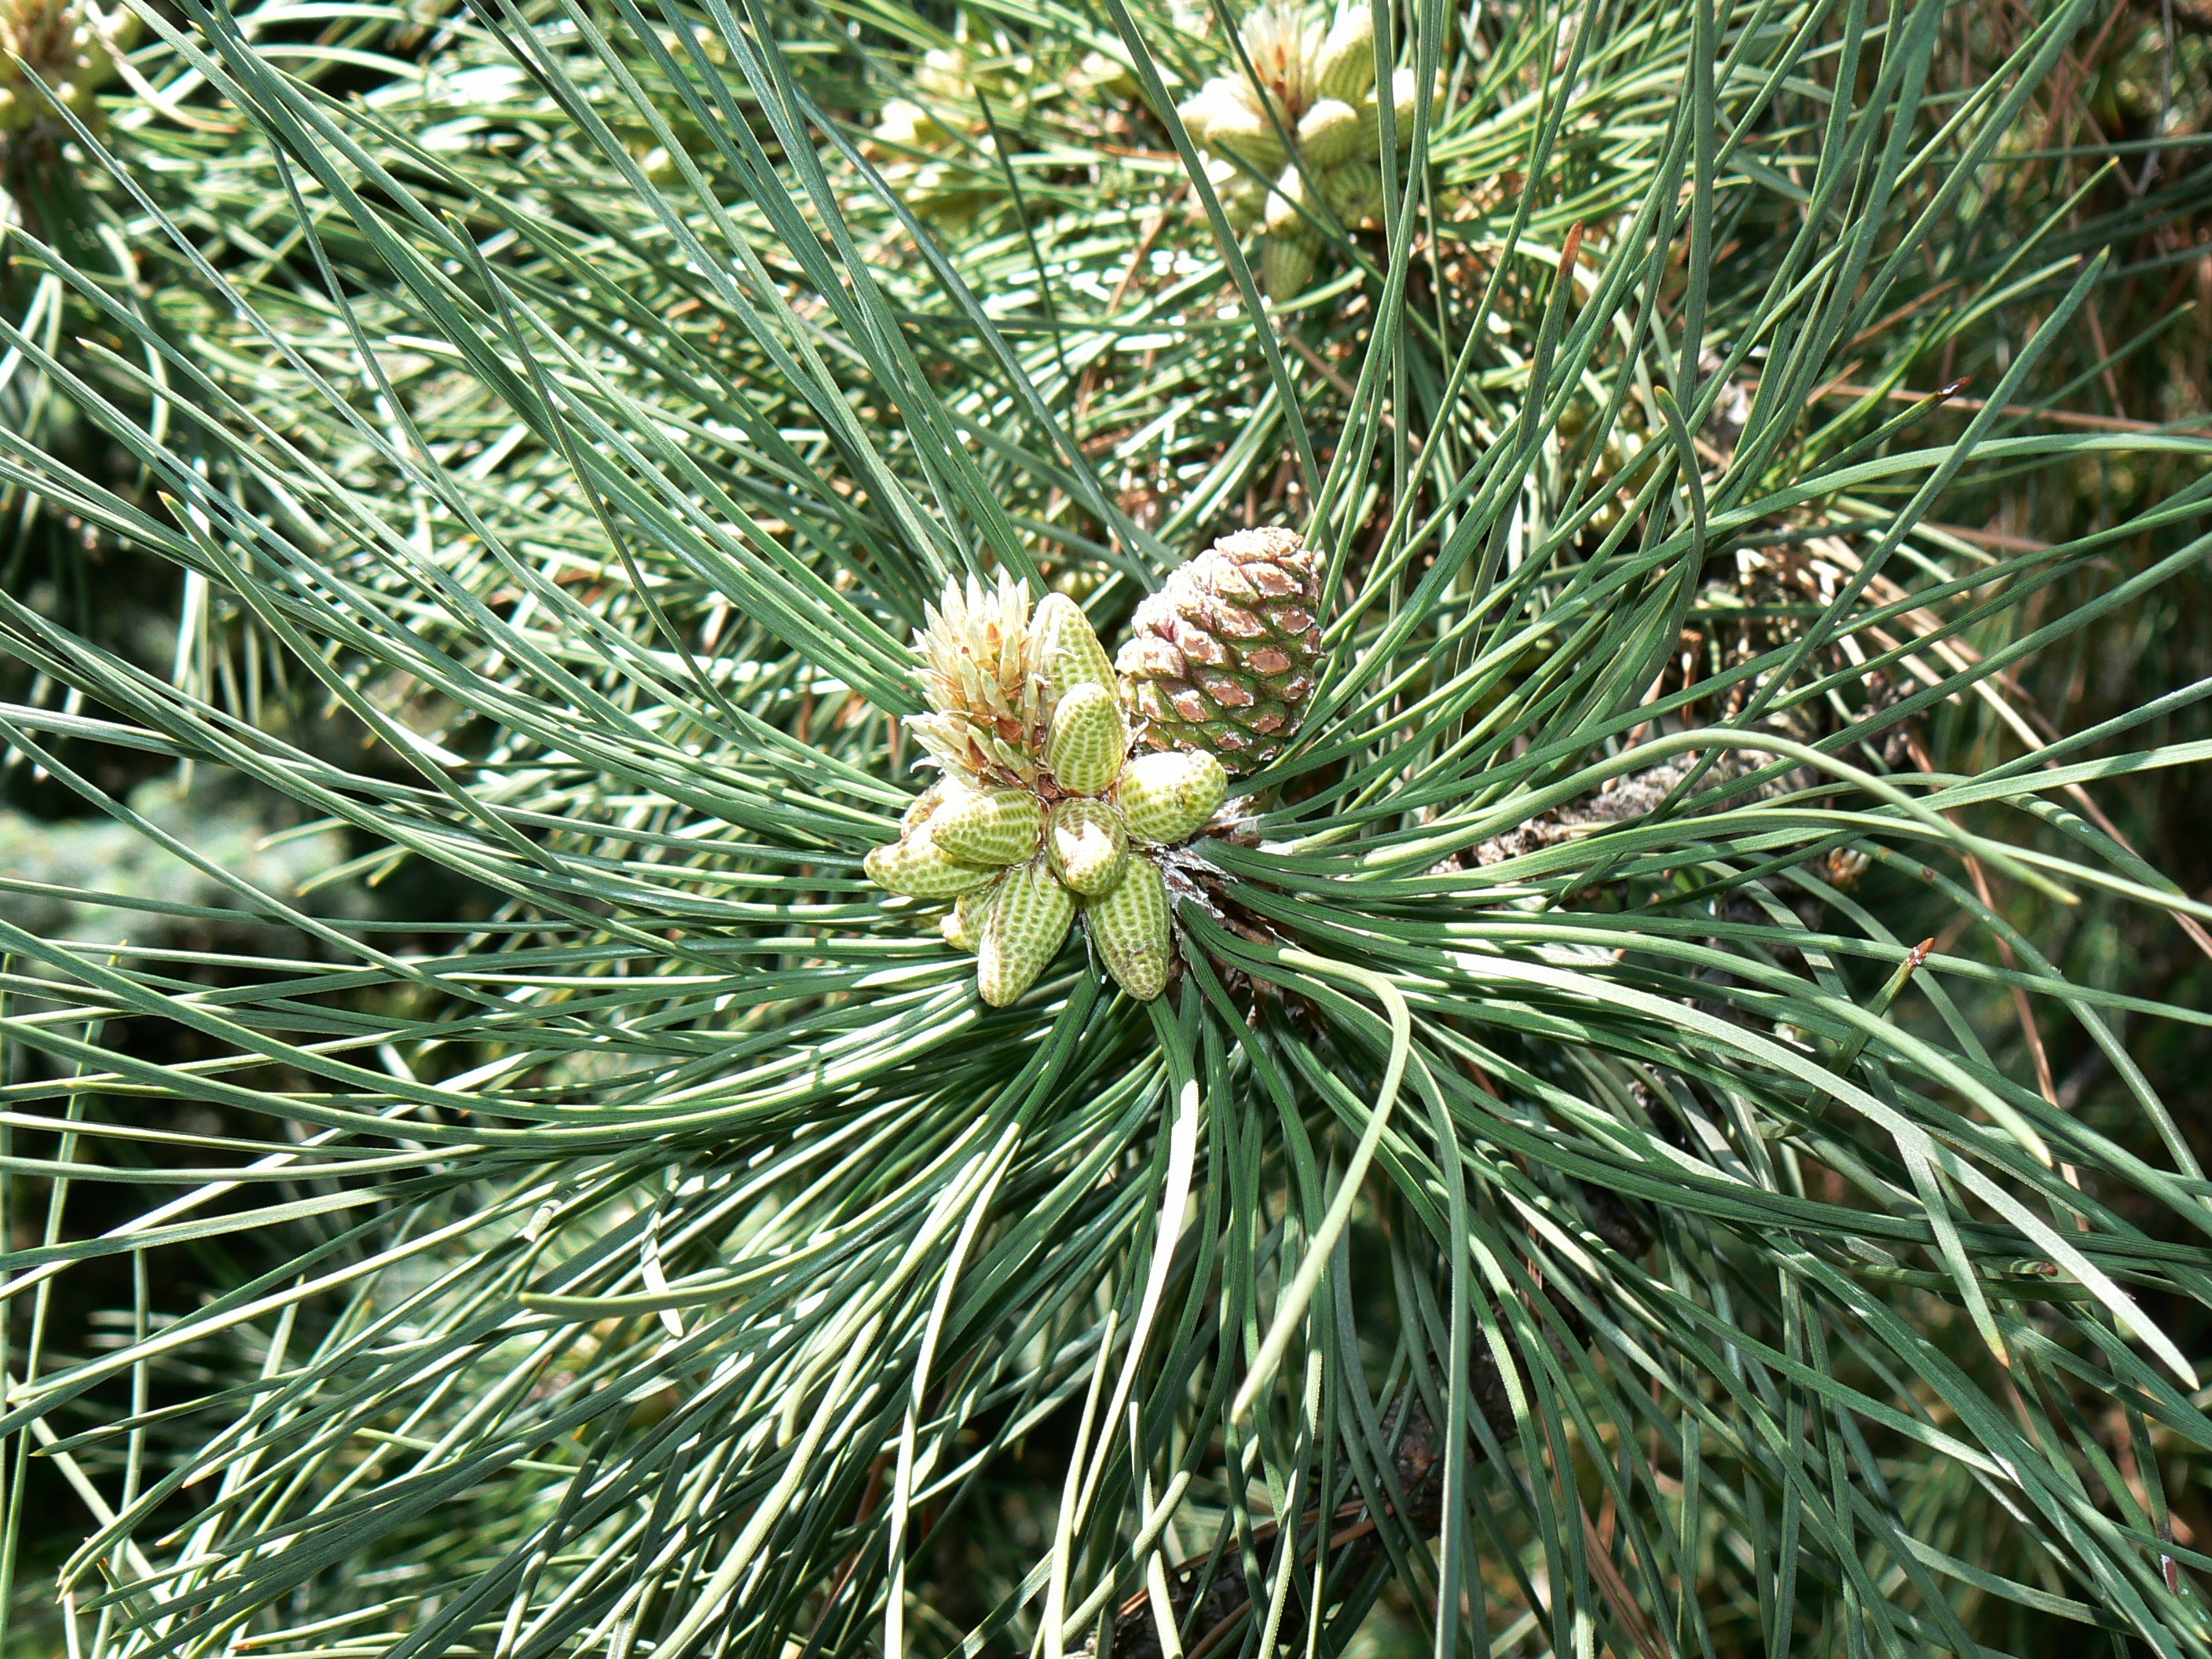



Effects of precipitation amounts on TM5/4
Dominique Bandy, Kelsey Locke, Sidney Giambrone
B
Hypothesis:
Our team thought that the answer will be yes the precipitation amounts will affect Tm5/4 ratios. We think this is because TM5/4 shows how much water is in the needles. Precipitation is how much rain hits the ground. If the amount of rain that falls to the ground is great, then the TM5/4 ratio will go down because the tree has more water. Same as if the precipitation goes down, Tm5/4 will go up.
Background:
The data we observed came from our white pine trees in local forests in St. Johnsbury, Vermont. However, the collected data came from Forest Watch books (the years ranging from 1997-2012). The precipitation average over the years came from our mentor Cameron McIntire from UNH, who obtained them from the National Weather Service. TM5/4 tells us how much water is in the tree and if the needles are healthy. If the precipitation amounts (how much rain falls) go up then the TM5/4 will go down because if the TM5/4 is lower, the needles have water and are healthy. If the precipitation amounts go down, the TM5/4 will go up because there is not a lot of water and the needles are starting to dehydrate.
Conclusion:
In 1998 the precipitation got lower while the TM5/4 decreased. This follows our hypothesis because if the precipitation goes down, then that means that not a lot of water is falling. If there is not a lot of precipitation falling, there will be lower water content in the trees, so the TM5/4 ratios will go up. Also, in 1999 the precipitation got lower while the TM5/4 got higher. In 2000, the same thing happened as in 1997. The precipitation increased and the TM5/4 decreased. 2001 still follows our hypothesis even though the TM5/4 went up just a little bit when the precipitation goes down quite a bit. However 2002 does not follow the hypothesis because the precipitation increased which means a lot of rainfall, while the TM5/4 also rose. It doesn’t exactly make much sense so there may be something affecting the trees. In 2003 the precipitation dropped but the TM5/4 only went up by 0.01. In 2004 the precipitation was 2.678 while the TM5/4 was .87. This was a terrible year concerning water content in the needles. The precipitation also went down a bit. This may have something do with a disease. So the data we collected and analyzed shows that precipitation sometimes affects TM5/4 ratios. We, however, had some questions to ask for TM5/4 ratios. After 2004, one of the worst years for, there was no TM5/4 data for 2005, there was nothing to compare it to so we don’t know if it increased or decreased after that year. Also concerning 2004, we wondered what caused this dramatic change in TM5/4 ratios that then went back to normal in 2006. The precipitation once went down a little bit and the TM5/4 went way up into the .8’s and .9’s. That was near 2004. In 2006 and 2007 the TM5/4 came back down around .4 and .5. In 2010 or 2011 the TM5/4 went back up a little to about .5 or .55. Something else might be causing this along with the precipitation because if the precipitation goes up, the TM5/4 should go down some and sometimes that doesn’t happen.
Question:
How do precipitation amounts affect Tm5/4 ratios? Would the amount of precipitation affect the amount of water in the needles? This is shown by the TM5/4 ratio, If there is more water in the needles, then they are healthier.
Procedure:
Wrote down our testable question and developed a hypothesis.
Used data from Forest Watch books from 1997-2012.
Collected data from trees in St. Johnsbury, Vt.
Found the mean average for all of the Tm5/4 ratios from 1997-2012.
Entered TM5/4 from St. Johnsbury trees onto a spread sheet.
Collected precipitation data from St. Johnsbury VT.
Put precipitation amounts from April to August on a spread sheet compared to TM5/4
Precipitation amounts in April, May, June, July, and August on a separate spread sheet because these are months that the tree mostly grows.
Made graphs of all these months on precipitation.
This graph shows the precipitation and the TM5/4 together. Also, this graph shows that when the precipitation either goes up or down it affects the TM5/4.If it rains more the TM5/4 will go up. If the precipitation amounts go down the then TM5/4 will goes up.
Acknowledgements:
We’d like to thank Mr. Wurzburg for introducing us to this organization. Thank you, Mr. Wurzburg, you have been a big help in this project. Thank you also to Forest Watch for providing us with the information we needed to complete this poster.
This graph shows TM5/4, and precipitation amounts of every year for the months of April, May, June, July, and August.

