Slide 1
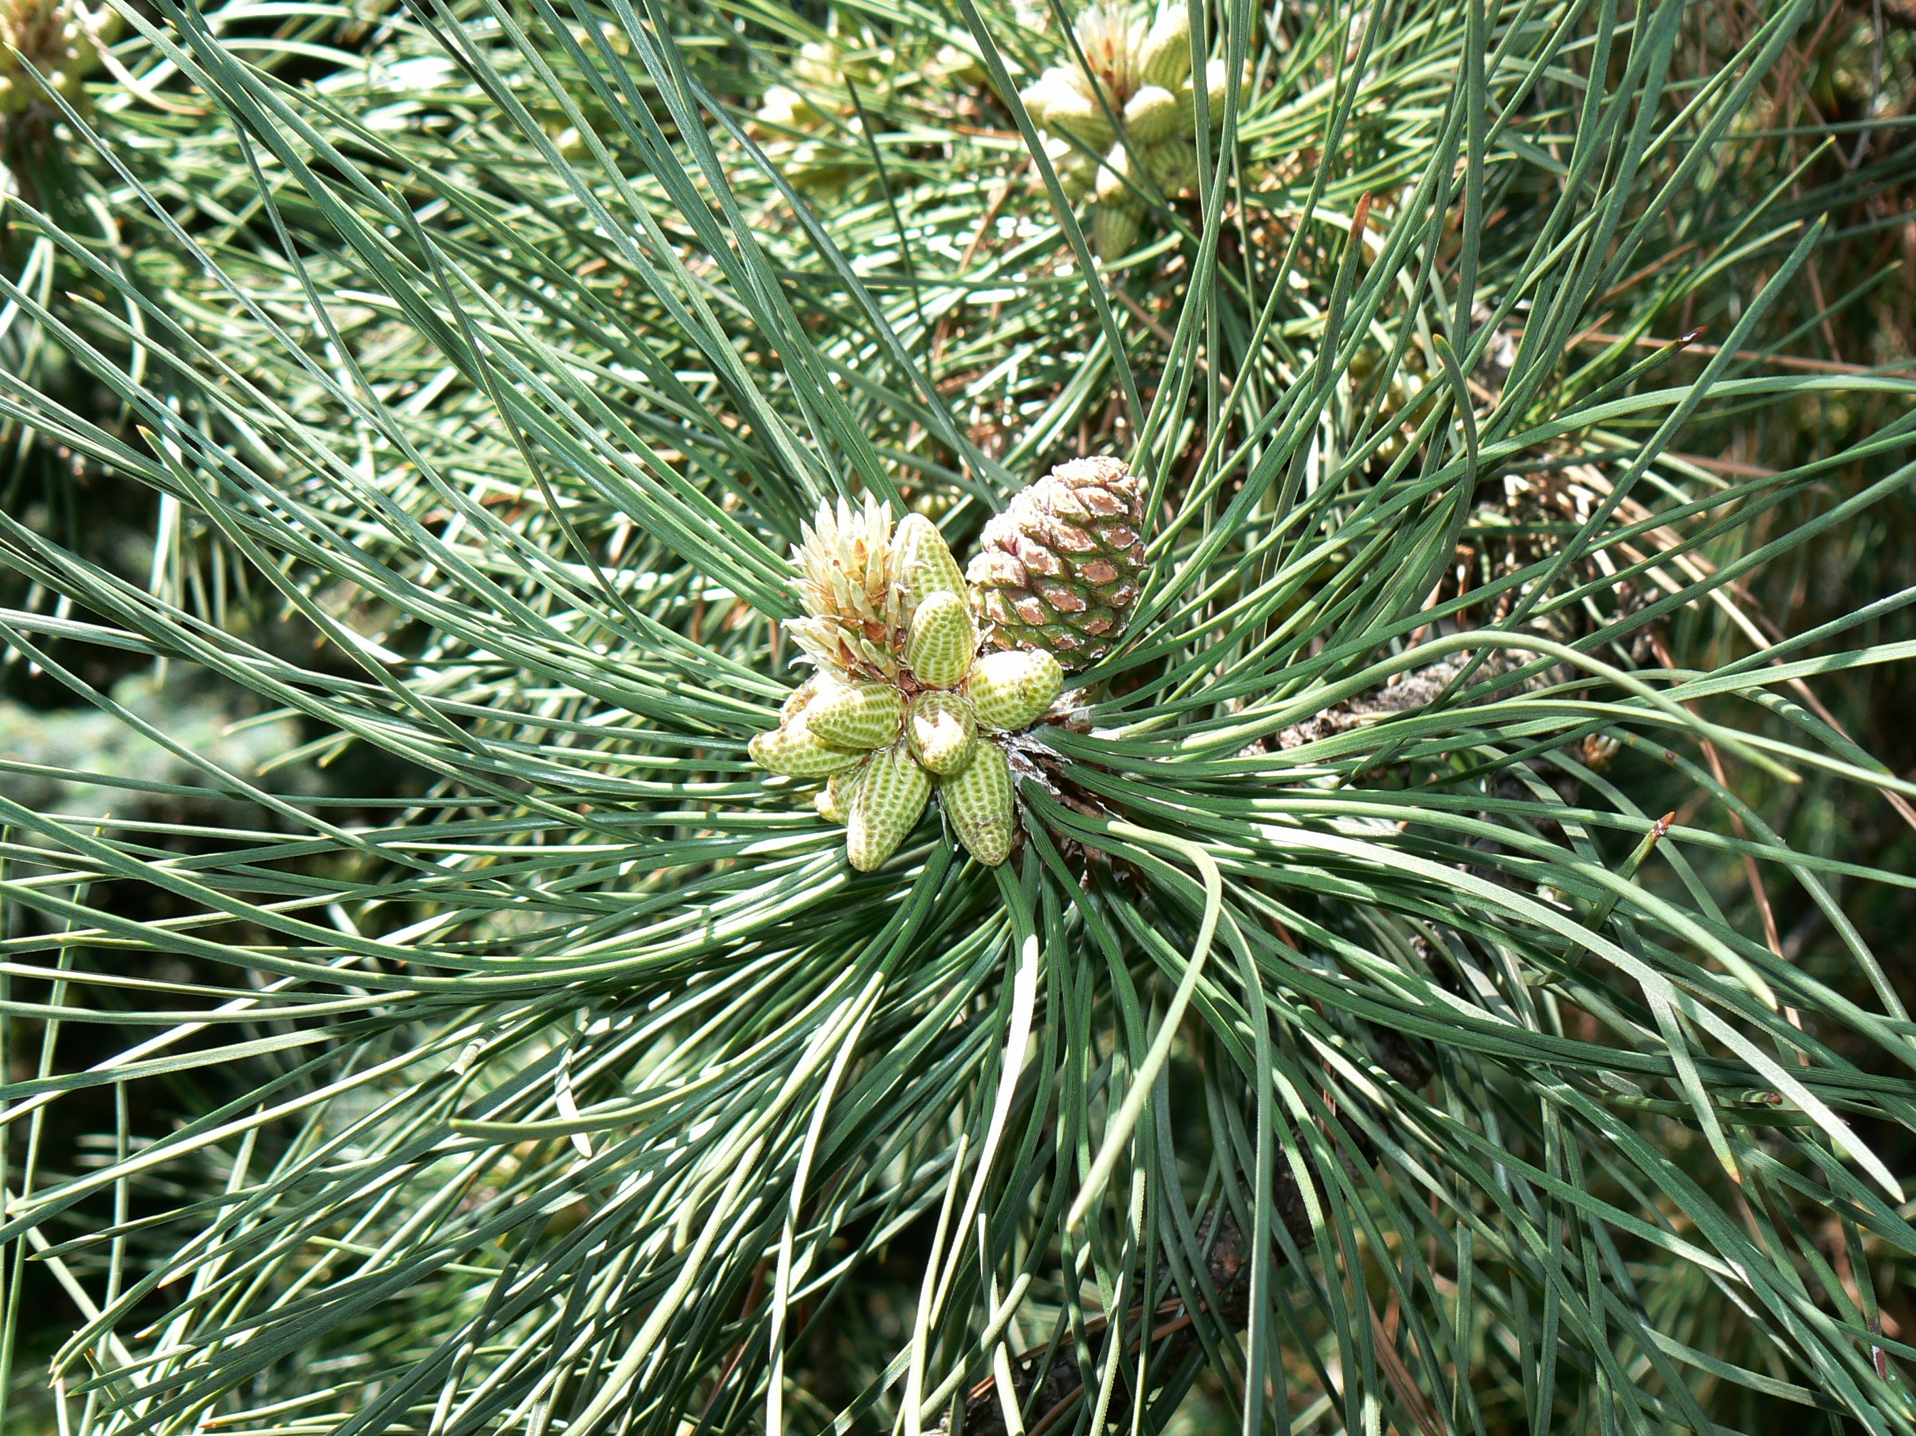


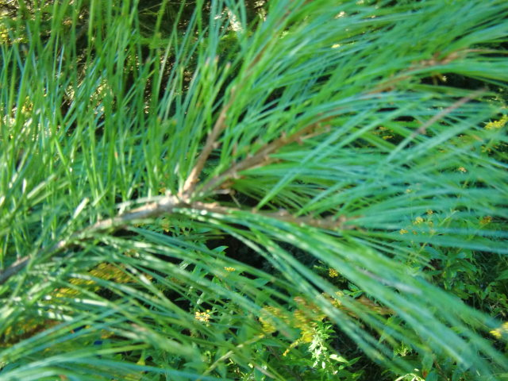
Olivia Brimmer, Katie Blassingame, Sophia Hendrick
Effects of precipitation on the NIR 3/1
Background:
The NIR 3/1 is a scientific ratio that is mainly used to catalogue the water content and overall health of an evergreen and its needles, specifically the ‘White Pine species of evergreen. The NIR in the ratio stands for Near Infrared. The health of the needles (and the tree) can be estimated by the NIR 3/1’s use of decimals. For example, if the needle’s NIR 3/1 ratio is lower than .9, then the tree is very healthy and sustained. If the NIR 3/1 ratio is .9, then the tree is acceptably healthy, but not ideally so. If the NIR 3/1 ratio reaches a higher level than .9, the tree is exhibiting slight stress and action on the tree’s part is recommended. If the NIR 3/1 ratio exceeds 1.0, then the tree has most likely expired or is on the brink of expiring and immediate action is stressed to attempt to revive the said tree.
Procedure/Methods:
1. We started by gathering the precipitation data from the National Weather Service and putting it on a spreadsheet.
2. Then, we decided which years to keep, and we decided on 1997-2013 because those were the years we had NIR 3/1 data.
3. Next, we chose the months we should use, and we decided to use April through July.
4. After that, we used the Forest Watch Data books and the Forest watch website to get the information about NIR 3/1 that we needed to use for our project, putting the information we found into the same spreadsheet as the precipitation data so we could compare them to see if our hypothesis.
5. We then put all of the information onto a Microsoft Excel spreadsheet where we could make a chart to represent it.
6. Lastly, our group put everything onto a poster.
Study Area: We based our information on the written data from a St. Johnsbury weather data from the National Weather Service and information collected by Forest Watch on St. Johnsbury School in St. Johnsbury, Vermont.
Question:
How do precipitation amounts affect the NIR 3/1ratio?
This graph shows the precipitation amounts and the NIR 3/1 and how the NIR 3/1 is almost mirroring the precipitation amounts. For instance, when there is more precipitation, the NIR 3/1 goes down meaning the needles or tree are healthier, and vice versa. When the precipitation amounts and the NIR 3/1 are almost symmetrical (nearly reflecting each other), the graph shows our hypothesis. Sometimes, the graph did not make our hypothesis exactly true. For example, the NIR 3/1 and the precipitation amounts would both go up (not the same amount), or would both be going down to a different extent than each other. The years that
Conclusion:
To conclude our study, we have found that the data doesn't prove that precipitation was the variable that changed the NIR 3/1 ratio. The years 1996-2001 supported our hypothesis, but this halted in 2002. As you can see the 1996-2001 data shows the NIR 3/1 ratio increasing as the precipitation decreases and vise versa. But after that the data was mixed. This data shows both numbers increasing or decreasing in the same years, or having one number stay the same and one changing. There must have been another variable affecting the NIR 3/1 ratio.
.
Hypothesis:
With any great change in precipitation, there would be weather stress on the tree and the needles. That would cause the NIR 3/1 to change by increasing or decreasing in ratio. If precipitation amounts are very high or low the NIR 3/1 ration will go up. We believe this will happen because if there were too much precipitation, the needle would get too much water. If there is a drought, the needles won’t have enough water, then couldn’t do photosynthesis. And then the tree stops growing, or grows more slowly.
Further Questions
What was affecting the NIR 3/1 ratio? Because of the mixed data we know that there were other forces involved. It could have been smoke, sun, ozone and more but it wasn’t just the precipitation affecting the health of the tree and the NIR 3/1 ratio.

