Slide 1
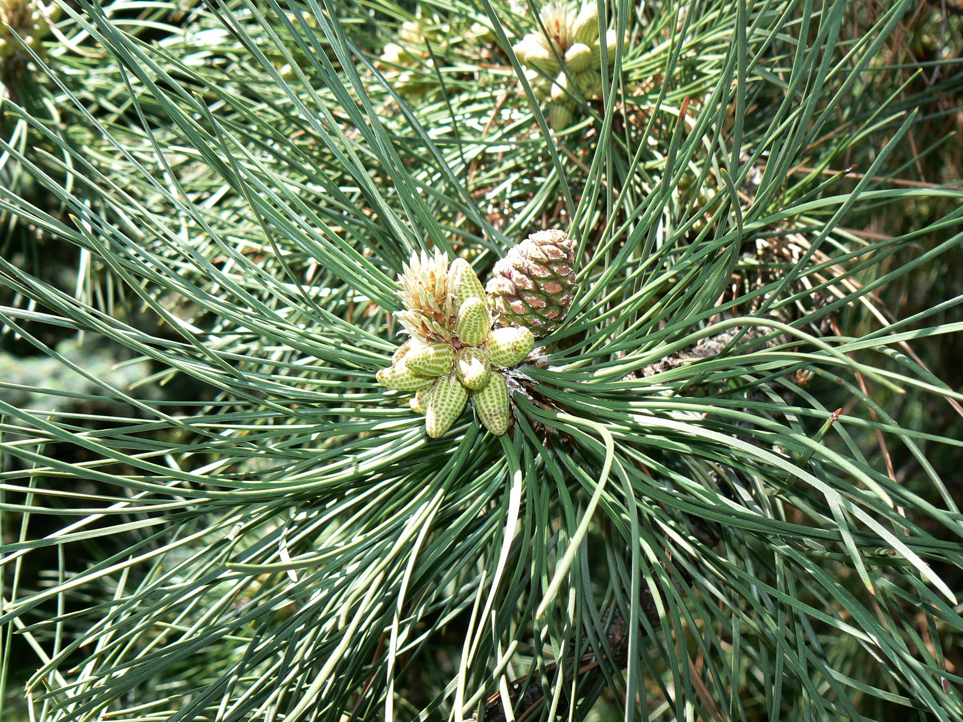

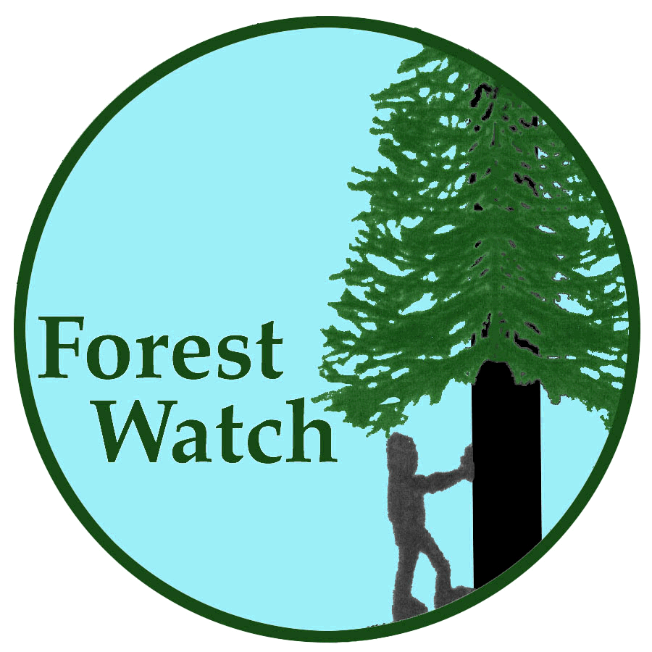

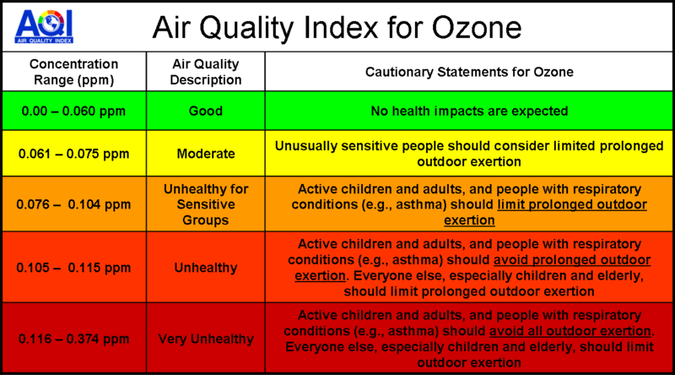
Do ozone levels affect the size of the annual rings of the white pine tree?
Forest Watch: St Johnsbury School 6th grade
Allison Maher, Gabby Flory, and Renee Audette
Of Saint Johnsbury School
Question: How do ozone levels affect the size of the annual rings of the white pine tree?
Our main question is how the ozone levels will affect the size or growth of the annual rings of the white pine tree. We have gained much knowledge in this subject, thanks to our Forest Watch teacher, Mr.Wurzburg. We hope you enjoy our presentation. Thank you!
Procedure
1. We gathered data from the past EPA records of ozone recorded in Bennington, VT and Burlington, VT.
2. Then, we searched for a standard ozone level.
3. We found more information about ozone and how it affects plants, wildlife, people and animals.
4. Then, we incorporated most of this information into several slides and made a graph.
5. We made a graph comparing the size of the tree rings to the exceedance days in Vermont.
6. Next, we created a hypothesis for our testable question.
7. We put all the information and graphs on the template from our teacher.
8. Finally, we sent in our template to UNH.
Background:
Ozone is a colorless, odorless gas that can harm people, plants, and animals. This “bad” ozone is found in the troposphere. Ozone gets worse in the summertime. This happens because there’s more heat, NOx, VOC’s, and sunlight to make bad ozone (Heat + VOC’s + NOx + sunlight = bad ozone). Children, more active adults, and people with respiratory diseases are more apt to get sick from bad ozone because they are more sensitive to bad air.
This chart shows how average annual ring size correlates with ozone exceedance days.
    Conclusion:
    Our data shows that our hypothesis was inconclusive. Both data sets did not match up to each other. There was no definite correlation between the high ozone years and the tree ring size. In 1994 ozone was high and ring growth was high. In 2010 ozone exceedance days were low and so was ring growth. One time where the data followed our hypothesis was in 2008. In this year the ozone exceedance days were very high and the ring growth was very small. One potential problem may have been that our data of ozone levels came from western Vermont and we live in eastern Vermont.
Hypothesis:
We think ozone levels may effect the size of the tree rings. Super high ozone will make the annual rings smaller because the needles were affected by the bad ozone. The needles get infected by the bad ozone which steals electrons and creates a chain reaction among the needle cells which causes the needles to leak or loose water and deactivate chloroplasts causing them to die. Therefore, the tree is not able to do photosynthesis correctly. Lower ozone levels will allow the tree to do photosynthesis correctly, and the rings will grow normally.
The air quality index for ozone shows the effects of different levels of ozone.
Acknowledgements: We would like to acknowledge Mr. Wurzburg and Cameron McIntire for helping us gain knowledge about ozone and tree rings.

