Slide 1
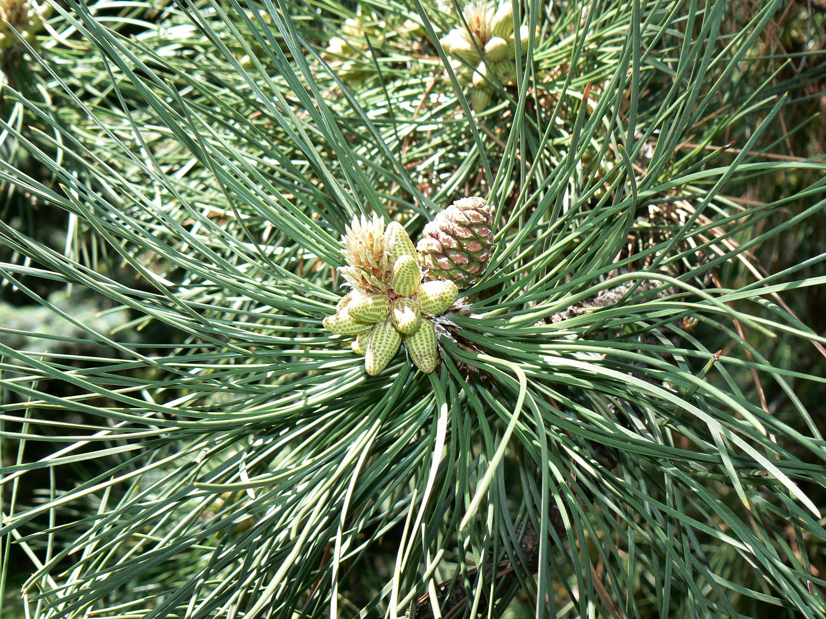



Does Precipitation Affect Ring Growth?
St. Johnsbury 6th Grade
Leo Desrochers, Sam Sylvain, Jericho Rutledge.
Testable Question
How does precipitation affect white pine ring growth?
Conclusion
The amount of precipitation doesn’t always affect the ring growth. However, we did note that in some years when the precipitation went down, the ring growth was less. Examples where this occurred were 1968,1969,1979,1988,1993,1999, 2001,2008,2010, and 2012. The opposite sometimes occurs when there is a large amount of precipitation and there are larger ring growth amounts. Examples when this occurred were 1973, 1976, 1978, 1983, 1989, 1990, 1992, 1994, 1998, 2000, and 2006. The best example would be the data for the year 2000 when the rainfall and the ring size went up almost the exact same amount.
Hypothesis
Our hypothesis was that the amount of precipitation does affect the ring growth. We said that the amount of rainfall can be the difference between lots of growth and little growth. If there is a large amount of precipitation, then the tree would have more ring growth. On the other hand, if the tree has very little water, then the trees rings wouldn’t grow very much and you would see smaller rings.
This graph shows the relationship between average precipitation and average ring size of tree cores in St. Johnsbury, Vermont.
Procedure
We collected data by measuring the ring size from 10 tree cores. The tree numbers were 1806, 1807, 1808, 1809, and 1810. We cored both the north and south side of each tree.
We created a spreadsheet to hold the data, all the way back to year 1965. We loaded all of the data up on the spreadsheet, and calculated the averages of each year’s ring size.
We calculated the average rainfall amount and ring growth, we copied the data onto a graph.
We found our worksite on Google Earth.
We wrote our hypothesis on our Google Docs.
We sent it to our PowerPoint, as well as the worksite and the graph.
We wrote out our procedure on the Docs and then sent it to the PowerPoint as well.
We wrote about our conclusion to the project and put that on the PowerPoint.
Work Site
We used data from five white pine trees at the St. Johnsbury School, which is located at 257 Western Ave, St Johnsbury, Vermont. With the help of dendropathologist Cameron Mcintire from UNH, we cored each tree on the north and south side. The tree numbers were 1806, 1807, 1808, 1809, and 1810.
We would like to thank Cameron Mcintire for the precipitation data and his guidance.
Thank You !!

