Slide 1


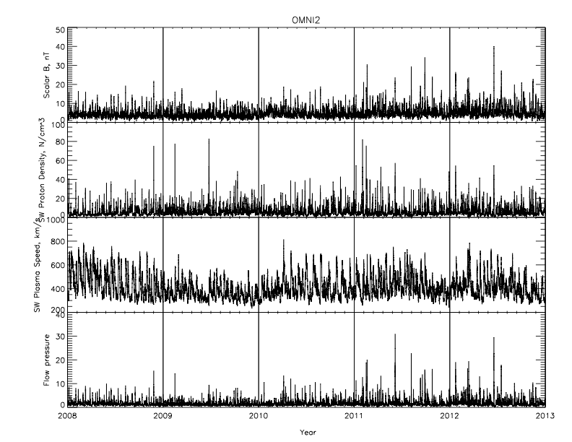
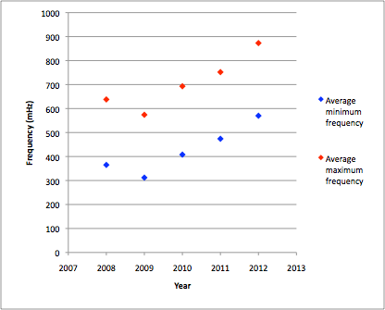
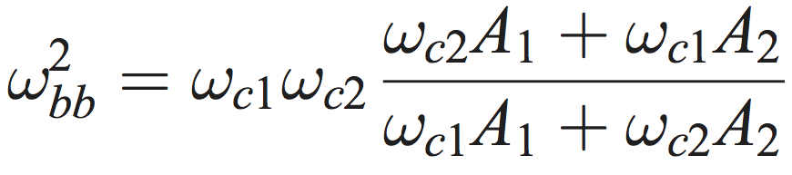
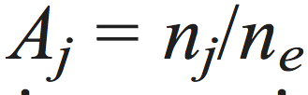

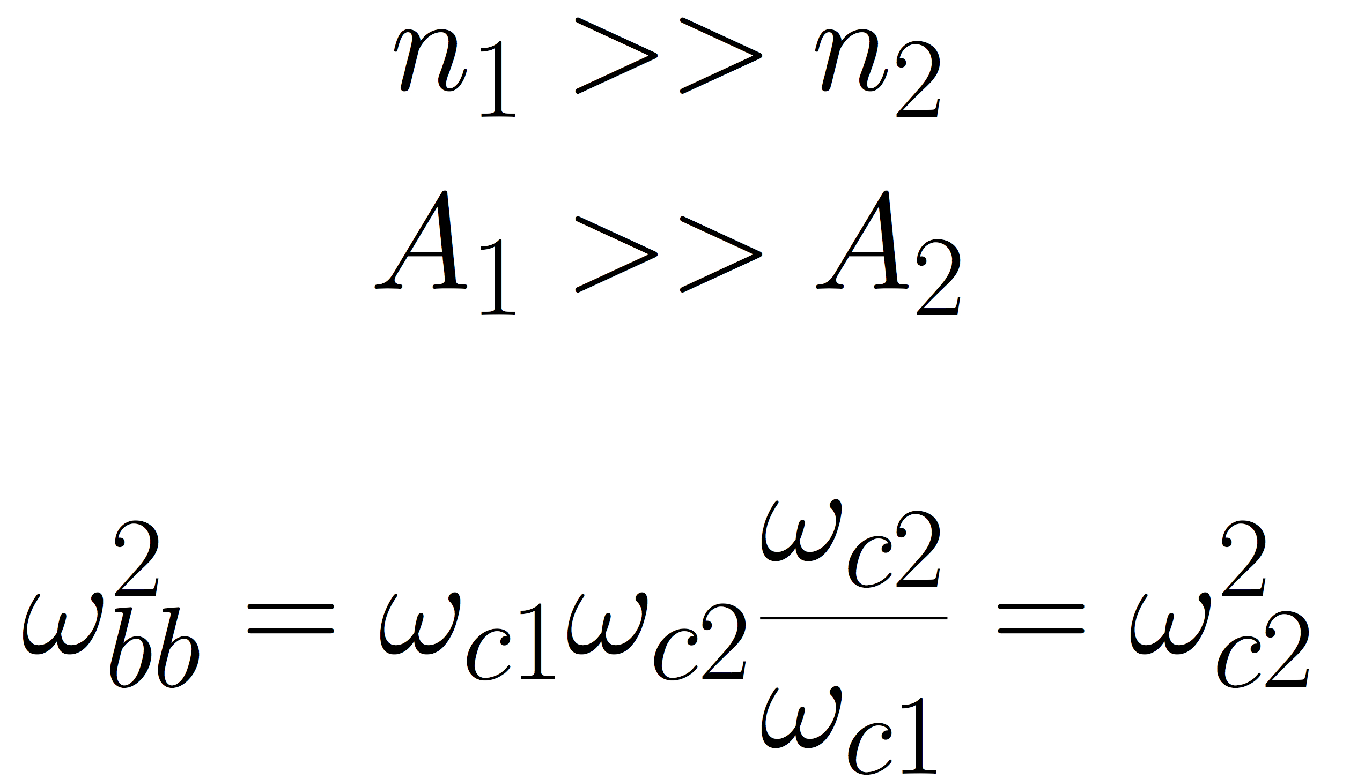
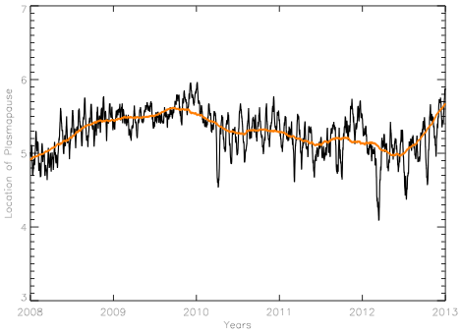
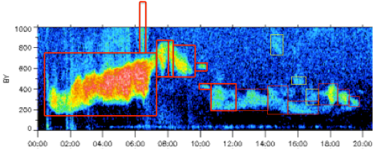
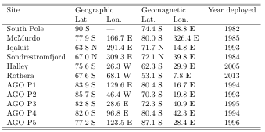
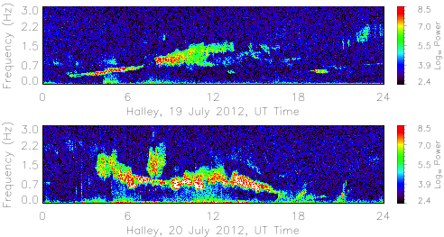
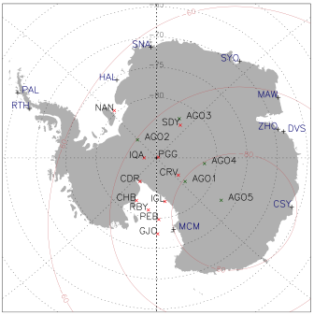
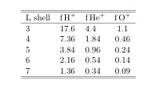
Solar cycle dependence of EMIC wave frequencies
Marc Lessard, Carol Weaver, Erik Lindgren¹ Mark Engebretson
University of New Hampshire Augsburg College
¹Now at MIT
Introduction
Spectacular sample event
Event Selection
EMIC frequencies versus solar cycle
Number of events recorded:
2008: 2009: 2010: 2011: 2012:
1029 624 1215 1174 1493
2. Can increased SW pressure have an effect?
Proton temperature anisotropies in the magnetosphere can generate electromagnetic ion cyclotron (EMIC) waves. These waves, generated near the equatorial region, often propagate to the ionosphere and couple energy through the ionosphere to produce a signature that can be observed on the ground. Such observations, acquired at Halley Station in Antarctica since February 17th, 2005, were used in this statistical study. Here, we present results from a statistical analysis of EMIC waves at Halley from 2008 throughout 2012. The focus of this study was motivated by a casual observation that spectra of these waves were increasingly reaching above 1 Hz over the past few years.
Does the shift perhaps coincide increased solar wind pressure pulse magnitudes that might drive pressure perturbations deeper within the magnetosphere? Well, maybe. The plot above shows solar wind parameters over the same time period, with the bottom panel showing pressure. Clearly, pressure pulses increase both in magnitude and occurrence rate in the later years.
3. Possible role of heavy ions during storms??
During geomagnetic storms, heavy ion densities are increased while proton densities remain largely unchanged. Lee et al. [J. Geophys. Res., 113, A11212, doi:10.1029/2008JA013088] discuss multi-ion hybrid resonances and the Buchsbaum-Bers resonant frequency, which is approximated by
The plot above shows the average minimum and maximum EMIC frequency per year from 2008 through 2012. Note the ~50% increase in frequencies from 2009 to 2012, concurrent with increasing solar activity. The increased frequency implies a shift in the location of the generation radially inward. For these particular frequencies, the location apparently changes from approximately L=6+ to L=5- (nearly an R_{E}).
where is the fraction of the ion density occupied by the jth ion species and is the electron density. It should be noted that the resonant frequency is determined only by the magnetic field and the relative population of each ion species.
In the limit where
or
the resonant frequency is
which implies that as the He+ density is increased, the EMIC frequencies should shift closer to H+ gyro frequency. Qualitatively, at least, this points to the shift in EMIC wave frequency being due to a relative density change (in the magnetosphere) between protons and heavy ions.
Of course, it is certainly possible that frequencies are increased both as a result of a shift of the plasmapause location as well as a change in the relative composition.
Possible mechanisms
1. Could the frequency shift result from enhanced plasmapause erosion?
Conclusions
Observations from Halley Station in Antarctica (L=4.6) show that frequencies of EMIC waves have increased by approximately 50% from the solar minimum in 2009 through the end of 2012. These waves tend to be located near 0700 MLT.
The change may be associated with a shift in the location of the plasmapause and may also be associated with increased magnitudes of solar wind pressure pulses. This change affects possible interactions with radiation belt electrons.
Another possible mechanism that may cause the shift in frequencies is an increase in the fraction of heavy ions in the magnetosphere during storm times.
Does the shift perhaps follow the location of the plasmapause (near dawn, where these events were primarily observed)? The plot on the right shows the plasmapause location (near dawn) as determined using the Moldwin et al. [2002] model, which is a K_{p}-driven empirical model. The plot does show a weak trend in the right direction, though perhaps only the order of ~.6 R_{E}. The implication is that the plasmapause may play a role here.
The start and end time of an EMIC wave was determined to the closest quarter of an hour; wave duration was measured in increments of 15 minutes. The minimum and maximum frequencies were recorded for each event. Note that the event definition in this study differs from others in the sense that unless an event was clearly contiguous, it was treated as a superposition of multiple events. This is a result of recent work regarding ionospheric ducting of these waves, which implies that multiple sources of waves will superimpose to produce the blotchy appearance shown in the above plots.
By the way, VAP fans, EMIC waves interact with ~1 MeV electrons. From the AE-8 model, electron fluxes at L=6 during solar minimum at 1 MeV are 9.978E+05/cm^2-s. This changes during solar maximum and at L=5 to 2.794E+06/cm^2-s -- the EMIC waves move to a region of fluxes that are nearly tripled!!
Acknowledgements
This research was supported by NSF grants ATM-0827903, ANT-0838917, ANT-0840133, and ARC-0806196 to Augsburg College, and grants ANT-0839938, ANT-0838910, and ARC-0806338 to the University of New Hampshire .We gratefully acknowledge contributions by UNH undergraduates Matt Blandin and John Heavisides.

