Slide 1


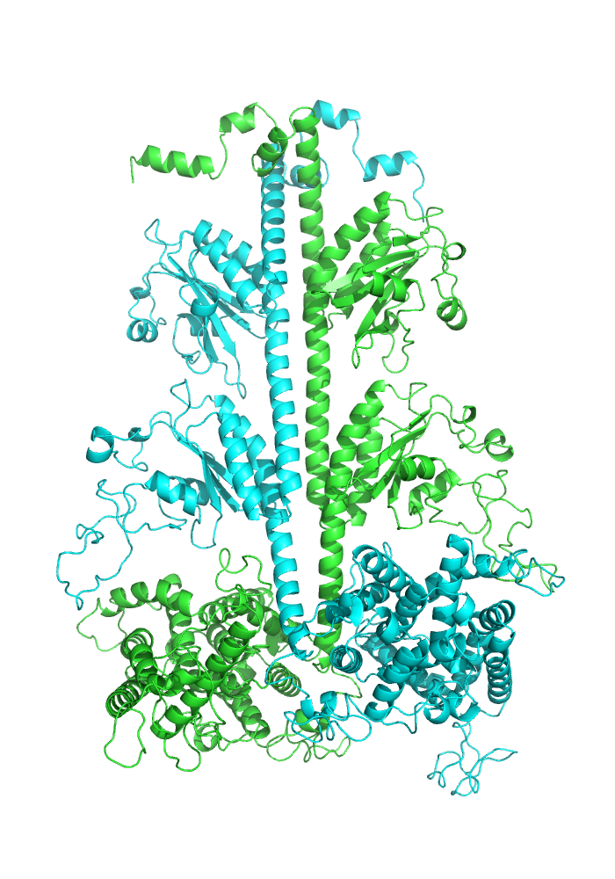
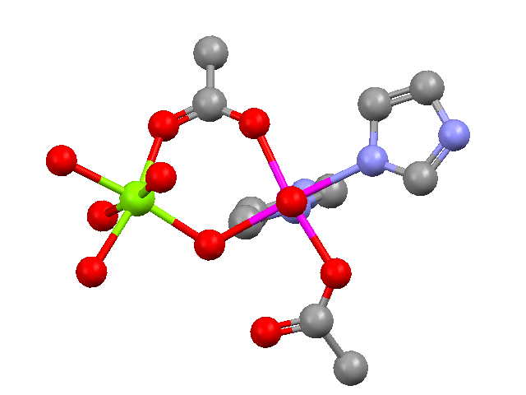
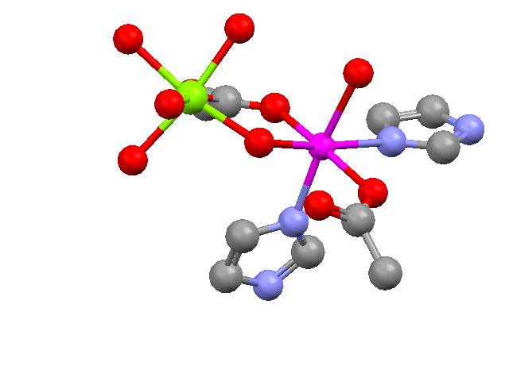
Investigation of the metal ion dependence of Phosphodiesterases 5 & 6
Rose Hadley, Rick Cote, Roy P. Planalp
Department of Chemistry, University of New Hampshire, Durham, NH 03824
Phosphodiesterase 6 (PDE6)
Results
Phosphodiesterases make up a superfamily of enzymes that degrade cyclic nucleotides in cells and are important in many cellular signaling mechanisms in the body. Phosphodiesterase enzyme 6 (PDE6) is involved in visual signal transduction, or turning light energy into electrical signals to be sent to the brain and processed. PDE6 has divalent cations involved in its catalytic processes.^{1,2}
The type and concentration of metal ion can impact the enzyme’s catalytic function. PDE6αβ binds two Zn(II) ions tightly per catalytic subunit, though activity of the enzyme requires additional metals to be present.²
Picomolar Pb(II) concentration inhibits activity in the presence of millimolar concentrations of Mg(II).³
Cd(II) is not only the most similar metal on the periodic table to zinc, but it has documented toxicity, and therefore investigation of its effect on enzyme activity may be medically relevant. ⁴
PDE5 PDE6
Radiotracer assays show the % hydrolysis of cGMP compared to the total hydrolysis control.
Phosphodiesterase 5 (PDE5)
Discussion
Acknowledgements & References
PDE5 is the most similar family member to PDE6. Not only are the metal-binding residues of the enzymes identical, but both selectively hydrolyze cGMP over cAMP.⁵
There are differences between the enzymes’ response to most metal ions studied
2 types of effects: activating & activating-inhibiting
EDTA chelates contaminating metal ions
Dr. Rick Cote, Dr. Roy Planalp. This research was made possible by funding from the NSF under grant no. CHE-1012897 (W. R. Seitz & R. P. Planalp), the UNH Hamel Center for Undergraduate Research (Undergraduate Research Award), and the UNH Department of Chemistry.
Mg²⁺
Mg²⁺
Zn²⁺
(1) Francis SH, Colbran JL, McAllister-Lucas LM, Corbin JD. Zinc interactions and conserved motifs of the cGMP-binding cGMP-specific phosphodiesterase suggest that it is a zinc
hydrolase. J Biol Chem 1994; 269: 22477–22480.
(2) He F, Seryshev AB, Cowan CW, Wensel TG. Multiple zinc binding sites in retinal rod cGMP phosphodiesterase, PDE6ab. J Biol Chem. 2000; 275: 20572–20577.
(3) Fox DA, Srivastava, D. Molecular mechanism of the lead-induced inhibition of rod cGMP phosphodiesterase. Toxicology Letters. 1995; 82: 263-270.
(4) Metal Ions in Toxicology: Effects, Interactions, Interdependencies. The Royal Society of Chemistry: 2011; p P001-422.
(5) Cote, RH. Characteristics of Photoreceptor PDE (PDE6): similarities and differences to PDE5. International Journal of Impotence Research. 2004. 16, S28-S33.
Zn²⁺
Side view (PDB 2h40)
Top view (PDB 2h40)

