Slide 1
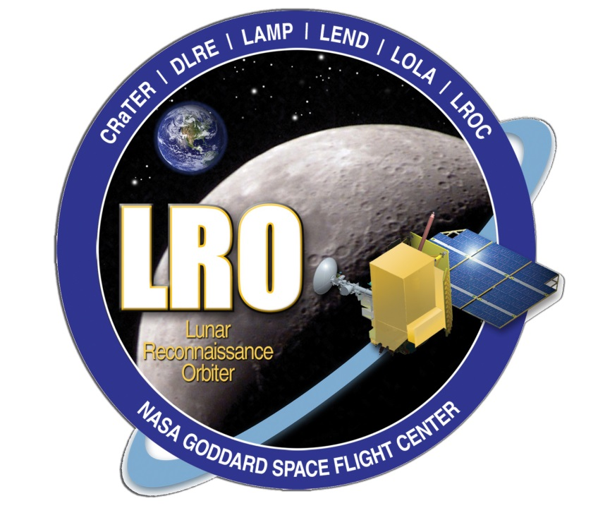
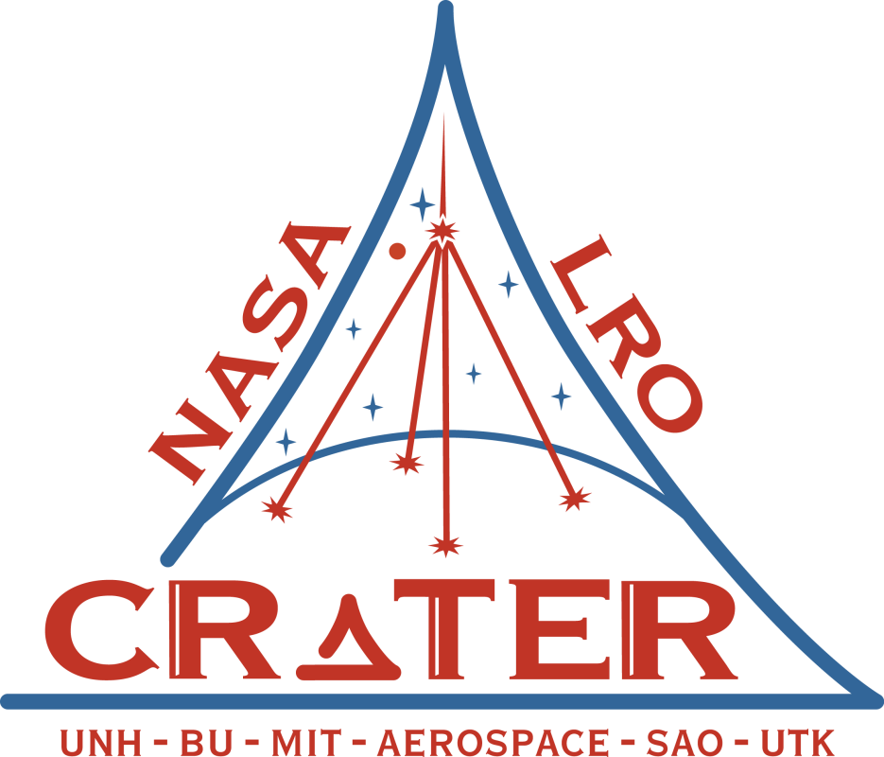
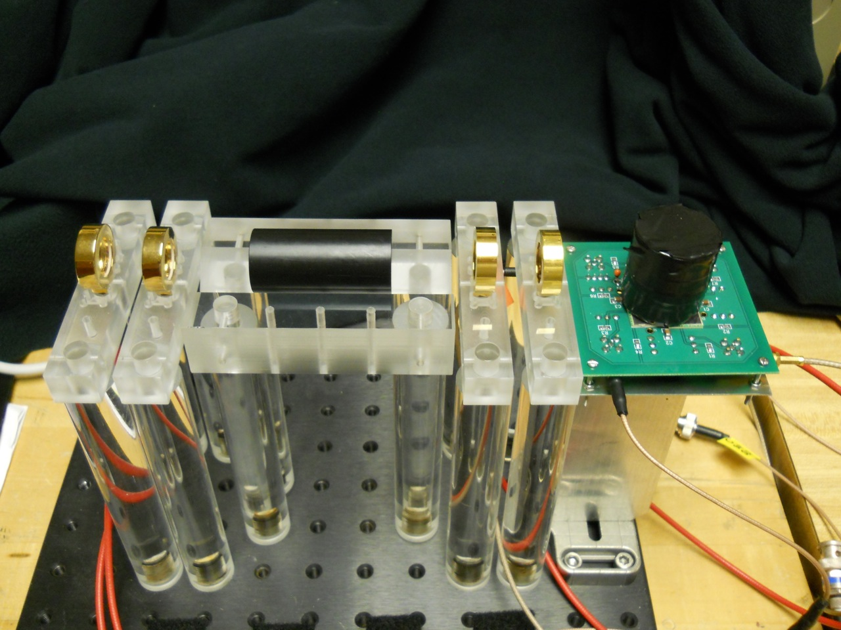
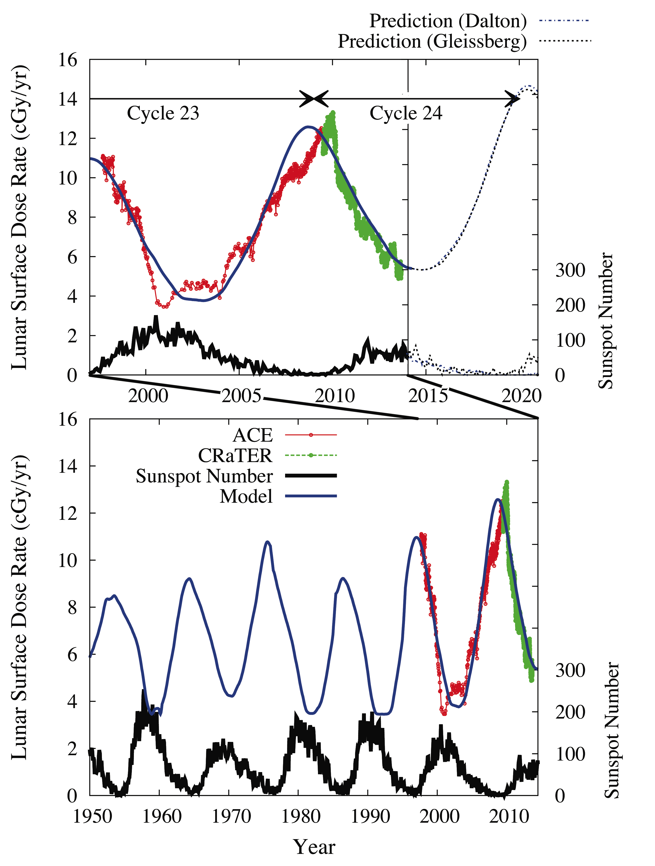
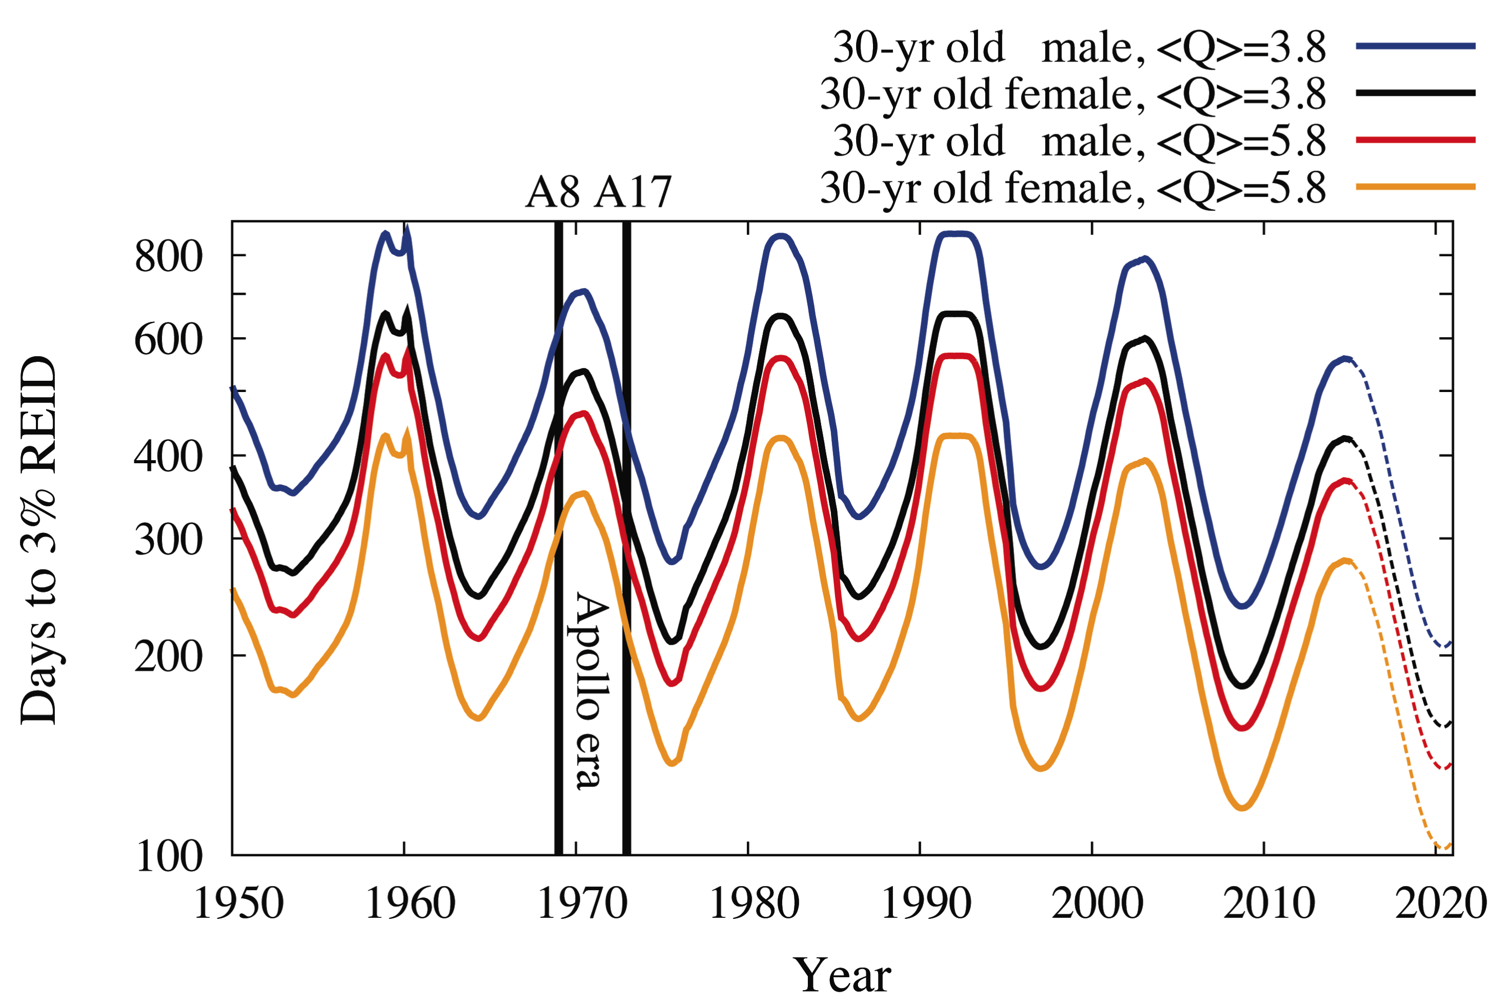
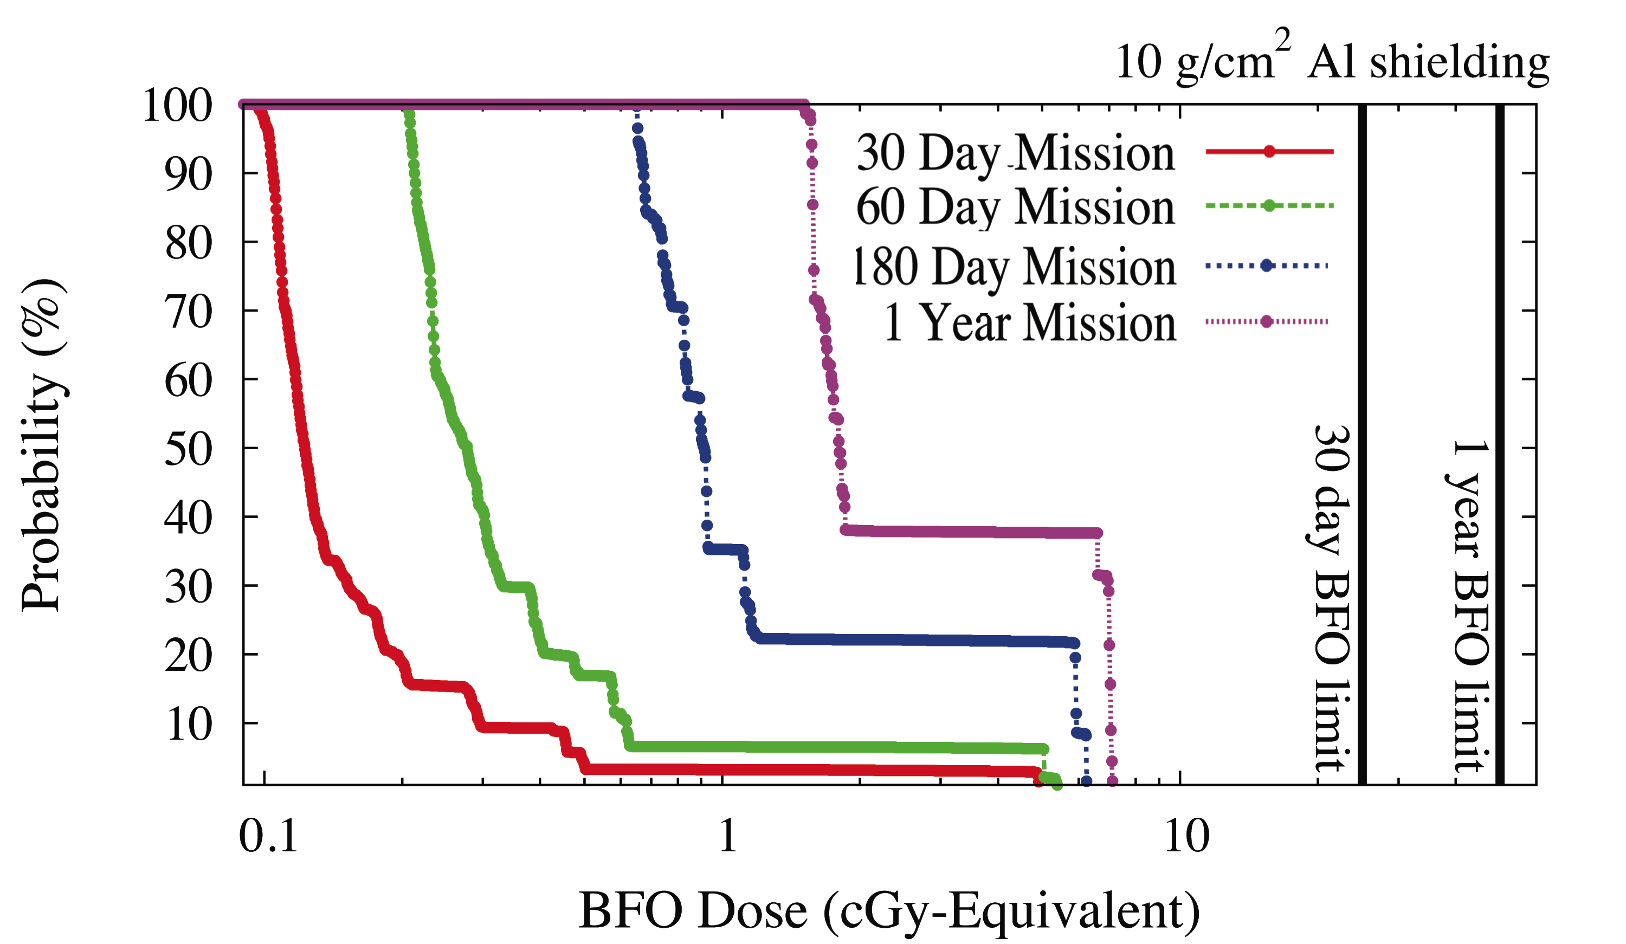
Elevated Astronaut Radiation Hazards in a New Era of Decreasing Solar Activity
N. A. Schwadron¹, C Bancroft¹, P. Bloser¹, J Legere¹, J. Ryan¹, S. Smith¹, H. Spence¹, J. Mazur², C. Zeitlin³, J. B. Blake², A. W. Case⁴, C. J. Joyce¹, J. Kasper^{4,5}, N. Petro⁶, J. A. Porter⁷, L. W. Townsend⁷, R. Turner⁸, J. K. Wilson¹
¹Institute for the Study of Earth, Oceans, and Space, University of New Hampshire, Durham, NH 03824; ² The Aerospace Corporation, El Segundo, CA 90009; ³Southwest Research Institute, EOS, Durham, NH; ⁴Harvard-Smithsonean Astrophysics Observatory, ⁵Dept of Atmospheric, Oceanic and Space Science, U. Michigan, Ann Arbor, MI; ⁶Goddard Spaceflight Center, MD; ⁷Department of Nuclear Engineering, University of Tennessee, Knoxville TN 37996; Analytic Services Inc., Arlington, VA 22206
Summary: The Sun and its solar wind are currently exhibiting extremely low densities and magnetic field strengths, representing states that have never been observed during the space age. As a result of the remarkably weak solar activity, we have also observed the highest fluxes of galactic cosmic rays in the space age, and relatively small solar energetic particle events. We examine the implications of these highly unusual solar conditions for human space exploration. The worsening radiation conditions in space motivate further validation of our understanding of the radiation interactions, particularly due to secondary populations behind shielding, at high altitude and in deep space. A new detector concept, Dose Spectra from Energetic Particles and Neutrons (DoSEN), combines two advanced complementary radiation detection concepts with fundamental advantages over traditional dosimetry. DoSEN not only measures the energy but also the charge distribution (including neutrons) of energetic particles that affect human (and robotic) health in a way not presently possible with current dosimeters. As we enter a new regime for the space environment due to drastic changes in solar behavior, the DoSEN concept lays a fundamental new groundwork for improving our understanding of the unique primary and secondary populations that cause biological damage.
A worsening Space Environment: The Sun and its solar wind are currently exhibiting extremely low densities and magnetic field strengths, representing states that have never been observed during the space age. The highly abnormal solar activity between cycles 23 and 24 has caused the longest solar minimum in over 80 years and continues into the unusually small solar maximum of cycle 24. As a result of the remarkably weak solar activity, we have also observed the highest fluxes of galactic cosmic rays in the space age, and relatively small solar energetic particle events. We examine the implications of these highly unusual solar conditions for human space exploration
Implications for Astronauts: While solar energetic particle events in cycle 24 present some hazard, the accumulated doses for astronauts behind 10 g/cm² shielding are well below current dose limits. However, galactic cosmic ray hazards limit mission durations in deep space to less than 1 year for 30-year old astronauts during solar minima. We predict that this allowable mission duration will decrease in successive solar minima as cosmic ray levels rise due to the weakening heliospheric magnetic field. Thus, our analysis suggests that, statistically, an astronaut may be better off venturing on a long deep-space mission during solar maximum since the risk associated with solar energetic particle events during solar maximum is smaller than the known effects of higher GCR fluxes at solar minimum. While statistics provide important guidance, the decision of when to travel to the Moon (or Mars) is ultimately the domain of ethics rather than statistics.
DoSEN –Dose spectra from energetic particles and neutrons – in a new era of space radiation. DoSEN is an early-stage space technology research project that combines two advanced complementary radiation detection concepts with fundamental advantages over traditional dosimetry. DoSEN measures not only the energy but also the charge distribution (including neutrons) of energetic particles that affect human (and robotic) health in a way not presently possible with current dosimeters. For heavy ions and protons, DoSEN provides a direct measurement of the lineal energy transfer (LET) spectra behind shielding material. For LET measurements, DoSEN contains stacks of thin-thick Si detectors similar in design to those used for the Cosmic Ray Telescope for the Effects of Radiation. With LET spectra, we can now directly break down the observed spectrum of radiation into its constituent heavy-ion components and through biologically based quality factors that provide not only doses and dose rates but also
dose equivalents, associated rates, and even organ doses.
DoSEN also measures neutrons from 10 to 100 MeV,
which requires enough sensitive mass to fully absorb
recoil particles that the neutrons produce. DoSEN develops
the new concept of combining these independent
measurements and using the coincidence of LET measure-
ments and neutron detection to significantly reduce
backgrounds in each measurement. The background suppression through the use of coincidence allows for significant reductions in size, mass, and power needed to provide measurements of dose, neutron dose, dose equivalents, LET spectra, and organ doses.
Photograph of the final lab prototype for DoSEN.
DoSEN’s LET coincidence in multiple SSDs allows species and quality factors, providing a direct relationship between LET measurements and biological impact (e.g., dose equivalents and organ doses). Shown here are “cross-plots” from CRaTER: the LET from the CRaTER D1 & D2 detectors versus LET from D3 & D4 detectors. We clearly resolve the different species that contribute to the radiation dose and dose –equivalent.
The DoSEN sensor configuration (see also lab prototype above) includes a combination of Solid State Detectors (SSDs), organic scintillator with PSD and Si photomulitipliers (SiPMs) allowing coincident detection of energetic particle LET and neutrons. The unique coincidence offered by LET & neutron detection promises a significant advance for a new generation of dosimetry measurements.
Safe Days in deep space. Days before a 30-year old astronaut reaches their radiation limit for 3% Risk of Exposure Induced Death (REID) at the 95% confidence level. Shown are safe days assuming different average quality factors: <Q>= 5.8, measured by CRaTER behind thin shielding, and <Q >=3.8 measured by RAD behind thicker shielding. Black lines indicate times spanned by the Apollo missions from Apollo 8 (A8) to 17 (A17).
Results of a beam run with a 230 MeV proton beam incident on an Al target. DoSEN in this case was mounted off to the side of the target and measured the material produced by beam interaction with target material. Shown here are protons and alpha particles observed by DoSEN. The LET coincidence between D4 (the silicon detector).
Evolving and increasingly hazardous radiation levels in space.
(Top Panel): ACE dose rates (red) are based on fits to CRIS spectra (ONeill, 2006), CRaTER measurements (green) indicate proxies for lens dose rates behind 0.3 g/cm² Al shielding (Schwadron et al., 2012). The sunspot number predictions (the lower black and blue dashed lines) show two cases based on a Gleissberg-like and a Dalton-like minimum, the results of which are similar. The dose predictions (solid blue line and the upper black and blue dashed lines) are from a sunspot-based model of the heliospheric magnetic field and the correlated variation in modulation of GCRs. The ACE, CRaTER, and model results are projected to the lunar surface.
(Bottom Panel): Same as top panel but for a longer time span.
Summary and Conclusions:
CRaTER quantifies the increasingly biologically hazardous radiation environment associated with reduction in solar activity in cycles 23 and 24 and the associated increase of galactic cosmic ray fluxes
Reduction of 30-50 days of “safe” days for astronauts from cycle-to-cycle associated with decreasing solar activity
DoSEN –Dose spectra from energetic particles and neutrons –builds on CRaTER technology to more fully characterize the space environment in the new era of decreased solar activity
Probability (%) versus integrated BFO dose for 30 day to 1 year missions. We use the PREDICCS database [http://prediccs.sr.unh.edu; Schwadron et al., 2012) to build up statistics for the probability of SEP events of varying integrated dose behind spacecraft shielding (10 g/cm²). The database currently provides doses for the period from July 2011 through April 2014. The PREDICCS doses are derived from proton spectra and use dose in 10 g/cm² water as a proxy for the Blood Forming Organ (BFO) dose.
References: [1] Spence, H. E., et al., (2010), Cosmic Ray Telescope for the Effects of Radiation on the LRO Mission, Space Sci. Rev., 150(1-4), 243-284. [2] Chin, G., et al., (2007) Lunar Reconnaissance Orbiter Overview: The Instrument Suite and Mission, Space Sci. Rev., Volume 129, Number 4, pp. 391-419. [3] Case, A. W., et al., (2013) The Deep Space Galactic Cosmic Ray Lineal Energy Spectrum at Solar Minimum, Space Weather, DOI: 10.1002/swe.20051. [4] Schwadron, N. A., et al., (2012) Lunar radiation environment and space weathering from the Cosmic Ray Telescope for the Effects of Radiation (CRaTER), J. Geophys. Res. – Planets, 117, DOI: 10.1029/2011JE003978. [5] Zeitlin, C., et al., (2013) Measurements of Galactic Cosmic Ray Shielding with the CRaTER Instrument, Space Weather, DOI: 10.1002/swe.20043. [6] Joyce, C. J., et al., (2013) Validation of PREDICCS Using LRO/CRaTER Observations During Three Major Solar Events in 2012, Space Weather, DOI: 10.1002/swe.20059. [7] Wilson, J. K., et al., (2012) The first cosmic ray albedo proton map of the Moon, J. Geophys. Res. – Planets, 117, DOI: 10.1029/2011JE003921. [8] Looper, M. D., et al., (2013) The Radiation Environment Near the Lunar Surface: CRaTER Observations and Geant4 Simulations, Space Weather, DOI: 10.1002/swe.20034. [9] Spence, H. E., et al., (2013) Relative contributions of Galactic Cosmic Rays and lunar proton “albedo” to dose and dose rates near the Moon, Space Weather. [10] Schwadron, N., C. Bancroft, P. Bloser, J. Legere, J. Ryan, S. Smith, H. Spence, J. Mazur, and C. Zeitlin (2013), Dose spectra from energetic particles and neutrons, Space Weather, 11(10), 2013SW000975, doi:10.1002/swe.20095.
Acknowledgments: We thank all CRaTER and LRO team members whose dedication, skills, and labor made this experiment and mission possible. This work was funded by the NASA under contract numbers NNG11PA03C and NNX13AC89G.

