Slide 1
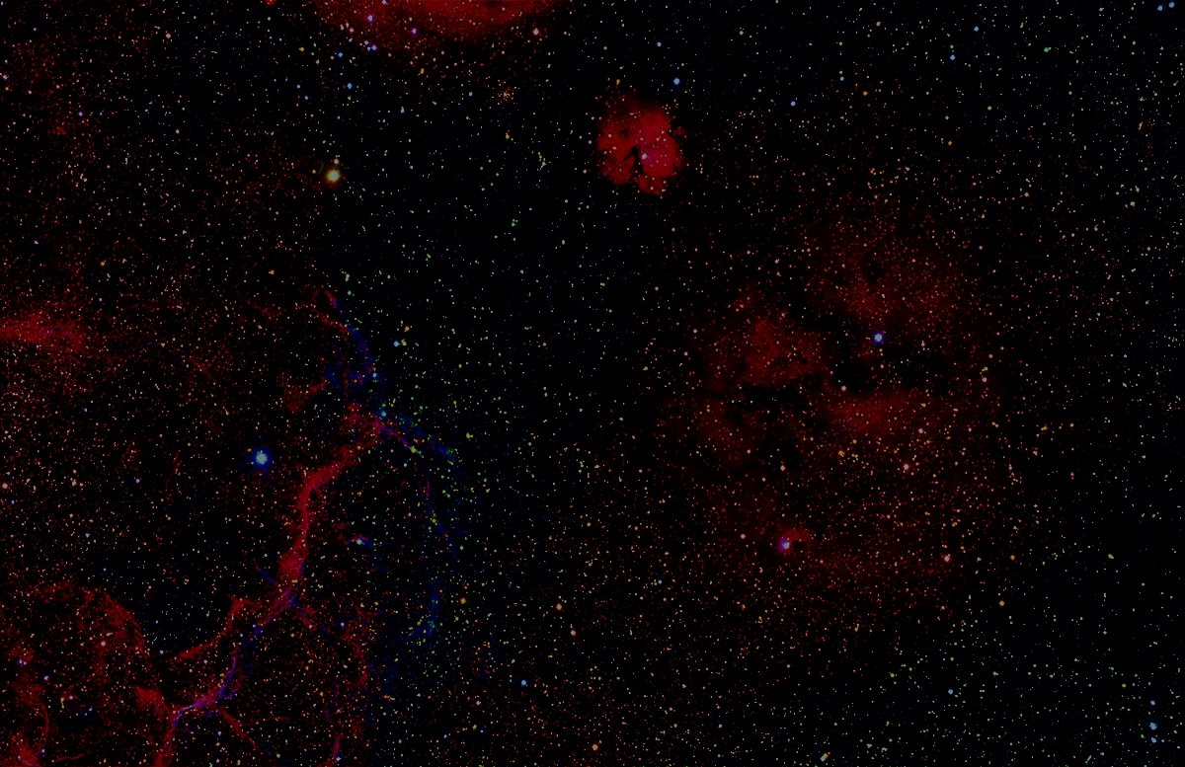


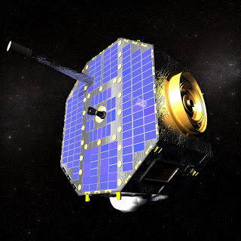
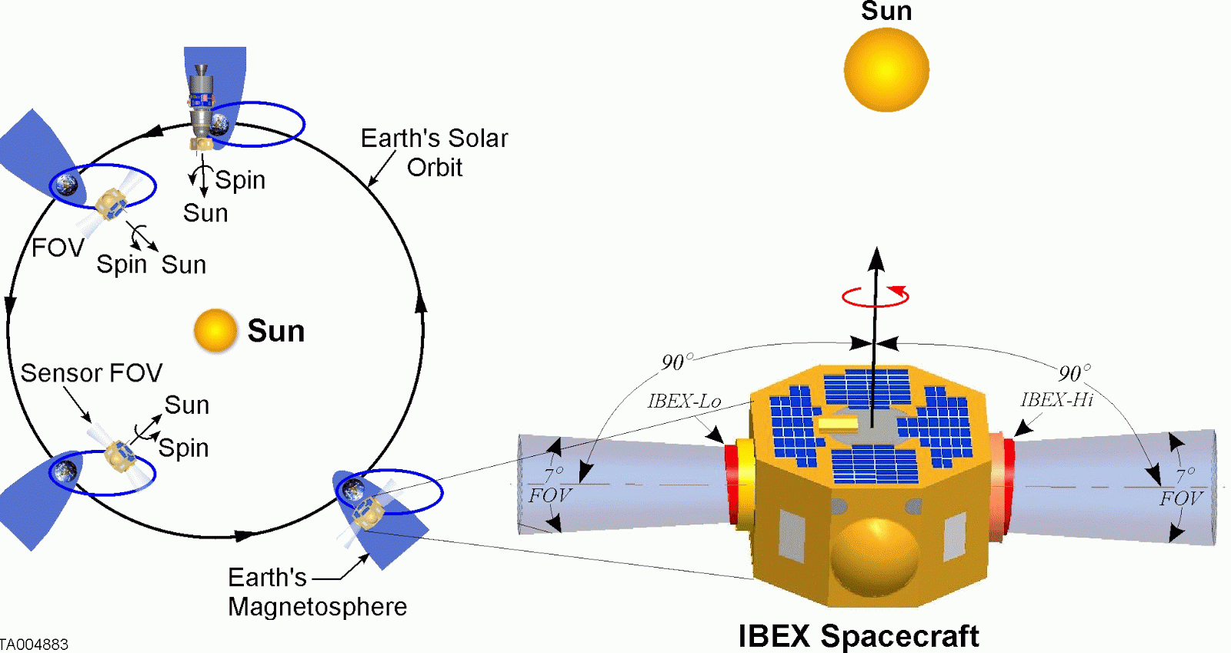
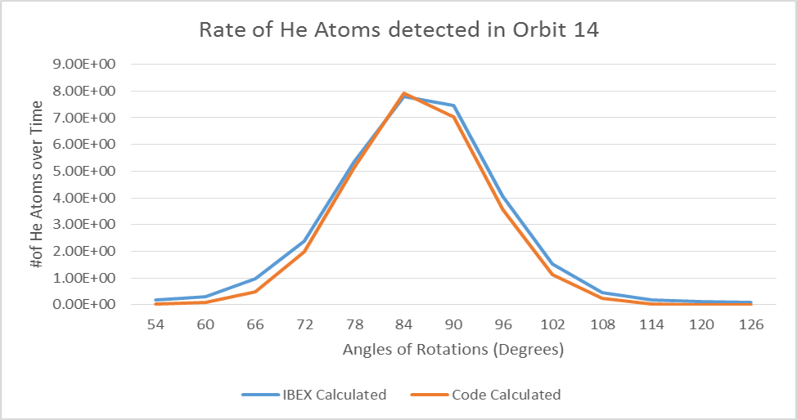
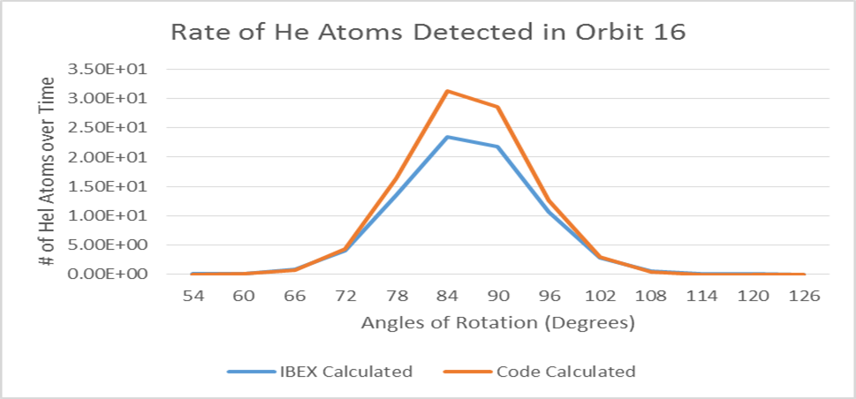
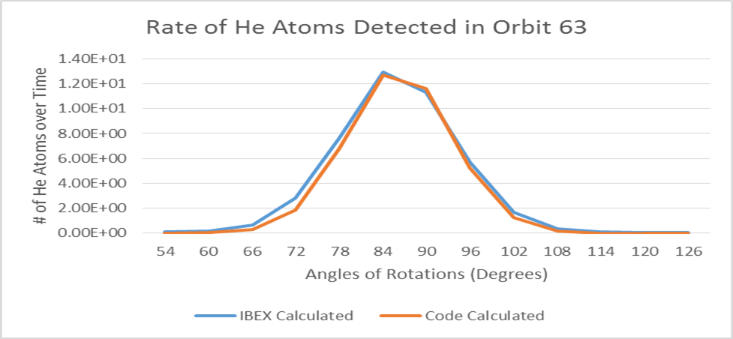
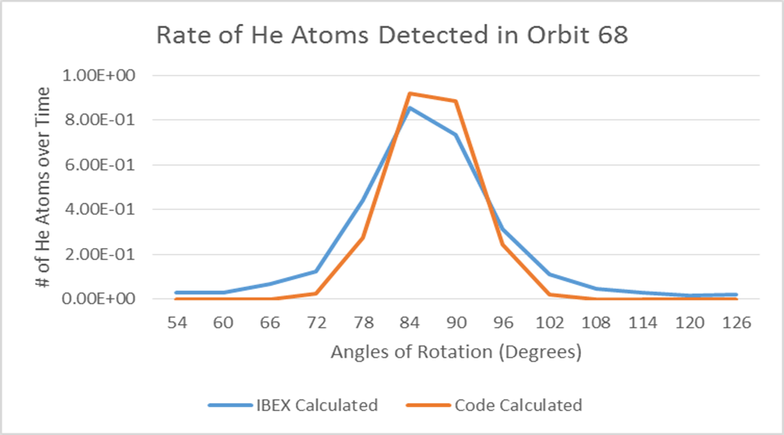
IBEX Neutral
Results
Using the data from IBEX’s orbits 14-20 and 63-67, it could be observed from the data that most of them matched accurately. As shown, this was most evident in the data from orbits 14 and 63, as there was almost no difference between the values. Although there was a significant difference between the two graphs for several of the orbits such as orbits 16 and 68, the data obtained using the code was still able to accurately mimic the graph behavior of the IBEX data. From this it could be concluded that the code was successful in simulating IBEX’s helium atom detection.
Victor Pierre & Gary Hu
Advisors: Fatemeh Rahmanifard & Nathan Schwardon
IBEX Orbit & Orientation around the Sun
IBEX
Background
The Interstellar Boundary Explorer (IBEX), a satellite built by NASA, maps the boundary between the solar system and the local interstellar medium (ISM).. The results from IBEX have given the scientific community much insight into energetic neutral atoms (ENA) present.
In 2011, Nathan Schwardon of the University of New Hampshire developed a systematic code that was successful in predicting the quantities of hydrogen atoms that would be detected by IBEX in the future. Recently, attempts to modify the code to predict the amounts of helium atoms have been made. Thiswould enable scientists to accurately gather information about the local ISM without the assistance of IBEX.
In this research, the data from the code was compared with the actual data garnered from IBEX to analyze the efficiency of the code.
Conclusion
There is little error differentiating the data values predicted using the code from the data values actually obtained from IBEX. The code was successful in predicting the amount of helium atoms in the ISM without the assistance of IBEX, just as it was able to with hydrogen atoms. The ability of IBEX to detect helium atoms based on its physical orientation in space was also analyzed. If the satellite was positioned perpendicularly, there would be a much higher concentration of helium atoms detected as opposed to if it were oriented parallel to the Earth’s orbit. This can most likely be attributed to the generalization that helium particles are more easily detected when they are directly in front of the collimators. Although there were several instances wherein the data did not match, the code could be improved to be as successful as it was for detecting hydrogen atoms. Then, when similar comparisons are made in the future, the data could show the code to be much more efficient and accurate in its predictions. Overall, this research shows that improvements being made to this code have been productive in advancing its functionality.
Graphs Based on Amounts of He Atoms Detected in Different Orbits
Methods
Using spherical coordinates, the orbit and physical orientation of IBEX in relation to the sun was calculated. Employing this information, it became possible to use the code to arrange data. With the results given, the rates of helium in different orbits gathered by both IBEX and by Nathan’s code were organized into graphs. This allowed for a visual and numerical representation of the number of helium particles detected at different angles. The data was sorted according to the different orbits of IBEX, as well as the angles at which the collimators were oriented
Acknowledgements
Fatemeh Rahmanifard- for being an excellent instructor and for her assistance throughout the entirety of this research project.
Nathan Schwardon- for providing the codes that we used to compare to IBEX’s data.
Scott Goelzer & Louis Brood Timberlane- for supervising the Space Science module in which this research project is held.
University of New Hampshire for funding the Project SMART program.
David Heirtzler & Trevor Leonard- for providing us with some of the data used to compare He atoms.

