Slide 1


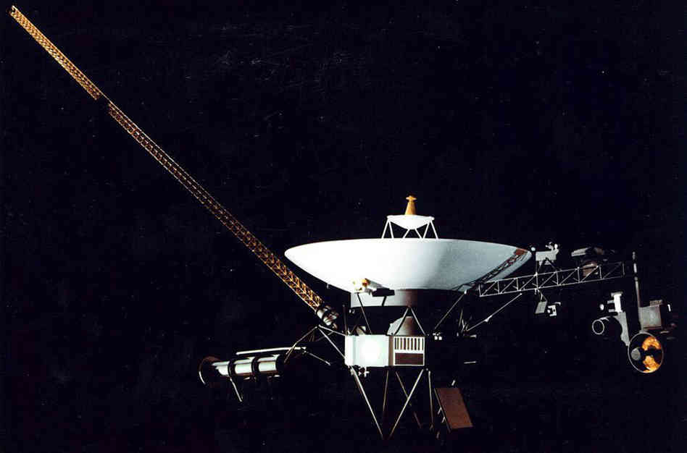
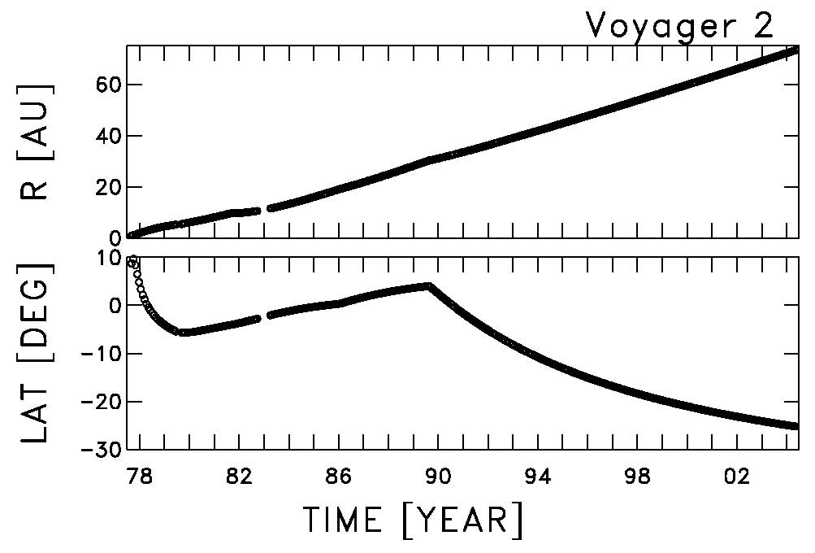
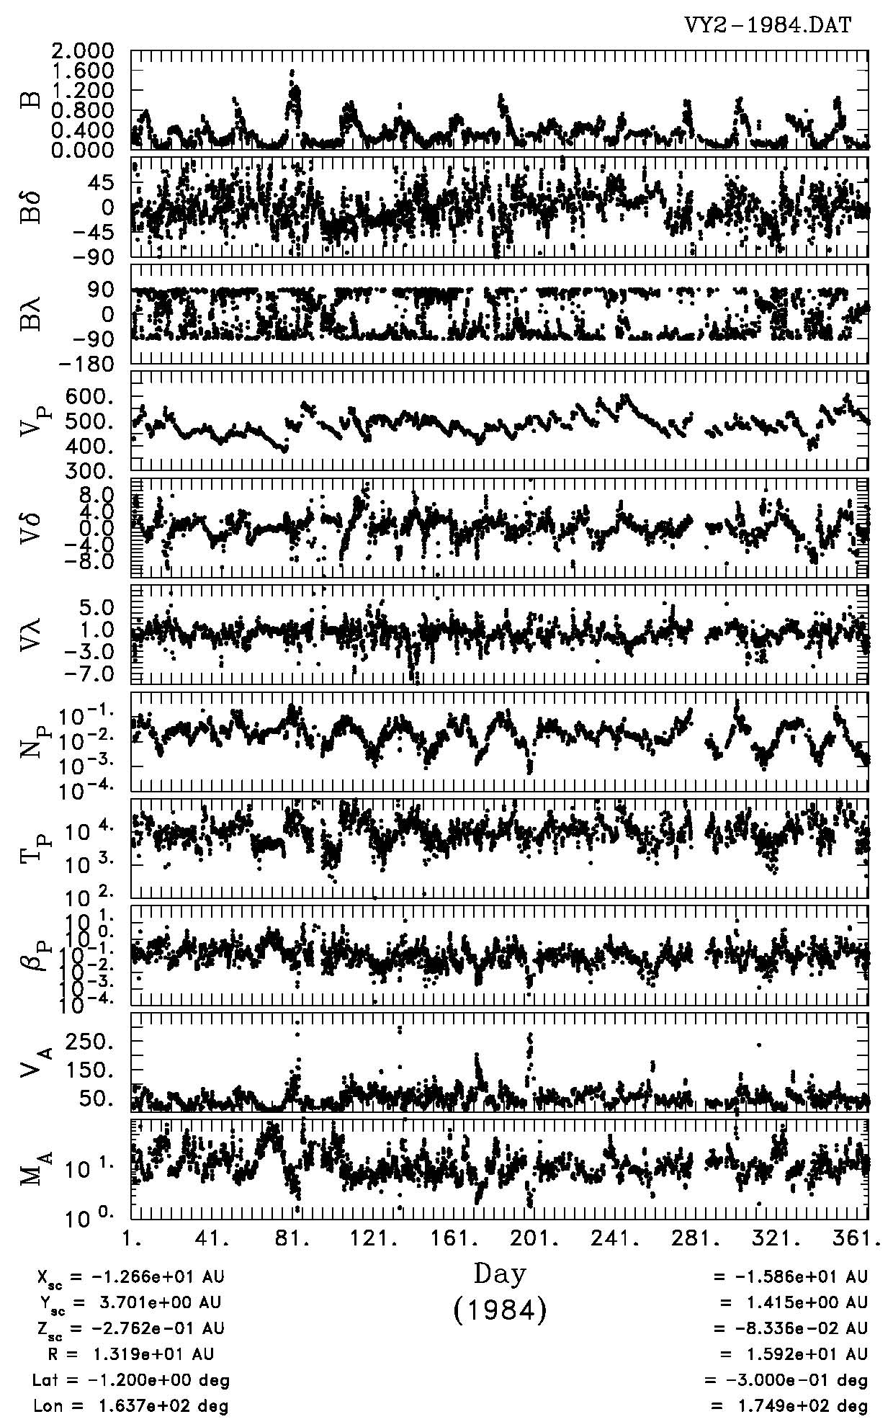
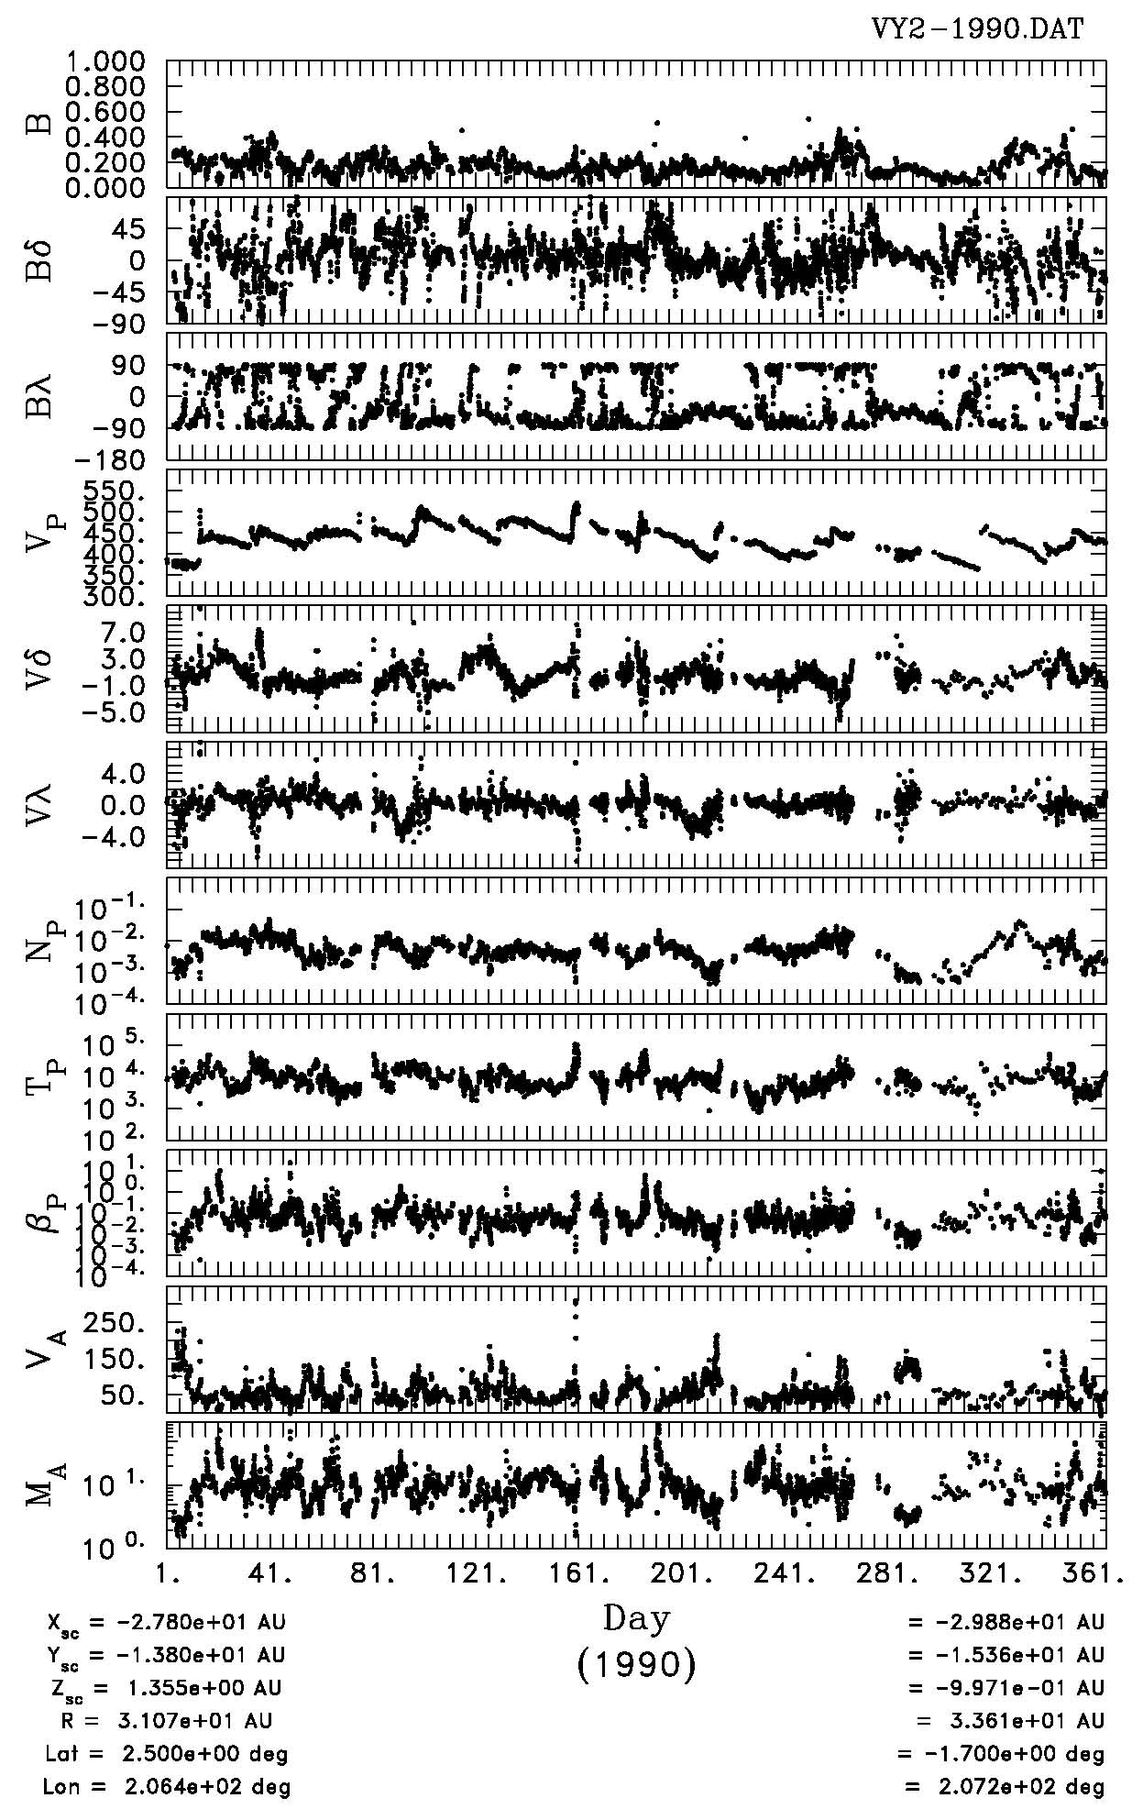
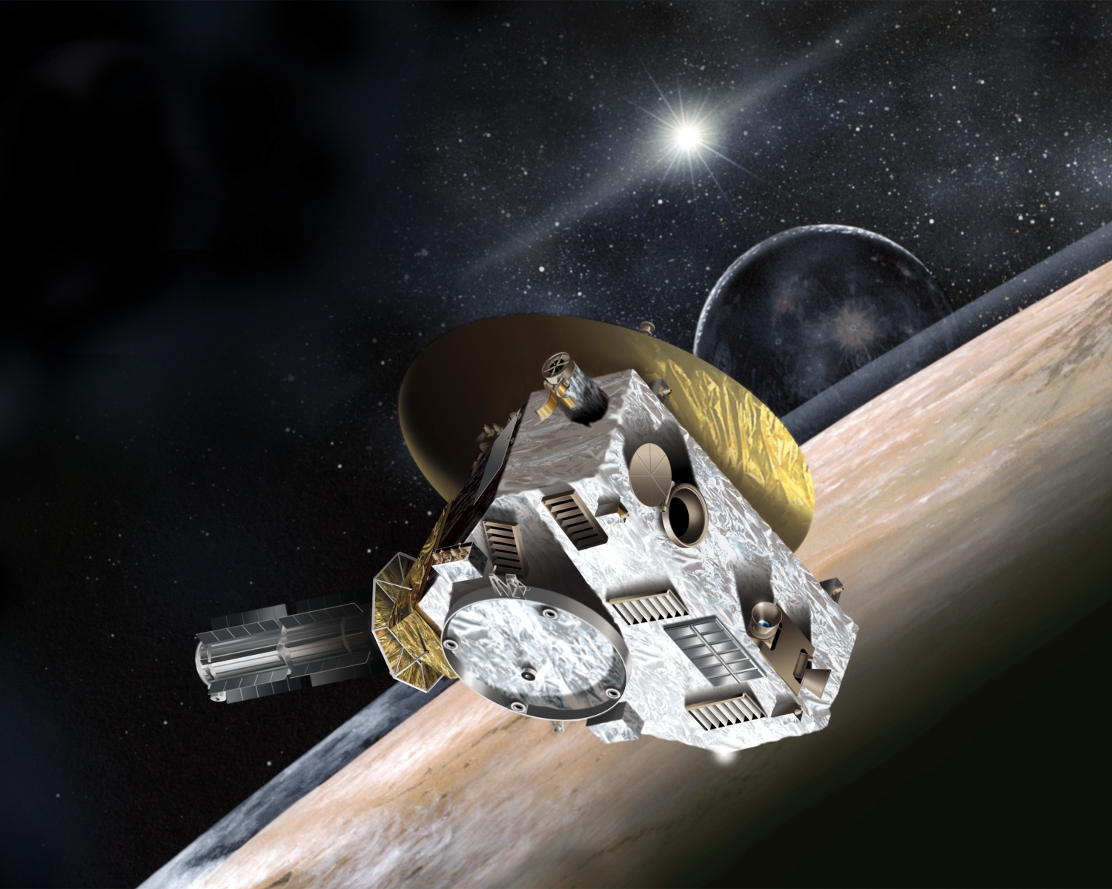
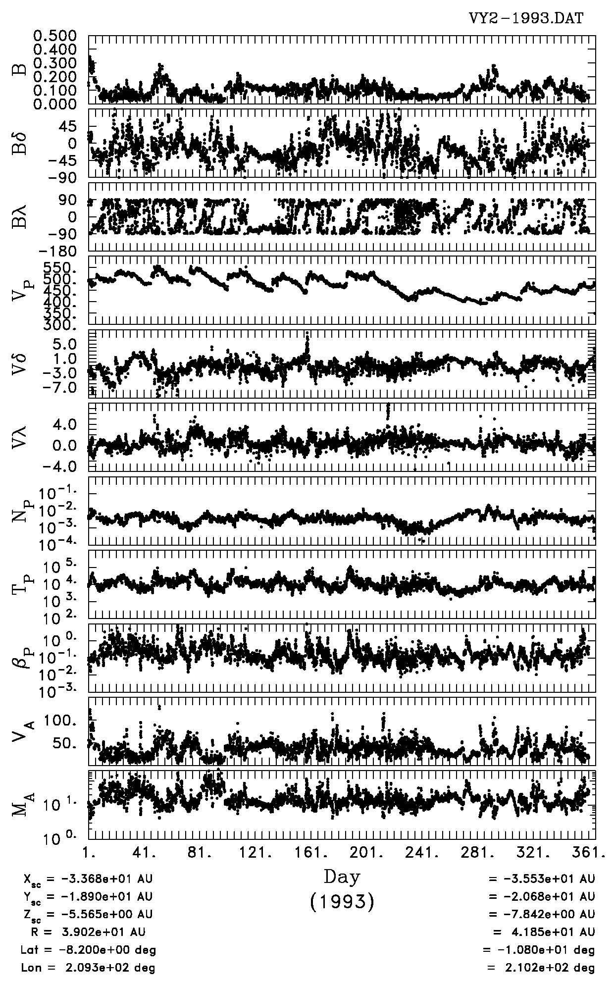
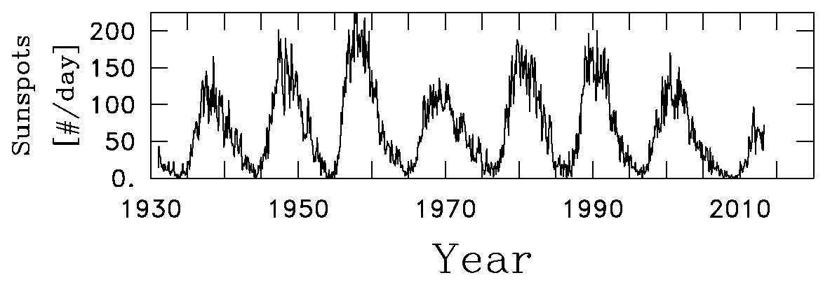
Nick Payne (Salem High School) & Jared Spang (Timberlane High School)
Advised By: Charles W. Smith
Voyager Study for New Horizons
Background:
New Horizons, a spacecraft to study Pluto, was launched in 2006. However, when it was launched, it was flown without a magnetometer (an instrument that measures magnetic field strength). Researchers realized only afterwards that a magnetometer was needed to measure the field near Pluto. Since Voyager II had flown to past the range of Pluto, an idea was formed about how the magnetic field strength and other measurements might correlate.
Observations:
In the Voyager II data from 1984, density and magnetic field strength correlated very strongly, which was expected. However, the correlation decreased as the range of Voyager II increased.
Data from Voyager II. The variable B is the magnetic field strength. V is velocity, N is density, and T is temperature. In the 1984 data set, there is a strong correlation between density and magnetic field strength. In 1993, there is no correlation.
Latitude and range of Voyager 2
Conclusions:
When the range from the sun increases, the correlation between density and the magnetic field strength becomes less reliable. This method cannot be used with New Horizons to find the magnetic field strength.
Predictions:
Since the strength of the magnetic field relates to the number of protons in the solar wind, it was assumed that density correlates to magnetic field strength.
Magnitude of the magnetic field strength is compared to the solar flux.
Methods:
Hourly data tables that contained velocity, density, temperature, and magnetic field strength from Voyager II were converted to daily averages.
Acknowledgements:
Meghan Fisher
Collin Joyce
The NASA Space Science Data Center
Thanks To:
Louis Broad & Scott Goelzer
The sun has periods of high and low solar activity. The number of sunspots indicates these different activities.

