Slide 1
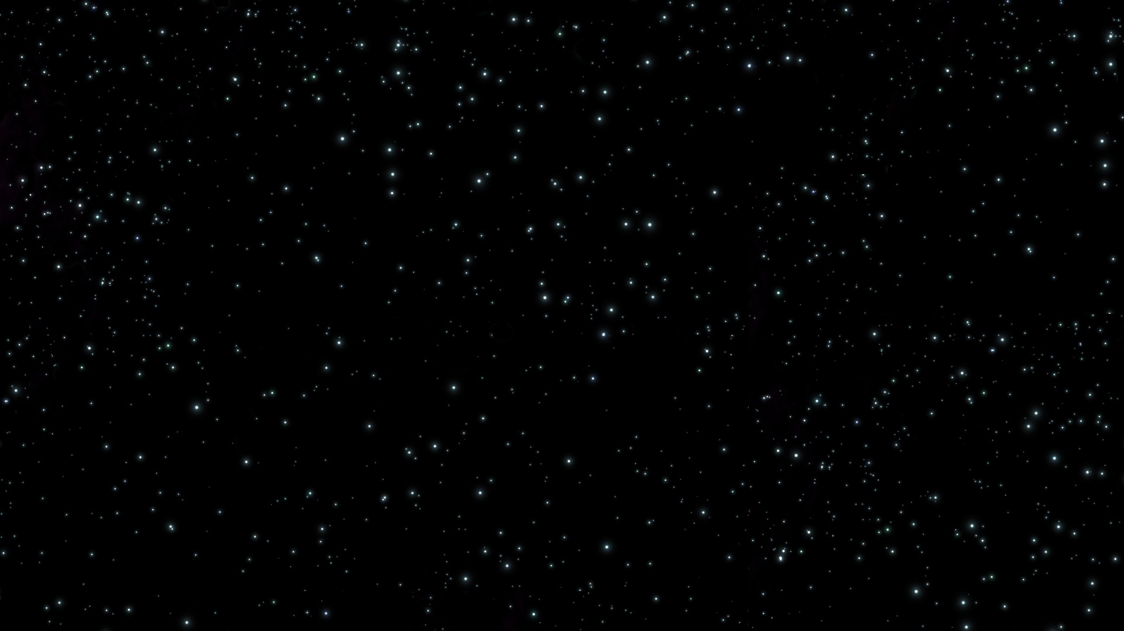


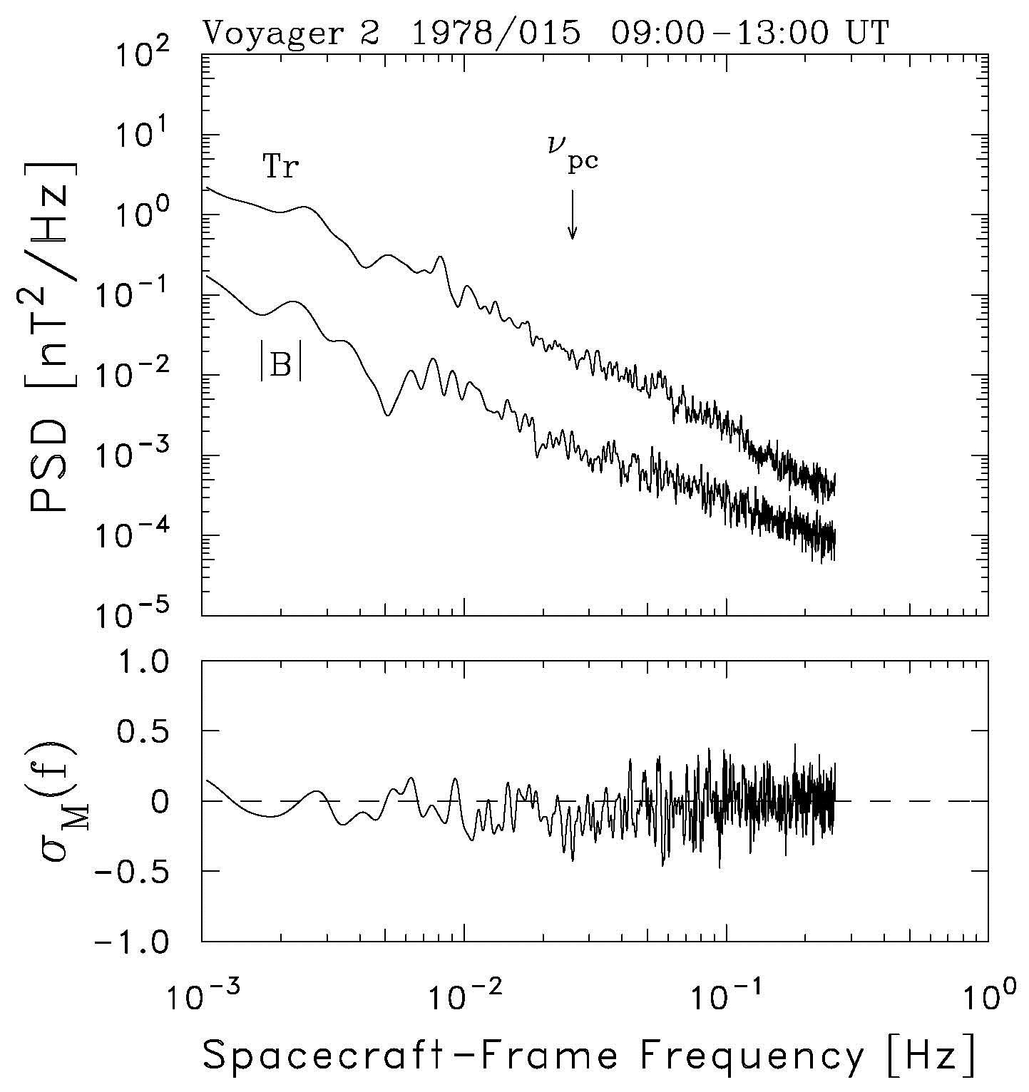
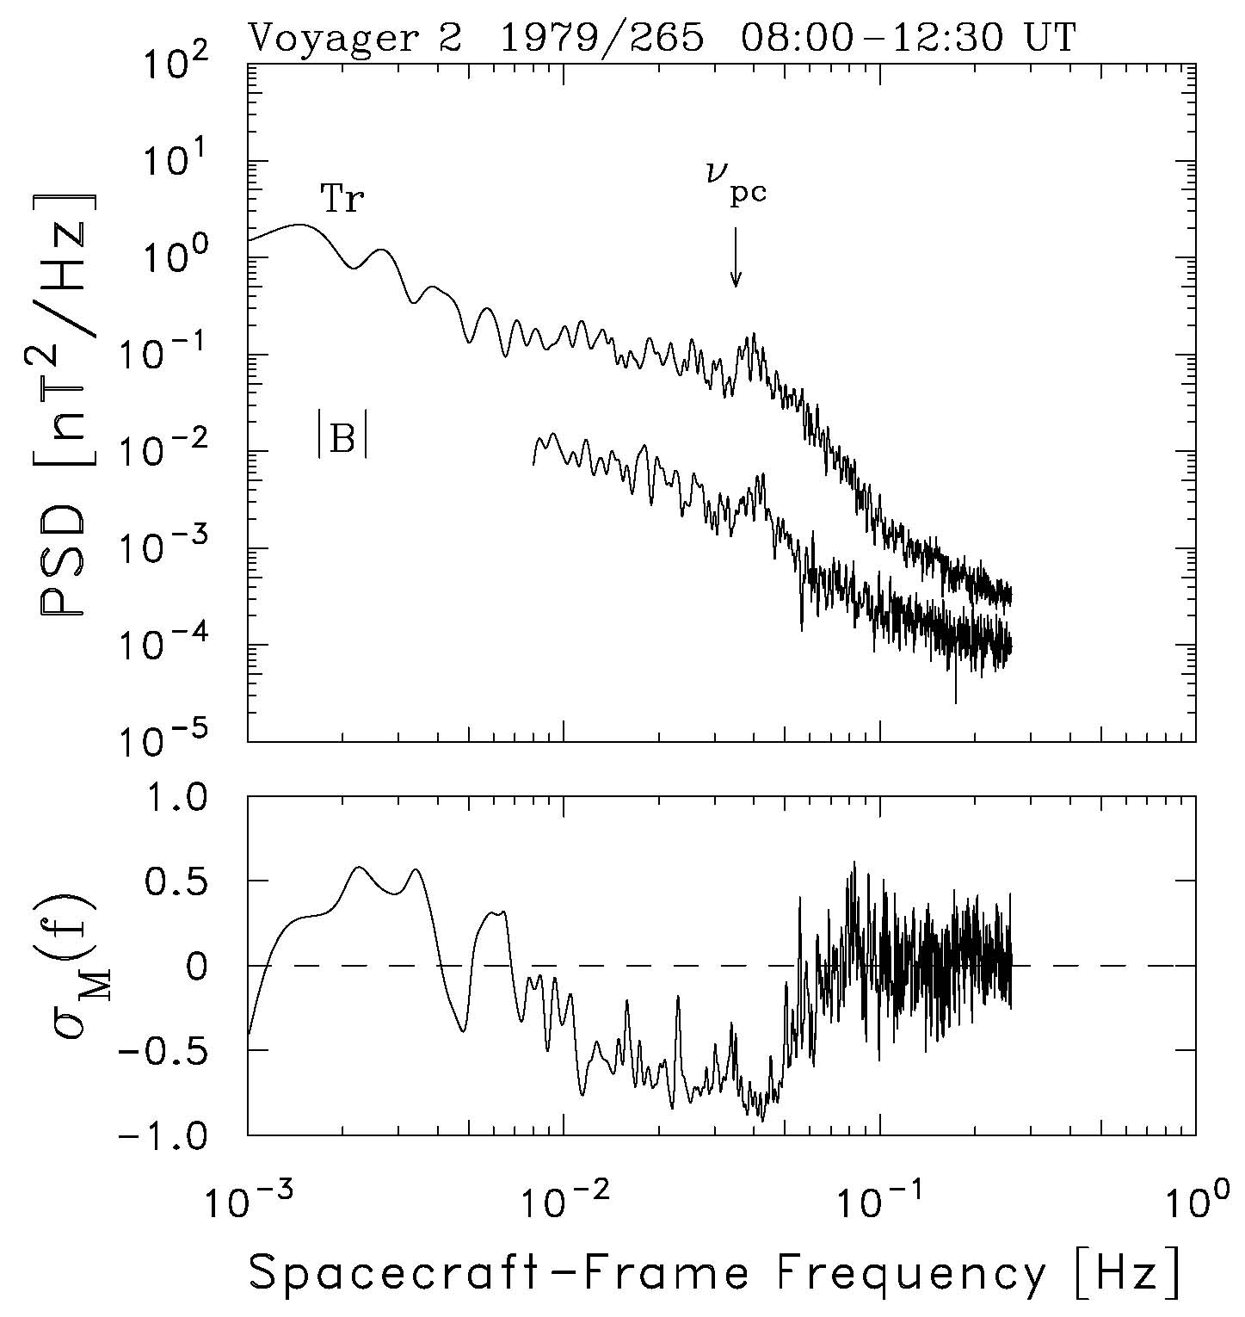
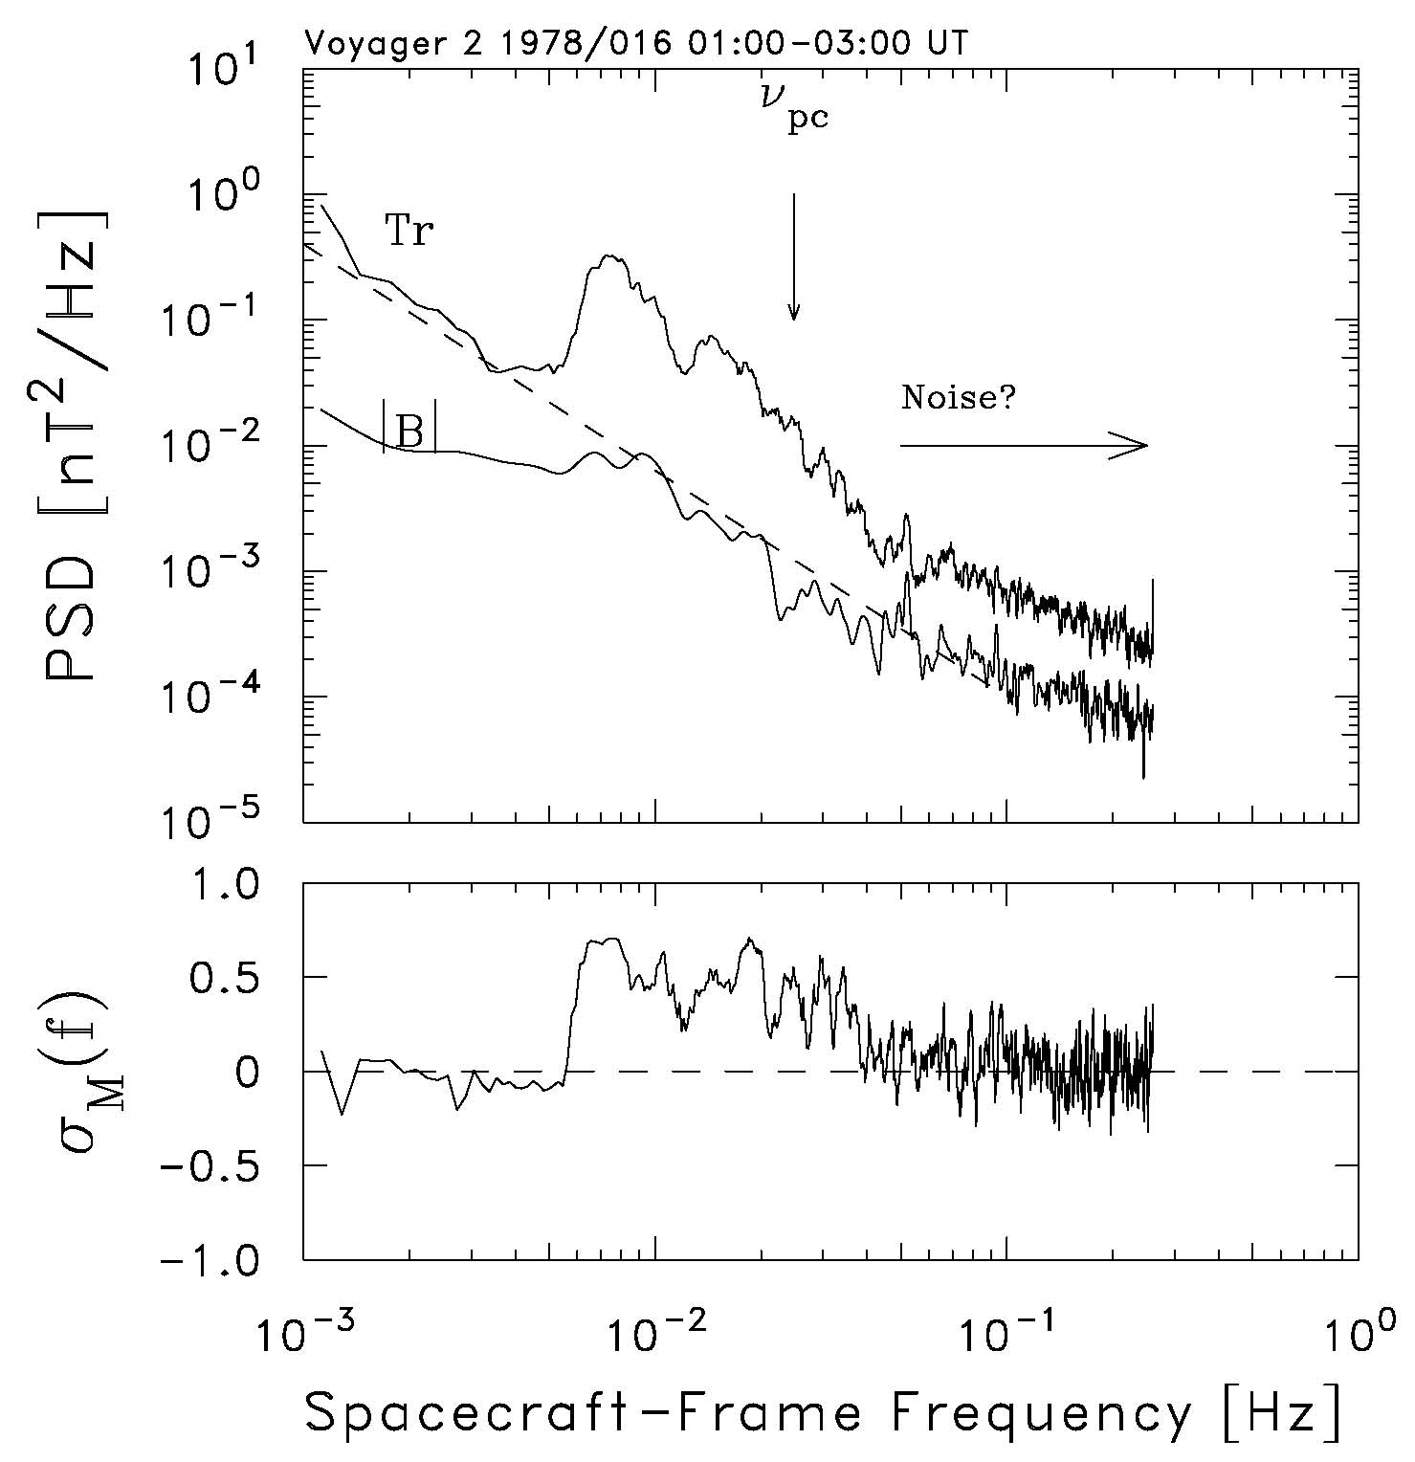
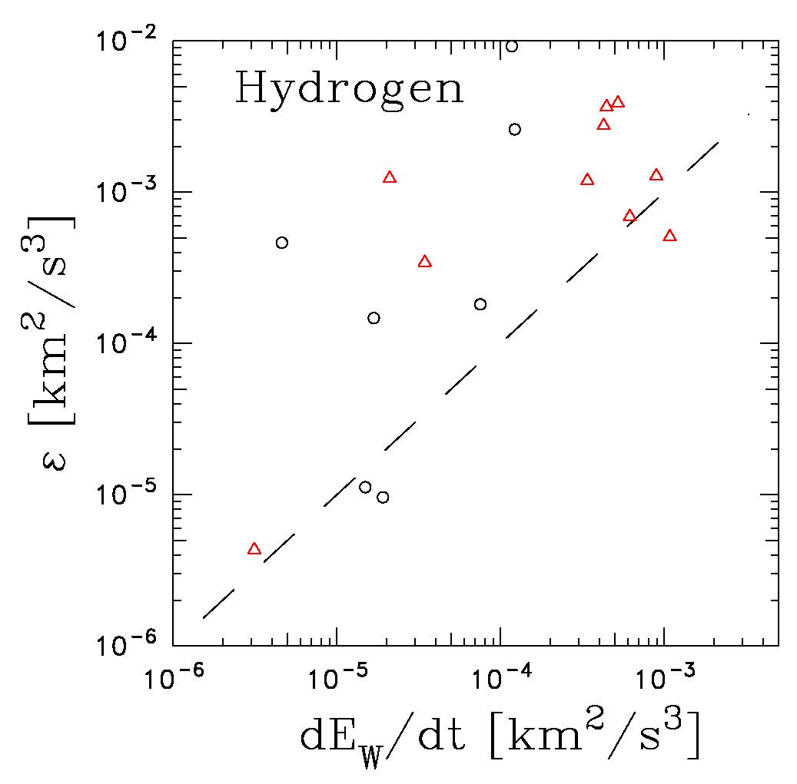
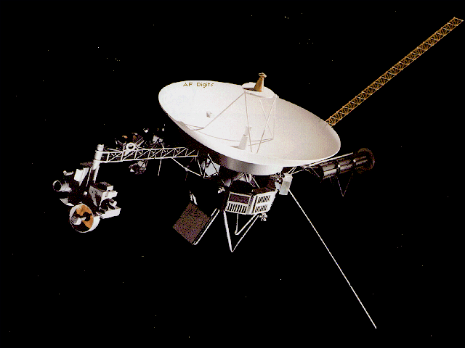
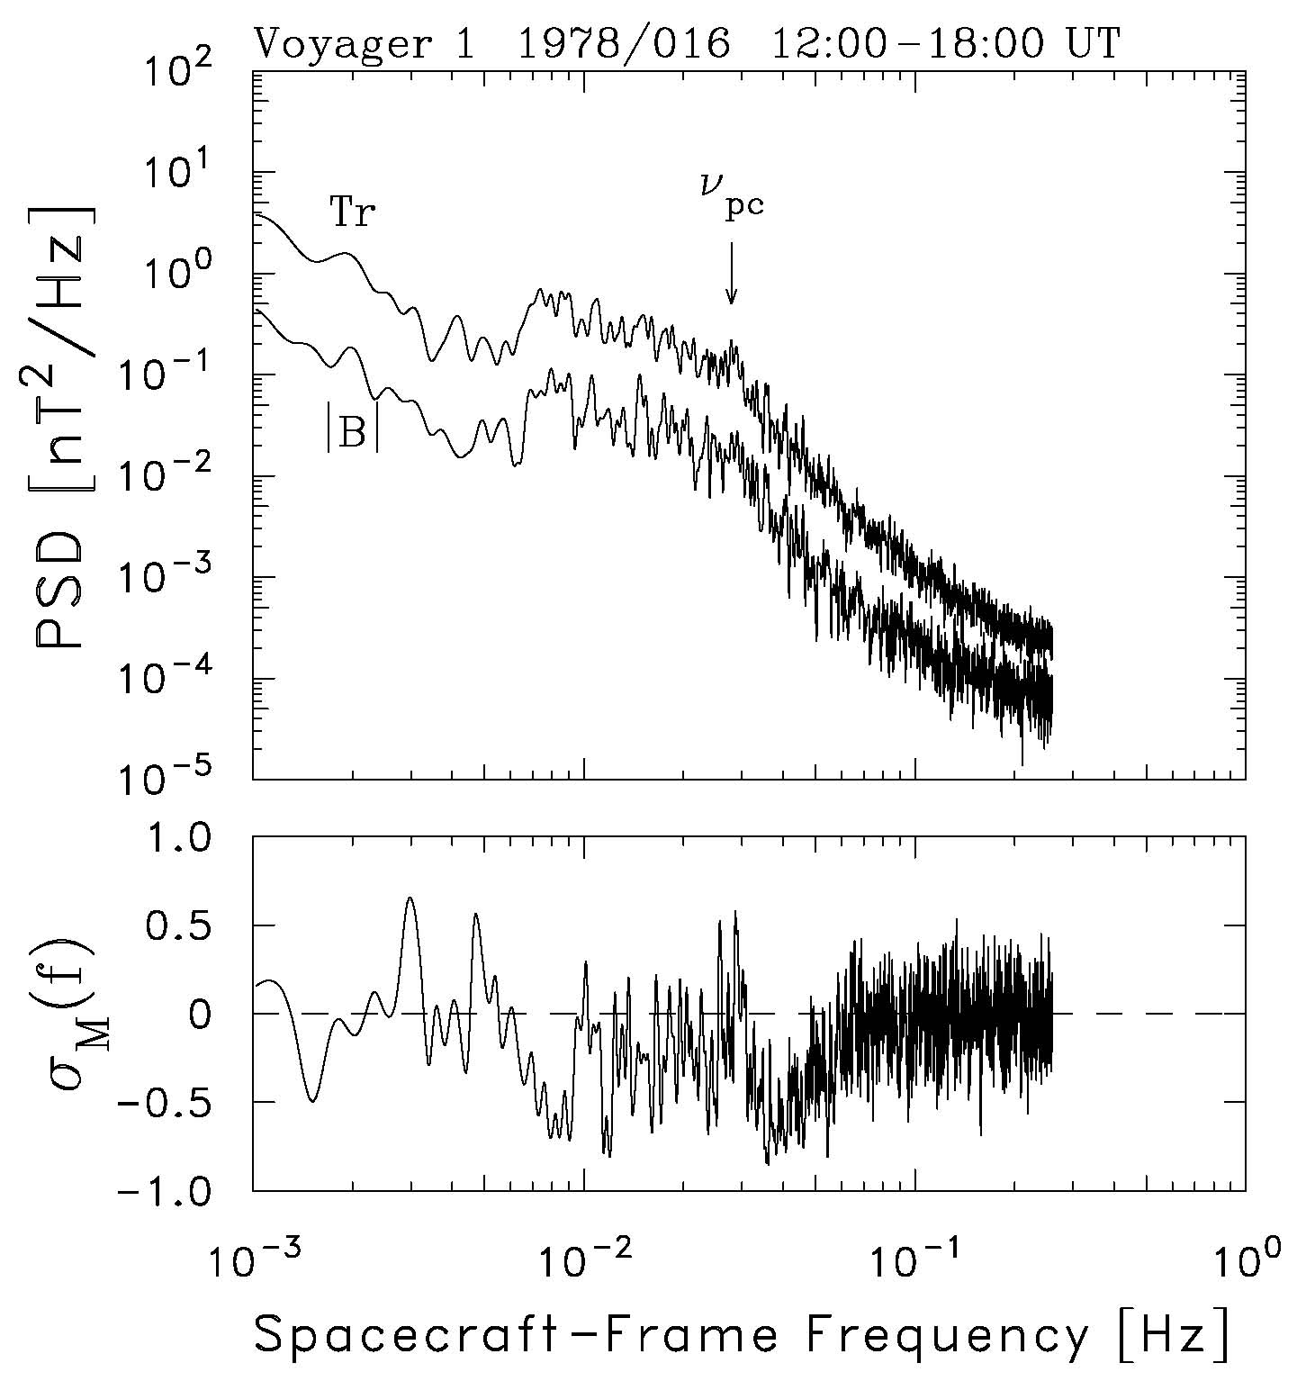
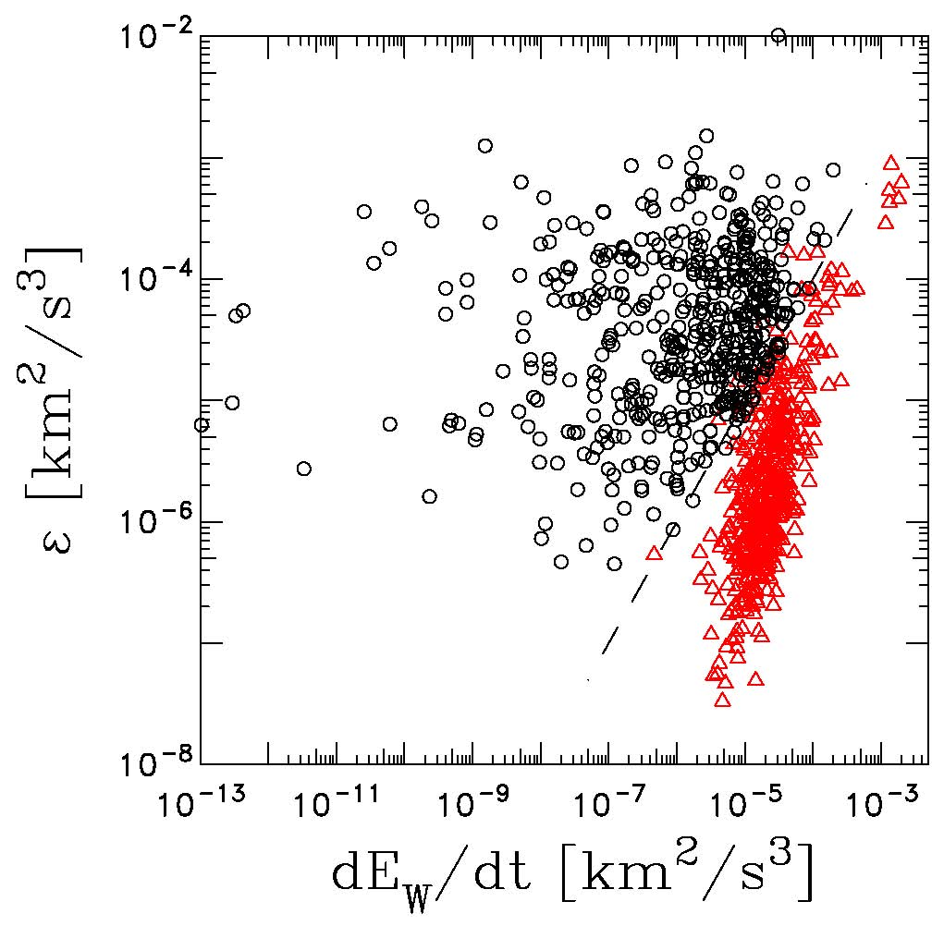

Pick Up Ions (P.U.I.)
Jared Spang (Timberlane High School) and Nick Payne (Salem High School)
Advised by: Charles W. Smith
How does this occur?:
P.U.I.s or pick up ions are atoms that have become ionized. They are formed when neutral interstellar matter enters the Heliosphere. The matter is then struck by photons from the sun in the form of solar wind causing them to become ionized. During the process of ionization, the atoms release an electron whose frequency can be used to determine which atomic element was struck.
Graph 1.
Data:
Graph 1 is defined by no large crests or troughs thus forming a generally straight line.
It is indicative of no P.U.I.s
Graph 1 demonstrates the typical results found in the data.
Graph 4.
Graph 4 demonstrates the wave frequency typically released by Hydrogen P.U.I.s
It is defined by a sudden crest at the indicated Hydrogen frequency (downward arrow).
This graphical result was among the most recurring of graph types.
Results:
Helium P.U.I.s were found in the data collected from Voyager I and II. However, the frequencies of the P.U.I.s were not as expected. Graph 5 and 6 demonstrate both the results of the experiment (graph 5) and the results of the experiment from which it was modeled after (graph 6). As shown the results were not consistent with the results shown in graph 6. The cause of the inconsistencies was determined to be an incorrect representation of the values. This inconsistency accounts for the non-separated pattern shown in graph 5.
Purpose:
The purpose was to prove the existence of helium P.U.I.s in the solar system. This was done by examining the wave frequencies released by atoms ionized by solar wind. Hydrogen atoms were previously the only proven P.U.I.s as a result of solar wind. This research will help increase our knowledge of interstellar matter and of what flows into the solar system.
Graph 2.
Graph 2 demonstrates the existence of Helium P.U.I.s
It is defined by a large crest before the indicated Hydrogen frequency and by runoff from the initial crest.
This trend occurred in various instances throughout the data and greatly supported Helium P.U.I.s
Graph 5.
Graph 3.
Graph 6.
What was done?:
Wave data from both Voyager I and II was compiled and formatted into a variety of graphs. The graphs were then analyzed in the search for crests and troughs. Specific crests were searched for at the frequencies of hydrogen (indicated by arrow) and helium (slightly before the hydrogen frequency).
Graph 3 indicates the existence of both Hydrogen and Helium P.U.I. emissions.
It is characterized by a primary crest followed by runoff and a secondary crest at the frequency of Hydrogen emissions.
The hybrid results from Hydrogen and Helium occurred rarely in the data .
Acknowledgements:
Meghan Fisher
Collin Joyce
This project was supported by N.A.S.A. Space Science data center.

