Slide 1
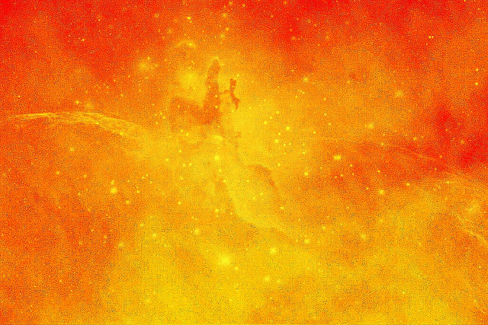


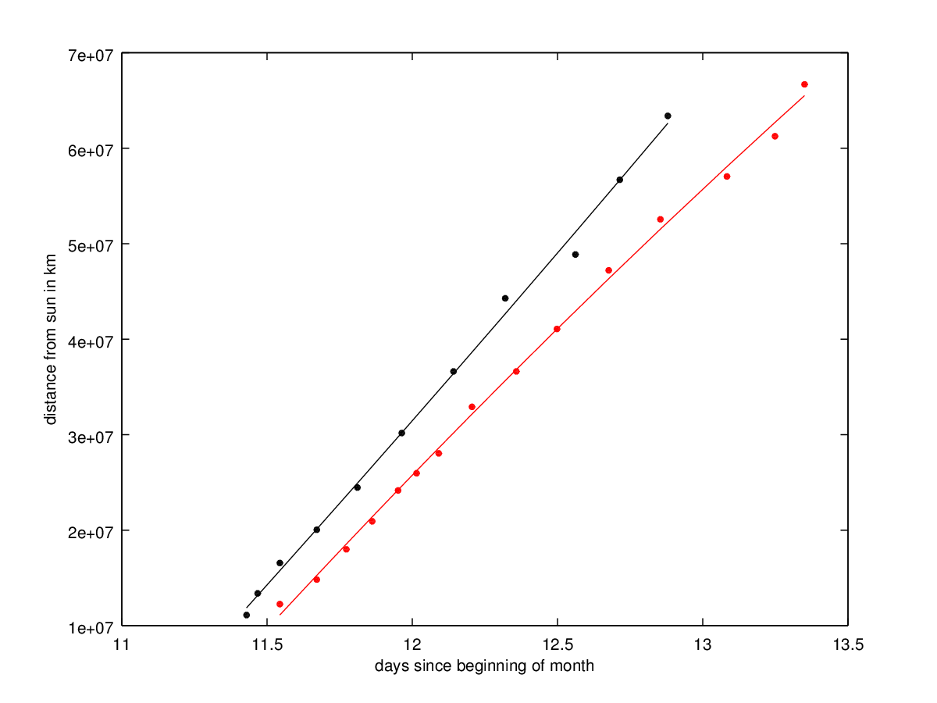
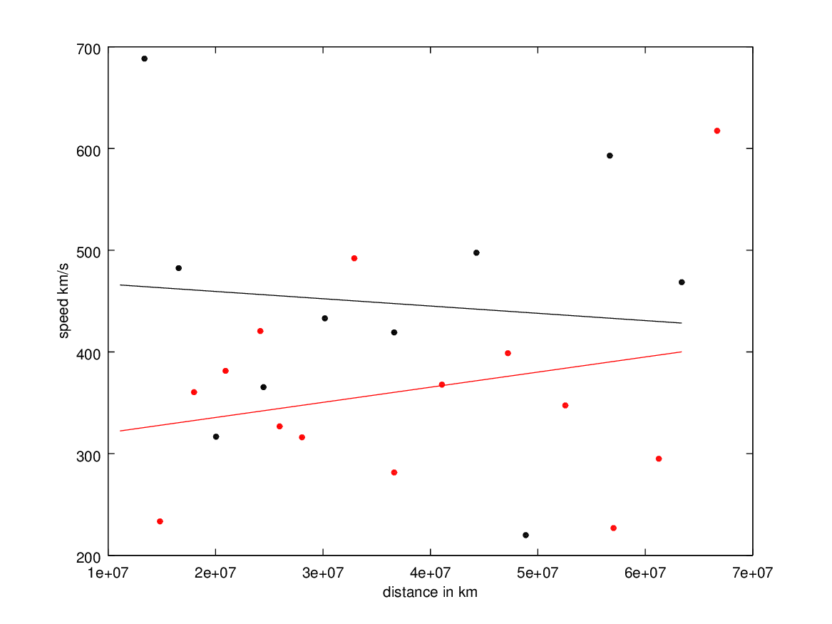
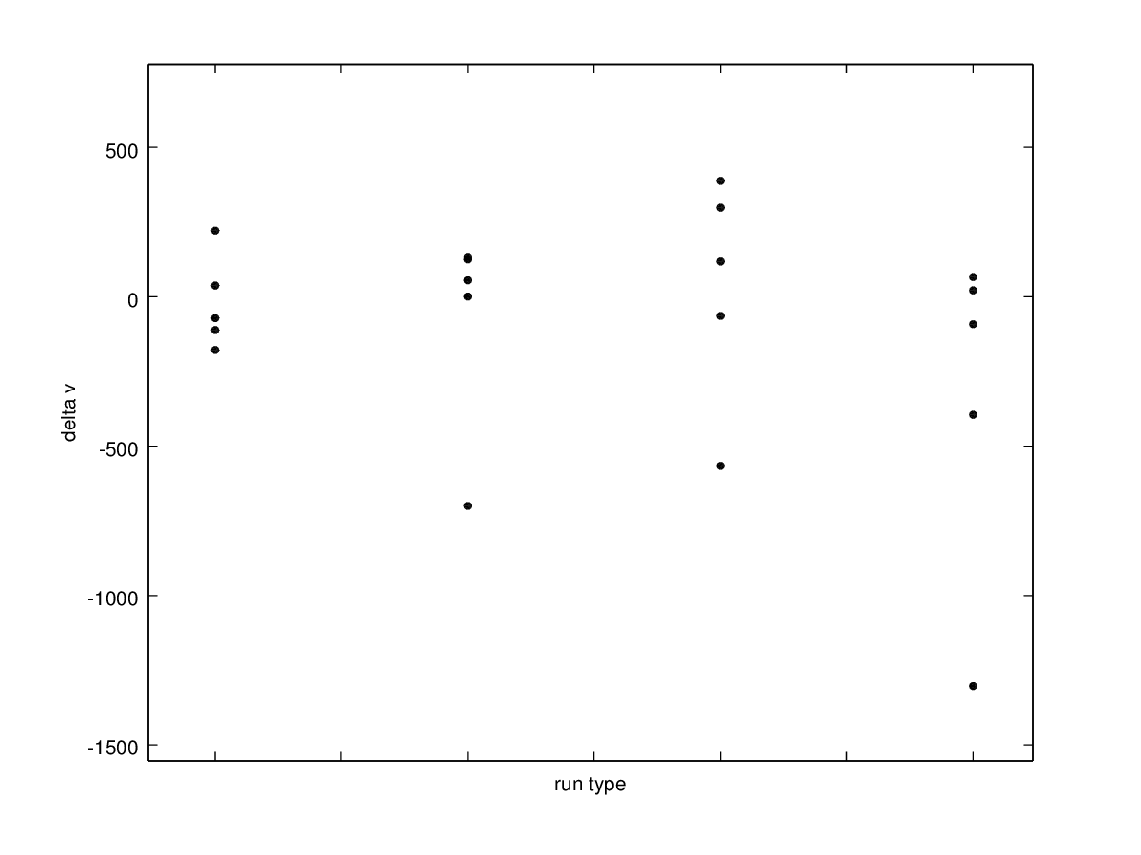
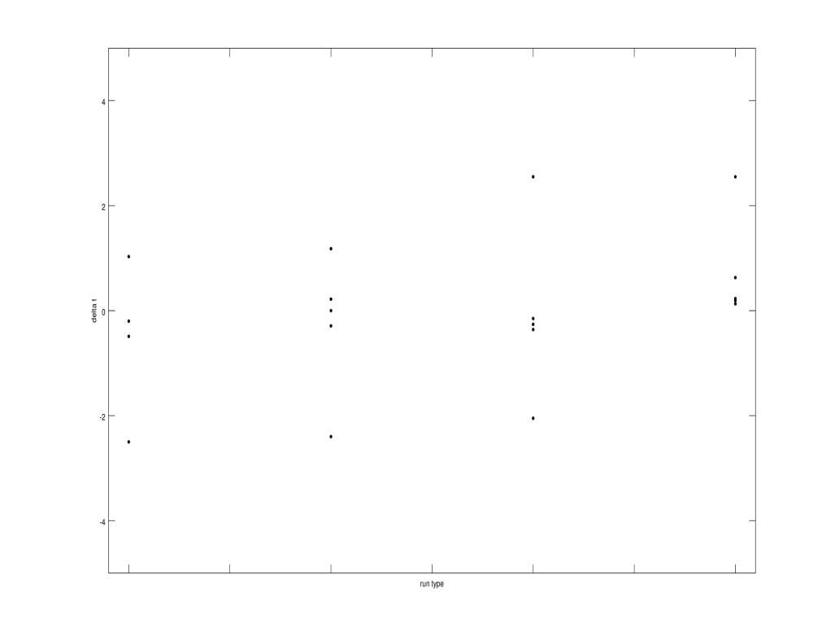
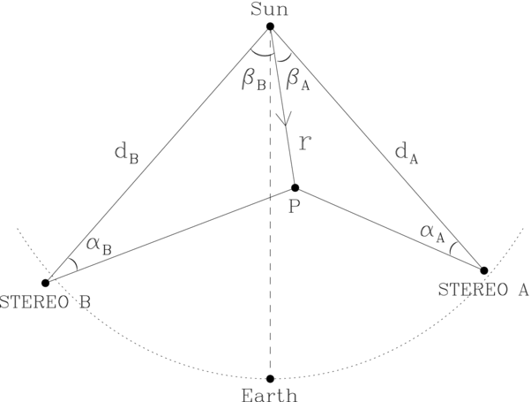
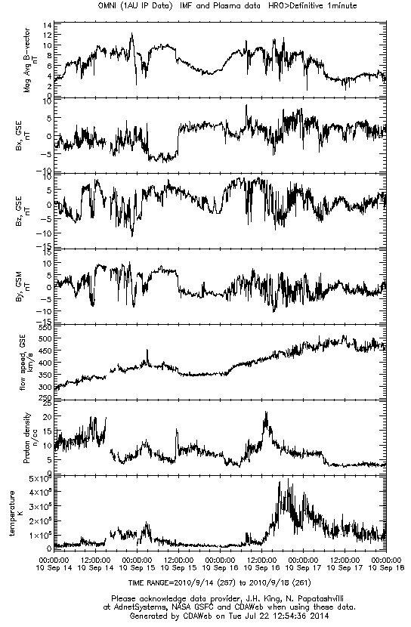
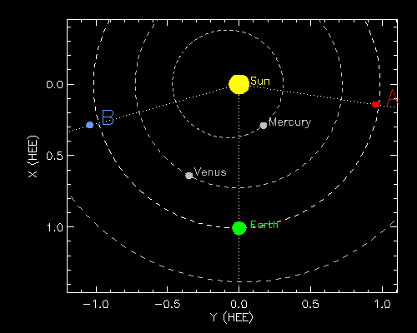
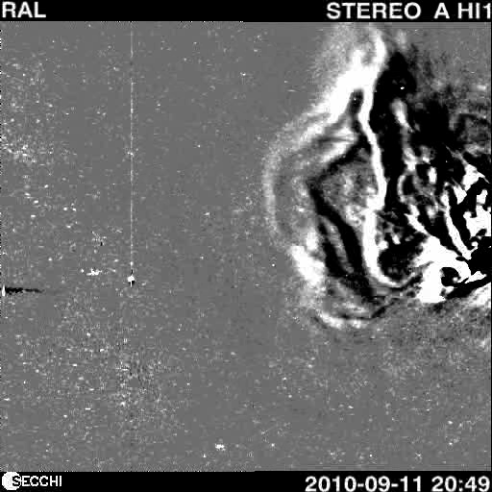
Coronal Mass Ejections (CMEs)
By: Estarlyn Hiraldo and Uri-Jaun Hall ------ Contributors: Noe Lugaz, Devin Thomas
Introduction
Using images from stereo spacecrafts, we predicted arrival times and speed of the CMEs as they passed Earth. Goals: Make predictions that indicates the arrival time called Coronal Mass Ejections(CMEs) on Earth Compare the predictions to the SWEPAM/ACE and OMNI data sets Coronal Mass Ejections (CME’S) are violent ejections of matter from the sun. They propagate away from the sun along magnetic field lines, forming a loop structure. These moving particles collide with the Earth’s magnetosphere causing damage on Earth’s magnetic field such as auroras and weakening the magnetosphere. The experiment consists of calculations that help to predict a specific arrival date/time for the CME to reach Earth's magnetosphere. Based on the data collected from stereo spacecrafts, m Position of the CME Velocity of the CME Expansion of the CME Acceleration of the CME These values were used to come up with predictions. Then, the predicted arrival times and velocity were compared with the actual arrival times from the data collected by the stereo satellites.
Methods and Calculations
Velocity: Divided two data points of distance by two data points of time (V=D₂-D₁/T₂⁻T₁) Convert distance (AU) into distance (Km)-------- {1 AU= 149,597,871 kilometers} Converted time (Hrs) into time (Sec) Expansion : As the CME propagates, it is expanding because the front usually moves faster than the back. Expansion is calculated by measuring the difference in velocity from the front and the back of the CME Distance between 2 CME tracks is measured as they expand and move into space (velocity vs. time): (=V_{front}-V_{back}/T_{front}-T_{back}). Later, these calculations were combined to come up with some predictions. The predictions were revised by comparing them with the ACE graphs, which plot the data about CMEs gathered by stereos/spacecrafts around Earth.
Results
These plots show the difference between our predictions (arrival velocities and arrival times) and the event’s actual arrivals. The plot on the left indicates how close the predicted velocities were to the actual arrival velocities (which are equal to zero). The plot on the right indicates how to close the predicated times were to the actual arrival times (also equal to zero). *Alpha= elongation angle (position of the CME) *Phi= direction of the CME The final results (predicted time) were off by about fourteen (14) hours. Fourteen hours off the mark isn’t too bad of an estimate when dealing with this kind of data. The important thing was to have a general idea and understanding of when the CME would arrive . Overall, these types of predictions were successful and they would help study CMEs closely and to also warn the people about them.
September 11, 2010 (Stereo A)
September 11, 2010 (Stereo A)
Background
delta v (km/s)
delta t (days)
Objectives
run type
run type
Dates | Errors in Velocity (km/s) |  |  |  |  | Errors in Time (days)
 | Normal | Normal w/ alpha restriction | Table phi | Table phi w/ alpha restriction |  | Normal | Normal w/ alpha restriction | Table phi | Table phi w/ alpha restriction
09-11-2010 | -178 | 55.1 | -64.1 | 65.9 |  | -0.2 | 0.22 | -0.26 | 0.19
10-26-2010 | 37.5 | 0.69 | 388 | -395 |  | 1.03 | 1.18 | 2.55 | 2.55
04-03-2010 | -111.5 | 124.7 | 298.4 | -91.9 |  | -0.49 | -0.29 | -0.36 | 0.13
09-11-2010 | 221.5 | 133.3 | 117.9 | 21.4 |  | -2.5 | -2.4 | -2.05 | 0.63
06-02-2011 | -71.5 | -700 | -566 | -1303 |  | -16.4 | N/A | -0.15 | 0.23
Alpha, Beta, Phi
Conclusions
 | Prediction | Actual
Arrival | 09/15@4 AM | 09/14@2 PM
Speed | 366.6 km/s | 400 km/s
Expansion | 79.25 km/s/day | 0 km/s/day
Position of STEREO A/B
September 11, 2010
Acknowledgements
Advised and Aided by: Noe Lugaz, Devin Thomas
Thanks to the rest of the contributors: Charles Smith, Scott Goelzer, Louis Broad
CME explosion from STEREO A
ACE
Graphs

