Slide 1



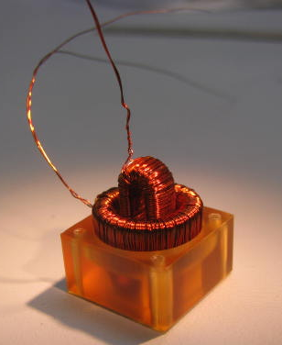
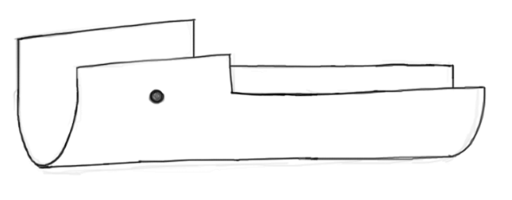
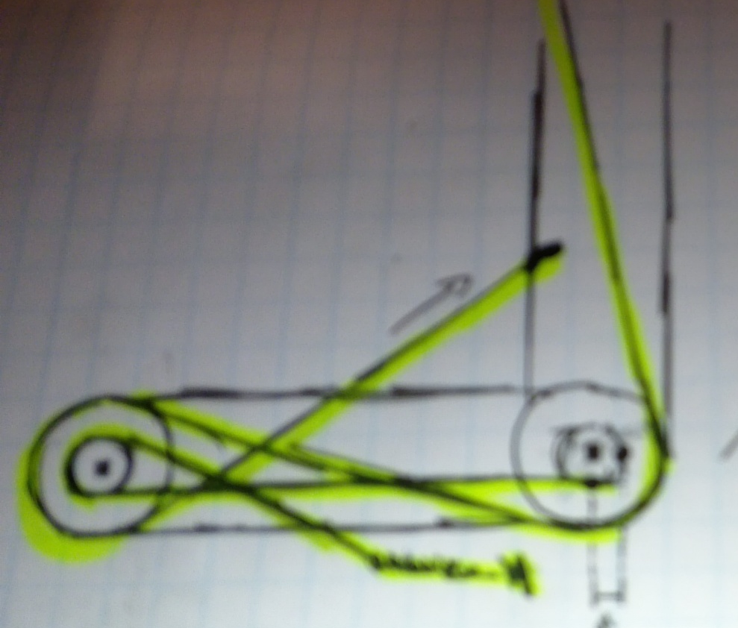
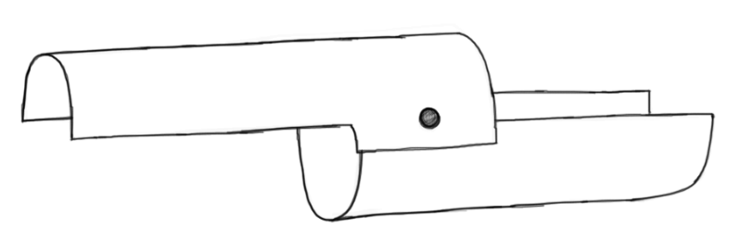
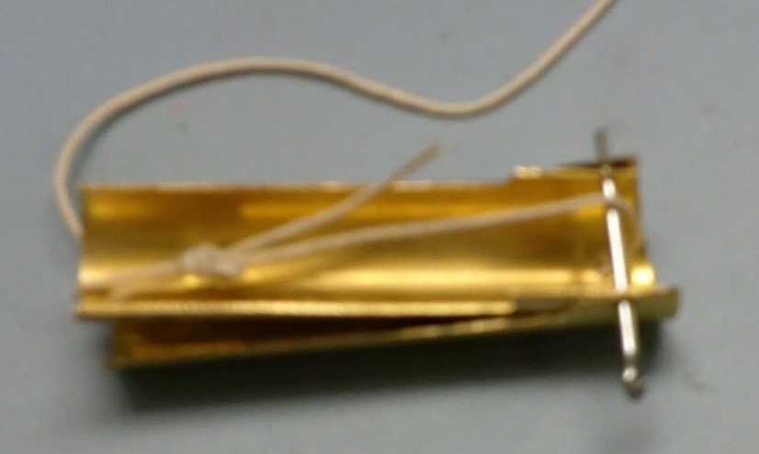
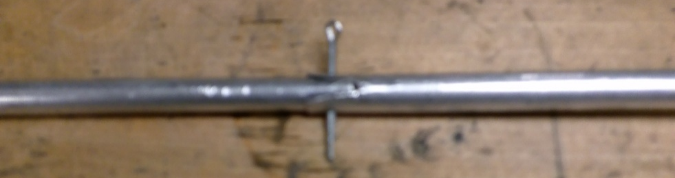
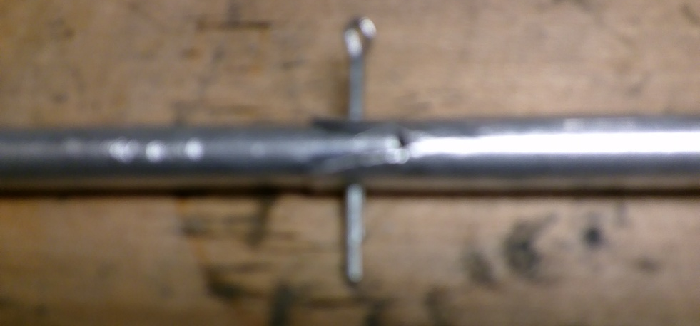
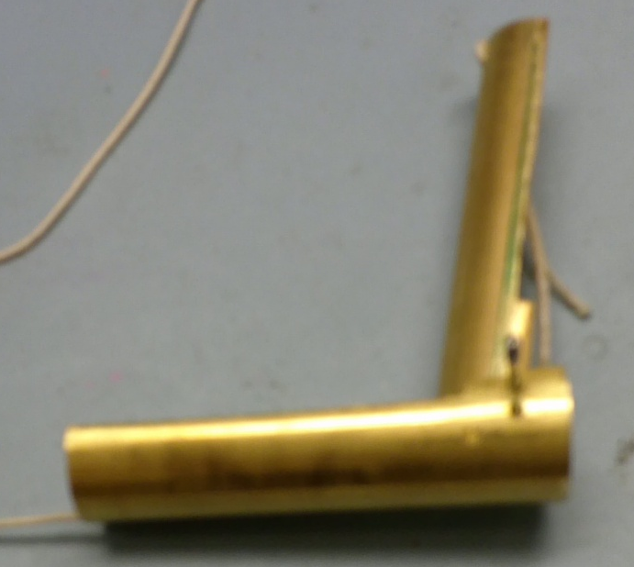
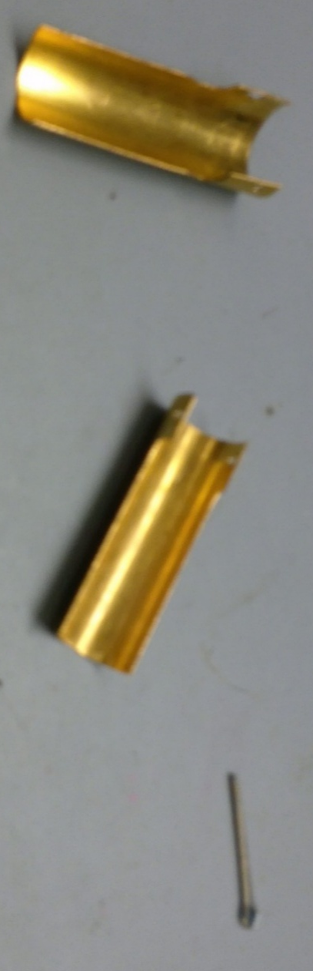
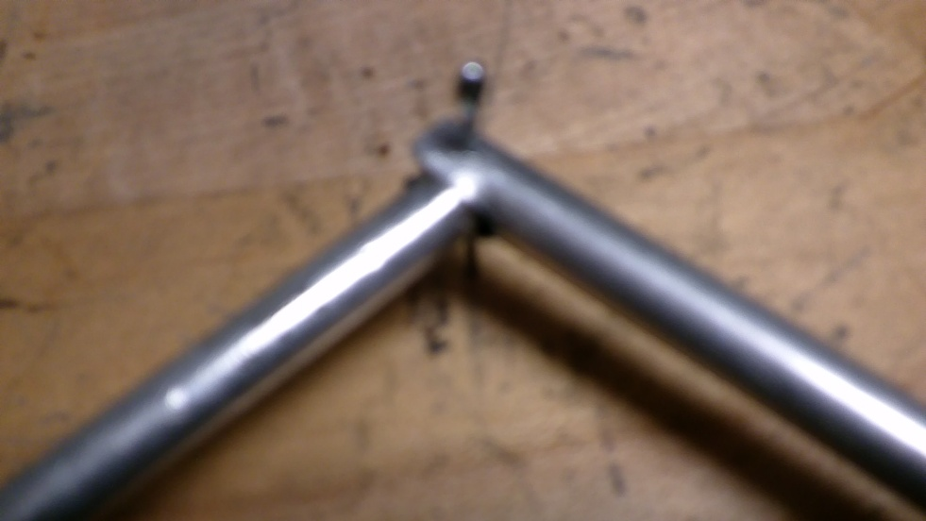
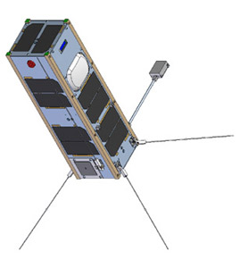
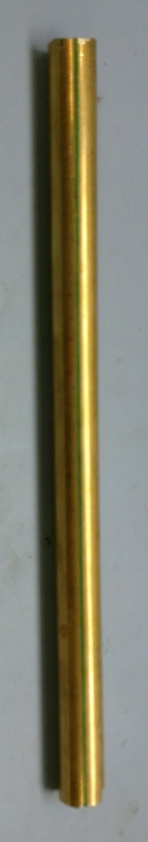
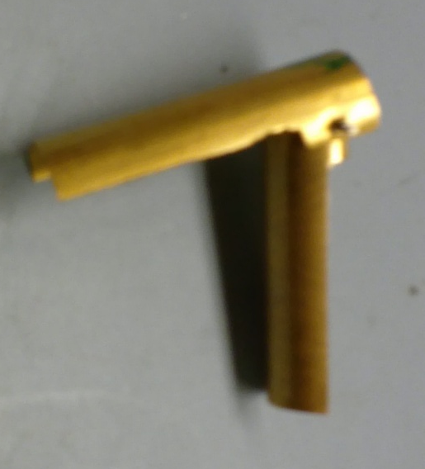
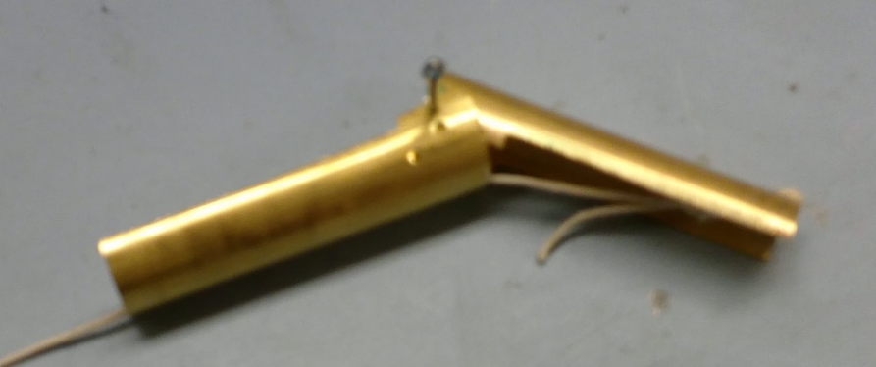
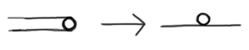
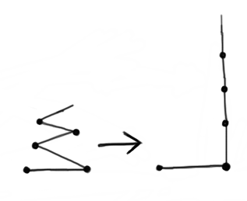
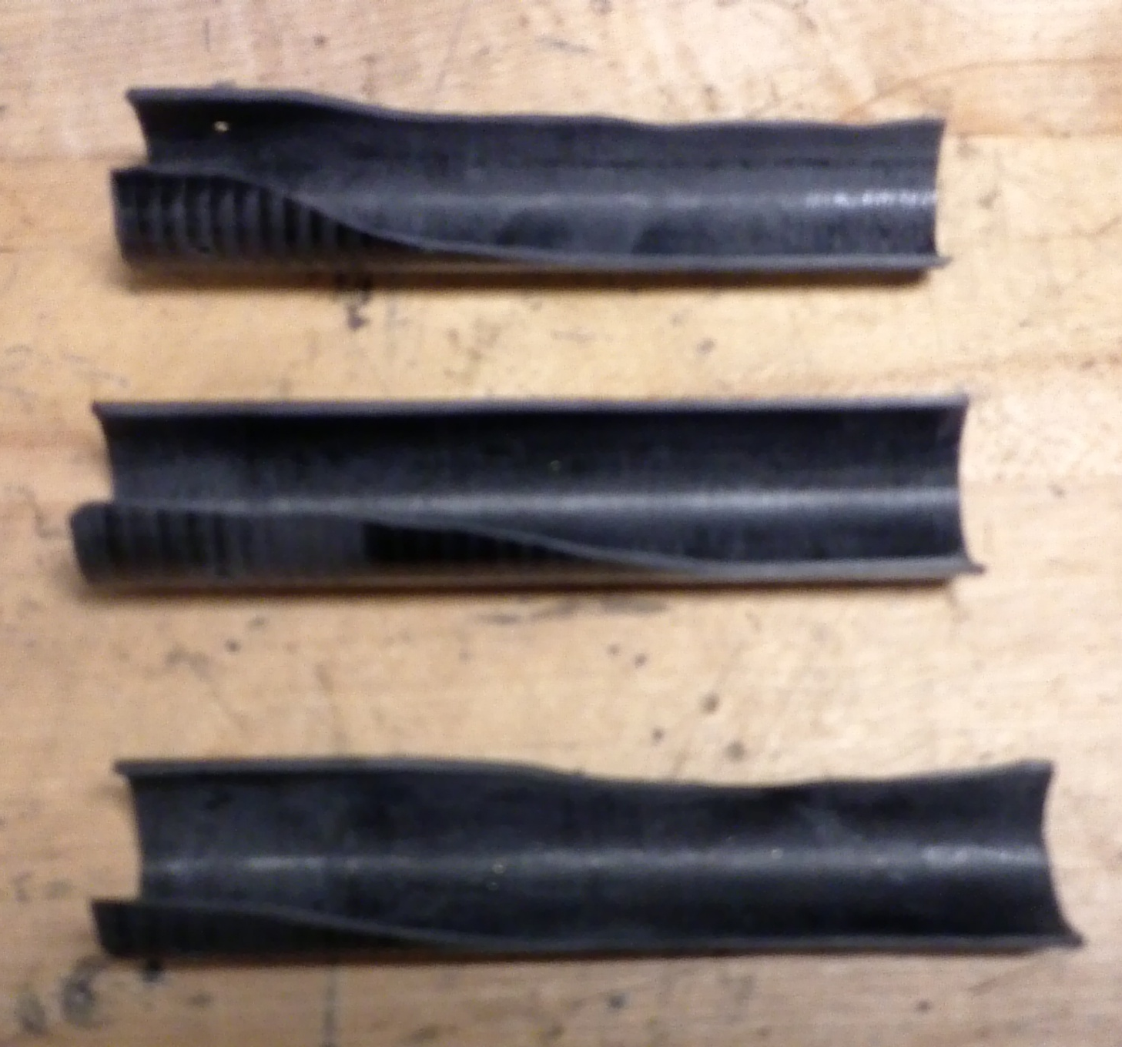
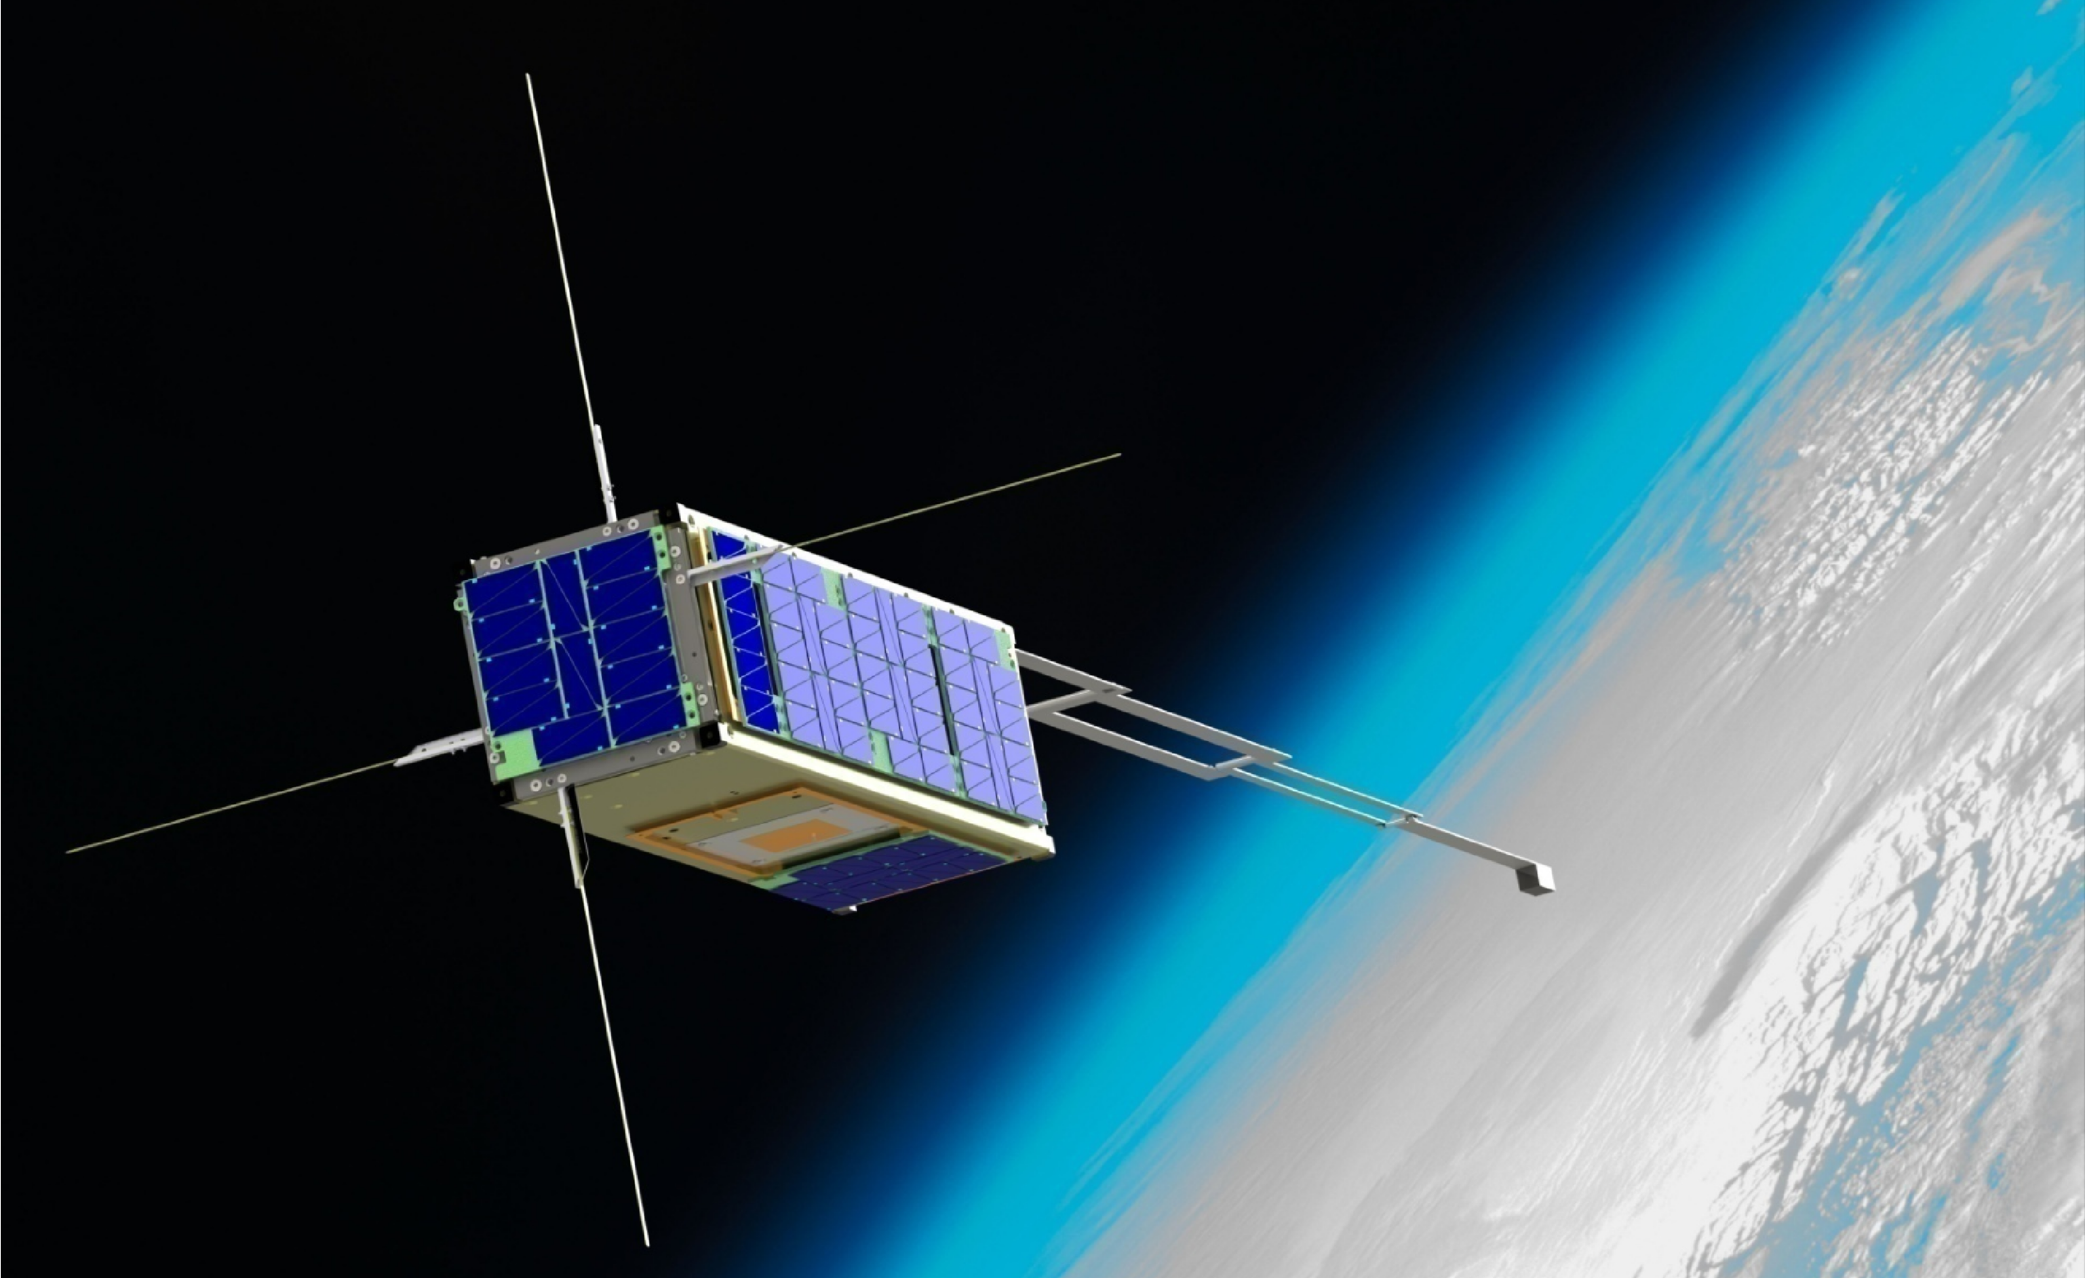

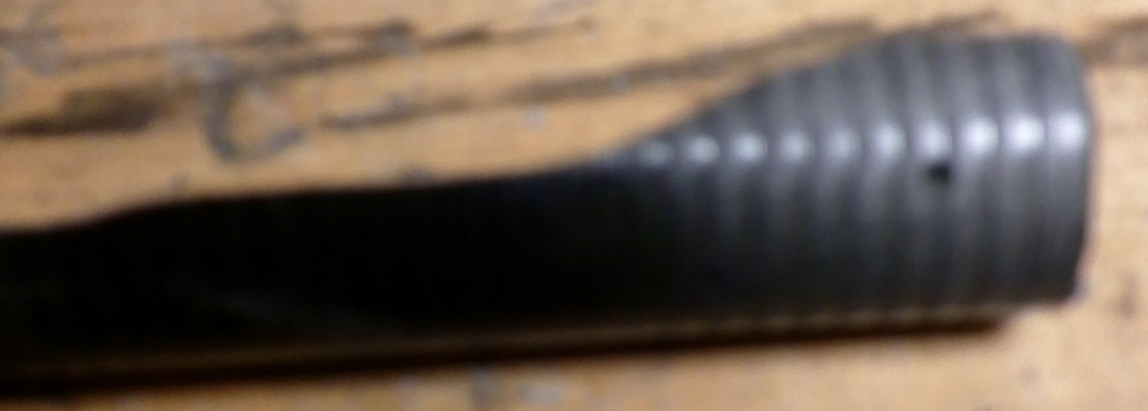
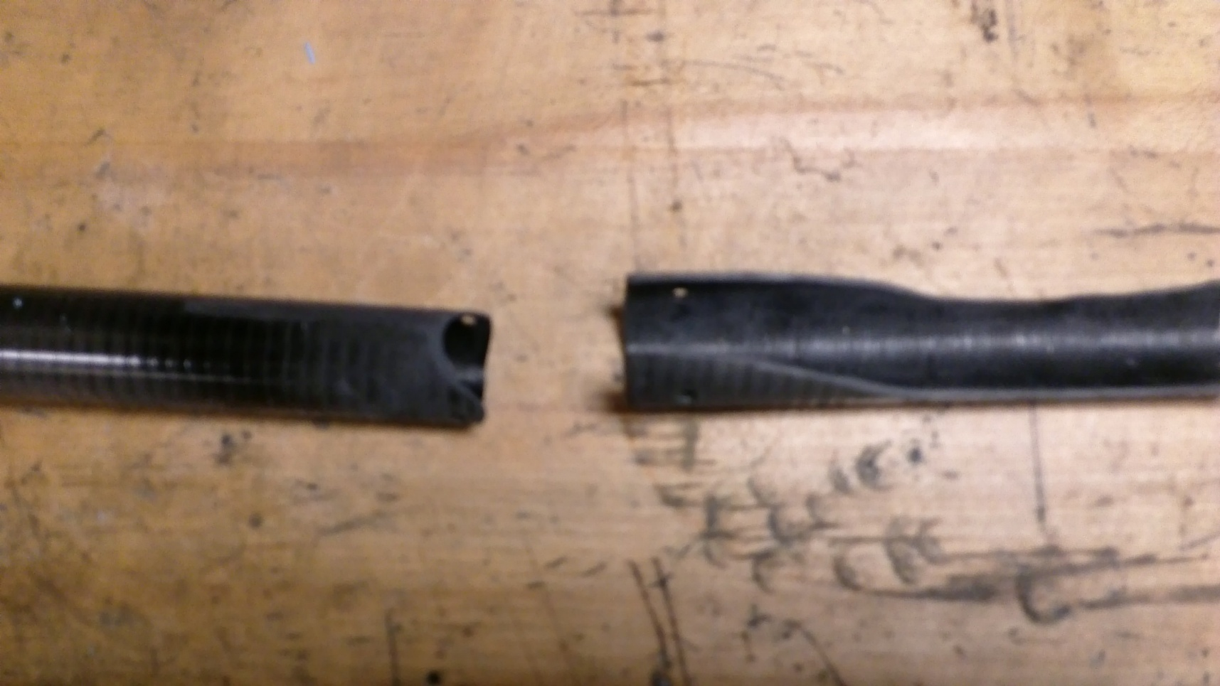
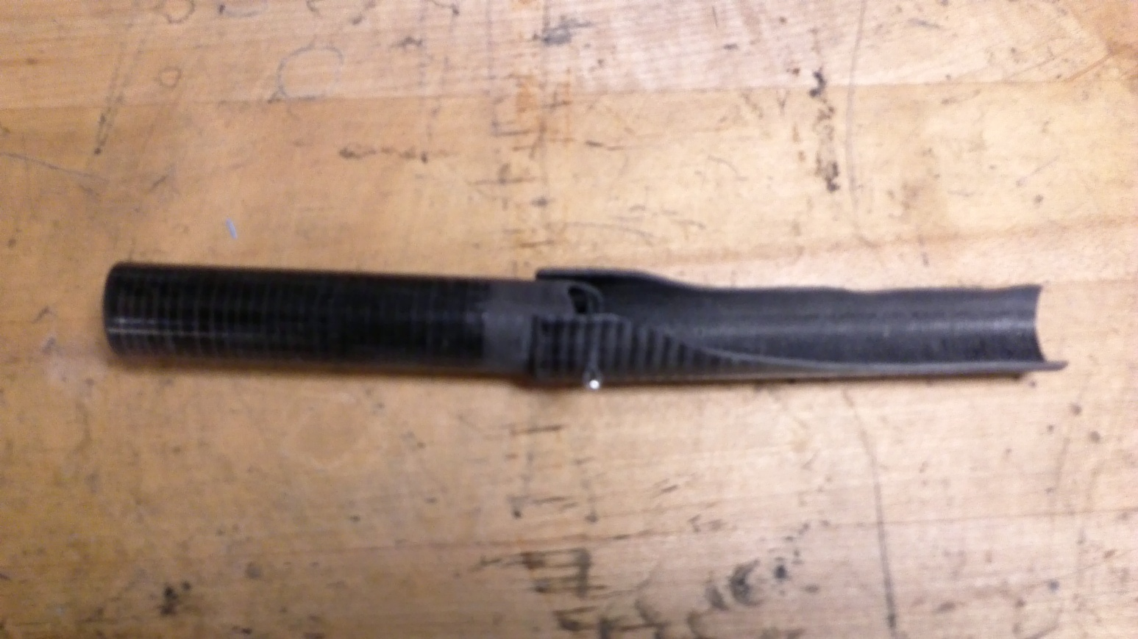
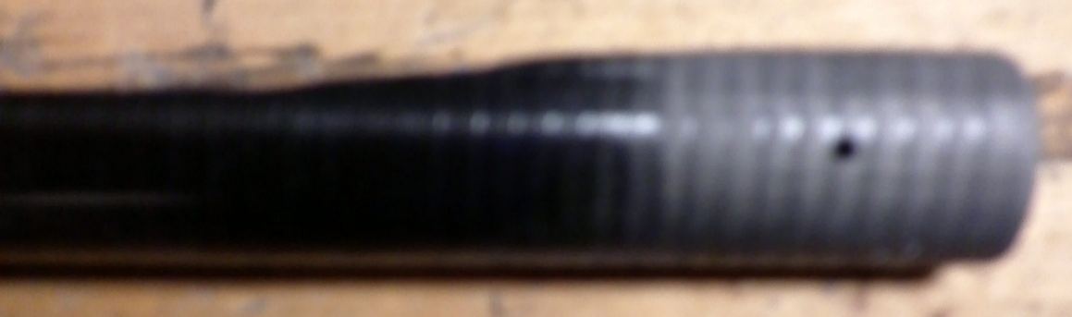
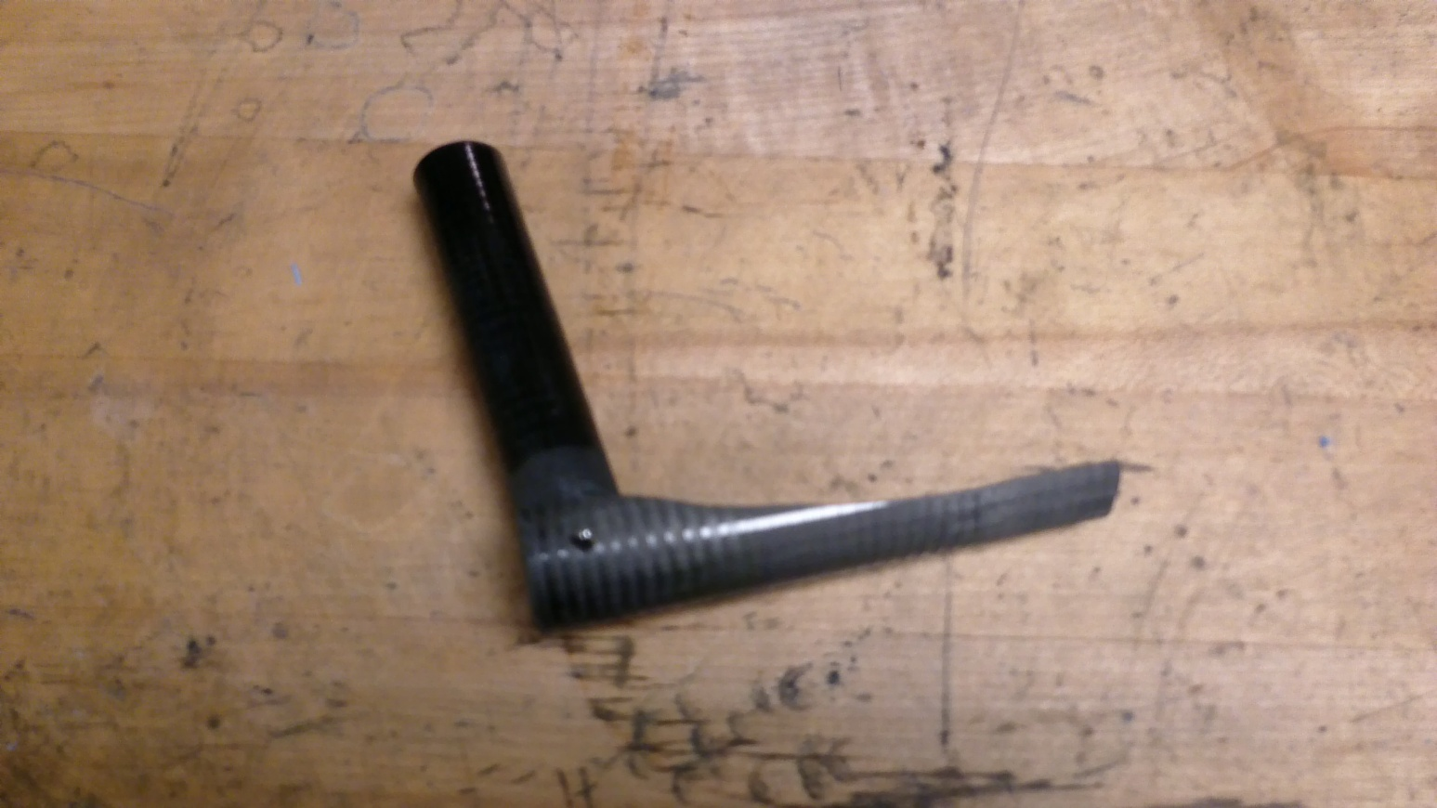
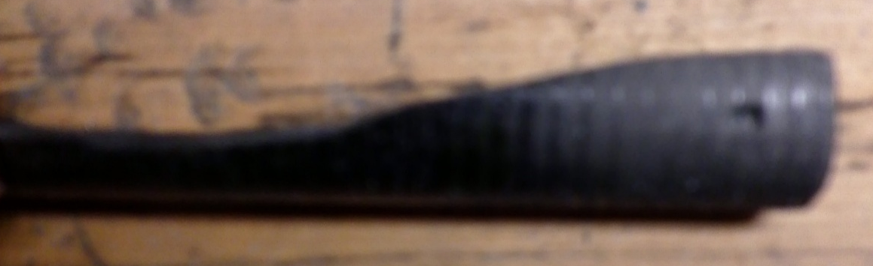
Magnetometer Boom Prototype
Sarah Coffen (Winnacunnet High School)
Advised and Aided by
Dr. Marc Lessard and Chrystal Moser
Introduction
Method
Future Work
The magnetometer boom for CubeSat Sigma, a South Korean satellite that UNH is building a magnetometer for, has flaws that can be used to create a more effective boom to use on future satellites.
The design for the magnetometer boom relies on the pieces snapping together so that they are sturdy.
This design is a modification of Dr. Marc Lessard’s original concept.
Build a mechanism for deploying the boom.
Continue to experiment with tab edges to find the best possible length and width.
A magnetometer is a device that measures the intensity and direction of magnetic fields.
A magnetometer needs to be held away from the spacecraft or satellite so that magnetic fields generated by the magnetometer’s carrier do not influence or alter the data.
The magnetometer boom is what holds the device away from the satellite.
The motivation behind the project is that the boom set to go up on CubeSat Sigma could be improved and used on future satellites.
Brass was used first as a test in principle.
The brass was not springy and did not hold the second part (SPbr) straight.
With the brass model of one of the hinges, a mechanism for extending the boom was fabricated.
A design for a boom deployment mechanism.
This magnetometer is approximately 4 cubic centimeters. It was built and photographed by Chrystal Moser.
Find a material that is more springy than carbon fiber that also is resistant to cracking and splitting.
Deployment Calculations
The next model of the joints for the boom was made of aluminium. The aluminium was not as springy or as strong as expected.
R_{pulley} = 1/4”
C_{pulley} = π/4”
SPbr
When the boom extends cable will shorten by half the circumference of the pulley at each joint.
The third set of models was made of carbon fiber. It was a material chosen for its strength.
An example of a 3U CubeSat.
Krebs, Gunter D. "CubeSat." CubeSat. 1996. Web. 22 July 2014.
cf1
There are three joints that open 180º and one that opens 90º, so that is 3.5 turns of the joints.
A CubeSat is a satellite built of U’s. One U is a 10cm cube. These cubes are put together to house the instruments the satellite will carry.
CubeSat Sigma is 3U.
π/4” = π/8”
2
π/8” x 3.5 turns ≈ 1.4”
cf2
Results
To deploy the boom, the main cable would have to be pulled approximately 1.4”.
Three different models of the hinges were created.
Acknowledgements
cf3
The support of the second part of the carbon fiber joints (SPcf) was best in the parts that had:
  Longer tabs
  A smaller opening
  Greater distance from the end of the tube to the pin hole.
The sturdiest joint was with the shape of cf2.
The Magnetosphere Ionosphere Research Lab, the University of New Hampshire, and Project SMART.
A CubeSat Sigma that will be sent up with a magnetometer from UNH. Picture courtesy of Dr. Marc Lessard.
Problems
Goals
cf1
The current boom on CubeSat Sigma is too large.
The boom is strong in one direction but weak in another.
Create a more compact design.
Make a sturdier boom that is stiffer and strong in multiple directions.
cf2
Advised and Aided by:
Dr. Marc Lessard
Chrystal Moser
SPcf
Thanks to: Scott Goelzer (Coe-Brown Academy), and Louis Broad (Timberlane).
cf3
"Blue Planet Wallpaper." - Space Wallpapers. Web. 22 July 2014

