Slide 1
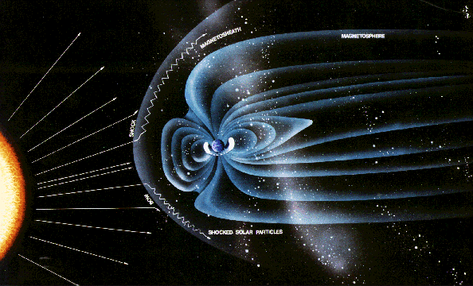


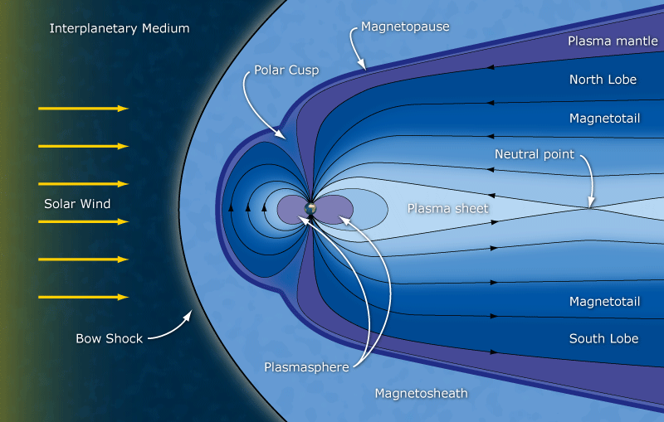
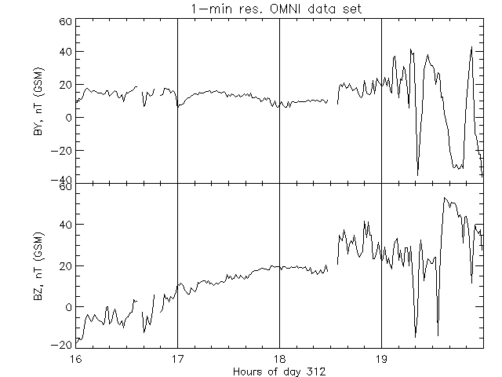
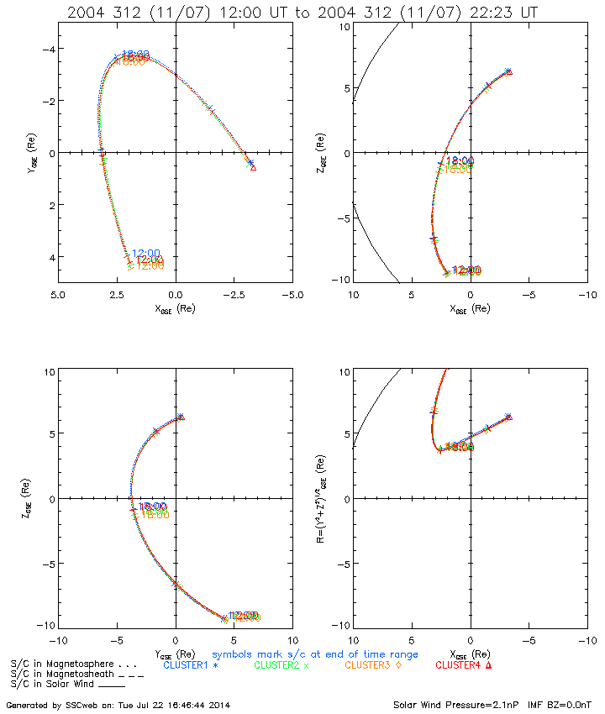
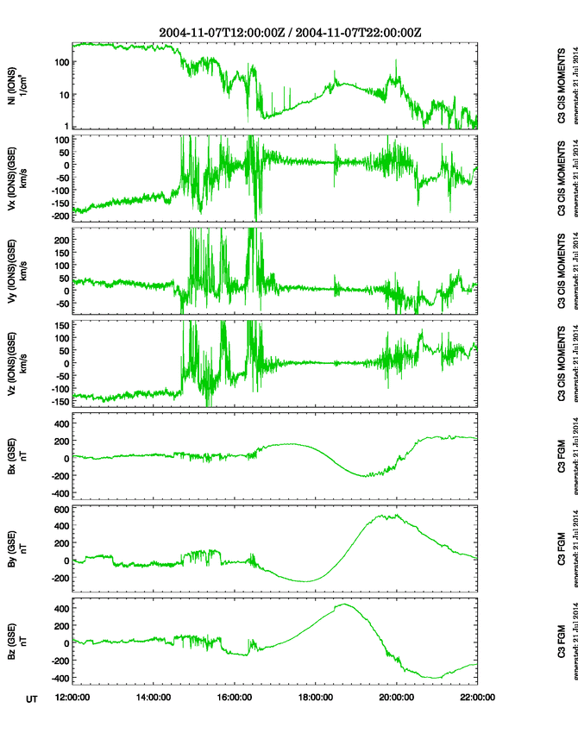
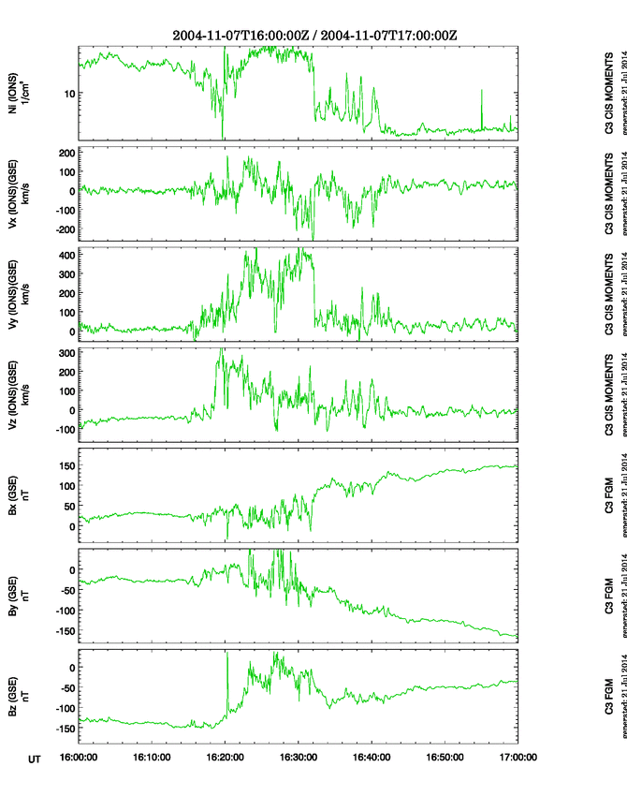
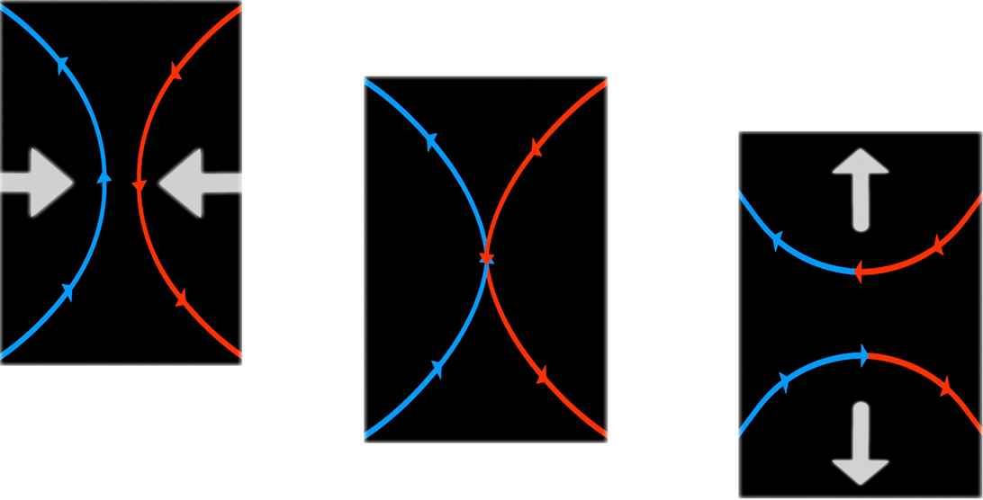
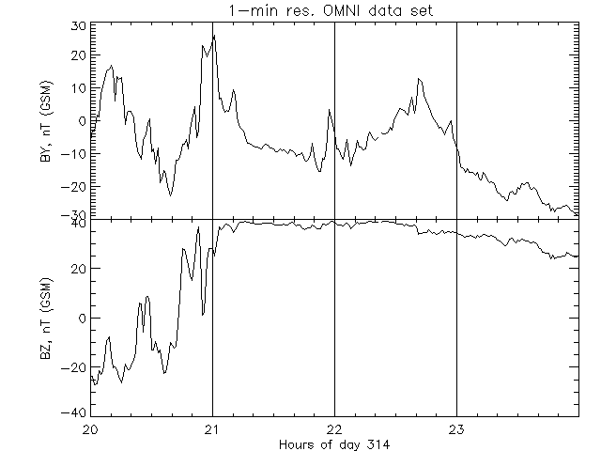
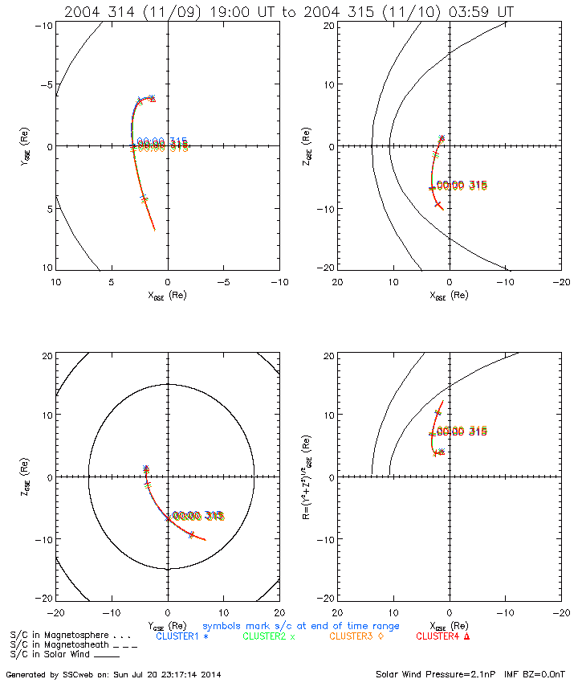
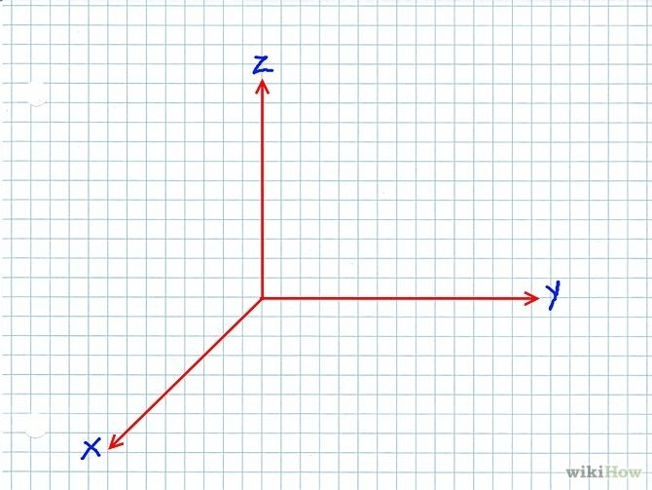
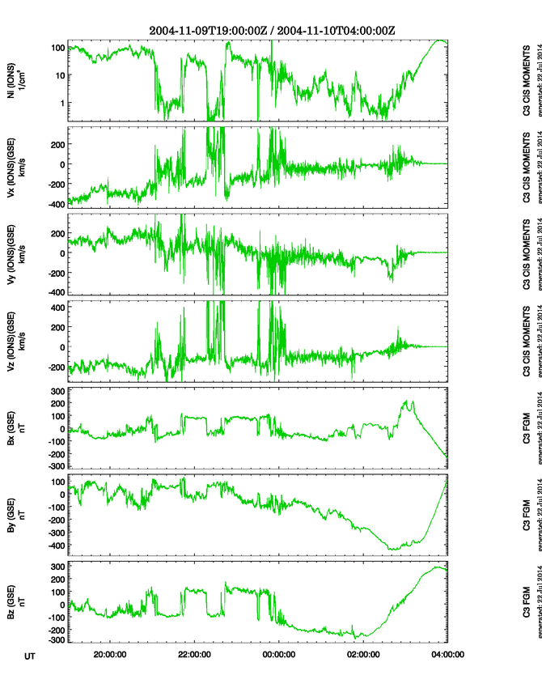
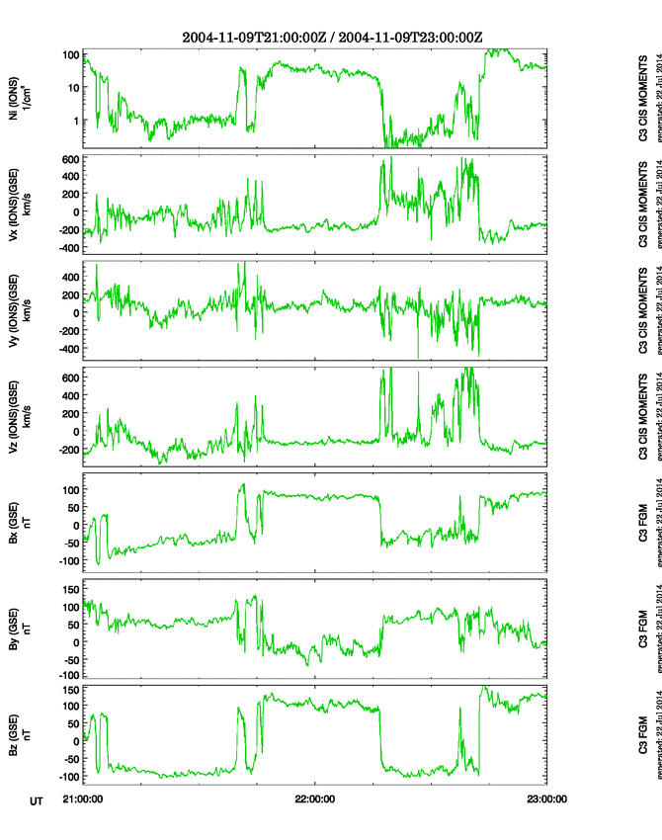
Magnetic Reconnection:
High Latitude Tail ward of the Cusp Events
Introduction
Madeline Hubbard (Keene High School)
Matthew Shindel (Stanwich High School) Advisors: Fathima Muzamil, Dr. Charles Farrugia , Dr. Roy Torbert
Space weather, such as solar flares, affect human technologies including communications, navigation, and power grids. The Sun is constantly emitting a barrage of radiation that is deflected in the Earth’s magnetosphere. The study of the magnetosphere (MSP) is important to understand why magnetic reconnection occurs and forms portals.
Magnetic Reconnection is a process by which the field lines of opposite polarity of the earth and the solar wind rearrange and release a burst of magnetic energy that is converted into kinetic energy, heat and particle acceleration. The orientation of the interplanetary magnetic field or IMF determines the location of the reconnection site on the magnetopause. When the IMF is strongly southward, reconnection occurs in the dayside of the MSP. When the IMF is strongly northward, reconnection occurs poleward of the cusp. The cusp is the region of the MSP that is behind the magnetosheath, which is the outermost layer of the MSP. This so-called “lobe reconnection” may take place either simultaneously in both hemispheres, or sequentially. In the north and the south hemispheres, the cusps acts as earth’s defense redirecting the sun’s energy onto the Earth’s poles..
Date | Interval | IMF Duration | Cluster time interval over high LAT | Polar time interval over high LAT
2003-10-24 2003-10-25 | 15:00-04:00 | 17:00-02:00 | C1:15:00-15:57 22:02-00:34 C2:15:00-15:59, 22:05- 00:37 C3:15:00-16:00, 22:03-00:34 C4:15:00-16:02, 22:06-00:36 | 20:42-21:12
2003-11-19 2003-11-20 | 10:00-24:00 | 13:00-20:00 | C1:13:04-20:56, 01:53-03:42 C2:13:04-20:59, 01:56-03:44 C3:13:09-20:59, 01:54-03:42 C4:13:09-21:01, 01:56-03:44 | 21:09-21:24
2004-11-07 | 12:00-22:00 | 17:00-19:00 | C1:12:00-14:13, 20:32-22:00 C2:12:00-14:31, 20:36-22:00 C3:12:00-14:37, 20:44-22:00 C4:12:00-14:24, 20:28-22:00 | 19:57- 21:00
2004-11-07 2004-11-08 | 20:00-06:00 | 0:00-7:00 | C1:20:32-22:58 C2:20:36-22:56 C3:20:44-23:02 C4:20:28-22:48
2004-11-09 2004-11-10 | 19:00-04:00 | 21:00-23:00 | C1:20:01-00:51 C2:20:29-01:05 C3:20:37-01:12 C4:20:26-00:58 | 2:42- 4:00
2004-12-05 | 05:00-22:00 | 9:00-18:00 |  | 7:48-8:03
2009-01-26 | 11:00-17:00 | 11:20-16:20 |  | 13:33-13:45
2009-03-12 | 5:00-20:00 | 14:30-16:30 |  | 06:36-06:54 13:06-19:36
2009-03-20 2009-03-21 | 19:00-6:00 | 22:00-4:00 |  | 03:27-06:00+
November 20, 2003
Results
Diagram of Magnetic Reconnection
22 events of strongly northward IMF from 2003-2013
Out of those 22, 5 matched up with high latitude Cluster crossings
Out of those 22, 8 matched up with high latitude Polar crossings
High speed flows were located, AKA, reconnections jets, which indicate crossings of magnetic reconnection regions
Method
Objective: Find high latitude events where magnetic reconnection occurs at the cusp of the MSP.
Process for finding Northward IMF:
· Find intervals where the IMF was strongly Northward, which means the clock angle is less than 30 degrees.
· Survey solar wind data for years 2003-2013, where Bz was at least twice as large as By
Process of finding high latitude crossings:
· Compared the positions of the Cluster spacecraft to the intervals of strongly northward IMF to check if it reached geomagnetic high latitude (MLAT) of 70 degrees or higher, i.e. checked if Cluster crossed the cusp of the MSP
· Compared the events to the Polar spacecraft orbits under the same criteria
November 09, 2004
Conclusion
Events of high latitude magnetic reconnection are rare and hard to find. After looking through ten years of data, 9 events fit our criteria. The study and data we have collected will help researchers analyze magnetic reconnection regions in more detail and help provide insight into these strange anomalies that we know so little about.
θ
The clock angle is the angle produced in the vertical plane from the vector addition of the By and Bz components of the IMF
Clock Angle in degrees:
Angle = 0 : IMF Bz north
Angle = 90 : IMF By +ve
Angle = 180 : IMF Bz south
Angle = 270 : IMF By -ve
Sources
http://omniweb.gsfc.nasa.gov/form/dx1.html
http://sscweb.gsfc.nasa.gov/cgi-bin/Locator_graphics.cgi
http://sscweb.gsfc.nasa.gov/cgi-bin/Locator.cgi
http://caa.estec.esa.int/caa/home.xml
spaceweather.com
Princeton Plasma Physics Laboratory
European Space Agency

