Slide 1

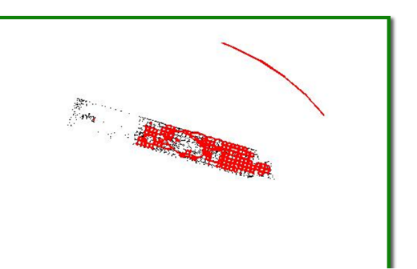
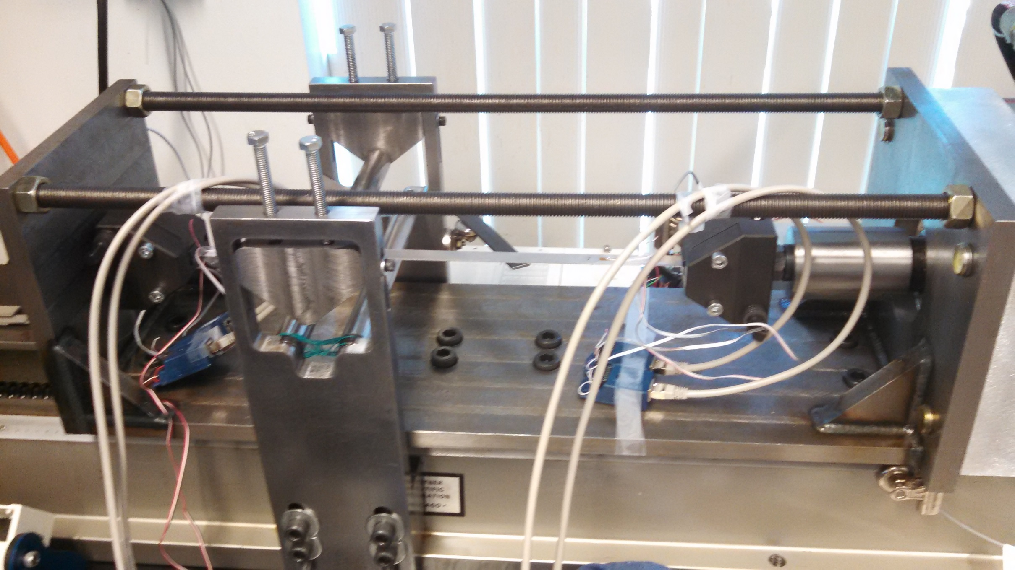
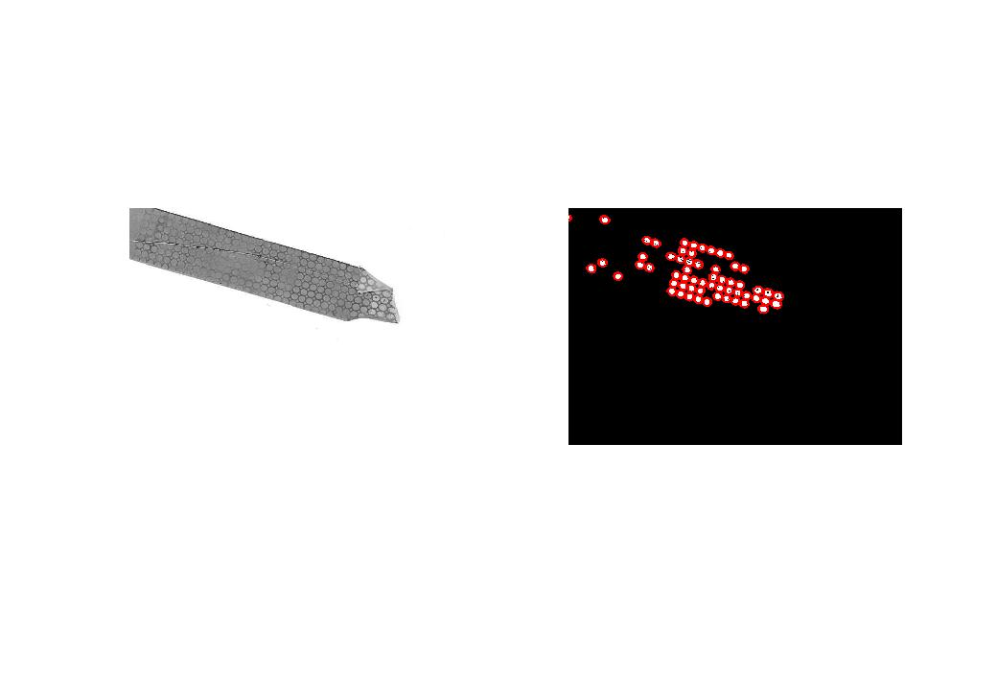
Methods for Measuring Elongation Values in
Pattern-etched Ferrous and Nonferrous Metals using Matlab
By: Bethany Poulin
Advisers: Brad Kinsey & Tim Roemer
Acknowledgments – This research was supported with funding from the National Science Foundation’s Research Experience for Teachers in Engineering Grant (ENG-1132648).
Methods & Outcome
Test strips are scanned to as a JPEG using a standard photocopier or flatbed scanner, and passed through ‘Prescan’ code
Data array is evaluated to determine desired range of test data
Values are manually entered in the test measurement code
Goal
Create a reliable method for measuring the elongation of etched circles on thin sheets of test metal stretched under continuously bending tension using Matlab image toolbox
Matlab evaluates the data a second time using ‘regionprops’ call tag to measure only the selected circles, establishing the longest and shortest axes to calculate change in elongation
Background
Metal under tension stretches until it reaches its ultimate tensile strength, when it breaks at its weakest point
Imposing a continuously moving bending moment in thin sheet metal under localized tension increases ductility of metals in tests
s=regionprops(imlabel,'MajorAxisLength','MinorAxisLength');
Artifacts
The unfiltered dataset is manually reviewed to separate ellipses representing data from image artifacts
Authentic data is extracted from the whole using criteria, entered into Matlab by the user
With search values entered the image is evaluated by CBT_measure
A table of filtered data exports into an Excel file containing the major and minor axis lengths for all selected ellipse diameters in the filter
Data is compare against a control strip evaluated in the same manner for use in elongation value calculation
Sample data points plotted from above images
Future Work
Establish protocol for scanning to ensure consistent measurements
Add a scale and modify the software to calculate absolute lengths instead of relative measurements
Importance
Using continuously bent tension to increase elongation in metals during forming could provide for greater conservation of metals in industries while decreasing the weight, shipping and forming costs of manufactured goods.
Image Analyzed by
CBT_measure
Literature Cited
Benedyk, J.C., Scwartz, D., and Parikh, N.M., “A Method for Increasing Elongation Values for Ferrous and Nonferrous Sheet metals,” Journal of Materials, JMLSA, Vol 6, No. 1 March 1971, pp16-29
Filtered Data Selections
Vocabulary
  Ductility - a solid materials ability to deform under tensile stress Elongation – the state of having been lengthened Ellipse- an planar curve with circular or oval shape
Notes:
1

