Slide 1


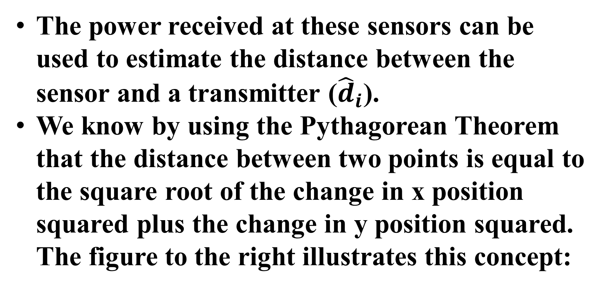

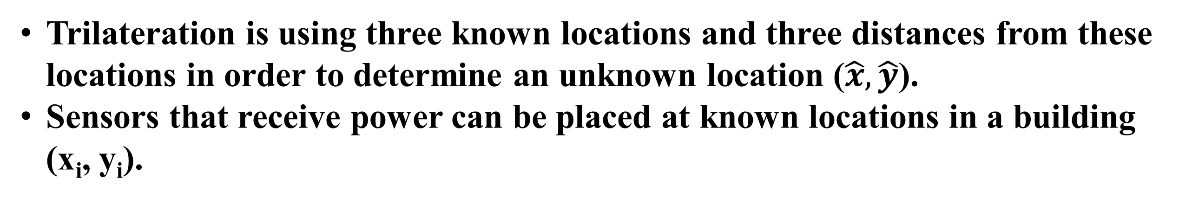


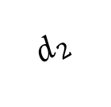
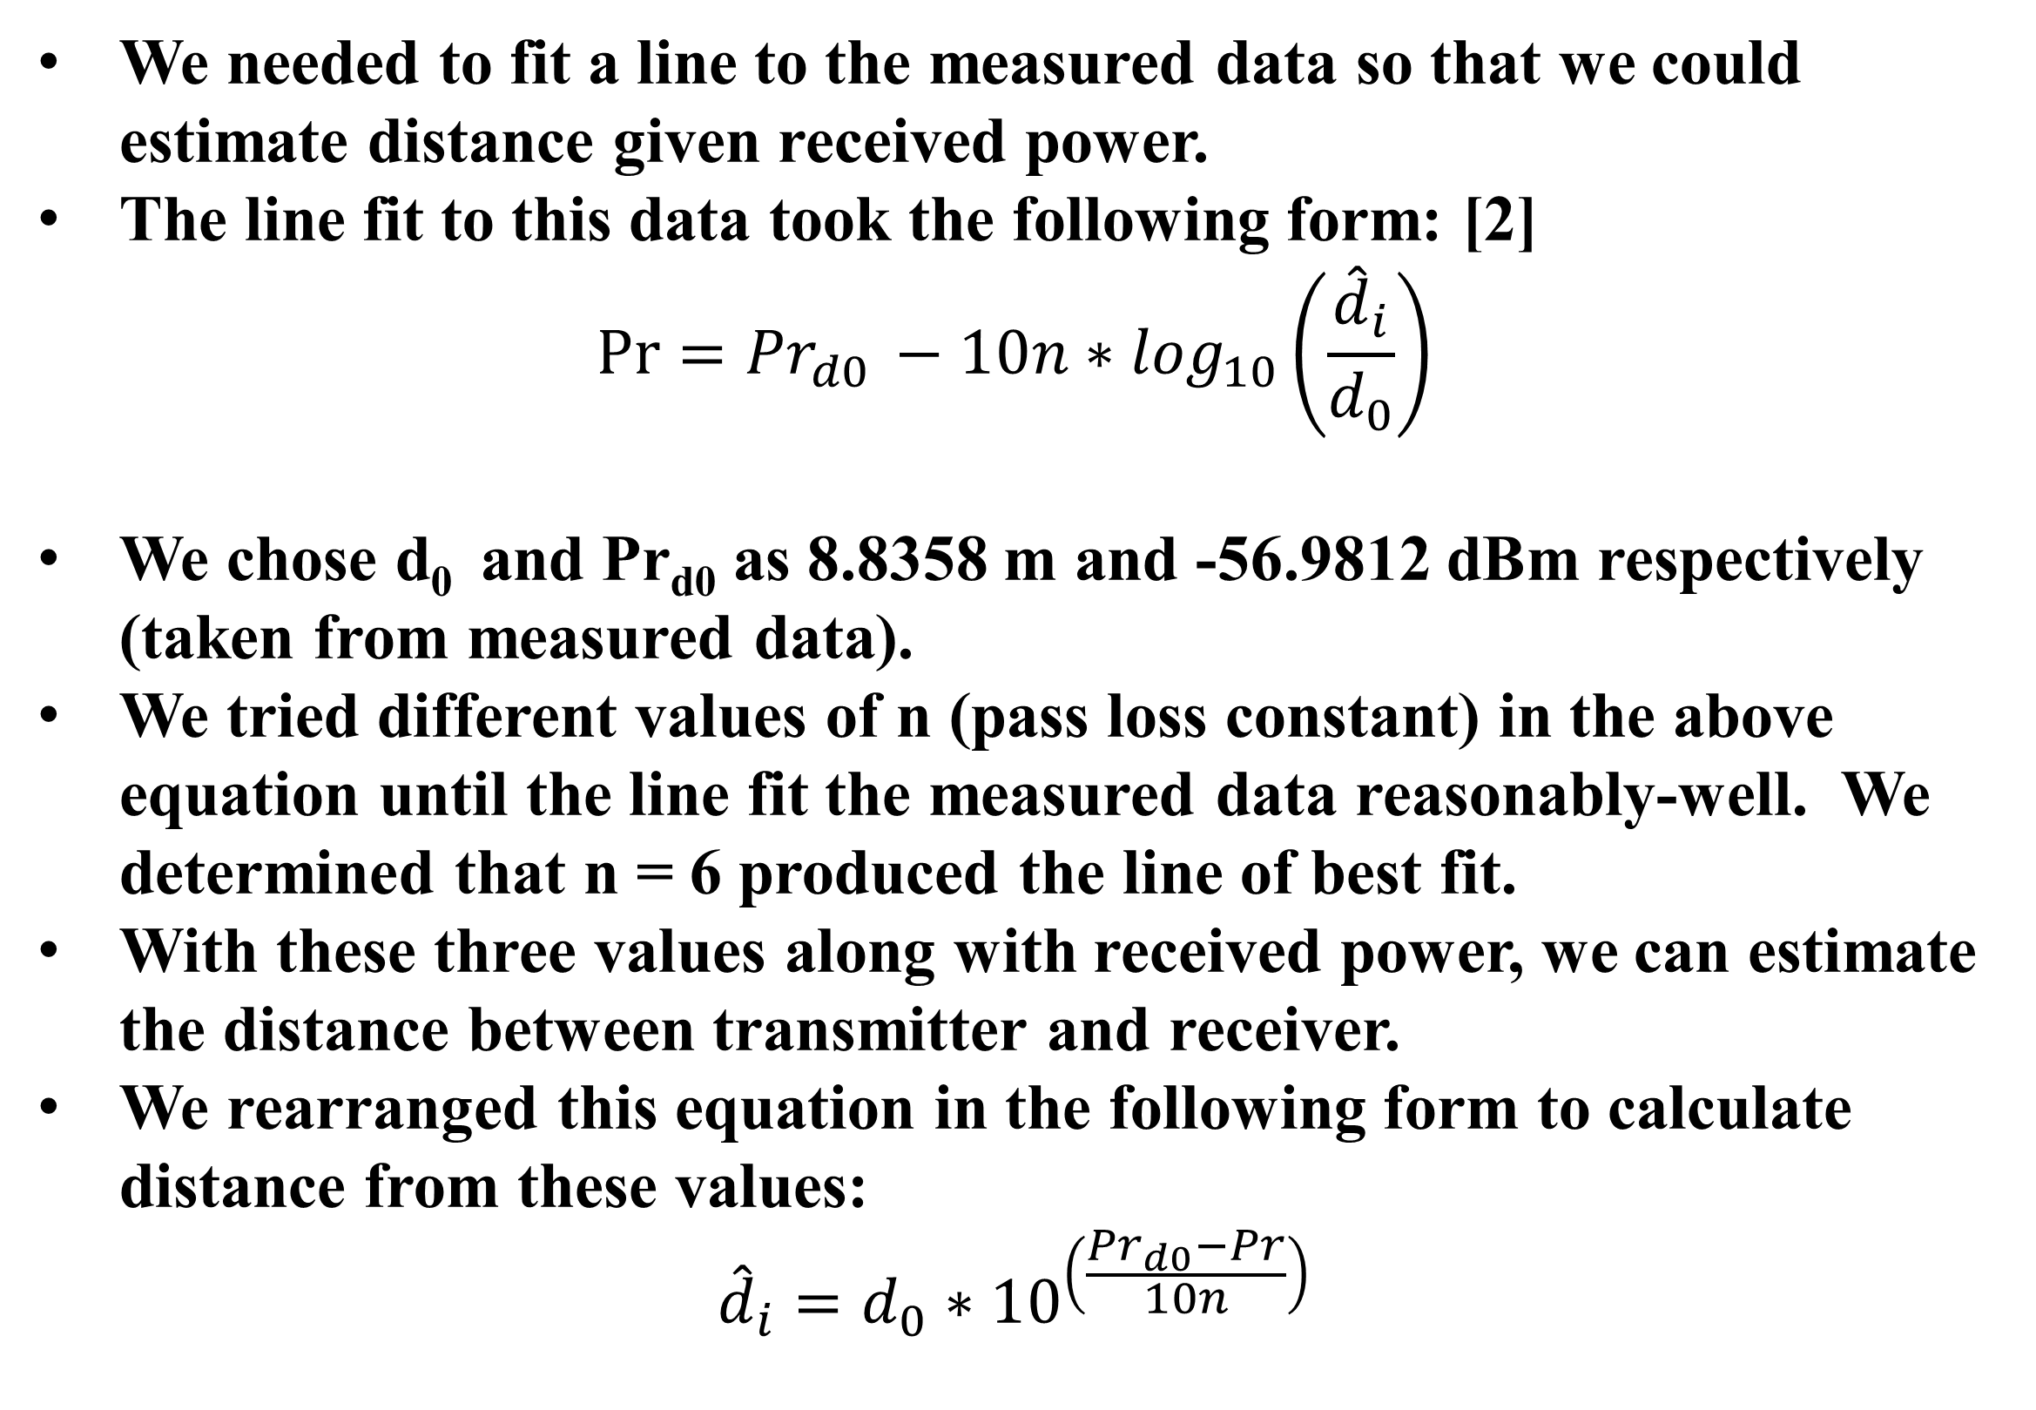
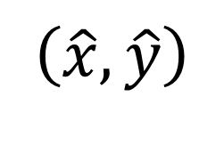

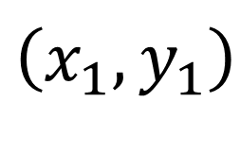
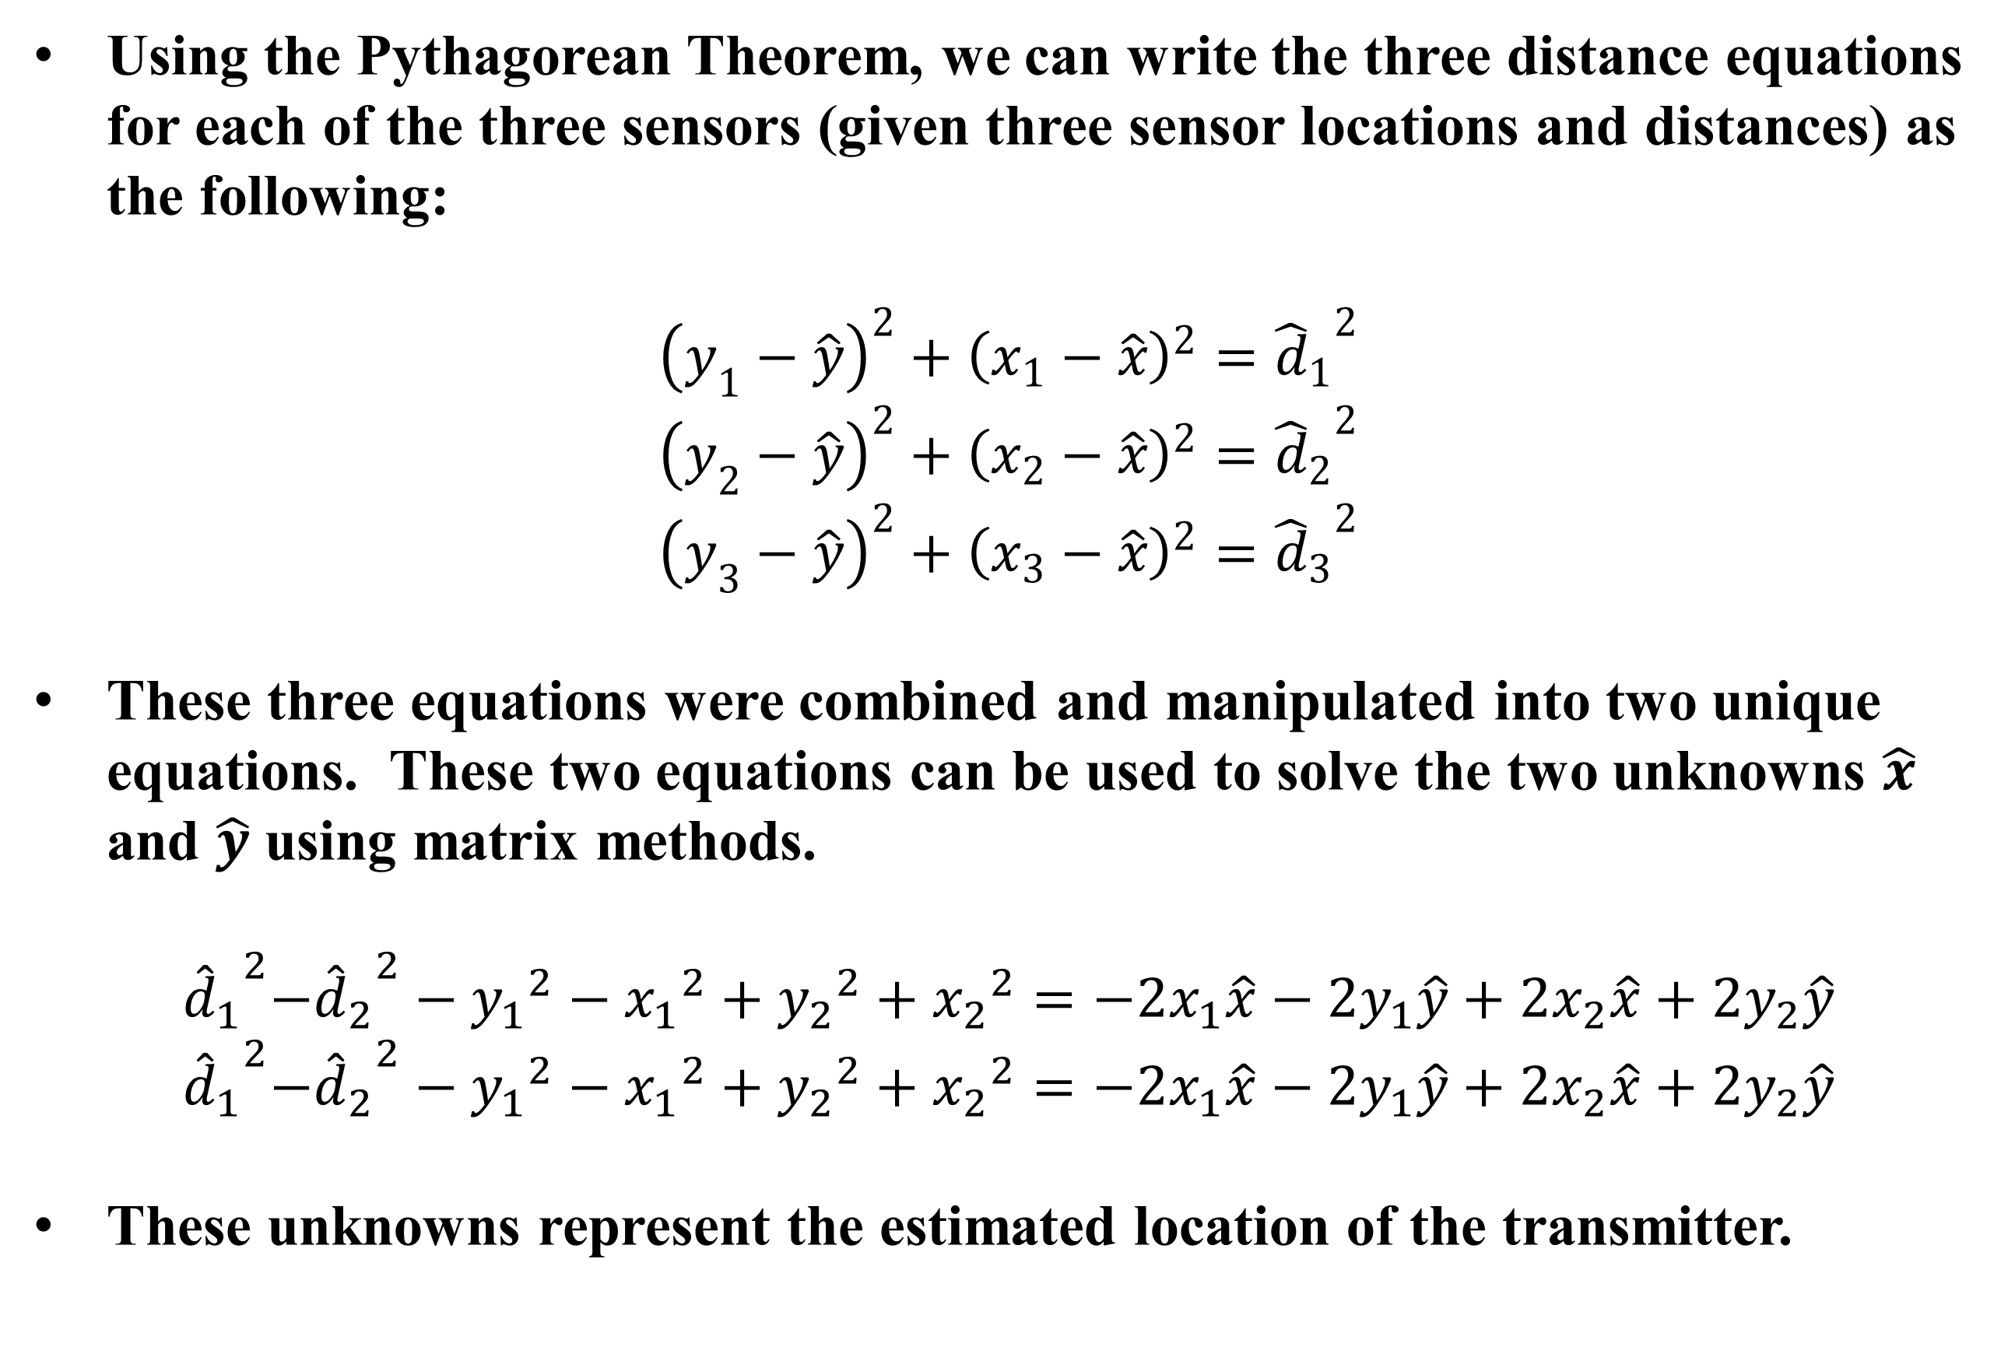
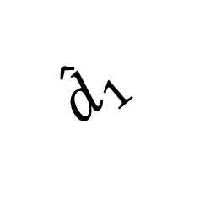
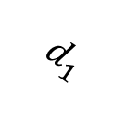
ANALYSIS OF INDOOR LOCALIZATION
Deborah Capistran, Hillside Middle School, Manchester, New Hampshire
Advisors: Nicholas J. Kirsch, Jonathan Tefft, and Eric Escobar, UNH Department of Electrical Engineering, Wireless Systems Lab
Introduction/Background
Trilateration
Results
Traditional building climate control techniques are inefficient and waste energy.
With the ability to locate people indoors, room occupation data can be used to efficiently control building climate.
GPS is not an option to locate people indoors.
Today 98% of adults have cell phones. [1]
We propose to use cell phone signal for detecting the location of people inside buildings.
Trilateration is using three known locations and three distances from these locations in order to determine an unknown location ($\hat{x},\hat{y}$).
Sensors that receive power can be placed at known locations in a building (x_{i}, y_{i}).
A spectrum analyzer was used to measure received signal power at three known locations. Using the path loss model for Kingsbury Hall determined two sections prior, this data can be used to estimate the distance from each sensor to the transmitter. The following table contains the measured received power at the three sensor positions for each of the two transmitter locations, as well as the estimated distances given these received powers:
The power received at these sensors can be used to estimate the distance between the sensor and a transmitter (${\hat{d}}_{i}$).
We know by using the Pythagorean Theorem that the distance between two points is equal to the square root of the change in x position squared plus the change in y position squared. The figure to the right illustrates this concept:
$$\left(\hat{x},\hat{y}\right)$$
Methods
$${\hat{d}}_{1}$$
Δy
 | Position of Sensor in Cartesian Coordinates (m) | Power Received from S216 Transmitter (dBm) | Estimated Distance From S216 Transmitter (m) | Power Received from Hallway Transmitter (dBm) | Estimated Distance From Hallway Transmitter (m)
Sensor 1 (S210) | (0 , 0) | -69.1363 | 12.0740 | -77.6000 | 16.7075
Sensor 2 (S211) | (-14.05 , -0.38) | -80.5075 | 18.6797 | -75.1000 | 15.1791
Sensor 3 (S220) | (-4.11 , 22.90) | -60.7454 | 8.7499 | -67.2000 | 11.2093
Determining a Path Loss Model for Kingsbury Hall
A transmitted cell phone signal was approximated using a signal generator.
A spectrum analyzer was used to measure received signal power at a known location.
The signal generator was moved to 24 known locations in Kingsbury Hall.
The distance from the spectrum analyzer to each of the 24 locations was calculated.
The distances and power received at the 24 locations is plotted in the following plot:
$$\left(x_{1},y_{1}\right)$$
Δx
We can see that knowing the distance between the sensor and a transmitter forms a circle of possible locations of the transmitter. Using two sensors and two distances, we know that the possible locations of the transmitter are the intersection of the two circles formed by the distances around each of the two sensors, i.e. two points. Adding a third sensor and a third known distance, we see that the position of the transmitter can be determined as the intersection of all three circles. The figure to the left illustrates this concept:
Using trilateration methods described in the previous section, these estimated distances along with known sensor positions can be used to estimate positon of each cell phone user within a building. The following table shows the estimated transmitter position using trilateration, the actual position of each transmitter, and the position error of the estimate:
$$d_{1}$$
Sensor 1
$$\left(x_{1},y_{1}\right)$$
Sensor 2
$$d_{2}$$
$$\left(x_{2},y_{2}\right)$$
$$d_{3}$$
Sensor 3
 | Actual Position of Transmitter in Cartesian Coordinates (m) | Estimated Position of Transmitter in Cartesian Coordinates using trilateration (m) | Position Error (m)
Transmitter 1 (Hallway) | (-9.2254, 13.9098) | (-9.1340, 13.5291) | 0.3915
Transmitter 2 (Room S216) | (-4.8517, 15.0809) | (-0.1657, 13.2990) | 5.0133
$$\left(x_{3},y_{3}\right)$$
Discussion / Conclusion
The data in the result section shows that the position of the transmitter can be accurately determined in the case of the hallway.
In the case of the transmitter in S216, the position was not accurately estimated. This may be due to variability in the building structure throughout the building (e.g. wall thicknesses, number of walls between transmitter and receiver, etc.)
Future work includes a more thorough path loss investigation in the building to ensure that distances can be more accurately estimated from received power, as well as new techniques more powerful than trilateration to more accurately determine the position of people inside of buildings.
We needed to fit a line to the measured data so that we could estimate distance given received power.
The line fit to this data took the following form: [2]
$$\operatorname{Pr}{={Pr}_{d0 }}−10n∗\log_{10}\left(\frac{{\hat{d}}_{i}}{d_{0}}\right)$$
We chose d₀ and Pr_{d0} as 8.8358 m and -56.9812 dBm respectively (taken from measured data).
We tried different values of n (pass loss constant) in the above equation until the line fit the measured data reasonably-well. We determined that n = 6 produced the line of best fit.
With these three values along with received power, we can estimate the distance between transmitter and receiver.
We rearranged this equation in the following form to calculate distance from these values:
$${\hat{d}}_{i}=d_{0}∗{10}^{\left(\frac{{Pr}_{d0}−Pr}{10n}\right)}$$
Using the Pythagorean Theorem, we can write the three distance equations for each of the three sensors (given three sensor locations and distances) as the following:
$${\left(y_{1}−\hat{y}\right)}^{2}+{\left(x_{1}−\hat{x}\right)}^{2}={{\hat{d}}_{1}}^{2}$$
$${\left(y_{2}−\hat{y}\right)}^{2}+{\left(x_{2}−\hat{x}\right)}^{2}={{\hat{d}}_{2}}^{2}$$
$${\left(y_{3}−\hat{y}\right)}^{2}+{\left(x_{3}−\hat{x}\right)}^{2}={{\hat{d}}_{3}}^{2}$$
These three equations were combined and manipulated into two unique equations. These two equations can be used to solve the two unknowns $\hat{x}$ and $\hat{y}$ using matrix methods.
$${{\hat{d}}_{1}}^{2}{{−\hat{d}}_{2}}^{2}−{y_{1}}^{2}−{x_{1}}^{2}+{y_{2}}^{2}+{x_{2}}^{2}=−2x_{1}\hat{x}−2y_{1}\hat{y}+2x_{2}\hat{x}+2y_{2}\hat{y}$$
$${{\hat{d}}_{1}}^{2}{{−\hat{d}}_{2}}^{2}−{y_{1}}^{2}−{x_{1}}^{2}+{y_{2}}^{2}+{x_{2}}^{2}=−2x_{1}\hat{x}−2y_{1}\hat{y}+2x_{2}\hat{x}+2y_{2}\hat{y}$$
These unknowns represent the estimated location of the transmitter.
Literature Cited
“Cell Phone and Smartphone Ownership Demographics.” Internet: http://www.pewinternet.org/data-trend/mobile/cell-phone-and-smartphone-ownership-demographics/, January 2014 [August 5, 2014].
Rappaport, T. Wireless Communications Principles and Practices 2nd Edition. Upper Saddle River: Prentice Hall PTR, 2002, pp. 138-139.
Acknowledgements – This research was supported with funding from the National Science Foundation’s Research Experience for Teachers in Engineering Grant (ENG-1132648). Nicholas Kirsch and (CBET .13-36824).

