Slide 1


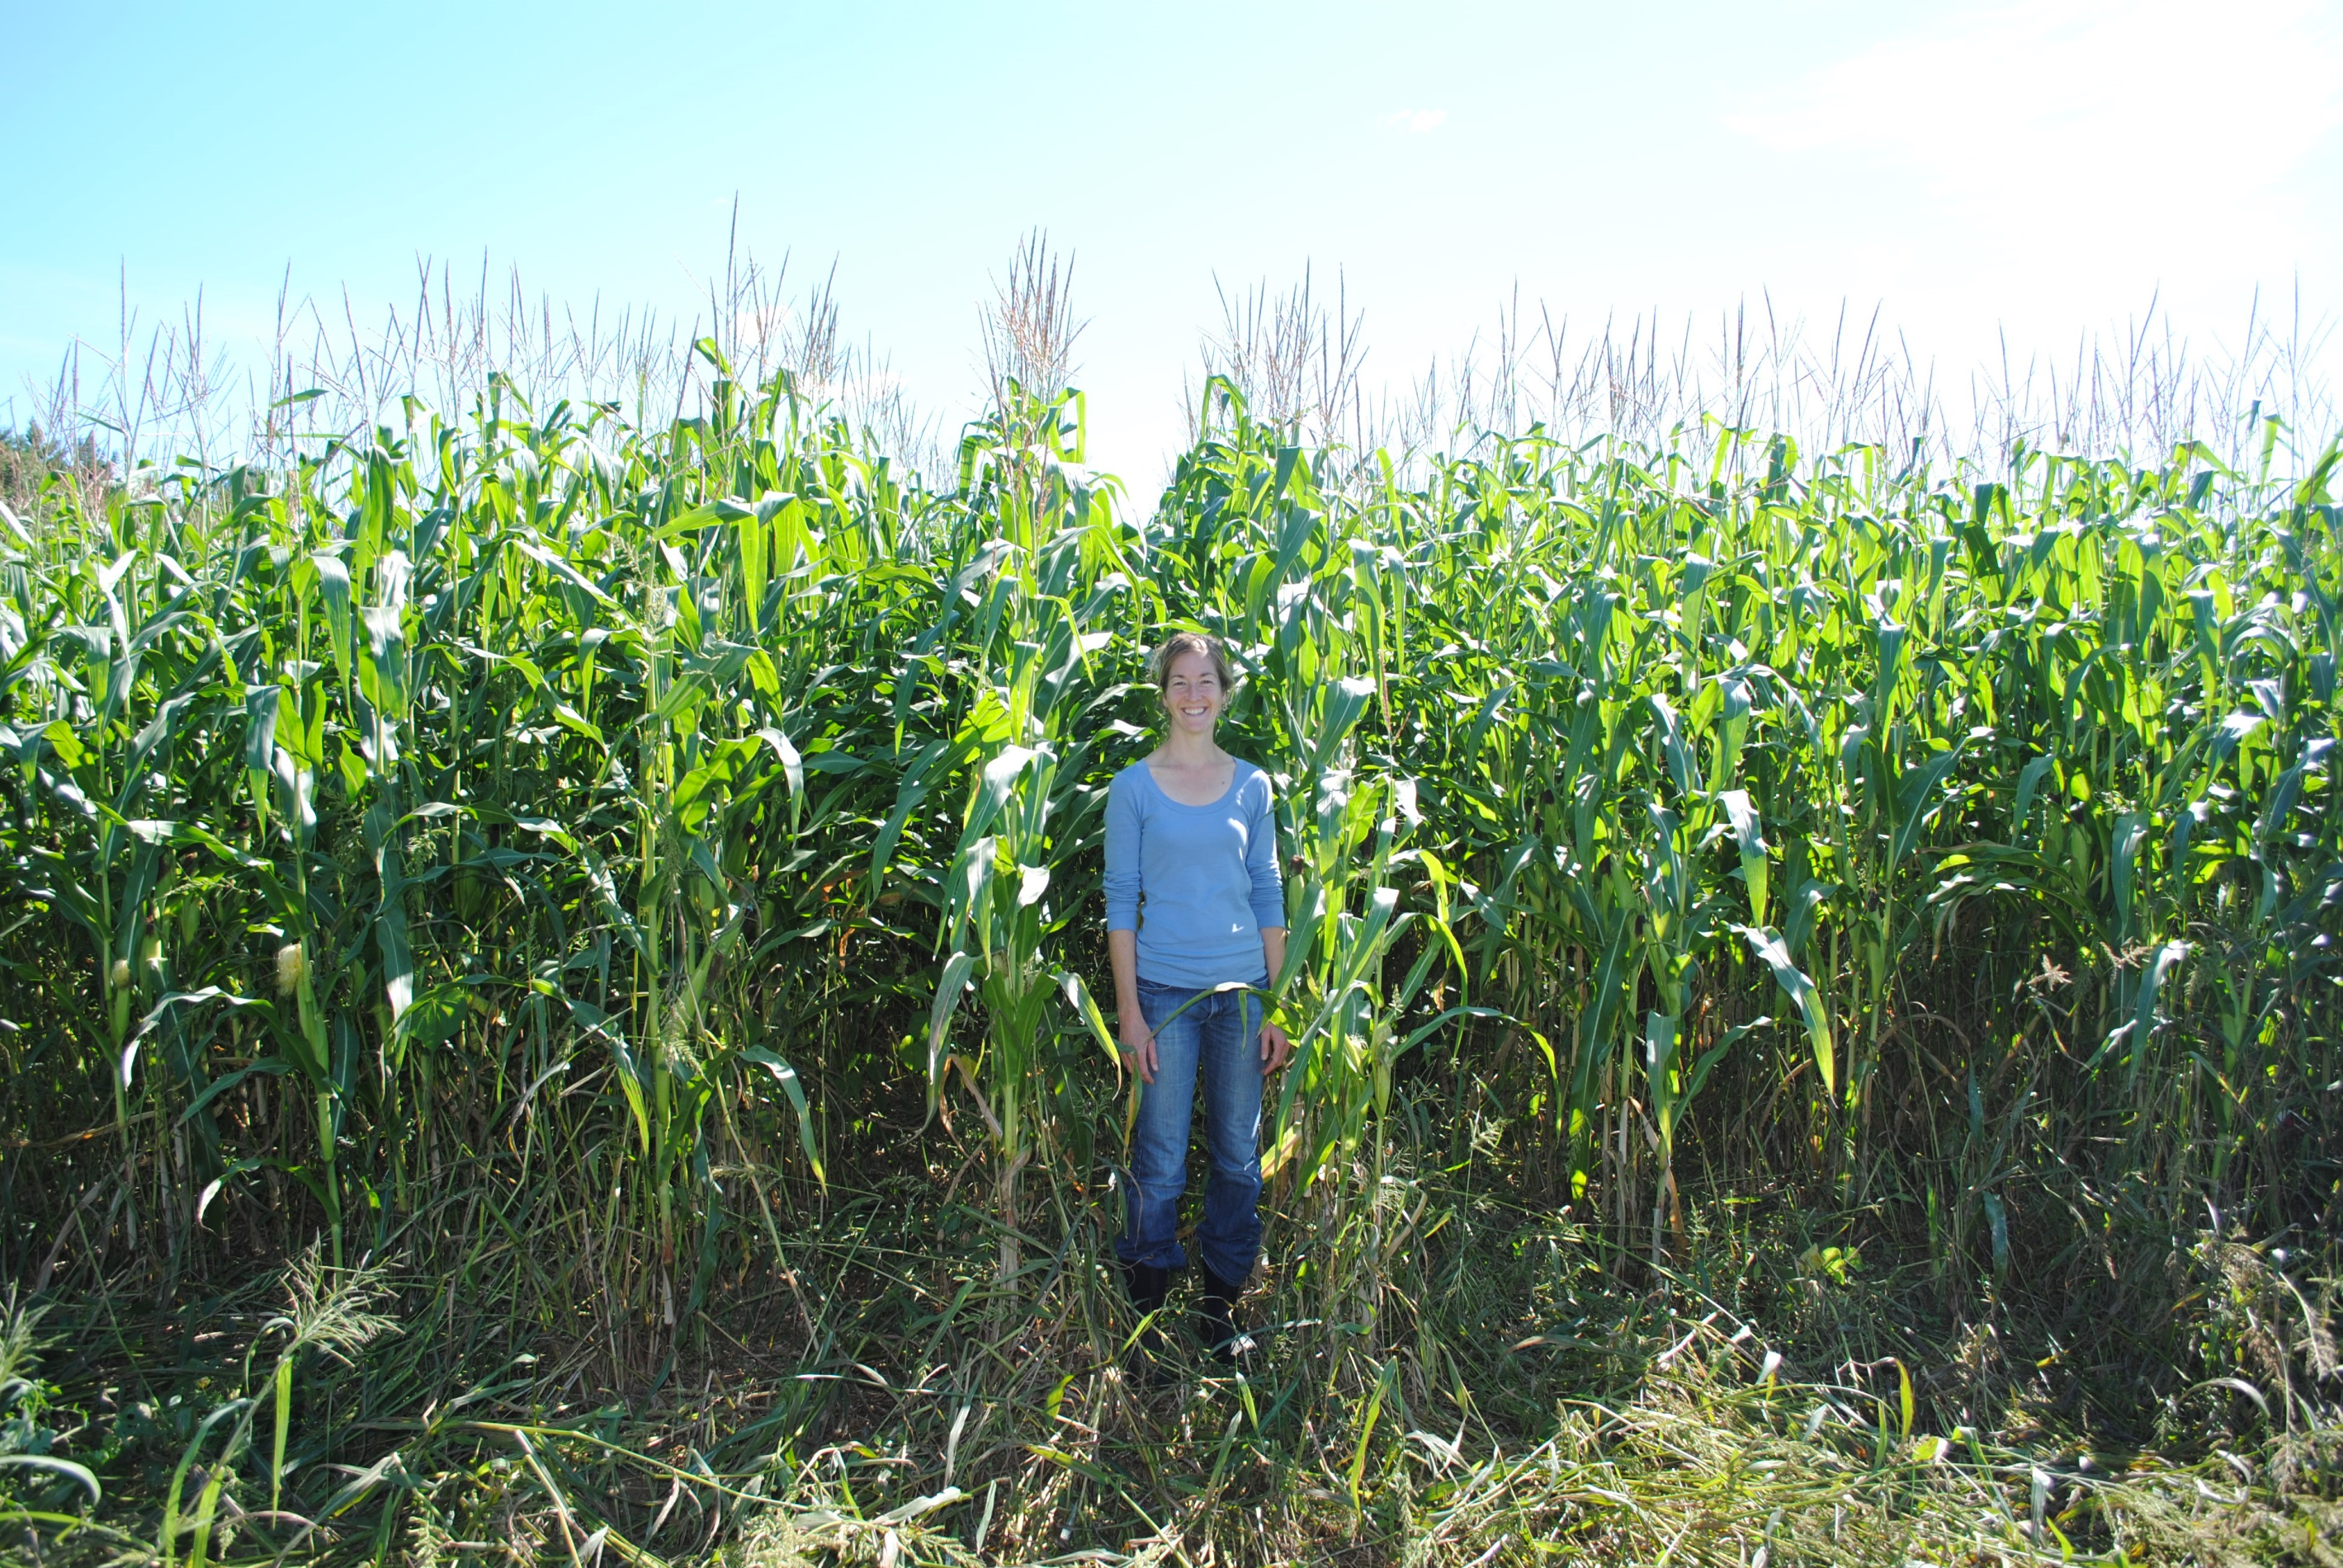
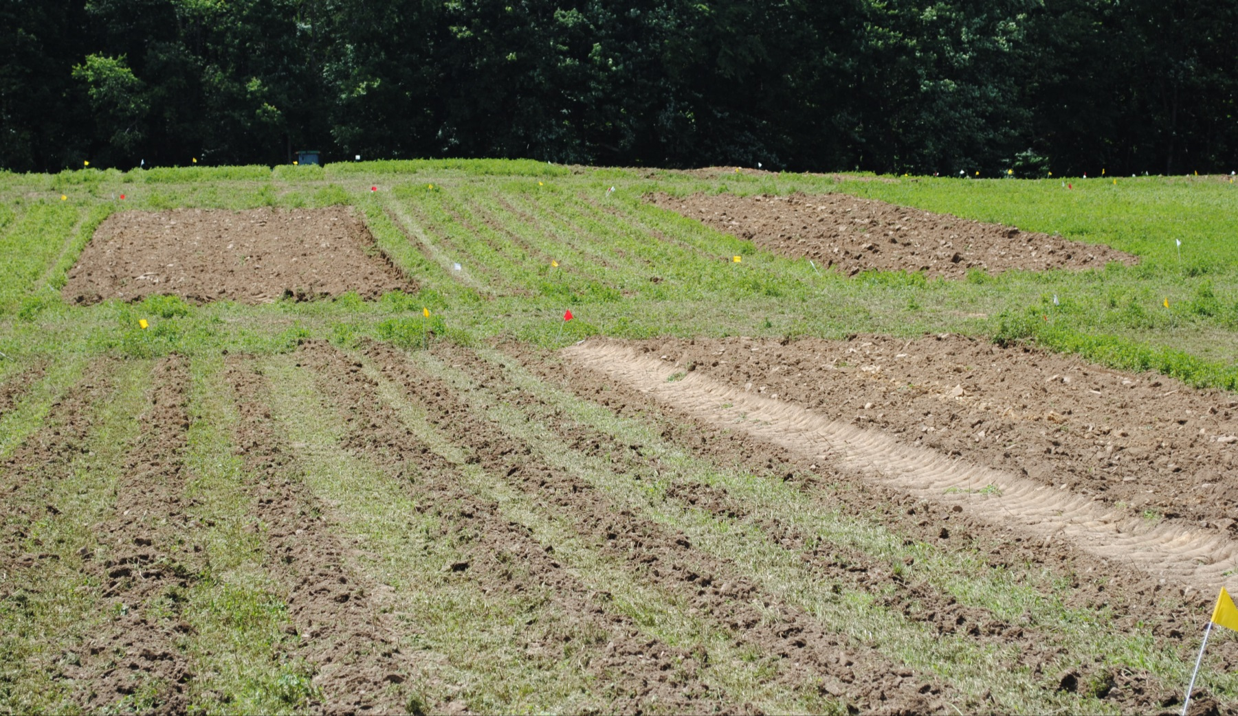
Intercropping for on-farm grain production and environmental quality in perennial forage systems
R. G. Smith,* N. D. Warren, J. A. Wilhelm; University of New Hampshire, Durham, NH
Department of Natural Resources and the Environment *Contact: richard.smith@unh.edu
INTRODUCTION
RESULTS AND DISCUSSION
The environmental impacts of annual grain production could be reduced by intercropping with perennial forages; however, the ecosystem service tradeoffs associated with this practice have not been adequately explored. Here we summarize the first year of data from a long-term cropping systems experiment aimed at quantifying the effects of several different approaches to annual crop establishment and perennial vegetation management on grain yields and other select ecosystem service indicators.
Questions: What combination of practices maximize provisioning ecosystem services (e.g., grain yield)? What are the tradeoffs associated with annual-perennial intercropping, and can these be minimized? How do these tradeoffs manifest over the longer-term?
Our cropping system treatments span two disturbance intensity gradients (see below) allowing us to explore ecosystem service tradeoffs associated with low external input annual grain crop production.
Corn grain yields averaged 4.8 and 5.6 Mg ha⁻¹ in the best performing treatments (T4 and T2, respectively; Figure 2).
Grain yield was affected more by the method of perennial forage community suppression than by the method of seedbed preparation and was highest where the perennial community was completely eliminated either via herbicide or full tillage.
Relative to the control (T9) most treatments resulted in slightly lower scores for non-provisioning ecosystem service indicators.
Weed abundance appears to be an emerging tradeoff associated with intense soil disturbance (Figure 3).
We expect to observe additional tradeoffs to emerge as this long-term study continues.
Figure 2. Co-author standing in corn growing in a strip-tilled treatment.
Suppression of perennial forage community
(Vegetation disturbance intensity)
METHODS
None
Mow
Glyphosate
Complete
Figure 3. Higher annual weed abundance at the time of planting (June 2014) may be a potential tradeoff associated with intense soil disturbance and complete elimination of the perennial plant community. While these practices (e.g., full tillage) resulted in high grain yields in 2013, they will likely necessitate additional weed management prior to planting the next crop in the rotation. Data are means ± SE, n = 4.
Figure 1. Experimental plots soon after suppression and seedbed treatments were applied. Plot in foreground was strip-tilled.
Experimental design. The field experiment is located at the University of New Hampshire Kingman Research Farm in Madbury, NH. In spring 2013, nine cropping system treatments were established in a perennial forage plant community dominated by alfalfa and orchard grass (Figure 1). The treatments represent gradients in disturbance to the plant
T9: Control
T8: Mowed, no-till
T6: Herbicide, no-till
None
T5: Mowed, shank-undercut
community and soil and were assigned randomly to plots within 4 replicate blocks. The perennial plant community was suppressed in June 2013 by flail mowing or herbicide (glyphosate), or completely eliminated by full tillage (moldboard plow). Corn was no-till planted either directly into the suppressed plant community or following one of three seed bed preparation operations (narrow shank tillage with undercut knives; strip tillage; or full tillage followed by disking and periodic inter-row cultivation). Two additional treatments (T2 and T7) are identical to T1 and T6, except they were interseeded with a perennial legume cover crop later in the growing season. The perennial plant community was left undisturbed in the control treatment (T9). Manure was applied to the entire site prior to treatment establishment. No additional inputs of fertilizer or pesticides were applied after corn planting.
Data collection. Weed abundance was measured in each treatment replicate in late August 2013 and again in spring 2014. Corn grain was harvested with a plot combine in fall 2013. Soil samples were collected in spring 2013 and 2014 and submitted to the Cornell Soil Health Test (CSHT) for analysis.
Ecosystem service indicators and spider plots. Here we report on select ecosystem service indicators for seven of the nine treatments. The suite of indicators are presented as “spider plots.” Each indicator axis has been relativized based on the highest value observed for that indicator among the nine treatments. For example, the treatment with the highest grain yield is assigned a score of 100. Grain yield scores for all other treatments are then represented as a percentage of this maximum yield. Low scores for a given indicator represent low values for ecosystem service indicators relative to the higher performing treatments; thus, asymmetries in the “spider web” represent potential ecosystem service tradeoffs among system treatments.
Undercut
F_{8,24} = 13.7, p < 0.001
Seedbed preparation
(Soil disturbance intensity)
T3: Mowed, strip-till
T4: Herbicide, strip-till
Strip tillage
F_{8,24} = 2.4, p = 0.048
T1: Full till
Full tillage
ACKNOWLEDGEMENTS
This research is funded by a Northeast Sustainable Agriculture Research and Education (NESARE) Graduate Student Grant. We would like to thank J. Palmer, E. Ford, M. Morris, S. Werner, N. Suhabolnik, K. Juntwait, M. Shaiyen, A. Guidice, and E. Hodgdon for technical assistance.
Ecosystem service and soil quality indicators are: AWC, soil available water content; SOM, soil organic matter; Organic N, fraction of SOM that is organically bound N; Soil Respiration; Soil Quality, a composite index based on the full suite of biological, chemical, and physical soil indicators measured by the CSHT.

