Slide 1
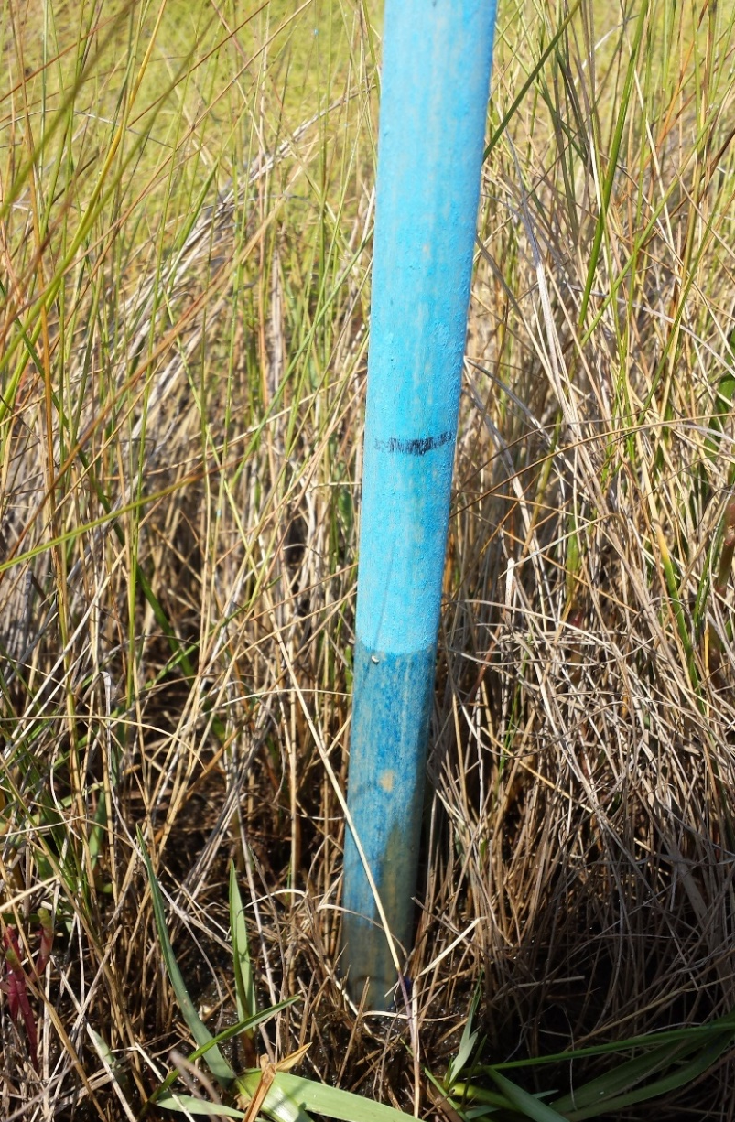
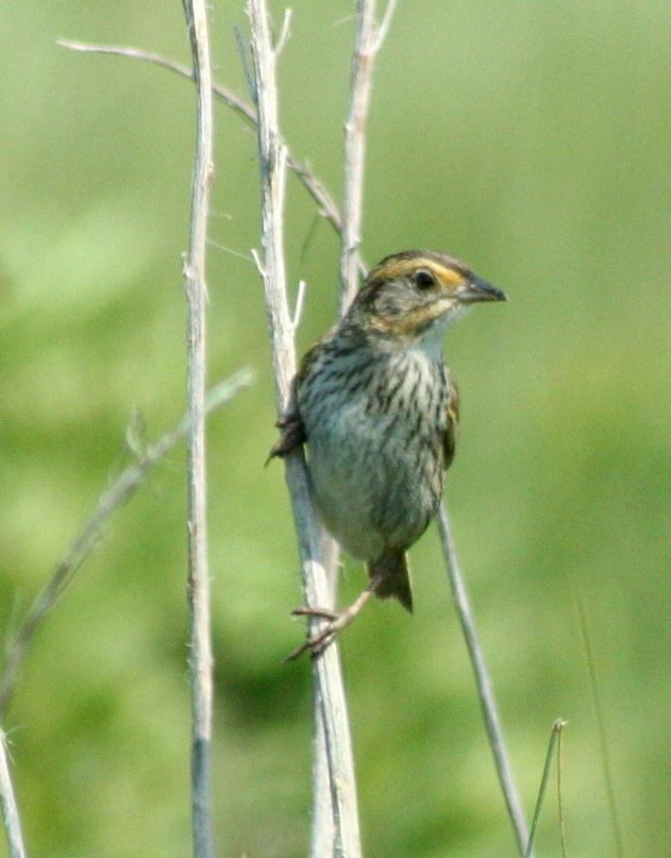
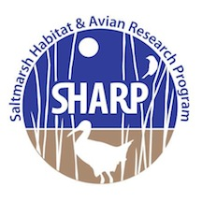
Floating Habitat Island for Salt Marsh-Nesting Birds
Bri Benvenuti¹, Adrienne Kovach¹, David M. Burdick¹, Jonathan B. Cohen², Chris S. Elphick³, Thomas P. Hodgeman⁴, Kathleen M. O’Brien⁵,
Brian J. Olsen⁶, W. Gregory Shriver⁷
¹University of New Hampshire, ²State University of New York College of Environmental Science and Forestry, ³University of Connecticut, ⁴Maine Department of Inland Fisheries and Wildlife, ⁵U. S. Fish and Wildlife Service, ⁶University of Maine, ⁷University of Delaware
Introduction
Tidal marsh birds are severely threatened by the impacts of rising sea levels on salt marsh ecosystems. Changes in vegetation, loss of nesting habitat, and increased tidal inundation will reduce, if not eliminate, the reproductive ability of marsh-nesting birds, such as the Saltmarsh Sparrow.
Conservation actions are needed in the very near-term to identify solutions to mitigate nest flooding and maintain breeding populations.
Monitoring during Spring Tides
Dowels coated in chalk were used to monitor tide height and evidence of flooding during spring tides August 8-14 2014.
Chalk sticks suggest the island was not substantially flooding during spring tides (Table 1).
Conclusions
Flooding was reduced on the floating island relative to the surrounding marsh and the water height did not reach average nest height.
Waterfowl appeared to use the island.
Floating habitat islands may be a viable management option to mitigate nest flooding.
Future Directions
Explore methods of vegetation collection, including propagation from seeds, nursery stock, and other field collection techniques.
Modify island structure to increase flotation and limit water which seeps through gaps in peat by increasing PVC diameter and using a less porous substrate material.
Establish conclusive methods of recording island water height using water level loggers.
Location | Max Water Height | Obs. Water Height
Land (control) | 27 cm | 14 cm
Island | 12 cm | 3 cm
Objective:
Evaluate the potential of floating habitat islands to provide Saltmarsh Sparrows with nesting habitat that is free of tidal flooding.
Table 1. Maximum and observed tide height measured on the island and land control.
iButtons collected temperatures at nest height on the island and on land, with ambient and water temperature control, and corroborated that the island was not flooding at nest height.
K. Papanastassiou
Vegetation Collection
Vegetated pieces of peat “marsh floaters” were collected.
Island Construction
Installation
Monitoring
Primary species were Spartina alterniflora and Spartina patens.
Approximately 50 square feet of vegetation was collected.
Island Construction
10 ft by 5 ft frame was made of 2- inch PVC pipe.
Plastic garden fencing was attached to frame with plastic zip ties.
Six foam pool noodles were added for buoyancy.
Wrack was spread on the frame as substrate for the vegetation.
Island was placed in a pool on Rachel Carson National Wildlife Refuge in late July.
It was anchored by four cinderblocks and attached by 10 feet of rope.
Site checks occurred for 3 months from July through September. approximately every 4 days to confirm that island was floating.
Acknowledgements: Funding was provided by the U.S. Fish and Wildlife Service and the University of New Hampshire Agricultural Experiment Station. This work stems from a regional collaboration to monitor and conserve tidal marsh birds in the Northeast. To learn more about our collaboration – SHARP – see: www.tidalmarshbirds.org

