Slide 1
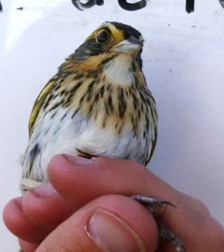
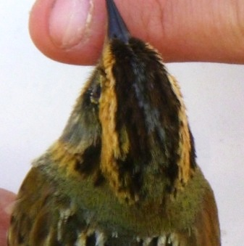
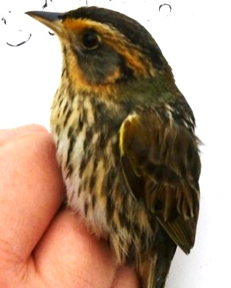
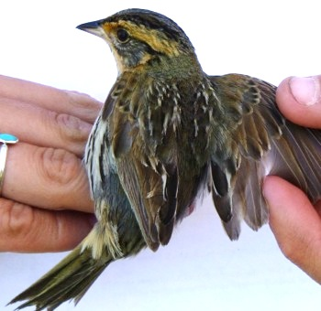
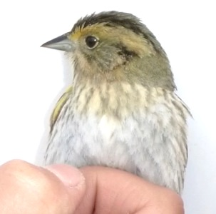
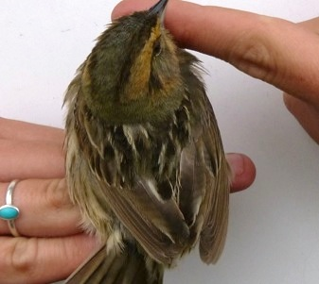
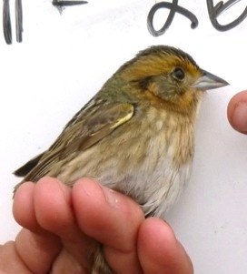
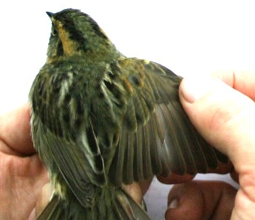
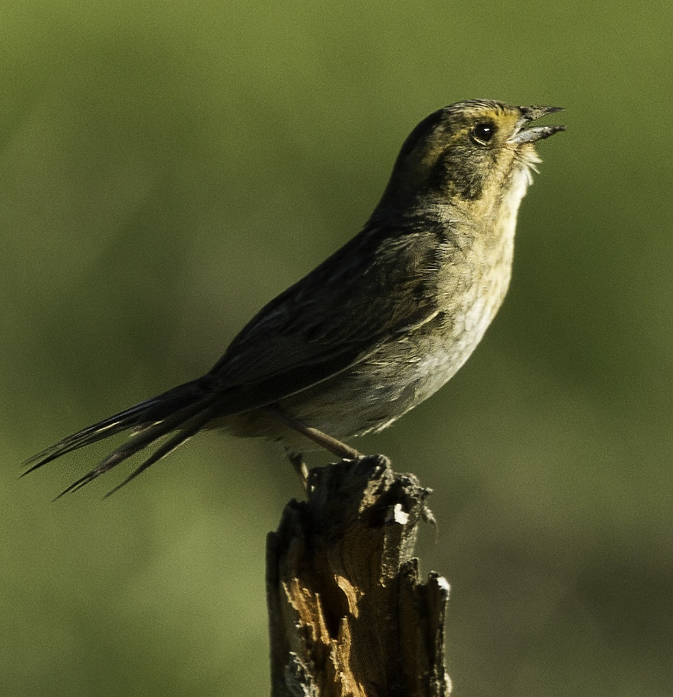
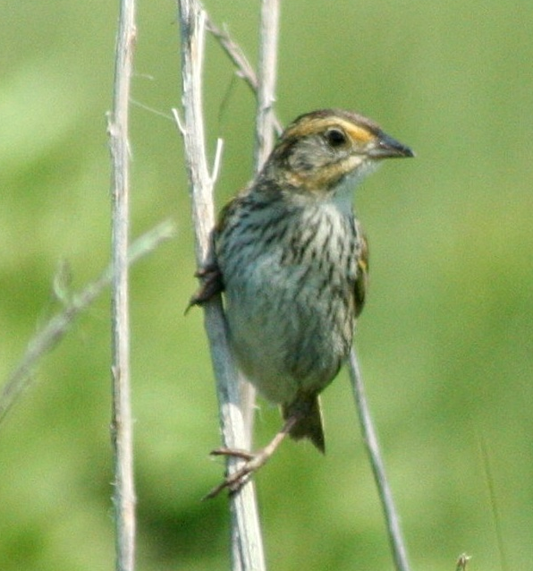
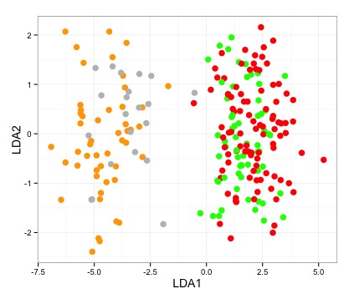
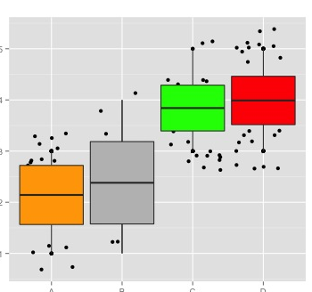
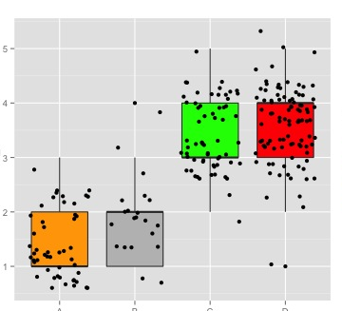
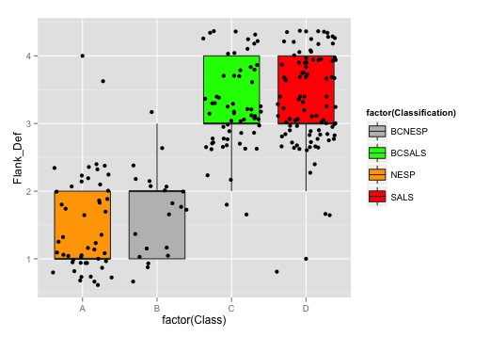
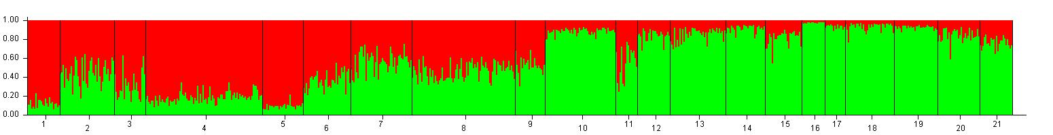
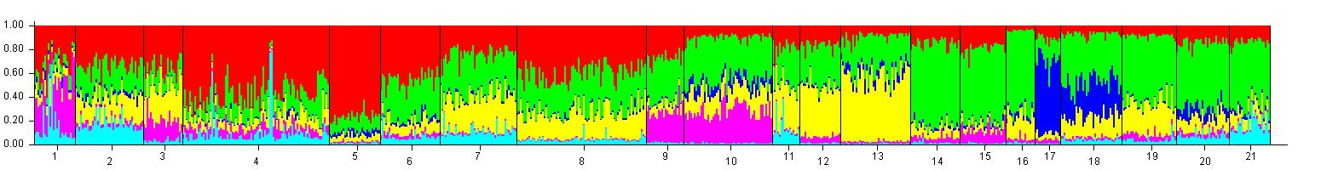
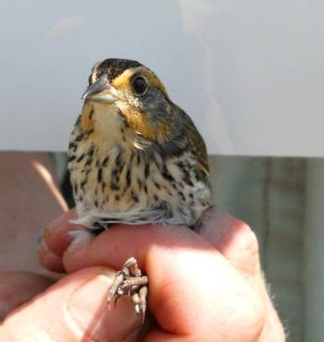
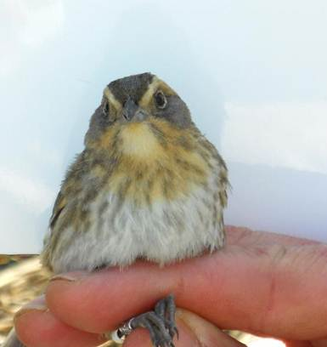
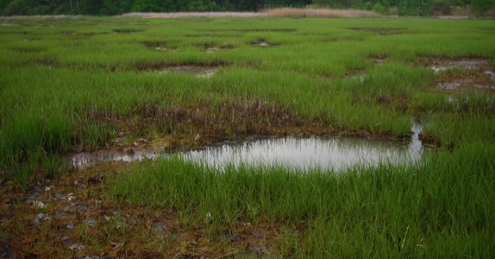
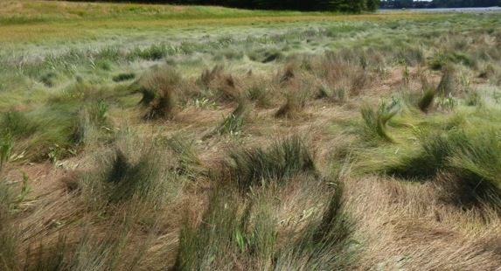
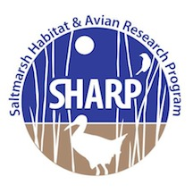

Using Genetic Tools to Inform Conservation of Saltmarsh and Nelson’s Sparrows
Adrienne I. Kovach¹, Jennifer Walsh¹, Kathleen M. O’Brien², Brian J. Olsen³, W. Gregory Shriver⁴, Jonathan B. Cohen⁵, Chris S. Elphick⁶, Thomas P. Hodgman⁷, Oksana P. Lane⁸
Author Affiliations: ¹University of New Hampshire, ²U.S. Fish and Wildlife Service, ³University of Maine, ⁴University of Delaware, ⁵State University of New York College of Environmental Science and Forestry, ⁶University of Connecticut, ⁷Maine Department of Inland Fisheries and Wildlife, ⁸Biodiversity Research Institute
Introduction
Hybrid Identification – Morphology vs. Genotype
Saltmarsh and Nelson’s Sparrows are priority tidal marsh species that breed in coastal marshes of BCR30, where they face threats imposed by rising sea levels¹. Where the two sister species overlap on the Northeast coast, they interbreed², thereby limiting the extent of pure populations and posing additional management challenges arising from difficulties in distinguishing pure and hybrid individuals. These threats are most pronounced for the Saltmarsh Sparrow, which is globally vulnerable to extinction³.
Goal: To aid in conservation planning, we are using genetic and genomic approaches to investigate metapopulation dynamics, interspecific interactions, and adaptive capacity of these tidal marsh birds on a regional scale.
We evaluated concordance between genotype and phenotype of pure and admixed Saltmarsh and Nelson’s Sparrows and the efficacy of morphological traits in identifying hybrids.
Hybrid Zone
Nelson’s Sparrow
Sparrows sampled from a hybrid-zone transect (see introgression box)
Genotypic data were collected from 24 microsatellite loci including 12 species diagnostic markers (see genomics box)
Plumage data and morphological measurements were taken (right).
Saltmarsh
Sparrow
52% of Saltmarsh and Nelson’s Sparrows in the overlap zone are of admixed ancestry, with extensive backcrossing.
Widespread introgression has generated high variation in morphology, with no clear intermediate plumage morphs.
Identification of backcrossed individuals is not possible from morphological features in the absence of genetic data.
Plumage Index: Individuals are scored (1-5) on 13 plumage-related traits used to differentiate the species², with scores of 1 indicative of pure Nelson’s Sparrow (bottom panels) and scores of 5 pure Saltmarsh Sparrow (top panels).
O. Ehrlich
K. Papanastassiou
Traits: bill color, color and definition of face and back, thickness and definition of crown and whisker line, definition and amount of streaking on breast and flanks
Metapopulation Dynamics
Linear Discriminant Function Analysis plot of pure and admixed Saltmarsh and Nelson’s sparrows based on morphological features – weight, wing chord, bill length, and a reduced plumage score consisting of the 7 most informative traits (see right).
Pure individuals of each species and sex were classified with high accuracy (77-95%), while admixed individuals had low classification success (28-53%).
Classification Accuracy (M/F):
Pure Nelson’s: 83%/95%
Pure Saltmarsh: 77%/95%
BC Nelson’s: 53%/50%
BC Saltmarsh: 28%/35%
Measurements: weight, wing chord, tarsus, bill height, bill length
We expanded on previous population genetics research⁴ with a data set of 725 Saltmarsh Sparrows genotyped from 21 marshes across the breeding range.
The most differentiated plumage traits were definition of maler, crown, face, breast and flank streaking, and color of face and bill, suggesting these traits introgress less freely.
Genetic structure was best explained by 2 clusters consistent with a North-South split corresponding to presence/absence of introgression with Nelson’s Sparrows.
Finer scale structure, despite gene flow, suggested 6 population groupings.
Isolation by distance was not observed and most marshes were differentiated from each other; a few marshes (Chapman’s, Four Sparrow) had elevated divergence.
Maler Definition
Breast Definition
Flank Definition
1
2
5
3,4
6,7,8
NESP
SALS
10
9
BCNESP
Box plots of 3 of 7 plumage traits distinguishing pure Saltmarsh and Nelson’s Sparrows.
18
17,16,15
14
11,12,13
BCSALS
19
20,21
Genomic Approaches
Coverage Depth | Assembly Size | No. of reads | No. of contigs | N50 contigs | Predicted Genes | Eukaryotic Orthologs
59X | 1.0 Gb | 533 million | 149,927 | 16,195 bp | 28,150 | 95%
26X | 1.0 Gb | 376 million | 142,556 | 30,931 bp | 25,486 | 95%
SPUR
SCAR
RYE
RI
OC
Sampling locations of 725 Saltmarsh Sparrows from 21 marshes. Red and green circle labels correspond to North-South population separation identified with STRUCTURE analysis.
We generated high quality de novo assembly drafts of Saltmarsh and Nelson’s Sparrow genomes from Illumina sequencing.
These genomic resources are aiding ongoing conservation research, as outlined below.
LR
FURB
CHAP
HAMP
PARKER
MONO
BARNI
HAMM
LI
MNC
IDW
FSM
SAW
ATT
MW
EASTR
SALS (n=6)
STRUCTURE analysis results for K=2 (top) and K=6 (below) for 21 marshes arranged North to South in the bar plots. Different colors indicate genetically distinct groupings and vertical bars show proportion of each individual’s genome in each genetic cluster.
Hybridization and Introgression
Genotype-Habitat Relationships
NESP (n=1)
Quality control statistics for Saltmarsh and Nelson’s Sparrow de novo genome assemblies.
We sampled and genotyped at 24 microsatellite loci 290 sparrows from 23 sympatric and 11 allopatric marshes along a transect through the 208-km hybrid zone.
Comparison of microsatellite repeats in the two genomes and screening of 37 putatively diagnostic loci revealed a panel of 12 loci informative in discriminating the two species. Very few fixed differences between the species is consistent with shallow divergence.
Genome-wide comparisons of polymorphism and divergence will yield insight into demographic history, divergence time, and rates of interspecific gene flow.
A panel of genome-wide SNPs may provide higher resolution genetic markers for fine-tuned studies of dispersal and introgression.
Future population genomic analyses with RAD sequencing will investigate adaptive divergence across the hybrid zone in relation to coastal and upriver habitat gradients.
Assignment of individuals to genotypic classes showed very few F1 hybrids and numerous backcrossed individuals, indicating widespread genetic introgression.
Distribution of genotypes was consistent with a mosaic hybrid zone, in which alleles were correlated with habitat features signaling a coastal to upriver gradient.
Saltmarsh alleles
SALS and NESP differ in their niches with respect to coastal (top) and upriver (bottom) marshes.
Nelson’s
Rivers
R² = 0.448, P<0.01
Hybrid Zone
Coast
Genotypic Class
Individual Genotype Compositions
BCNESP
BCSALS
F1
NESP
SALS
Saltmarsh
Acknowledgements
Allopatric Nelson’s
Habitat PC2
Funding was provided by the United States Fish and Wildlife Service and the University of New Hampshire Agricultural Experiment Station.
We are grateful to Kelley Thomas for collaboration on genomic approaches and Kazufusa Okamoto and Jordan Ramsdell for bioinformatics assistance.
Hybrid Zone
Allopatric Saltmarsh
Nelson’s
genotypes
References
Habitat PC1
¹Bayard, T. and C.S. Elphick 2012. Auk 128: 393-403.
²Shriver, W. G., J. P. Gibbs, P. D. Vickery, H. L. Gibbs, T. P. Hodgman, P. T. Jones, and C. N. Jacques. 2005. Auk 122: 94-107.
³Butcher, G., Comins, P., Elphick, C., Greenlaw, J., Rosenberg, K., & Wells, J. (2012). Ammodramus caudacutus. The IUCN Red List of Threatened Species.
⁴Walsh, J., A.I. Kovach, K.J. Babbitt, K.M. O’Brien. 2012. Auk 129: 247-258.
Sampling Location – North to South

