Slide 1

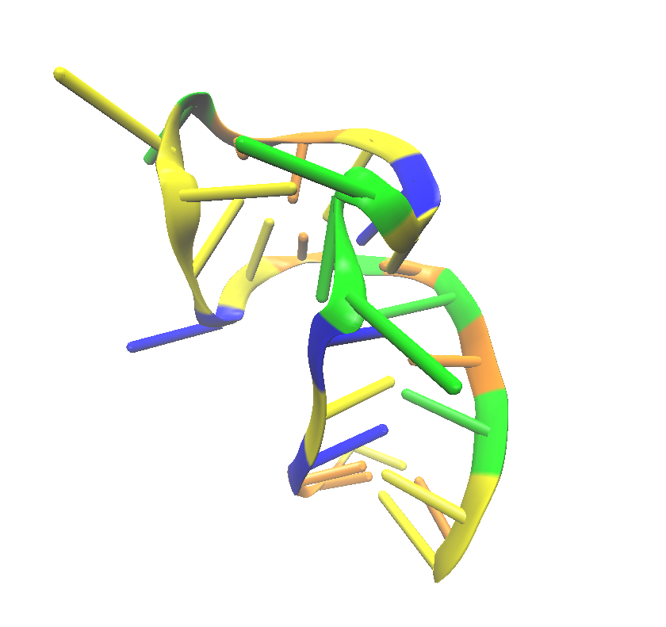
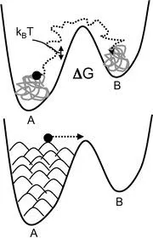
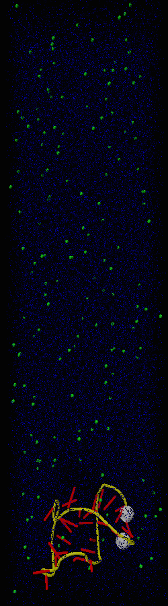
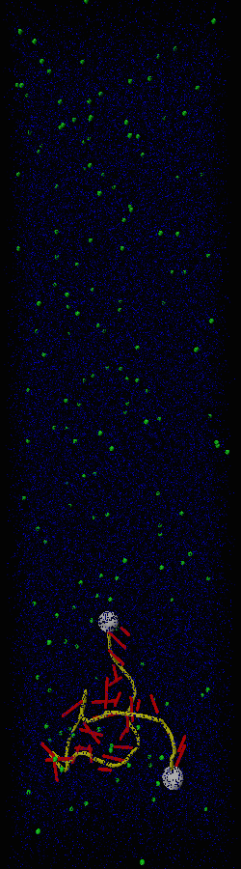
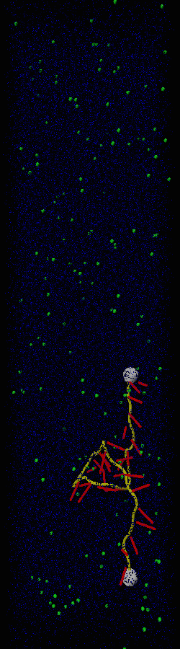
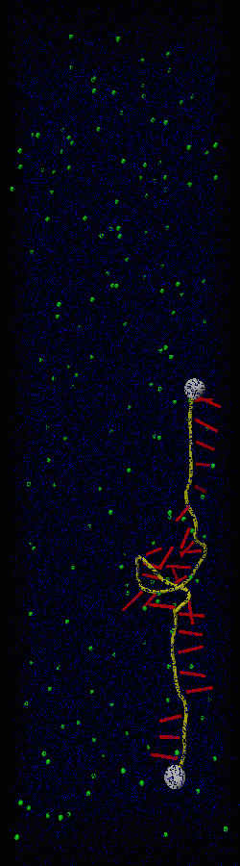
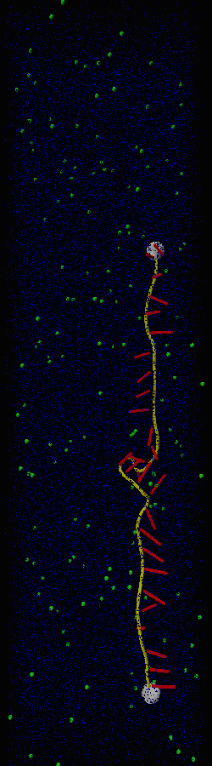
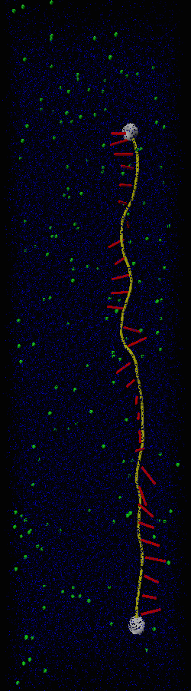
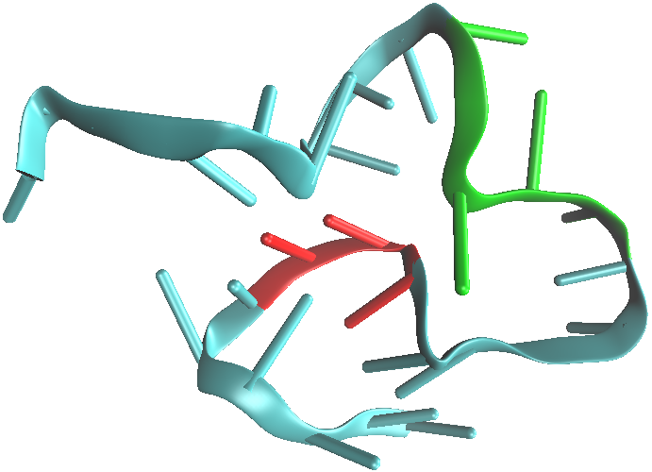
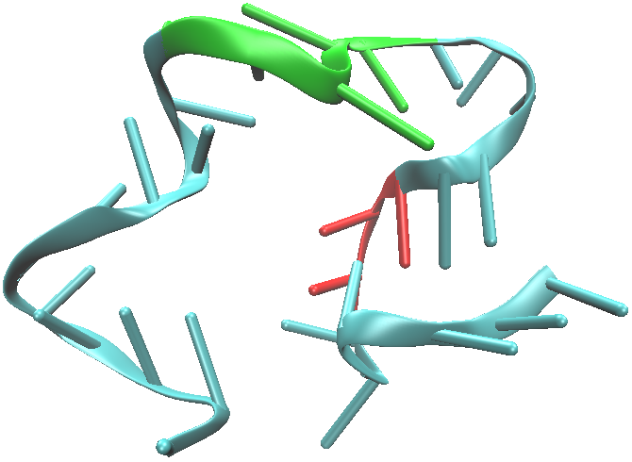
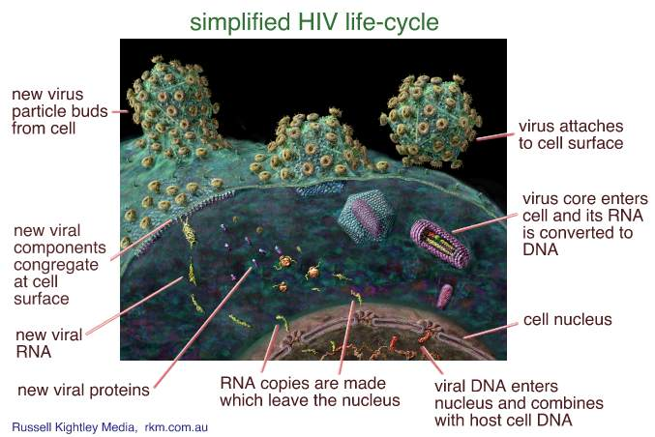
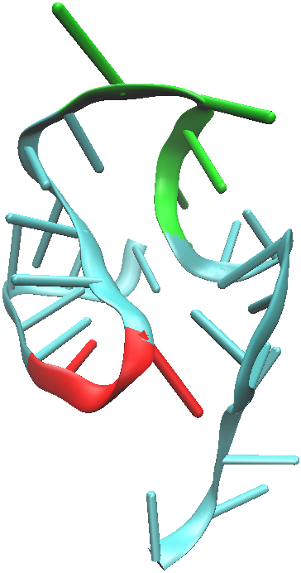
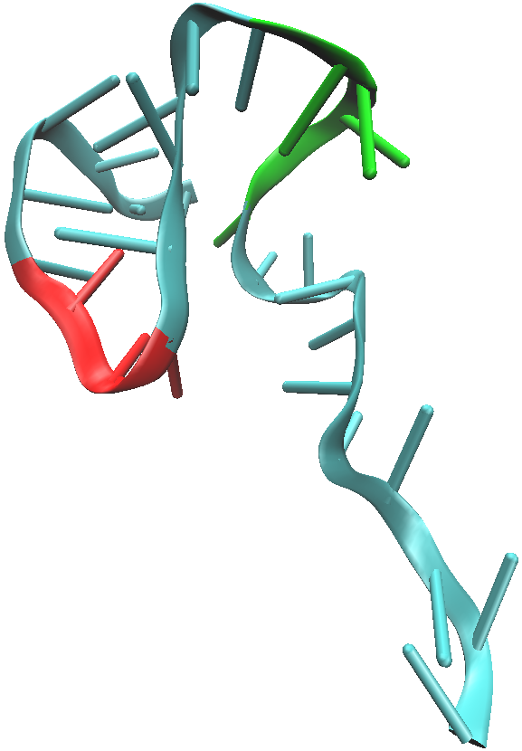
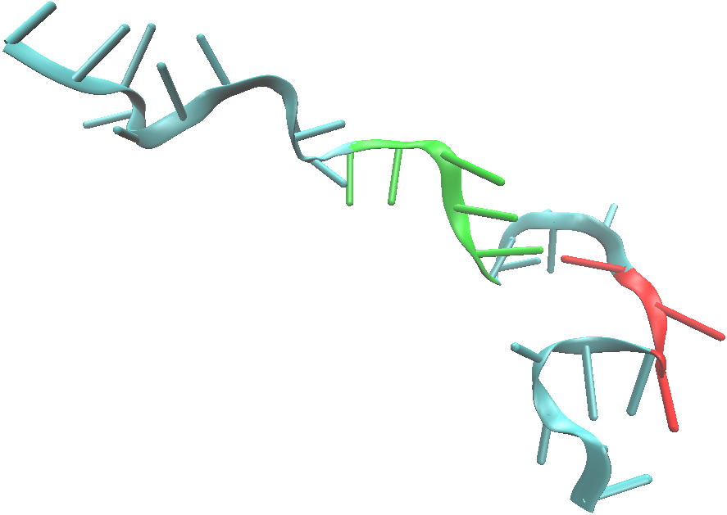
Mapping the Free Energy Landscape of HIV-1 TAR RNA with Metadynamics
Tyler J. Mulligan¹, Harish Vashisth²
¹M.S. Student, Department of Chemical Engineering, University of New Hampshire, Durham NH
²Advisor, Department of Chemical Engineering, University of New Hampshire, Durham NH
ABSTRACT
INTRODUCTION
HIV-1 TAR RNA
Steered MD of TAR RNA
References
RNA Hairpin Loop
METADYNAMICS
Metadynamics is a method to explore the free energy landscape in a large collective coordinate space. The height and width of the energy gaussians are manipulated and added at a certain frequency to explore the depth of the free energy wells. This allows for the RNA molecule to explore metastable states that it may not be able to reach in a standard simulation.
HIV-1 trans-activated response element (TAR) RNA is the RNA molecule located in the human form of the immunodeficiency virus. This TAR RNA molecule plays an essential role in the reproduction of viral proteins, and ultimately the reproduction of virions themselves. Through the use of molecular simulation methods such as steered molecular dynamics (SMD) and Metadynamics, the free energy landscape of this RNA is to be mapped. SMD will allow for a quantitative analysis of the force required to break the nucleotide interactions of TAR RNA, while Metadynamics will allow for quantitative analysis of the free energy barriers between the various low energy conformations that TAR RNA encounters on its way to the folded native state.
HIV-1 TAR RNA (right)
molecule rendered using VMD^{[1]}
The Hairpin loop can be seen in yellow
The 3-nucleotide bulge in green
Both structures play an important role
Orange (Cytosine) Yellow (Guanine) Blue
(Adenine) Green (Cytosine)
3-nucleotide bulge
Simulation Parameters:
Box Dimensions 59x64x168 (A)
NPT Ensemble
1.0 fs timestep
Colvar width 2.0
Hill Weight 0.1
Hill Frequency 1000
59,644 atoms
HIV-1 TAR RNA
SMD Parameters
Cell size (angstroms)
X: 58 Y: 47 Z: 188
2fs timestep
NPT ensemble
SMD k constant: 7
SMD vel.: 0.05 A/ps
SMD dir: X(0) Y(0) Z(1)
Minimize 100 steps
Ran for 4 ns
216,000 atoms
Ions: Mg Cl
Aqueous, not implicit solvent.
Pulling Velocity: 0.05 A/ps
The two graphs below show the molecules free energy in kcal/mol (Z)
t= 0ps
t= 267ps
t= 533ps
t= 800ps
t= 1.1ns
t= 1.4ns
HIV affects Human T-Cells
50,000 infected yearly in the US
Globally over 35 million people have HIV
36 million have died as a result of the virus
TAR RNA assists in reproduction of viral proteins (ribozyme)
TAR RNA has multiple metastable conformations that give yield to multiple functions
ΔG= 1.5 Kcal/mol
Red: Bulge
Green: Hairpin
ΔG= 2.5 Kcal/mol
Force vs. Time averaged over 10 identical SMD runs
Pulling velocity 0.05 A/ps
The dashed line represents 0pN of force
Black line shows the averaged force
Average of about 100pN of force
Elongated RNA resolvated and used as starting molecule for Metadynamic simulations
ΔG= 1 Kcal/mol
Pulling force analysis for 10 averaged SMD simulations for HIV-1 TAR RNA.
ΔG= 2 Kcal/mol
ΔG= 4 Kcal/mol
[1] Humphrey, W., Dalke, A. and Schulten, K., "VMD - Visual Molecular Dynamics", J. Molec. Graphics, 1996, vol. 14, pp. 33-38.
[2] Knightly, Russell. “HIV AIDS Virus Replication (viral Life Cycle).” Diagram by Russell Knightly Media. Web. Oct. 2014.
[3] Cheng, Bingqing. "Quora." How Does Metadynamics Calculate the Potential Mean Force (PMF) or the Free Energy Profile of a Reaction Coordinate? -. 27 June 2014. Web. 4 Oct. 2014.
[4] James C. Phillips, Rosemary Braun, Wei Wang, James Gumbart, Emad Tajkhorshid, Elizabeth Villa, Christophe Chipot, Robert D. Skeel, Laxmikant Kale, and Klaus Schulten. Scalable molecular dynamics with NAMD. Journal of Computational Chemistry, 26:1781-1802, 2005.
Acknowledgements
^{[2]} Diagram by Russell Knightly Media.
All images were produced using VMD [1] All simulations were run using NAMD [4]. We would also like to thank the University of New Hampshire for allowing our group access to the Trillian Supercomputer.

