Slide 1

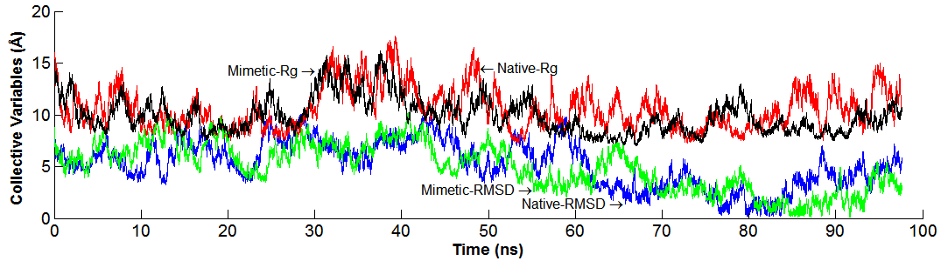
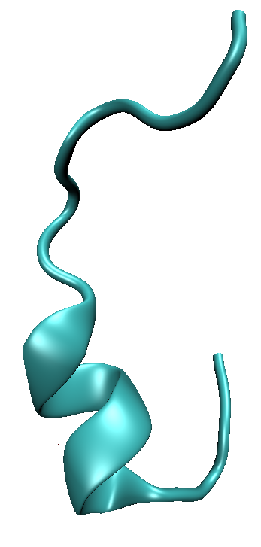

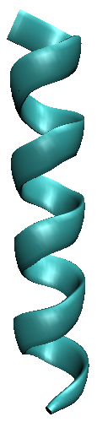

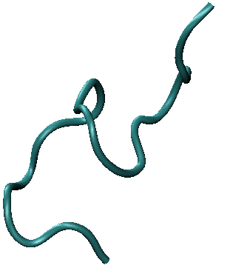
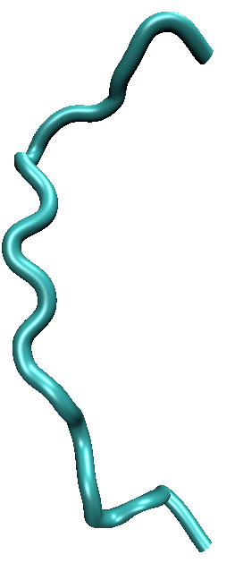
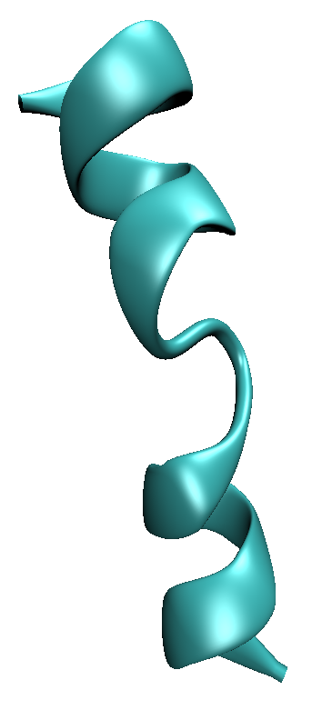
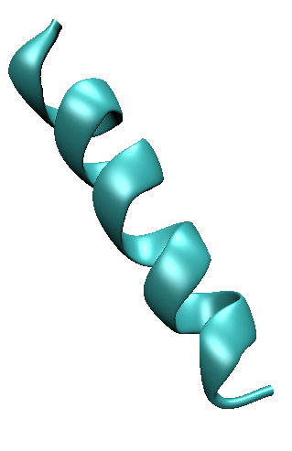
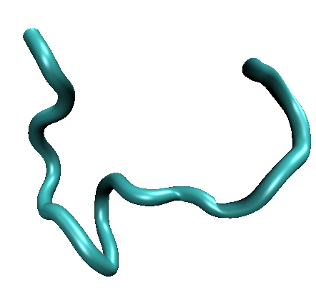
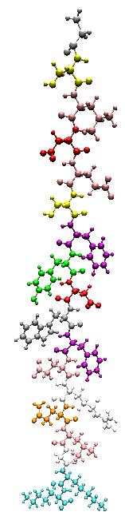
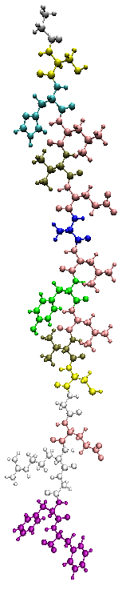

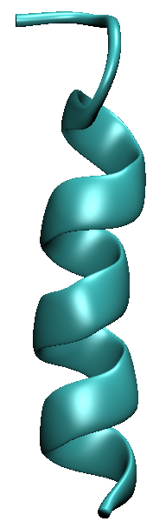
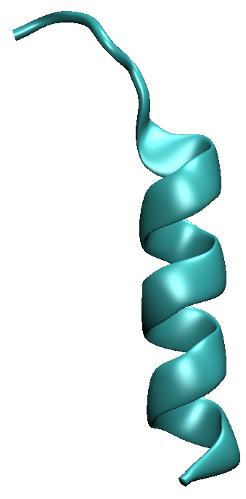
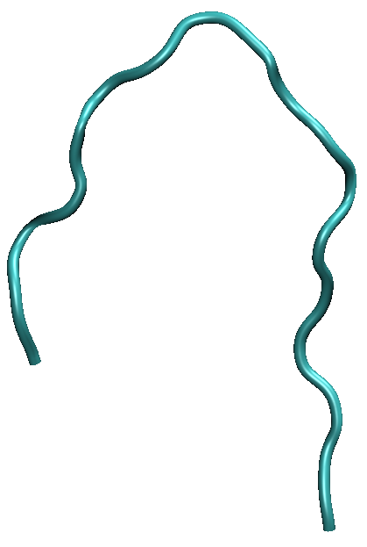
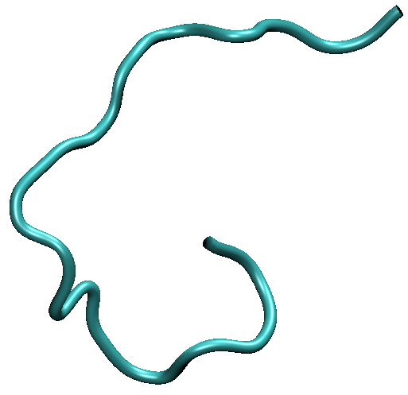
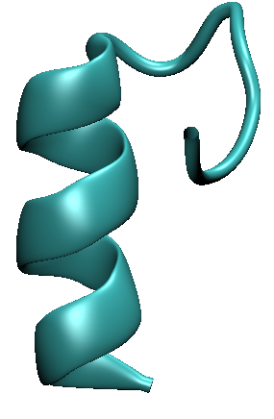
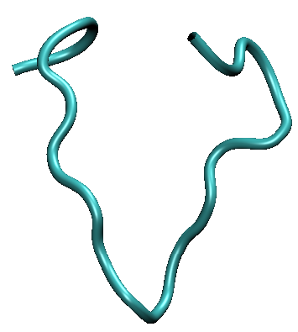
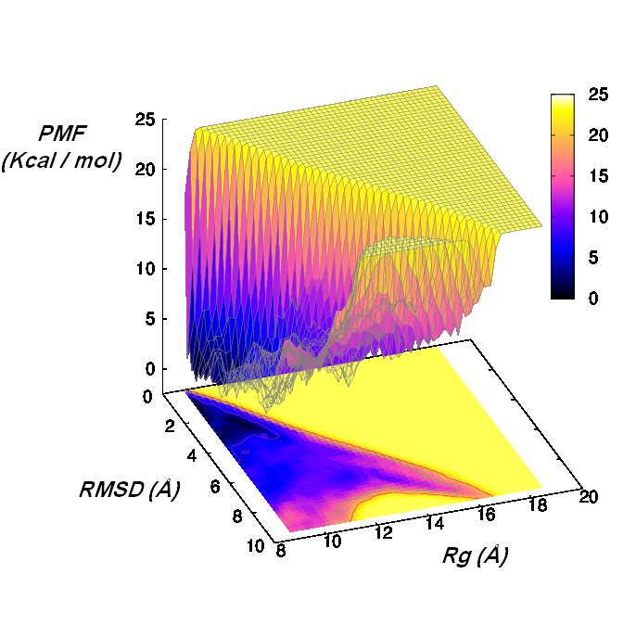
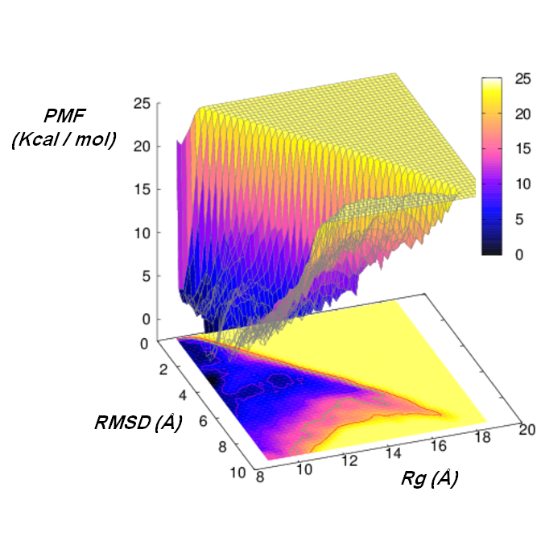
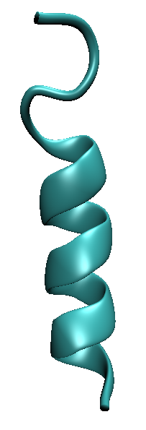
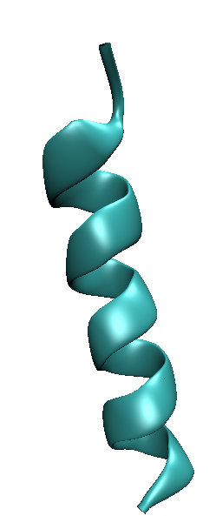
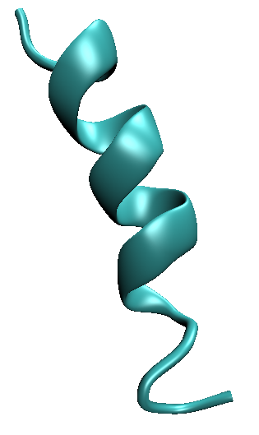
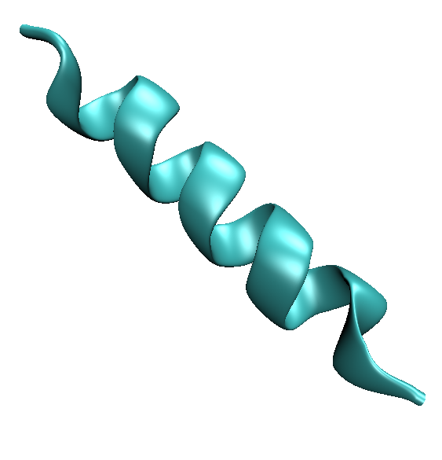
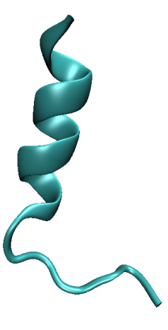
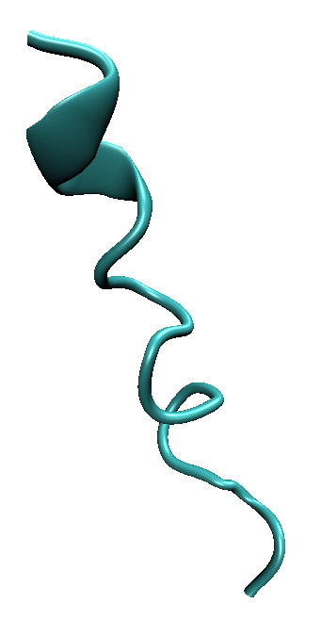
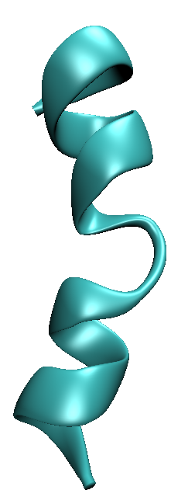
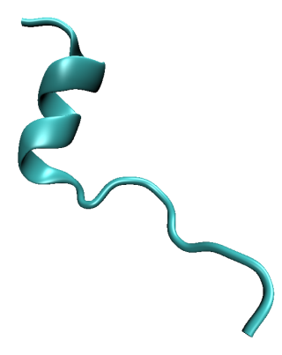
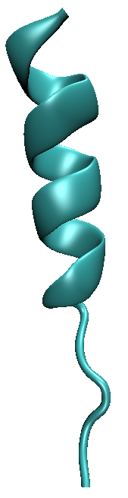
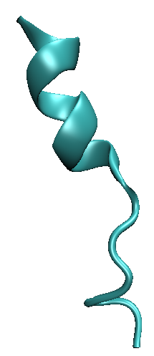
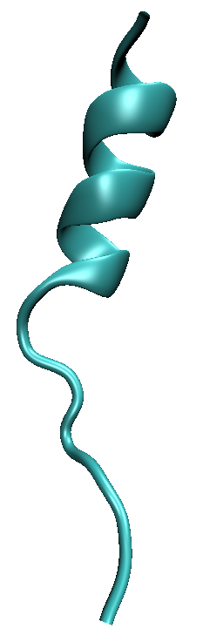
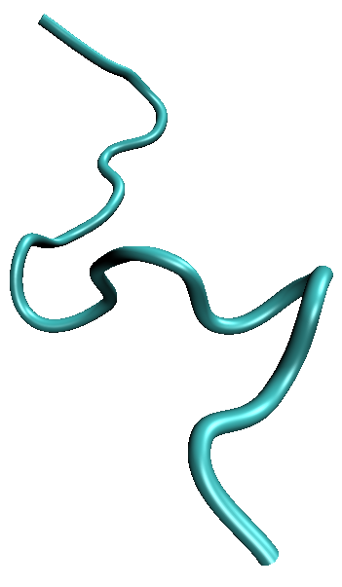
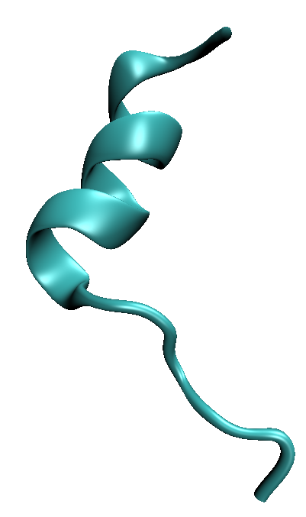
Folding of Distinct Sequences into Similar Functional Topologies
Hossein Mohammadiarani and Harish Vashisth (Advisor)
Department of Chemical Engineering, University of New Hampshire, Durham, NH
Abstract
Folding Trajectory
MD Simulation Parameters
Molecular dynamics is a simulation technique to investigate the molecular and atomic interactions by numerical solution of classical equation of motion of all particles. In this work, we study folding of insulin B-chain and its mimetic peptide (RP9-S371) to compare their folding mechanisms. Folding structure of mimetic peptide is yet elusive although it is known that it causes insulin receptor activation.
Peptide immerse d in water box (50 Å x 75 Å x 72 Å)
Neutralized in saline water (0.05 mol/L NaCl)
Equilibration time : 200 ps, time step : 2.0 fs
NPT ensemble with periodic boundary conditions
Number of atoms: 25119 atoms (including hydrogen)
CHARMM 22 force filed with CMAP correction
Metadynamics Parameters
Simulation time : 100 ns
Time step : 1.0 fs
hillWidth : 1.0
hillWeight : 0.1
HillFrequency : 1000
Width : 0.2
Two collective variables
Collective variables:
Sequence Alignment
[2]
Sequence alignment of human insulin B-chain with the insulin mimetic peptides. Residues which are conserved in the alignment between mimetic peptide and the B-chain of human insulin are colored.
RMSD = 9.5 (Å)
Rg = 18.7 (Å)
RMSD = 0 (Å)
Rg = 8.7 (Å)
[1]
Native peptide
Mimetic peptide (S371) |  | Insulin B-chain
GLY | 1 | GLY
SER | 2 | SER
LEU | 3 | HSE
ASP | 4 | LEU
GLU | 5 | VAL
SER | 6 | GLU
PHE | 7 | ALA
TYR | 8 | LEU
ASP | 9 | TYR
TRP | 10 | LEU
PHE | 11 | VAL
GLU | 12 | CYS
ARG | 13 | GLY
GLN | 14 | GLU
LEU | 15 | ARG
GLY | 16 | GLY
LYS | 17 | PHE
LYS | 18 | PHE
Conclusions
Mimetic peptide
Predicted fold of mimetic peptide is highly similar to the
known native fold
Additional metastable states appear accessible to the
native peptide
The free-energy differences between the completely
unfolded and fully folded states of native and mimetic
peptides are comparable
These results support the hypothesis that mimetic peptide
likely binds to the insulin receptor in same conformation
as insulin
Methods used are generally applicable to understand
folding of other sequences
Folding Thermodynamics (Potentials Mean Force)
References
Methods and Software
[1]. Ward CW, et al. Ligand-induced activation of the insulin receptor. Bioessays 31:422–434.
[2]. He ́nin, J,et al. 2010. Exploring multidimensional free energy landscapes using time-dependent biases on collective variables. j. Chem. Theory Comput. 6:35–47.
[3]. James C. Phillips, et al, Scalable molecular dynamics with NAMD. Journal of Computational Chemistry, 26:1781-1802, 2005.
[4].Humphrey, et al."VMD - Visual Molecular Dynamics", J. Molec. Graphics, 1996, vol. 14, pp. 33-38.
NAMD (NAnoscale Molecular Dynamics program) is a parallel molecular dynamics code designed for high performance simulation of large systems of particles.
VMD (Visual Molecular Dynamics program) is a molecular visualization software for displaying, animation and analyzing the result of MD simulation.
Metadynamics is an algorithm for mapping free energy landscape in molecular computations. NAMD is equipped with this algorithm.
[3]
[4]
Acknowledgment
Mimetic peptide
Native peptide
We appreciate the University of New Hampshire for seed funding. Computations were performed on Trillian, a Cray XE6m-200 supercomputer at UNH supported by the NSF MRI program under grant PHY-1229408.

