Slide 1



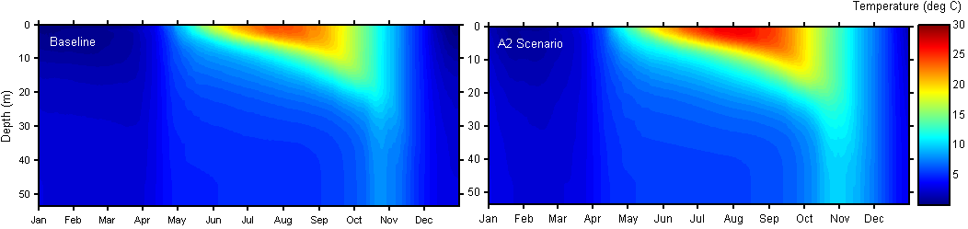
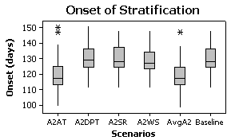
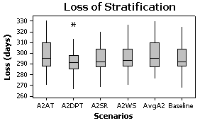
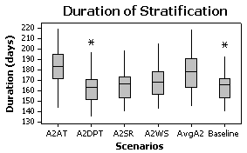
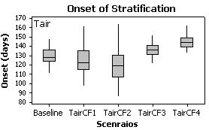
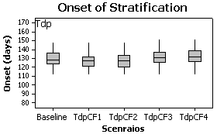
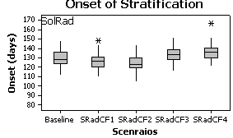
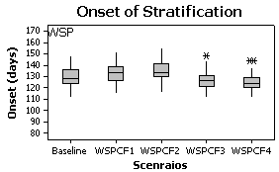
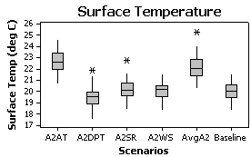
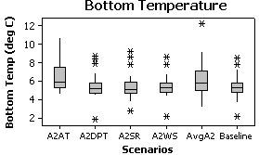
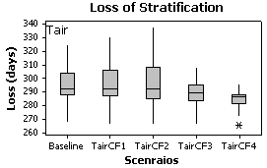
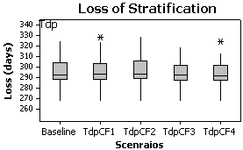
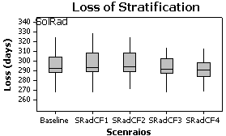
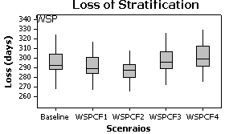
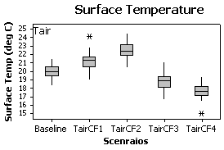
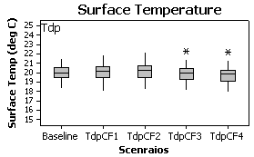
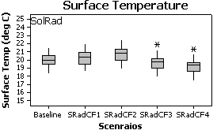
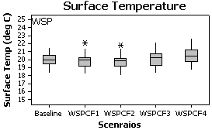
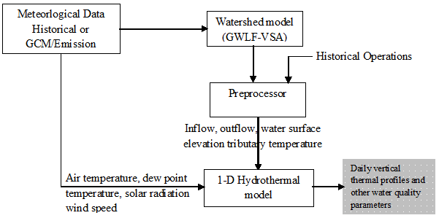
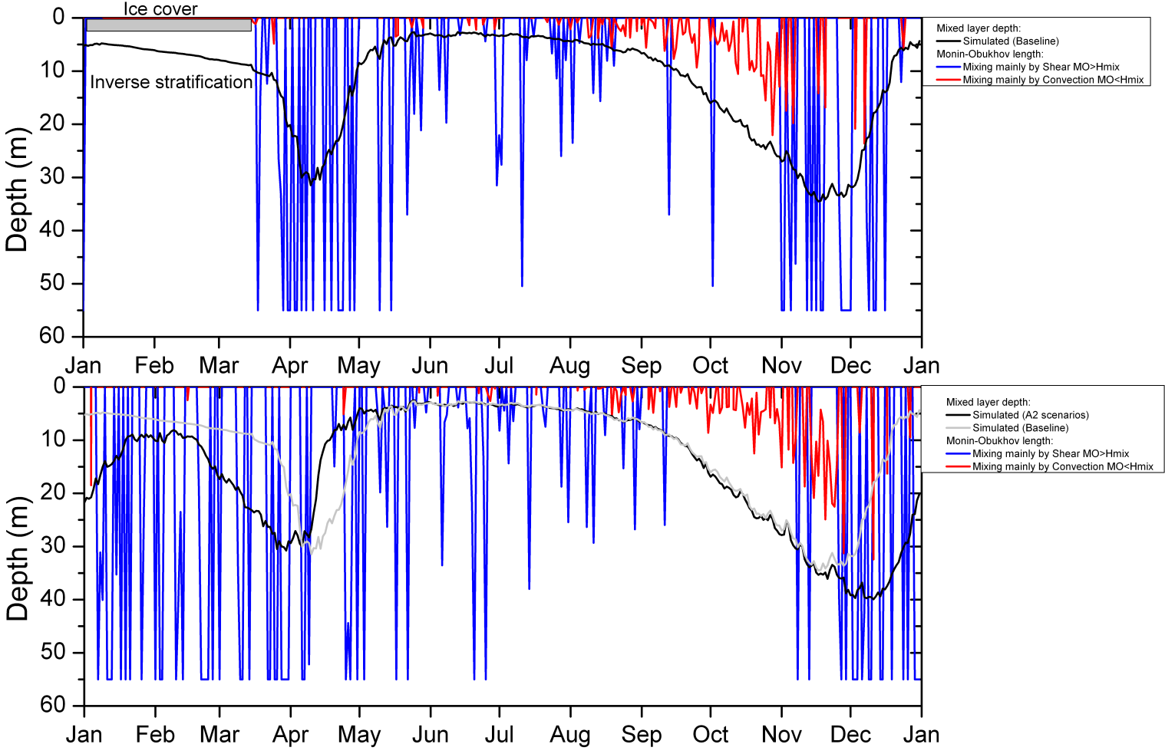
Sensitivity analysis on reservoir water temperature under future climate change
Nihar R. Samal¹, Donald Pierson², Y. , M. S. Zion², Klaus D. Joehnk³, E. M. Owens⁴, E. Schneiderman²
1 Earth System Research Center, University of New Hampshire, Durham, USA
2 Bureau of Water Supply, New York City Department of Environmental Protection
3 CSIRO Land and Water, Black Mountain, Canberra ACT 2601, Australia
4 Upstate Freshwater Institute, Syracuse, USA, Contact: nihar.samal@unh.edu
INTRODUCTION & OBJECTIVES:
The potential impact of climate change on lakes and reservoirs will be strongly influenced by changes in thermal stratification and mixing. However, systematic investigation of the effects of climate change on reservoir hydrodynamics are not common.
In this study we perform a sensitivity analysis on reservoir water temperature considering the meteorological and watershed effects under present day climate data (baseline conditions) and future simulations (change factor adjusted baseline conditions) .
Identifying the dominate physical processes affecting the reservoir water temperature can provide guidance for others simulating the effects of climate change on lake and reservoir hydrodynamics.
RESULTS:
IV. Baseline and Future (A2)Temperature distribution:
Watershed model (WSM) and Reservoir model (RESM) using baseline and A2 Scenarios meteorological forcing
V. Single future meteorology runs
DATA AND METHODS
Baseline meteorological forcing (1966-2004):
Cannonsville Reservoir in New York City Watersheds
Global Circulation Models: (Avg. of all three A2 FOR 2080-2100)
Canadian Center for Climate modeling and analysis (CGCM3)
European Center Hamburg Model (ECHAM)
Goddard Institute of Space Studies (GISS)
II. Meteorologic change sensitivities (Change factors created from baseline
Three Stage Analysis:
Watershed model (WSM) and Reservoir model (RESM) using baseline and A2 Scenarios meteorological forcing
A. WSM:met-A2, RESM:met-A2
B. WSM:met-Bas, RESM:met-A2
C. WSM:met-A2, RESM:met-Bas
II. Meteorologic change sensitivities (Change factors created
from baseline
Changed Factors: CF1= (95thP-mean), CF2= 2(95thP-mean) CF3= - (mean-5thP), CF4= - 2(mean-5thP)
III. Single future meteorology runs: Only A2 specific
meteorological parameter is changed in each run while others are baseline
CONCLUSIONS
The inter-annual variability in air temperature is influencing lake thermal characteristics more than the inter-annual variability in solar radiation.
The sensitivity of future simulations of reservoir thermal stratification to changes in air temperature is therefore, related to two different causes:
1) Climate sensitivity of air temperature. It is the change in air temperature embodied in the GCM data which is predicted with the high certainty, and which shows the greatest change relative to other meteorological drivers of the reservoir model .
2) Model sensitivity to changes in air temperature.
It appears that predictions of changing thermal stratification can be made with a high level of certainty that is similar to that now attributed to future scenarios of air temperature
Coupling of hydrothermal and hydrological model run
with climate data
III. Monin-Obukhov length:

