Slide 1
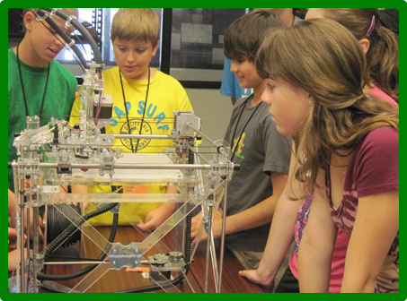
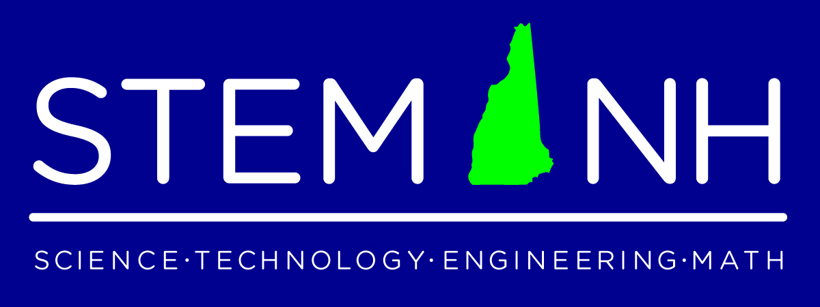
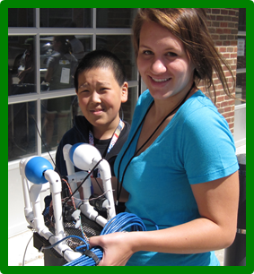
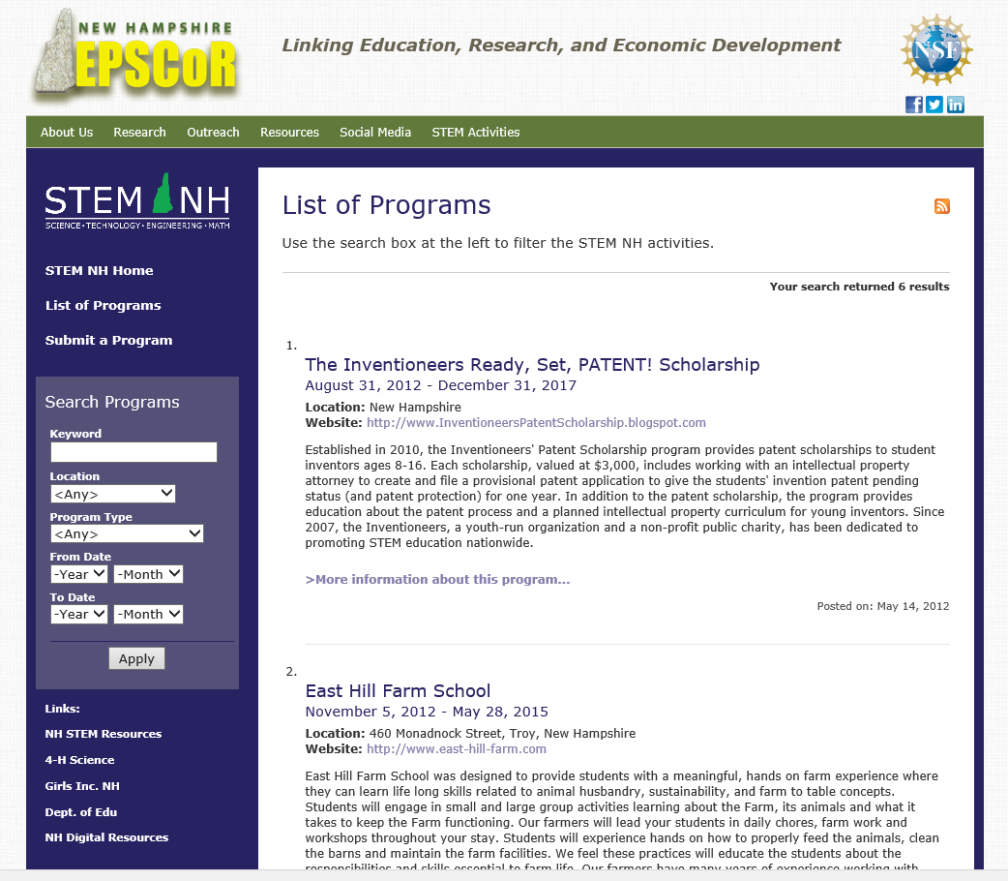
Seeking members and partners for the advancement of STEM education in NH
STEM NH is a statewide STEM education consortium
Established in 2010
Seeking to increase the understanding of STEM education and related careers for NH educators, students, research, business and community
Seeking to develop effective partnerships and resources for advancement of STEM education
Offering connections, coordination and facilitation with STEM education stakeholders statewide
Offers an online searchable database of STEM education opportunities.
Goals for STEM NH
Increase NH student participation and achievement in STEM
Increase number of NH teachers effective in providing STEM content that engages and excites learners Increase usage of effective instructional strategies that incorporate technology and engineering principles.
Increase understanding and awareness of STEM careers and career pathways, mentoring, and training.
Work with established groups and on-going efforts that support STEM and New Hampshire’s economic development.
NH STEM Programs Online Database
STEM NH Coalition – Leadership Council
Douglas Earick Research Assistant Professor Plymouth State University | Michelle Gregoire Program Manager – NH EPSCoR University of New Hampshire
Dr. Stephen Hale UNH Leitzel Center for STEM Education University of New Hampshire | Dr. Sally Jean Director of ScienceTeacher Preparation Keene State College
Linda Hammond Division of Online and Continuing Studies Plymouth State University | Julia Steed Mawson Extension Educator, Emerita University of New Hampshire, 4-H Youth Development
Dr. Michele Munson Superintendent Goshen-Lempster School District | Julie Sick Panus President – NH Technology Educators Association Plymouth Elementary School
Dr. George Tuthill Assoc. VP for Graduate Studies, Ret. Plymouth State University | Mark Wiley Extension Associate Professor; Dir. Marine Docents University of New Hampshire
http://nhepscor.org/stem

