Slide 1
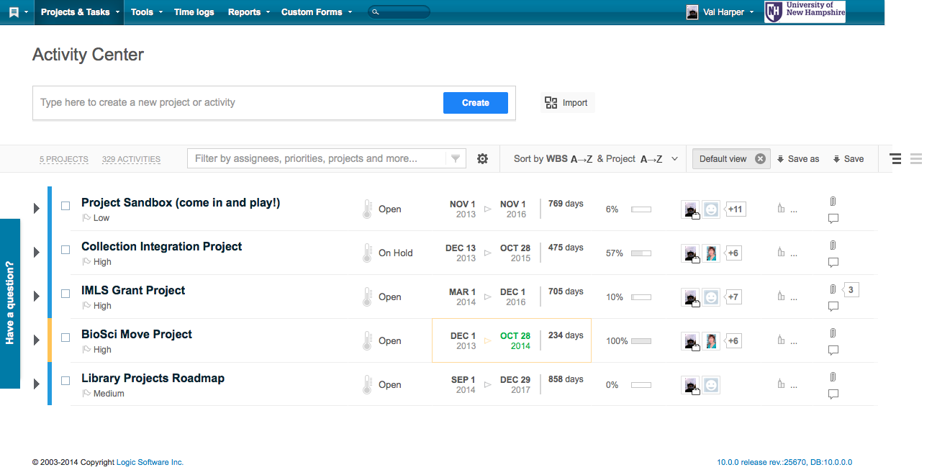
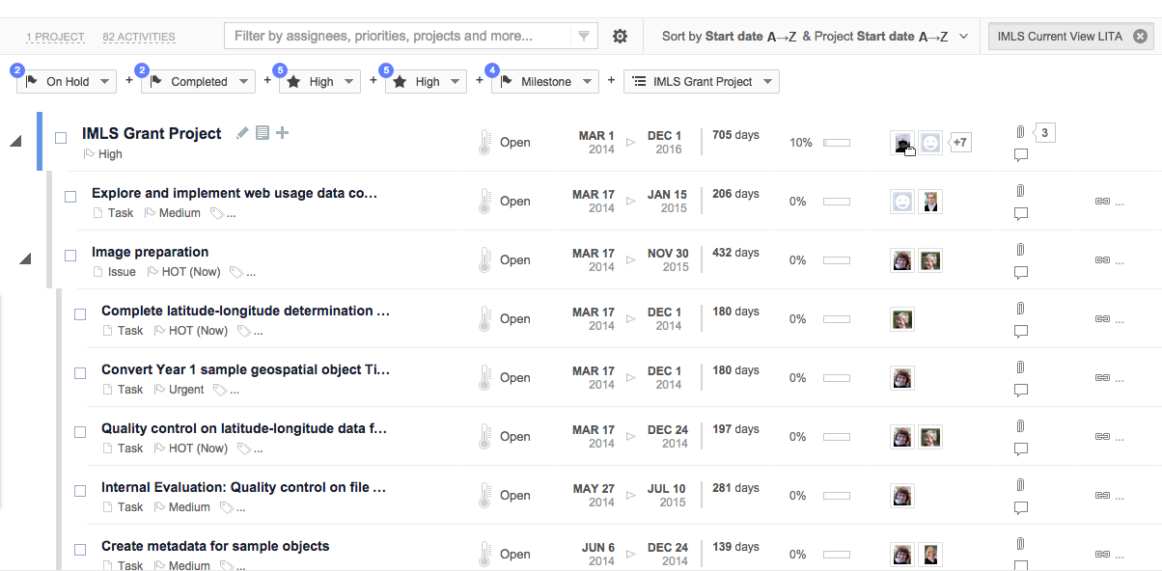
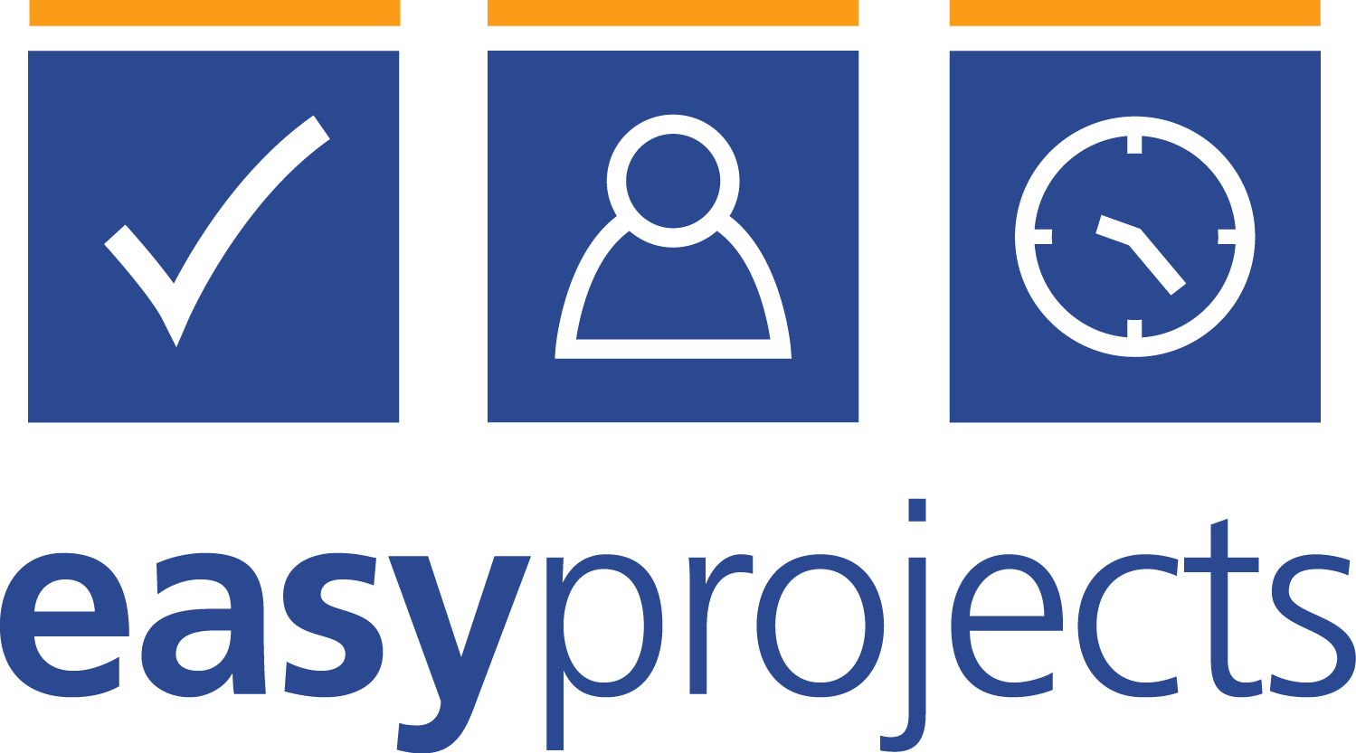

Rightsizing Project Management with EasyProjects
Val Harper, Faculty Fellow for Project Management
University Library, University of New Hampshire
Problem:
The University Library is using project management methods to implement new services and manage new initiatives. Librarians and staff expressed a clear desire to prevent “scope creep”, inadequate project handoff, increased workloads, and poor prioritizing. Two projects were just about to begin: a 3-year IMLS grant project to create a geospatial search interface to some of our digital collections, and the closing of a branch library and integration of its collections into the main library. Each project had its own project team.
Rightsizing for the library:
Chose not to use financial indicators (job role rates, expense tracking, etc.) – the grant budget was being handled by our campus business center, and the branch library move budget was handled by campus planners
Every task assigned to a team member, emphasizing responsibility, authority, and accountability
Allowed all project team members full editing privileges
Allowed a fair amount of extra time to tasks, recognizing that projects were on top of regularly assigned duties for many project team members
Chose not to input dependencies, critical paths, hourly time recording but to concentrate on task assignment and due dates for now. Team members picked up on risks and dependencies without tool
Needs and solution:
Project teams wanted a tool like Microsoft Project that they could access, add tasks to, view milestones, and check off completed tasks. Several packages were examined - EasyProjects was our choice.
Web-based, hosted service
Included guest seats for free, allowing the Library Dean or others to view project progress
Customizable – could add our own data fields, remove those we did not wish to use
Project team members could set up own “dashboards” for customized views
Less costly than similar applications -
Very easy to set up and use
Included data storage for group documents
Features included Gannt charts, calendars, milestones, reports, task assignments, weekly project updates by email
Support was excellent
Activity Center view – all projects
Outcomes:
One project team (IMLS grant) reviews the project site at every bi-weekly executive team meeting to chart progress, modify due dates, add tasks. Group members beginning to add own tasks to plan and mark off tasks accomplished. Faculty group members who delegated tasks to staff seemed more inclined to view the project in EasyProjects
Other team (branch library move) was more content to let the project manager maintain and report out at meetings
While timelines were flexible, project teams were more aware of deadlines and strove to meet them
Terms of the project plan were more closely followed – scope maintained, timelines realistic, risks and dependencies identified
Projects in forthcoming year will continue to use EasyProjects and make use of more of its potential
Work breakdown structure

