Slide 1

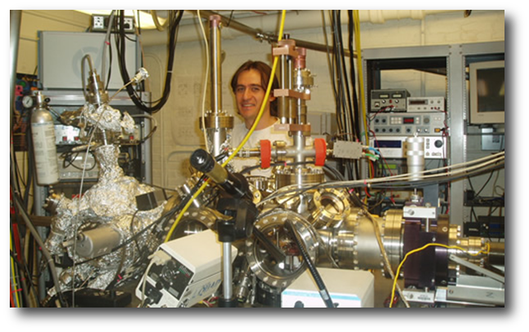
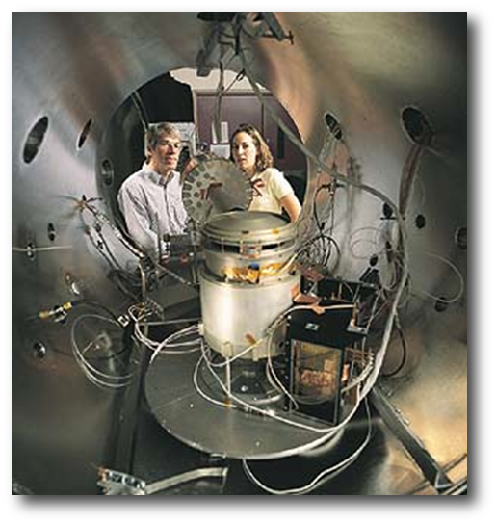
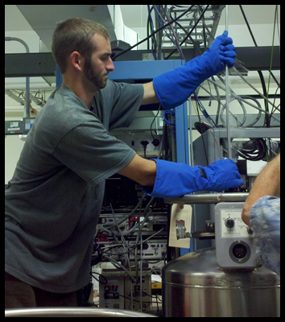
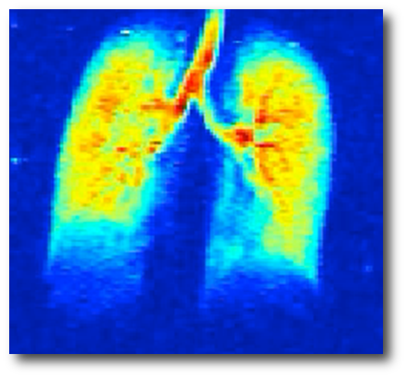
UNH Physics Department
Charles W. Smith
Space Science Center, Morse Hall, UNH, Durham, NH
The physics program at the University of New Hampshire, in collaboration with the Institute for the Study of Earth, Oceans and Space, offers a range of opportunities for students wishing to pursue advanced degrees in subfields of Physics. We have active programs in Condensed Matter, Nuclear and Particle Physics, Particle Theory, Medical Imaging, Space Physics and Physics Education. We have 37 faculty and approximately 60 graduate students. More information can be found at www.physics.unh.edu. The application deadline is February 1.
Selecting a graduate school is a serious decision. Before you decide, come visit us and see what we can offer.
Condensed Matter and Materials Science:
Investigation of the relationship between the structure of materials at atomic or molecular scales and their macroscopic properties.
Recent studies include:
Variable temperature Scanning
Tunneling Microscopy (STM)
Low-Energy Electron Microscopy
Directed Self-Assembly of Nanotemplates
Ion beam assisted deposition on thin films
Participation in the Material Science Program enhances the productivity through multi-department collaboration.
Space Physics and Astrophysics:
Development of ground-based, suborbital, and space-borne instruments for the study of complex, multi-dynamic, nonlinear processes.
Analysis of data and derivation of
theoretical descriptions using
analytical and numerical techniques.
Research spans solar, interplanetary,
ionospheric, magnetospheric, and interstellar dynamic.
Space physics is E&M, fluids, thermo, stat. mech., atomic and nuclear physics.
Nuclear and Particle Physics:
Two primary areas of study:
  Searches for physics beyond
  the standard model
  Structure of the nucleon and
  light nuclei
    How this can be understood in terms of the strong interaction and spin degrees of freedom
Mission goals map to:
  What is dark matter?
  Where is the missing spin of the nucleon?
High-Energy Particle Theory:
Explorations of beyond Standard Model physics:
Supersymmetry, string theory and quantum gravity
Applications to cosmology and astro-particle physics.
Undergraduate Physics Education:
Advancing methods for undergraduate physics education.
Working in concert with the Leitzel Center to further high school science education.
Our current work focuses on reform of the introductory physics for life science majors:
Creating and assessing tutorials on fluid dynamics including Bernoulli’s equation and viscosity
Investigating how to teach and assess model building
Medical Imaging and Optics:
UNH Physics faculty are developing
noninvasive methods of using
nuclear-polarized xenon gas to
image lung function.
Ventilation patterns reveal patency of large and small airways
Diffusion distance of gas atoms on millisecond timescales probe integrity of alveolar walls
Absorption of xenon in tissues and blood mimic oxygen transport
New spinoff program has applications in laser weapons for ballistic missile defense.
Applications for Graduate School:
Before deciding on a graduate school we strongly recommend that you visit several schools and meet the faculty. Explore the curriculum and learn as much as possible about the research and the opportunities.
Graduate education includes an extensive curriculum.
Ph.D. students are expected to pass a Comprehensive Examination based on undergraduate physics in the first two years and defend a dissertation of original research.
Applications to UNH are due February 1.

