Slide 1






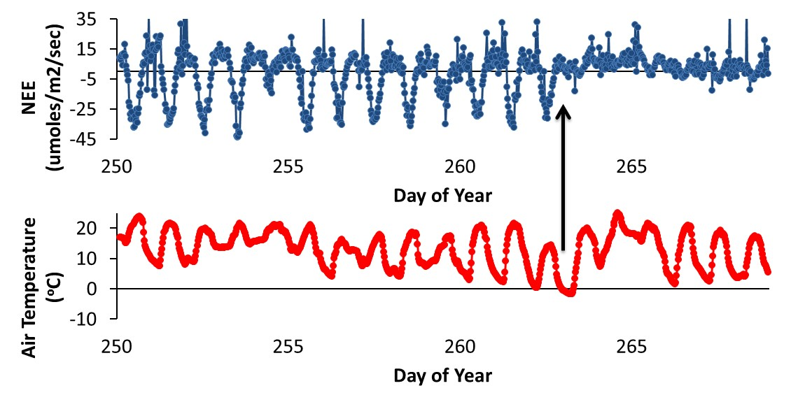
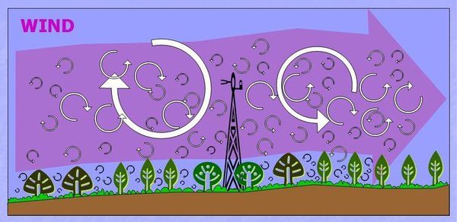
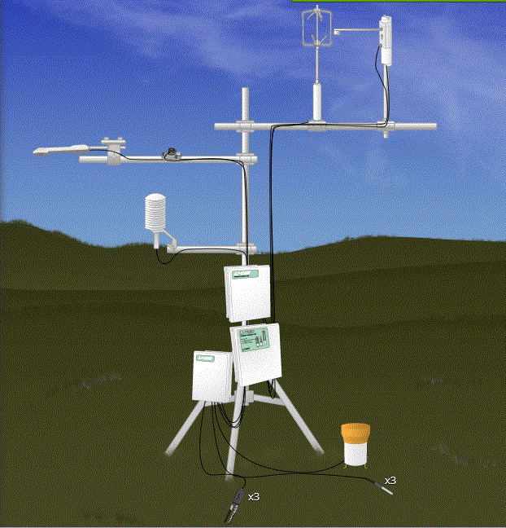


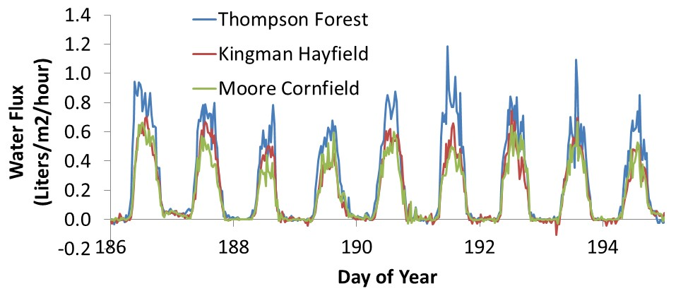
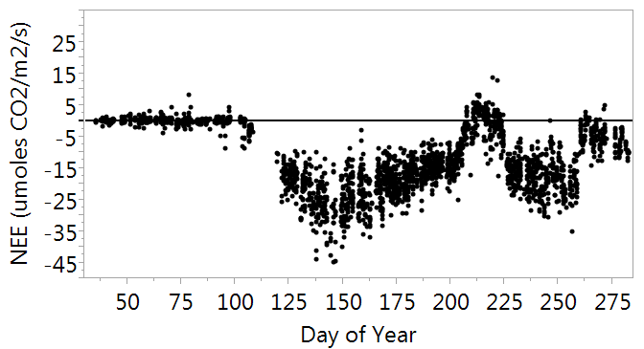


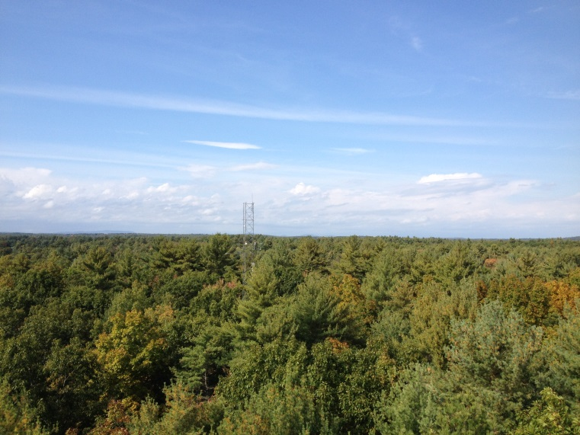
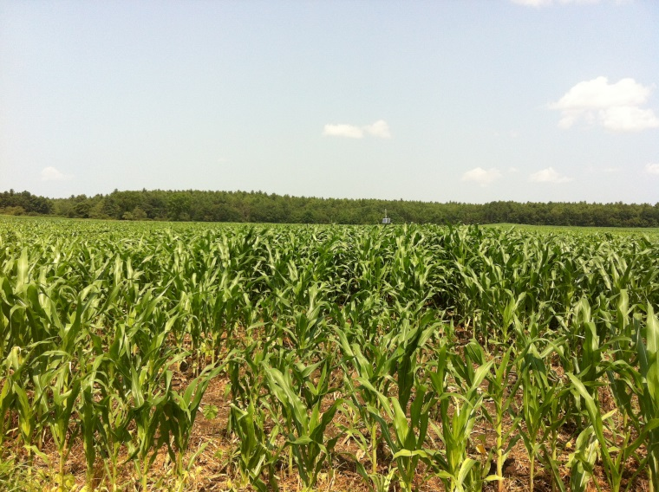
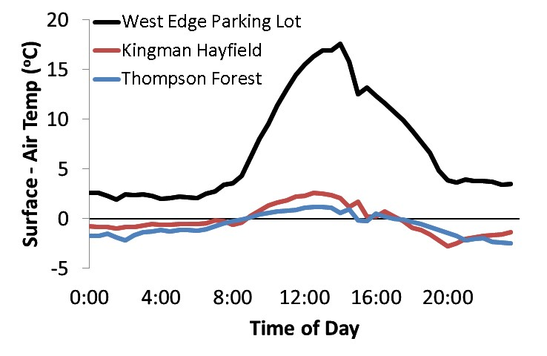
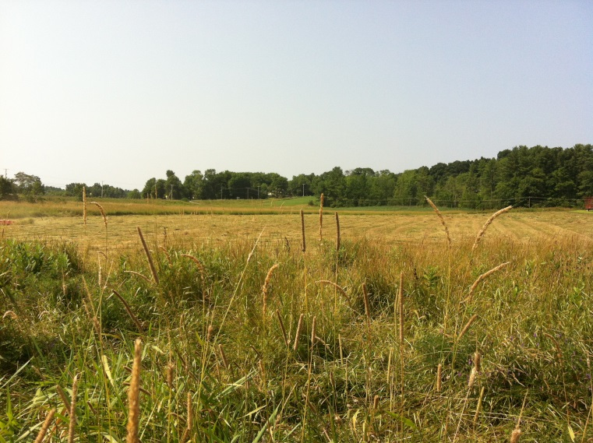
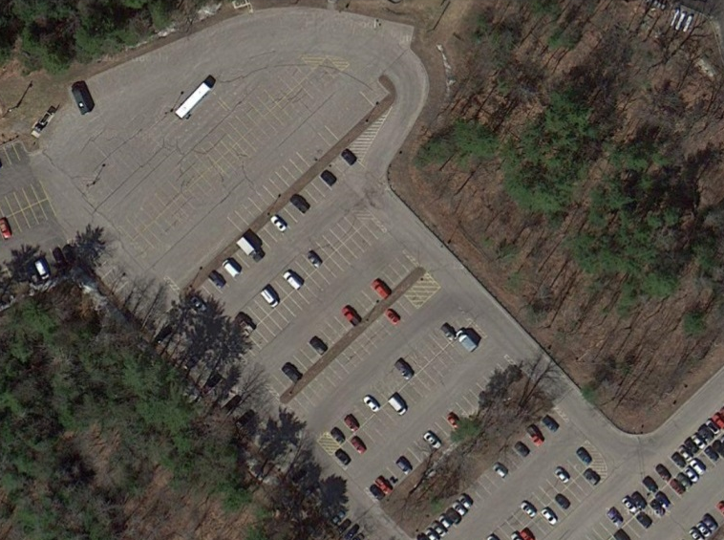
Land-Climate Interactions Across 4 Land Cover Types in New Hampshire
Andrew Ouimette, Lucie Lepine, Mary Martin, Scott Ollinger
Earth Systems Research Center, University of New Hampshire, Durham, NH 03824, USA
andrew.ouimette@unh.edu, lucie.lepine@unh.edu, mary.martin@unh.edu, scott.ollinger@unh.edu
Support for the NH EPSCoR Program is provided by the National Science Foundation's Research Infrastructure Improvement Award # EPS 1101245.
Abstract
How can we measure these interactions?
Carbon Fluxes over time
To better assess land-climate interactions in NH under future change scenarios, we are measuring greenhouse gas, energy, and radiation fluxes across 4 different land cover types that broadly represent the NH landscape: forest, field/pasture, corn/agriculture, residential/paved. In the simplest terms, these fluxes can be thought of as breathing (respiring CO₂ and other greenhouse gases), reflecting (albedo), and sweating (evapotranspiration. Here we present data from eddy covariance towers and biometeorological sensors across the 4 land cover types, highlighting the land-climate interactions of each land cover type and their effect on local and global climate.
Eddy flux systems use the eddy covariance method to measure covariance of H₂O and CO₂ concentrations and vertical wind speed in eddies over the land surface, and allow for measurements of greenhouse gas fluxes and sensible heat and latent heat (e.g. evaporative water loss).
A suite of meteorological, solar radiation, soil and canopy sensors will help interpret these flux data, and gapfill:
Incoming and outgoing short and long-wave radiation
Incoming photosynthetically-active radiation
Soil and air temperature and humidity probes
Rain gauge tipping bucket
Net ecosystem exchange (NEE) at Moore Cornfields during 2014. Negative values indicate carbon (C) uptake by the land surface (photosynthesis) while positive values indicate C release. An early season overnight frost event (day 263 or Sept 20th) killed the corn shutting down C uptake for the year. (Air Temperature shown in red, CO₂ flux in blue)
Land-Climate Interactions
Albedo
Latent and sensible heat
Gas exchange
Differences in “Sweating” rates across sites
Impacts of Land Management on Carbon Fluxes
“Reflectivity”
“Sweating”
“Breathing”
Liquid manure application
~
Greenhouse Gases
Mowing
Mowing
~
~
~
~
~
Longwave
Radiation
Eddy Flux Tower Sites
Comparison evapotranspiration rates of the 3 vegetated ecosystems during early summer. The Thompson Farm mixed forest site has the highest water vapor flux rates presumably due to the larger leaf area index and deeper rooting depth of the forest stand. Not shown is West Edge Parking Lot where evapotranspiration rates are nearly zero.
Net ecosystem exchange (NEE) at Kingman Hayfield during 2014. Negative values indicate carbon (C) uptake by the land surface (photosynthesis) while positive values indicate C release. Data shown are only for daytime. Mowing resulted in a decrease of C uptake by the land surface while fertilization was coincident with an increase in C uptake.
Thompson Forest, Durham, NH
Moore Cornfield, Durham, NH
Urban Heat Island
Future Directions
Design and apply data filters to clean up data including:
  1) logical filters to exclude values that are outside of the range of values that are reasonable,
  2) ustar filtering to remove data when wind conditions are inadequate to create sufficient to meet method assumptions,
  3) footprint filtering to remove data that represent land area outside of the land cover type of interest.
Gapfill missing values and provide annual radiation, energy, and greenhouse gas flux estimates across the 4 land cover types.
Partition net ecosystem exchange (NEE) into gross primary production (GPP) and ecosystem respiration (Re).
Determine the drivers of radition, energy, and carbon fluxes across the 4 land cover types using supporting meterological and biometric data.
Compare the climate forcing of the 4 different landcover types under present climate to derive a climate forcing for the state of New Hampshire.
Use future scenarios to estimate future climate forcing of New Hampshire under various future land use scenarios
Albedo is the ratio of incoming to reflected shortwave solar energy, with values ranging between 1 (100% reflectivity) and 0 (100% absorbance).
The eddy flux systems and data they capture will also provide opportunities for undergraduate and graduate research projects, as well as middle and high school science and technology projects and internships.
Kingman Hayfield, Madbury, NH
West Edge Parking Lot, Durham, NH
Data derived from the eddy flux systems have direct relevance to the EPSCoR Ecosystems & Society project, as they will be used not only by terrestrial and hydrologic modeling groups, but also to assess climate and future land-use scenarios. By understanding how each component of the landscape contributes to the surface energy budget, we will be better able to estimate climate forcing under various land-use scenarios. This knowledge will help inform decisions about future land use.
Comparison of the difference between land surface temperature and air temperature for Kingman Hayfield, Thompson Forest, and West Edge parking lot during a typical July day. The inability of non-vegetated surfaces to “sweat” or evapo-transpire results in warmer surface temperatures (urban heat island effect) and the release of proportionally more energy through sensible heat loss.

