Slide 1
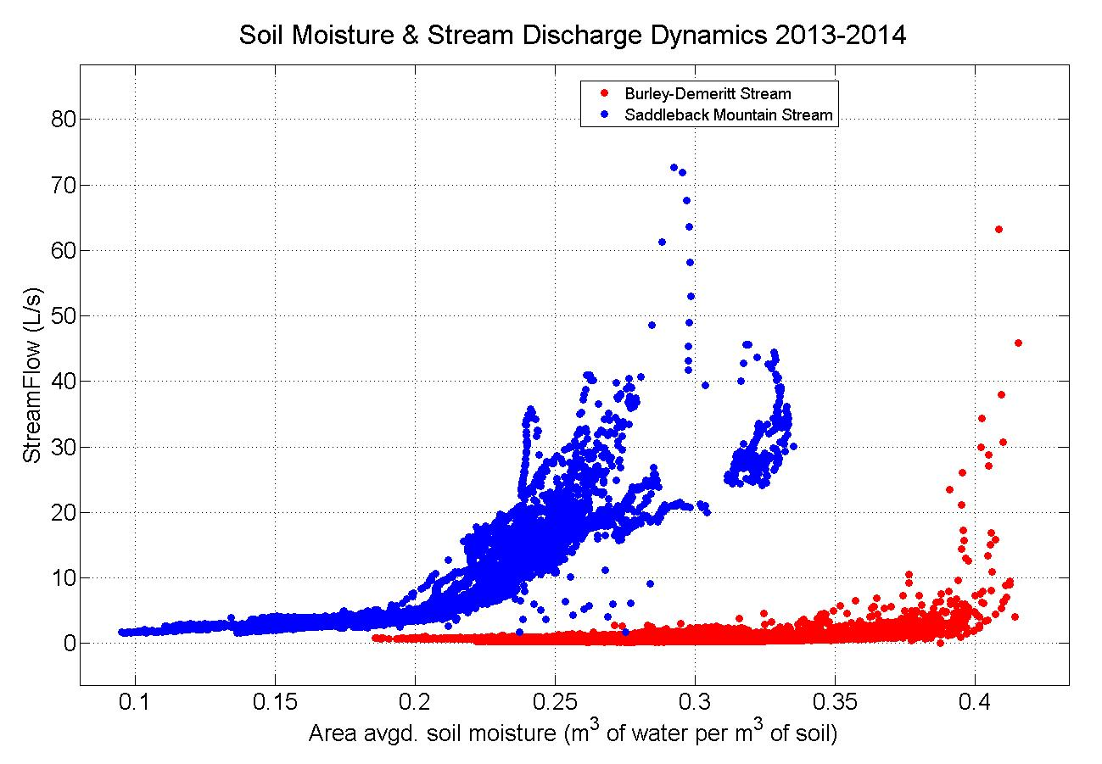
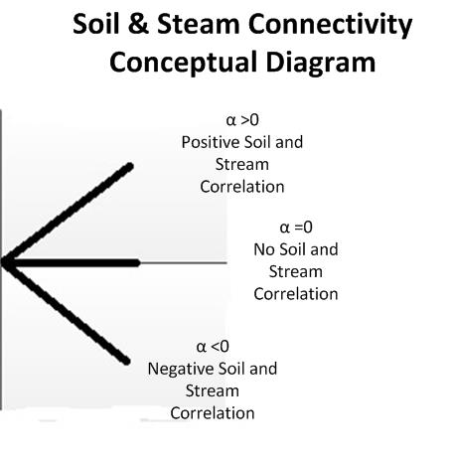
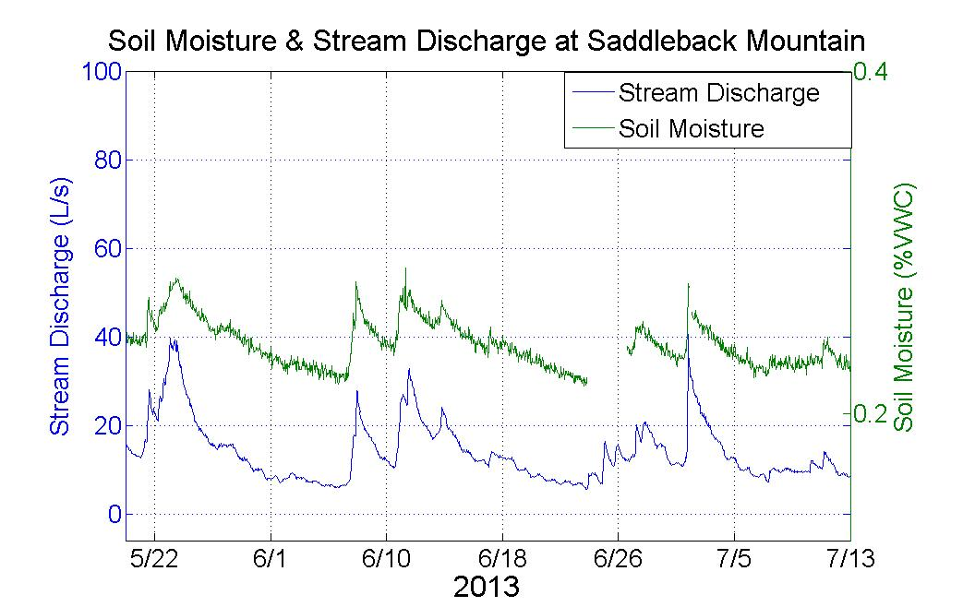
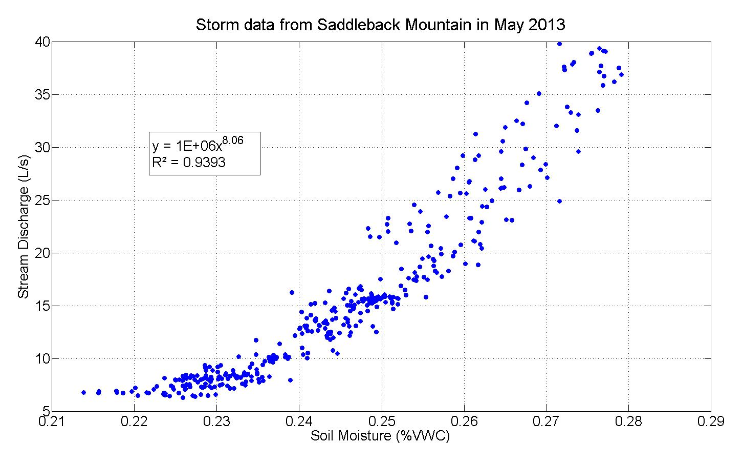
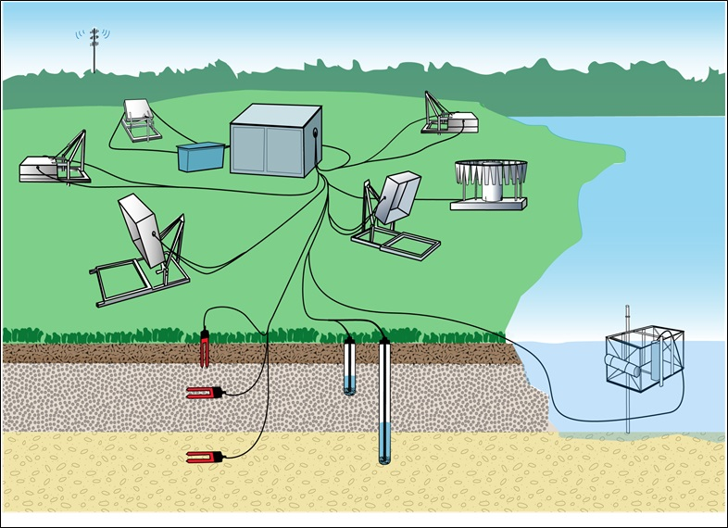

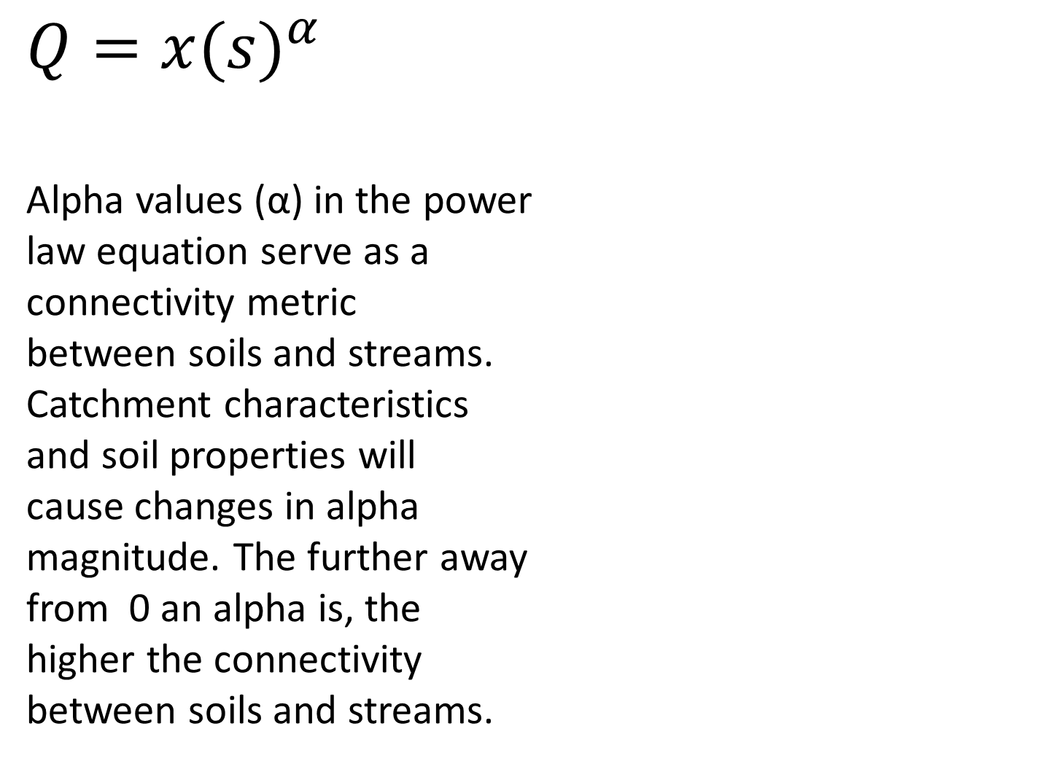
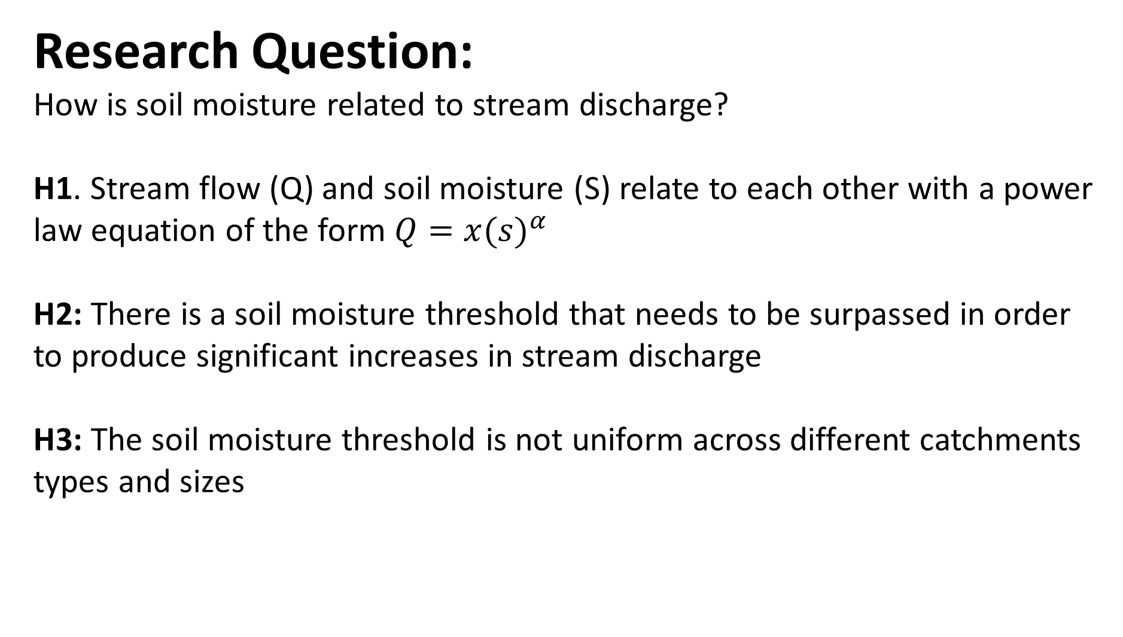
The Effect of Soil Moisture Dynamics on Stream Discharge
Brian T. Godbois¹, Gopal K. Mulukutla², William H. McDowell¹, Serita D. Frey¹.
¹ Department of Natural Resources and the Environment, University of New Hampshire
² Earth Systems Research Center, Institute for the Study of Earth, Oceans, and Space, University of New Hampshire
Background:
Soils are physically connected with steams, regulating flow and playing an important role in controlling how water inputs are stored and released.
An active connection is present during storm events when soils become saturated. When infiltration is at its maximum potential, excess water is diverted to streams, significantly increasing discharge. Catchment characteristics such as topography, location in the watershed, land use, and soil properties will influence the rate of infiltration.
Soil moisture is generally estimated based on precipitation and temperature, due to a lack of sensors deployed in the environment. The EPSCoR sensor network combines collocated in situ soil and stream sensors to quantify how soil properties influence water chemistry parameters.
Soil moisture dynamics and its relationship to catchment scale hydrology have so far been studied at daily or longer time scales. The examination of sub-daily data will allow us to quantify water flux from soils to streams and may play a key role in understanding solute transport dynamics.
$$Q=x{(s)}^{α}$$
Alpha values (α) in the power
law equation serve as a
connectivity metric
between soils and streams.
Catchment characteristics
and soil properties will
cause changes in alpha
magnitude. The further away
from 0 an alpha is, the
higher the connectivity
between soils and streams.
Research Question:
How is soil moisture related to stream discharge?
H1. Stream flow (Q) and soil moisture (S) relate to each other with a power law equation of the form $Q=x{(s)}^{α}$
H2: There is a soil moisture threshold that needs to be surpassed in order to produce significant increases in stream discharge
H3: The soil moisture threshold is not uniform across different catchments types and sizes
The soil moisture threshold varies between sites due to soil texture, soil porosity, and the vegetation present.
Connectivity between soils and streams changes across temporal scales. Seasonal variation in connectivity suggests that antecedent moisture conditions and vegetative water demand alter flow paths and may impact physical connectivity.
Next Steps:
Examination of connectivity metric (alpha) for seasonal variation, during baseflow, and during storm events with a distinction between the rising and falling limb of the hydrograph
Analyze data from five remaining sites
Analyze data using FDOM concentration as a proxy for dissolved organic carbon dynamics (DOC) to determine how soil moisture levels relate to stream DOC concentrations
Map By: Lucie Lepine
Conceptual Diagram of Coupled Terrestrial & Aquatic Sensor Network Design
Method:
To capture this coupled terrestrial and aquatic system response, we are utilizing data from the NHEPSCoR in situ soil and stream sensor network that is deployed across the state collecting data every hour.
Contact info:
brian.godbois@unh.edu

