Slide 1


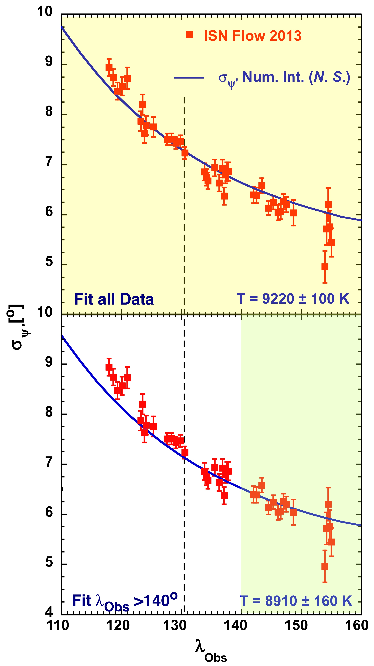
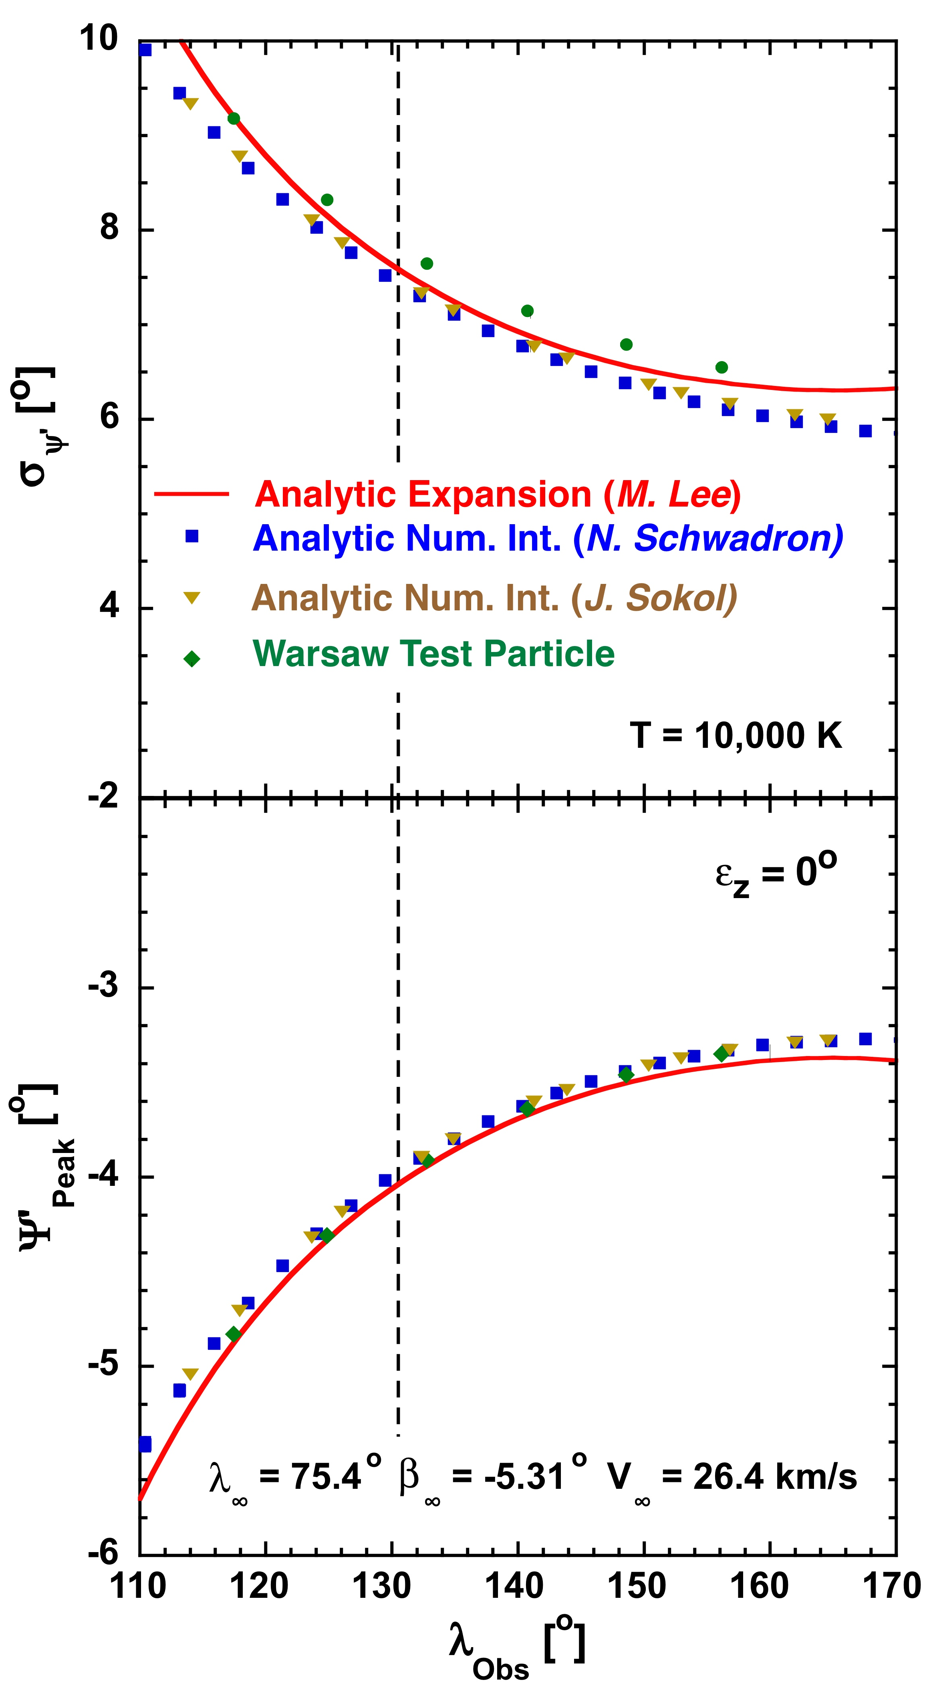
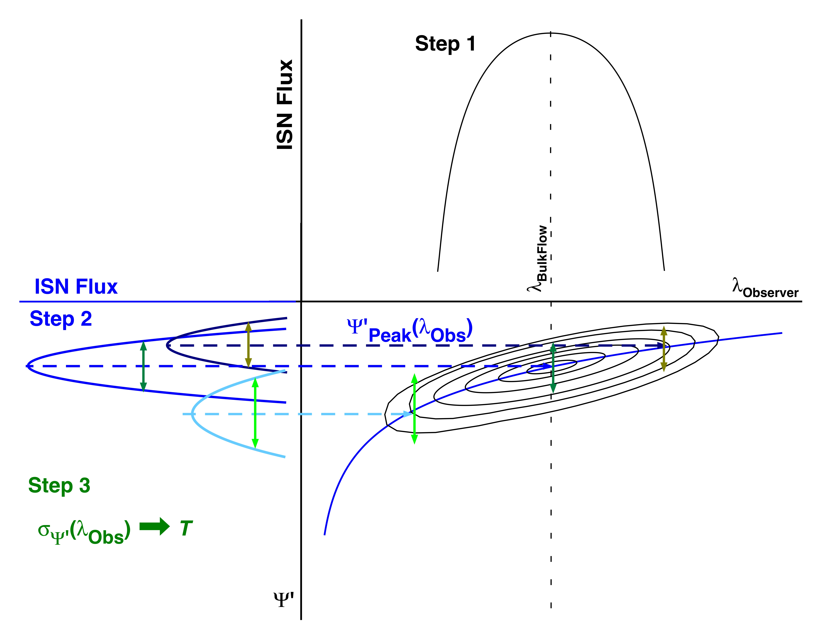
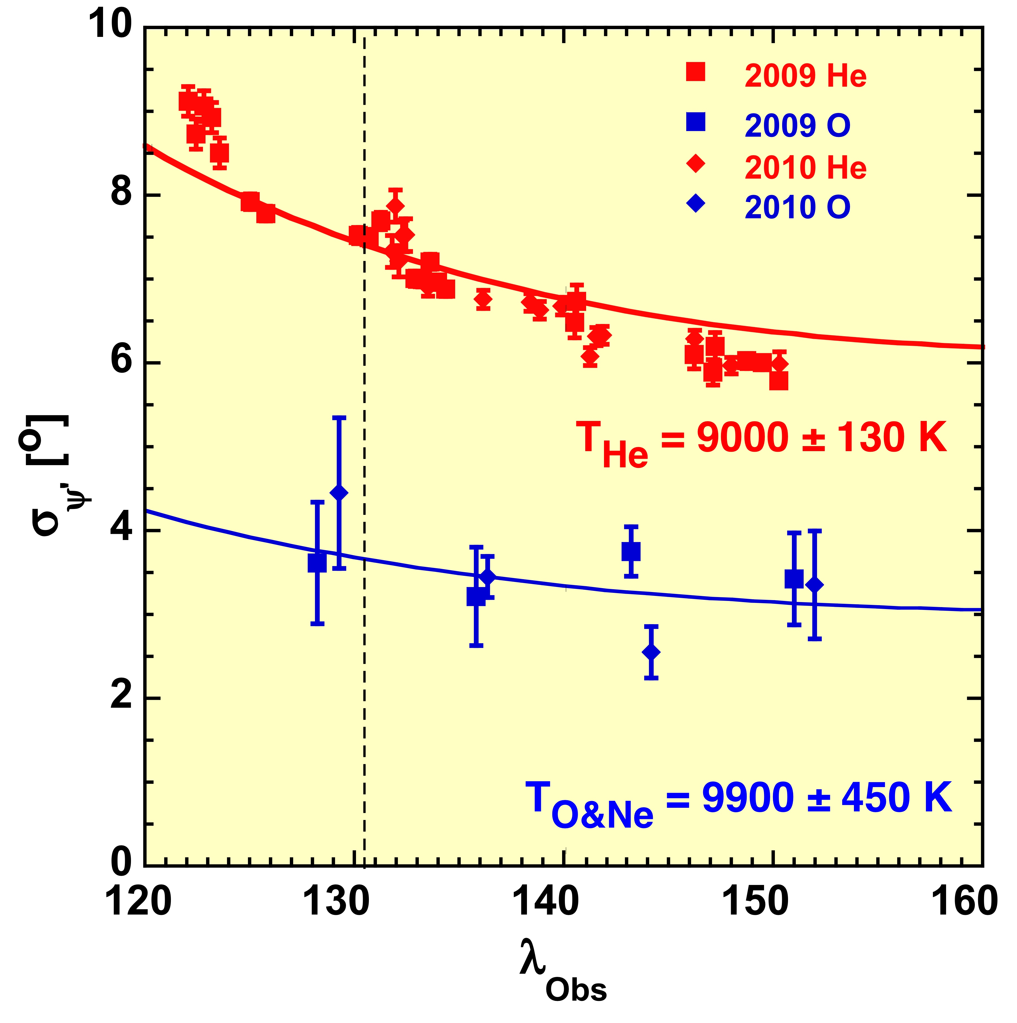
Local Interstellar Cloud Temperatures as Observed with IBEX
SH11C-4060
E. Möbius¹(eberhard.moebius@unh.edu), M. Bzowski², P.C. Frisch³, S.A. Fuselier⁴, D. Heirtzler¹, M.A. Kubiak²
H. Kucharek¹, M.A. Lee¹, T. Leonard¹, D.J. McComas^{4,5}, N.A. Schwadron¹, J. M. Sokół², P. Swaczyna², P. Wurz⁶
Supported by:
NASA Explorers
Polish Academy of Sciences
Swiss Nationalfond
PRODEX
¹Space Science Center & Department of Physics, University of New Hampshire, Durham, NH 03824
² Space Research Center of the Polish Academy of Sciences, Warsaw, Poland
³Department of Astronomy & Astrophysics, University of Chicago, Chicago, IL 60637
⁴Southwest Research Institute, San Antonio, TX 78249
⁵University of Texas at San Antonio, San Antonio, TX 78249
⁶Physikalisches Institut, Universität Bern, 3012 Bern, Switzerland
Introduction
Comparison of ISN Flow Models
Fit to Width of ISN Flow Distributions
Resulting Temperatures and Error Bars
The temperature of the interstellar neutral gas (ISN) that surrounds the heliosphere is coarsely known from astronomic observations and only integrated over the line-of-sight of the observations, with values ranging from <6000 K to >10,000 K [Frisch et al., 2014]. Therefore, a local measurement, probing the gas in the heliosphere is important. The first direct interstellar He observation with Ulysses GAS suggested a temperature of 6300±300 K [Witte, 2004]. Recent analyses of the IBEX observations [Möbius et al., 2014; McComas et al., 2014] as well as re-analyses of the GAS observations [Bzowski et al., 2014; Wood et al., 2014] suggest substantially higher values.
To test the validity of the temperature analysis, we compared 4 available ISN Flow Models for the IBEX Analysis:
• Analytic Expansion Model [Lee et al., 2012]: Analytic expression of
ISN trajectories, flow distribution is expanded to 2nd order
• Full Analytic Model [Schwadron et al. 2013]: Analytic expression of
ISN trajectories, flow distribution integrated numerically
• Full Analytic Model [J. Sokół, Warsaw, priv. comm.]: Similar as above
• Warsaw Test Particle Model [Bzowski et al., 2012]: Grid-based numerical
solution of ISN trajectories and their integration
Note: All Models assume a Maxwellian Distribution at infinity.
• Typically, 5 time periods per orbit (arc) that satisfy ISN Good Times
criteria [Möbius et al., 2012] are fitted to a Gaussian.
• Using the width σ_{ψ’}(λ_{Obs}) and fit error ∆σ_{ψ’}, a χ²-fit for T is performed.
Consistency over the years and over ranges of λ_{Obs} is tested.
• Systematic Uncertainties for T-Determination
- IBEX-Lo Data Flow suppression: ∆T_{He} ≤2.5% (N/A after 2012)
- Influence of non-uniform Background: a few % for >10% BG
→ Eliminated for ISN Good Times
- Off-pointing uncertainty for individual Collimator quadrants
→ From Cross-Calibration observations: FoV widened by ≤0.23º
→ T_{He} increased by ≤1.2%, T_{O&Ne} by ≤6%
- Potential deflection of ISN Trajectories by the Earth
Maximum at 15 R_{E}: ±0.07º → Convolution of FoV σ = 0.06º
→ T_{He} increased by ≤0.35%, T_{O&Ne} by ≤4.5%
• Error Hierarchy
- For a fixed V_{ISN∞} the Errors from the χ²-Fit to σ are applicable
- For a given λ_{ISN∞} the Error in V_{ISN∞}(λ_{ISN∞}) must be added
- Overall, the Bounding Range in λ_{ISN∞} enters as correlated error
Shown are He data and χ²-fit results for IBEX observations in 2013 (ε_{z} ≈ 0º and after mode change in 2012 that eliminated data transfer effects.)
Resulting T is shown for
V_{ISM∞} = 26 km/s
Based on fit to Model by N. Schwadron.
Top: χ²-fit performed for the entire range in λ_{Obs} used for the He ISN Flow analysis.
It is found that a χ²-fit only to observations for 120º < λ_{Obs} < 140º, i.e. symmetrical about the bulk flow, where the flow is defined most accurately, returns ≈3% higher T. Therefore, also the range >140º was used separately.
See Table 1 for full results!
Bottom: χ²-fit performed for the range in λ_{Obs} >140º to test how the T determination varies with λ_{Obs}.
For all years, the χ²-fit to this selection returns a consistently lower T by >1 σ.
Shown are the ISN flow peak ψ’(λ_{Obs}) (bottom) and width σ’(λ_{Obs}) (top) in Latitude in the observer frame (‘ system moving with the Earth). The models are compared for a generic ISN Parameter Set:
λ_{ISN∞} = 75.4º, β_{ISN∞} = -5.31º,
V_{ISN∞} = 26.4 km/s, T = 10,000 K
and with the IBEX spin axis exactly in the ecliptic: ε_{z} = 0º
For ψ’(λ_{Obs}) all 4 models agree over the longitude range used for analysis (115º – 160º, eliminating ISN H [Schwadron et al., 2013] and the He Warm Breeze [Kubiak et al., 2014]), except the Analytic Expansion Model is slightly more negative by 0.1-0.15º, likely due to neglecting ionization effects in the current rendition.
For σ_{ψ’}(λ_{Obs}) the Full Analytic Models [N. Schwadron & J. Sokół] agree exactly, while the Analytic Expansion Model yields a slightly wider σ at the bulk flow location
(λ = 131º) of ≈0.1º and deviates further away, likely due to neglecting ionization effects and higher order terms.
The Warsaw Test Particle Model results in a wider σ by ≈0.3º in the simulations available for comparison.
After update it agrees with the J. Sokół model <1%.
Note: Wider σ (by +0.3º or +4%) in a Model results in a lower T derived from data by -8%.
Table 2: Temperatures and Error Bars
Color coded map view of the ISN He flow distribution (center) and cut in latitude (right) through the ISN flow maximum. The angular flow distribution represents a local Mach Cone, whose angular width σ’_{M} in the observer frame is determined by the thermal speed V_{Th} of the ISN and the flow speed of the observed part of the distribution at 1 AU V₀ (left).
3-Step Extraction of ISN Flow Parameters
Conclusions
• ISN Temperature Determined from IBEX Observations (2009-2014)
- All Models Agree in Width of ISN Flow (And thus T)
- From width of flow distribution over longitude range
- χ²-Fit to Full Analytical Model [Schwadron et al., 2013]
• Consistent Small Difference Over Observer Longitude
- May point to non-thermal ISN distribution
Note: Maxwellian Distribution assumed in all Models
- ISN is likely not in thermal equilibrium
Interstellar plasma is driven and couples to Neutrals
→ κ-Distribution? [e.g. Livadiotis & McComas, 2013]
• Study of Systematic Error Sources
- Sensor pointing uncertainty & Earth deflection estimated → Added
- Error hierarchy: Fit Error + V_{ISM∞}(λ_{ISM∞}) Error + Range in λ_{ISM∞}
• T_{O&Ne} and T_{He} Agree Within 1 σ
- Including known potential systematic errors
- But T_{O&Ne} value slightly higher
We make use of the tight coupling of the ISN Parameters, Inflow Speed V_{ISN∞}(λ_{ISN∞}), Inflow Latitude β_{ISN∞}(λ_{ISN∞}), and Temperature T(λ_{ISN∞}) as a function of Inflow Longitude λ_{ISN∞}, caused by the IBEX observation geometry [Möbius et al., 2012; McComas et al., 2012] and obtain the parameters in a step-by step approach:
Table 1: He Temperatures for 4 Years
In the Analytic Expansion Model, and thus to very accuracy in all models, the temperature T enters the relation σ_{ψ’}(λ_{Obs}) only as a multiplicative factor. The quantity D_{ψ} is derived from the ISN distribution by expansion about the bulk flow location as:
Open Questions
• Consistently, T derived from ±10º around the ISN Bulk Flow (131º) is somewhat higher (≈2%) than from all ISN Good Times data.
• Trend of σ with λ_{Obs}! We adopt T from all data, add Systematic Error.
• What is the reason behind the systematic difference in resulting
temperature, when selecting portions of the ISN Flow Distribution
farther away from the ISN Bulk Flow? → Non-Thermal Effects?
• Can we tighten the uncertainties to test how closely
the He and O&Ne temperatures are isothermal or not?
•
Here t and v_{ISM} are the temperature ISN flow speed normalized by the speed of the Earth [Lee et al., 2012], λ is the observer longitude, λ₀ the location of the bulk ISN flow, and β the inflow latitude.
σ width of O&Ne together with He ISN distributions for 2009 & 2010, when O&Ne available with good counting statistics.
χ²-fit curves similar as above are also shown.
σ_{O&Ne} much smaller than σ_{He}
M_{O&Ne} = 16.85 based on Ne/O at 1 AU [Park et al., 2014]
→ susceptible to systematics
The O&Ne error bars are much larger due to substantially lower (>100x) counting statistics.
T_{O&Ne} somewhat higher than T_{He}, but within 10%
→ Systematic Errors?
References
Schematic iso-contour representation in observer longitude λ_{Obs} and latitude ψ’ of the ISN Flow Distribution observed by IBEX, along with cuts in λ_{Obs} (top) and ψ’ (left). These cuts are used to obtain 1) V_{ISN∞}(λ_{ISN∞}), 2) λ_{ISN∞} & β_{ISN∞}, and 3) T.
• D_{ψ} is related to σ_{ψ} as:
Bzowski, M. et al. 2012, ApJ Supp. 198:12, doi:10.1088/0067-0049/198/2/12
Bzowski, M., et al. 2014, A&A 569, A8
Frisch, P.C., et al. 2014, ApJ, subm.
Kubiak, M.A., et al. 2014, ApJ Supp., 213:29
Lee, M. A., et al. 2012, ApJ Supp. 198:10, doi:10.1088/0067-0049/198/2/10
Leonard, T., et al. 2014, ApJ, submitted
Livadiotis, G. & D.J. McComas 2013, Space Sci. Rev., 175:183–214
McComas, D.J., et al. 2012, Science, 336, 1291
McComas, D.J., et al., 2014, ApJ, subm.
Möbius, E., et al. 2012, ApJ Supp. 198:11, doi:10.1088/0067-0049/198/2/11
Möbius, E., et al. 2014, Proc. of the 13th Internat. Astrophys. Conf., in press
Park, J., et al., 2014, ApJ, 795:97
Schwadron, N.A., et al. 2013, ApJ, 775:86, doi:10.1088/0004-637X/775/2/86
Witte, M. 2004, A&A 426, 835
Wood, B., H. Mueller, M. Witte 2014, ApJ, subm.
• To obtain the width in the observer frame σ needs to undergo a
Galilean Transformation: v and v’ are
the normalized ISN speeds of the observed portion of the distribution.
We follow a 3-step approach developed with an analytic model [Lee et al., 2012] that is also applicable to numerical models of the ISN [e.g. Schwadron et al., 2013]: → Parameter dependencies directly visible
• 1) ISN Flow Maximum Longitude → V_{ISN∞}(λ_{ISN∞}) [Möbius et al. 2014]
• 2) Peak in Latitude over Observer Longitude → λ_{ISN∞} & β_{ISN∞}
[Leonard et al., 2014; see also Poster SH11C-4058]
• 3) Width of ISN Distribution in Latitude σ_{ψ’} → T, for known V_{ISN∞}
Small Error Bar of T(V_{ISN∞}): Overall Error incl. ∆V_{ISN∞} & ∆λ_{ISN∞}
• Except for the proportionality σ_{ψ}² ~ T there is no further dependence
on T in terms that depend also on λ.
Also, σ_{ψ’} does not depend on ε_{z} (All curves are identical {Not shown}).
Thus, the any model, simulated for an ISN Parameter Set can be used and then scaled for T, when performing a χ²-fit to IBEX data.
→ Here we use the Full Analytical Model [N. Schwadron]

