Slide 1

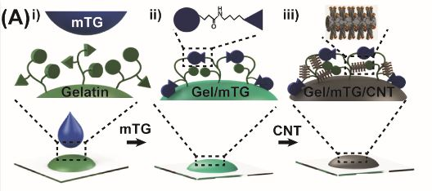
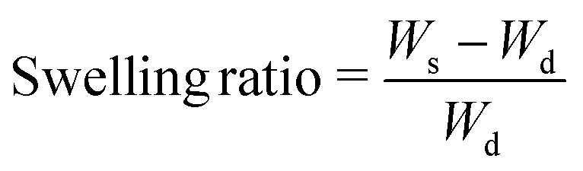
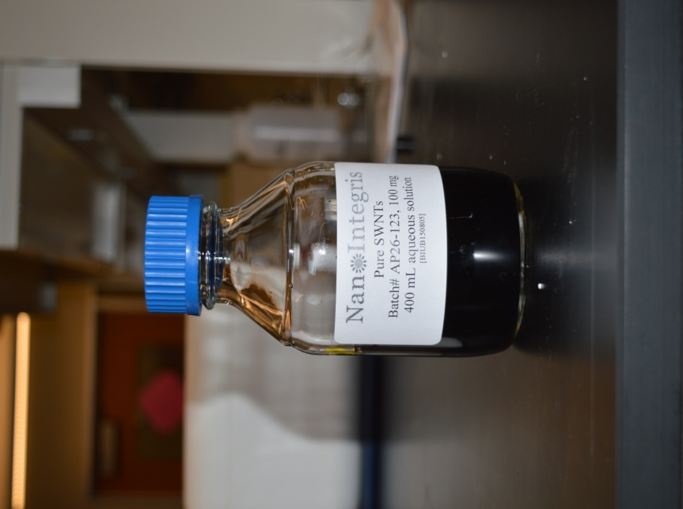
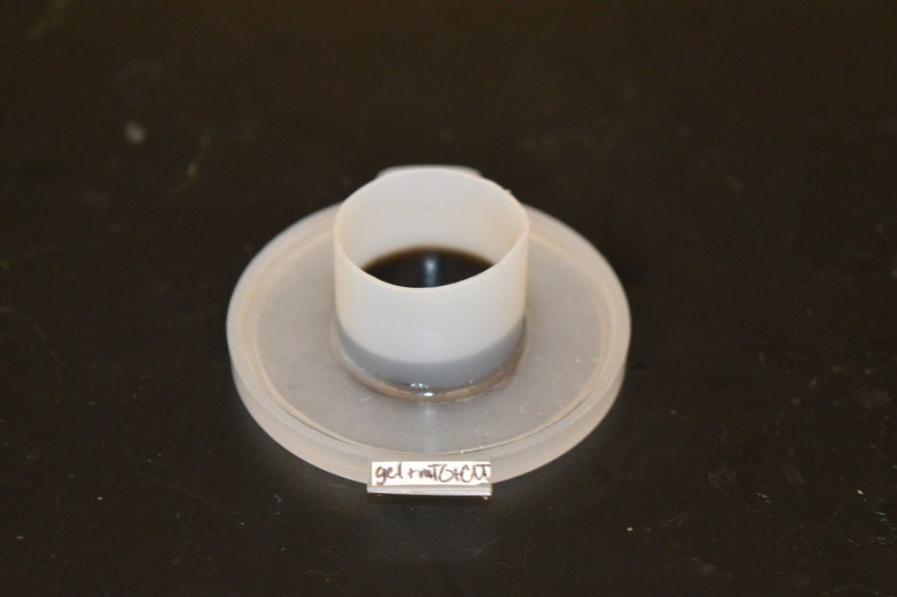
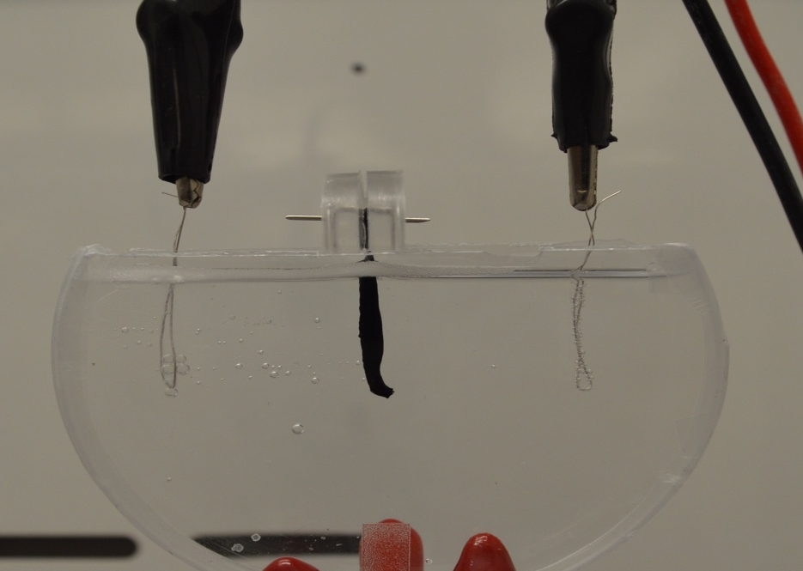
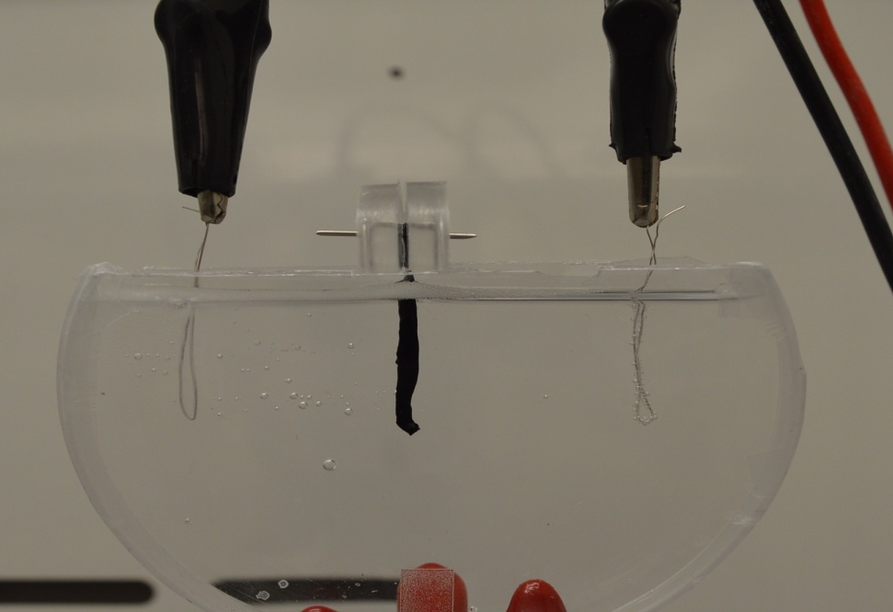
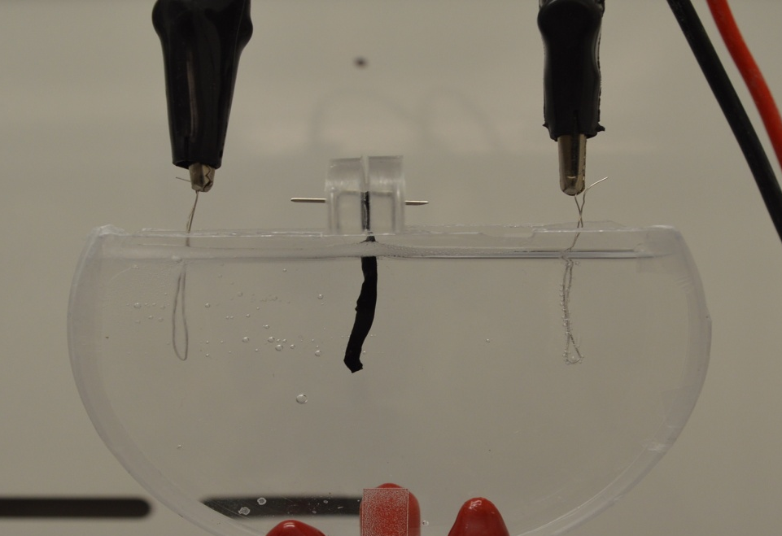
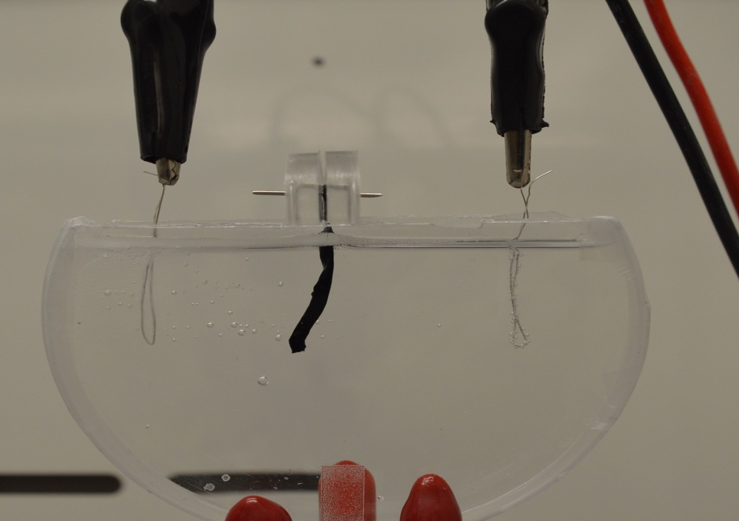
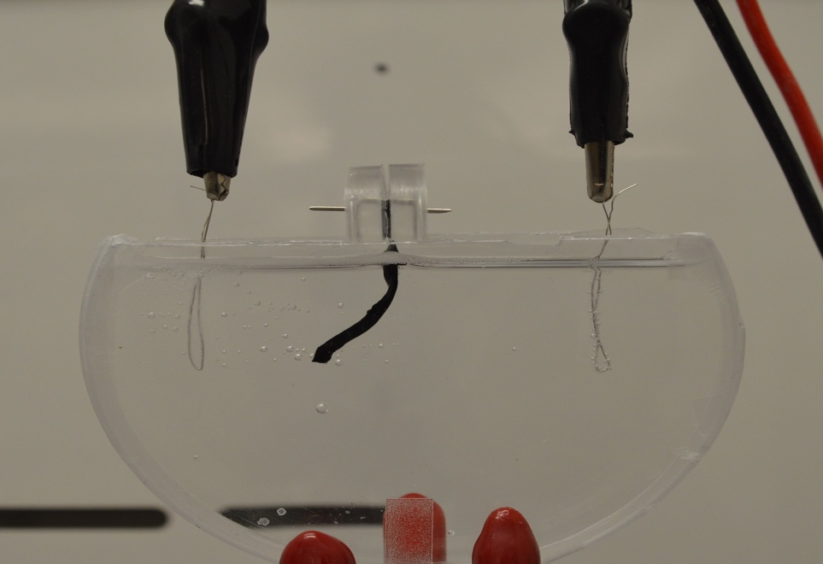
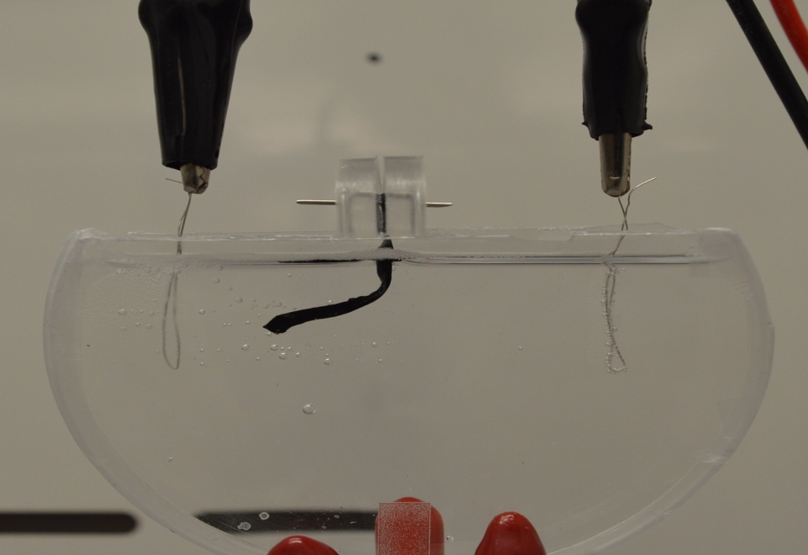
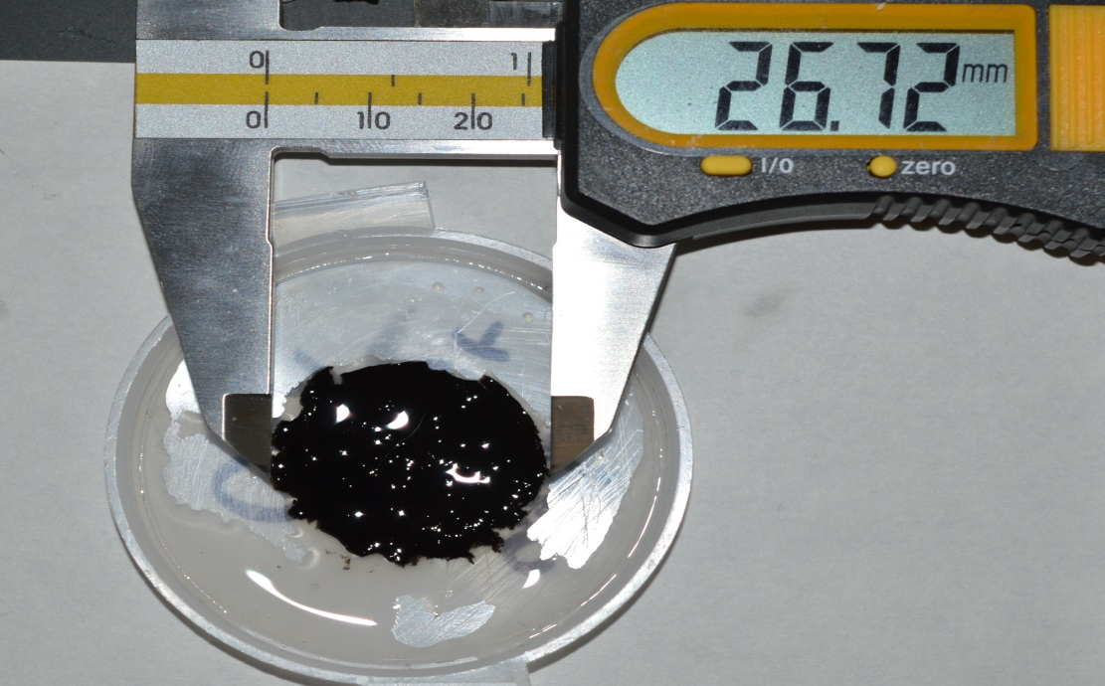
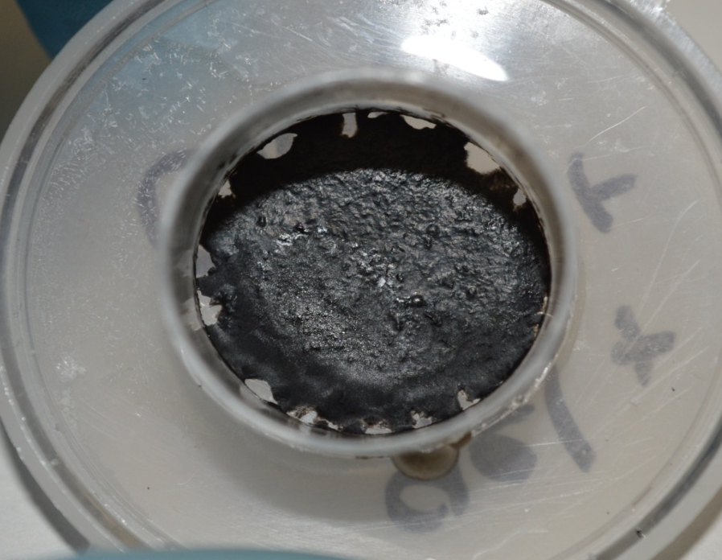
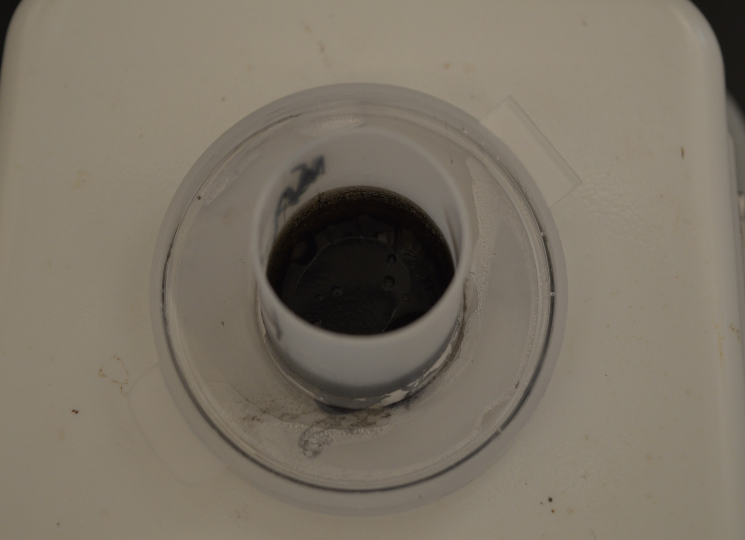
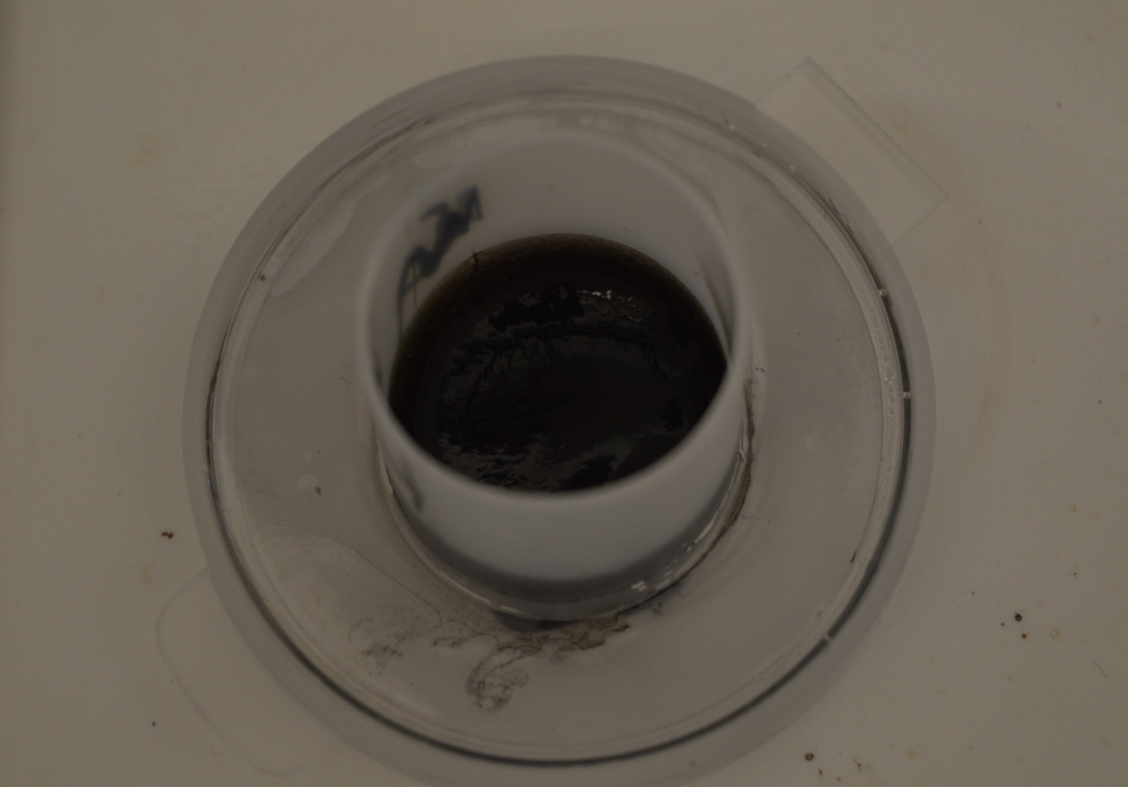
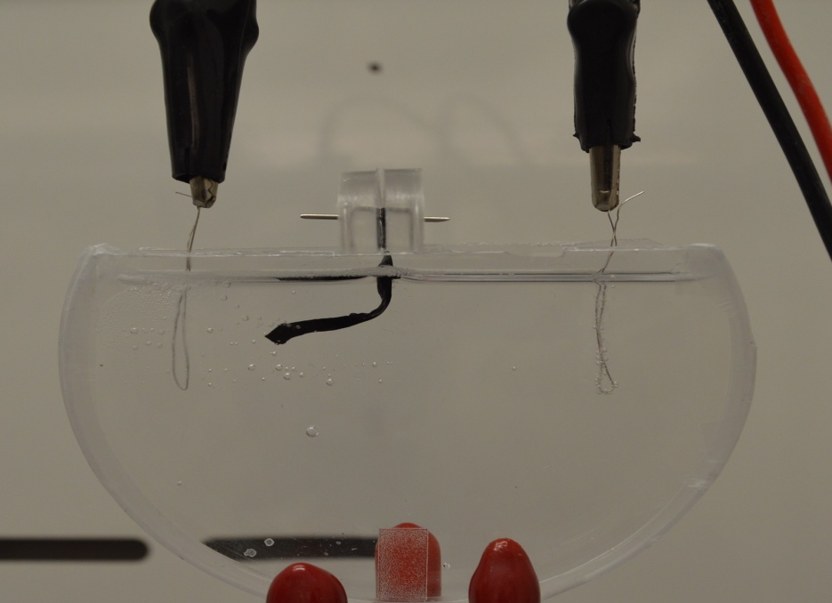
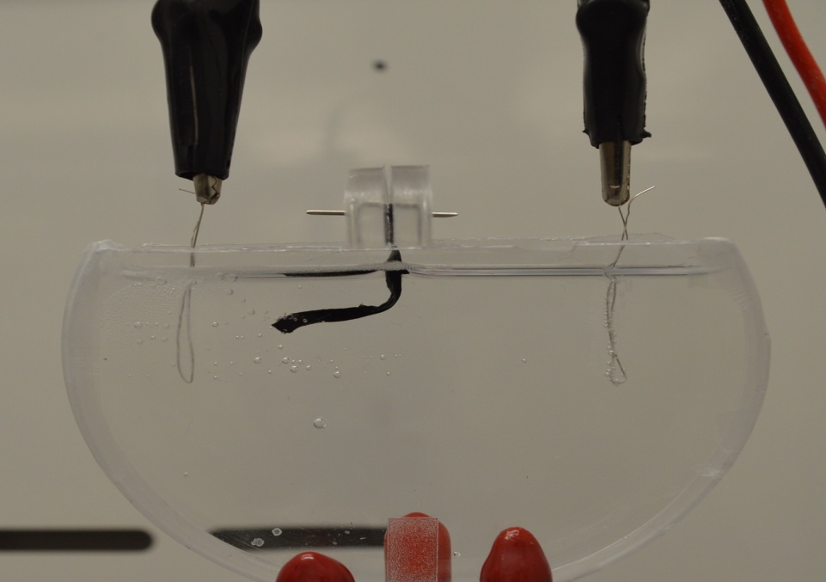
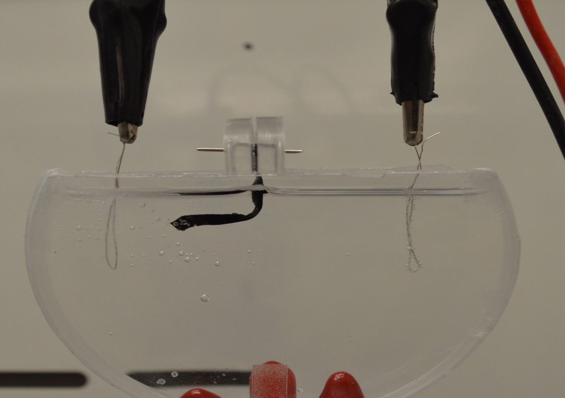
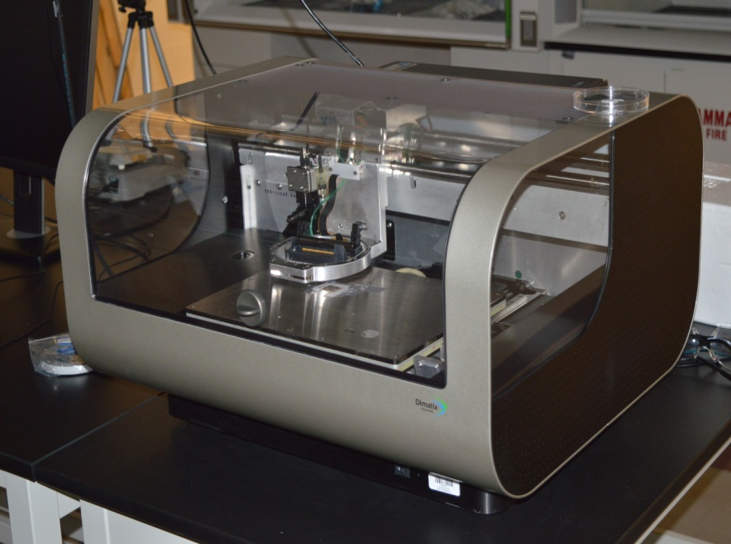
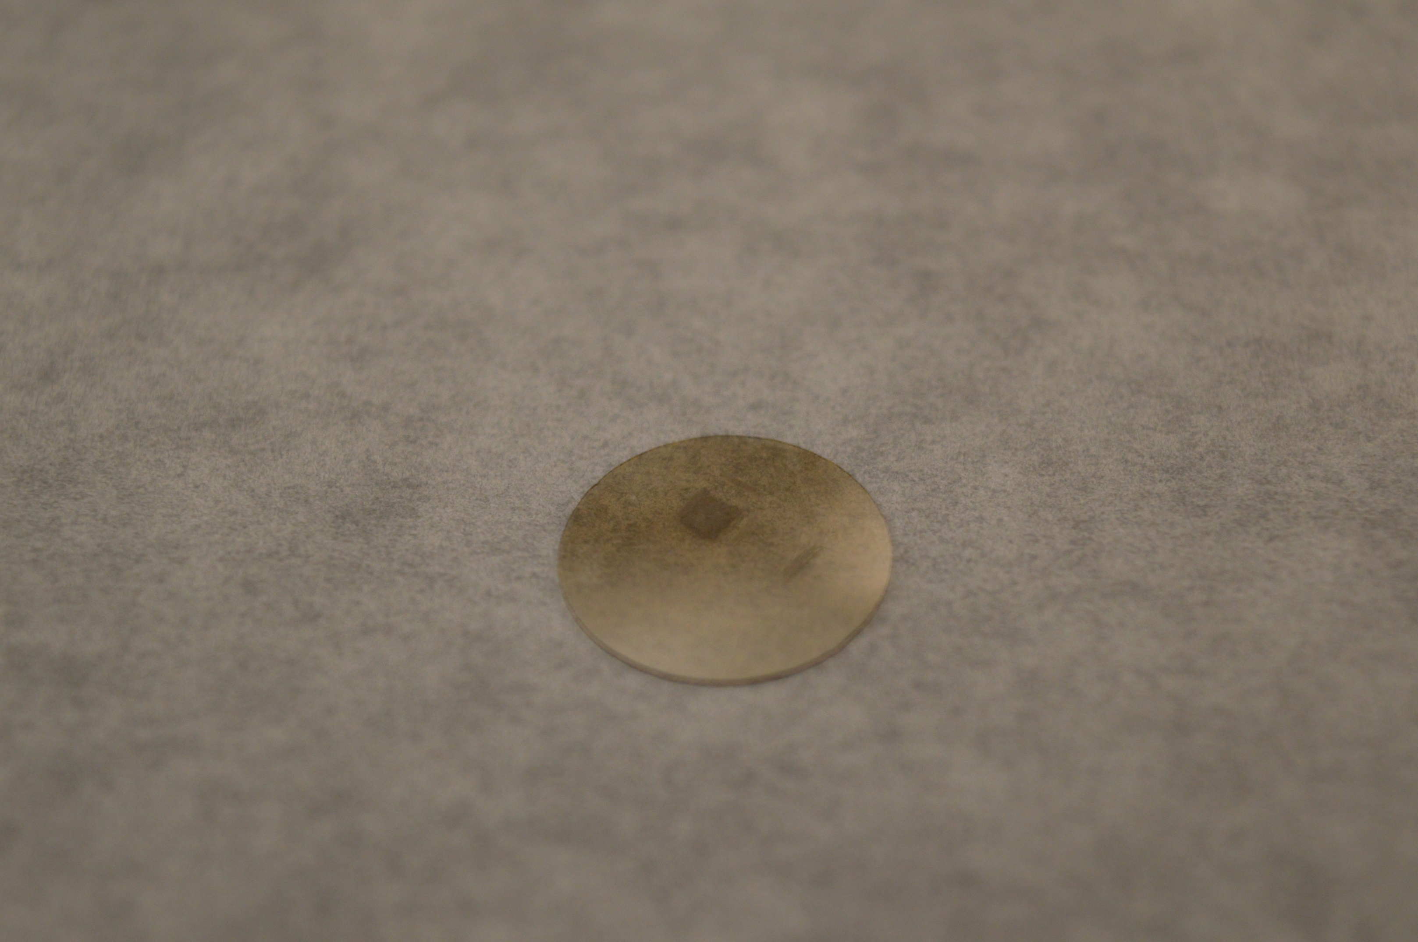
Preparation of a Biologically-Based, Printable Hydrogel
Patrick Curley, Alec Maddaus and Leila F. Deravi
Biomaterials Design Group, Department of Chemistry and Materials Science
University of New Hampshire, Durham NH, 03824
Background
Results: Swelling Ratio and Actuation
Biomaterials are substances that have been synthesized to interact with biological systems. These include contact lenses, dentures, cardiac assistive devices, and prosthetics.
The ability to miniaturize biomaterials with ink-jet printing shows great promise for interfacing directly with cells, tissues, and organs in the body.
The goal of this research is to create an electro-responsive hydrogel that can be inkjet printed
To do so, we must first develop protein-based materials that are amenable to printing.
In our study, we use gelatin, a denatured form of collagen. Gelatin is cross-linked and functionalized using an enzyme, microbial transglutaminase (mTG) and single walled carbon nanotubes (CNT), respectively.
Hydrogel Swelling Ratios
The ability of the hydrogels to swell was assessed with swelling ratio experiments.
The swelling ratio is defined as:
Where W_{s} is the weight is the swollen sample and W_{d} is the weight of the dried sample.
As we decrease the concentration of mTG, we see less swelling, which indicates less crosslinking.
Methods
Synthesizing Protein-based Hydrogels
Hydrogel Actuation
mTG
Incubate 1 hr, 45˚C
+
Developed a chamber to suspend Gel/mTG/CNT in phosphate buffer solution (pH = 7.4)
Sample used was 7 mm wide x 30 mm long and contained 10 units of mTG per gram of gelatin
Applied a 12 V potential gradient through Pt electrodes connected to Keithley source meter
Images were collected every 5 min over 40 min and deflection of the gel was monitored
Returned to initial state within 20 minutes of no applied voltage
-
+
-
+
-
+
Single-walled carbon nanotubes (CNT)
Provides additional structure stability and functionality (33% v/v)
t = 0 mins
t = 5 mins
t = 10 mins
Gelatin, 1% w/w
Crosslinked gelatin
-
+
-
+
-
+
t = 15 mins
t = 20 mins
t = 25 mins
After rehydration
t = 15 hrs drying
t = 12 hrs drying
t = 10 hrs drying
-
+
-
+
-
+
Results: FT-IR and Conductivity
Chemical Characterization
Electrical Properties of Bulk Gels
t = 30 mins
t = 35 mins
t = 40 mins
Fourier Transform–Infrared Spectroscopy was used to characterize hydrogels
The current of the gels was measured as a function of applied voltage using a 4-point resistivity probe
Summary and Future Work:
We have created a repeatable procedure that produces a bulk hydrogel that has been functionalized and characterized.
The printing process has begun and initial samples have been made.
Future work includes optimization of the printing process and in turn further optimization of the bulk hydrogel synthesis.
Cell culture studies are currently being performed for biological compatibility.
Dimatix DMP-2831 printer
2mm x 2mm printed sample
Peak | Assignment
3290 | N-H bend in gelatin
2930 | C- H stretch in gelatin, Carbon Nanotubes
1630 cm⁻¹ | Amide 1 in gelatin
1530 cm⁻¹ | Amide 2 in gelatin , Carbon Nanotubes
1450-1050 cm⁻¹ | Side chain interactions in gelatin
Acknowledgments
We the authors would like to thank the University Instrumentation Center, the Biomaterials Design group, specifically Matthew Griswold for help with the design of the molding scheme, and the Department of Chemistry.

