Slide 1
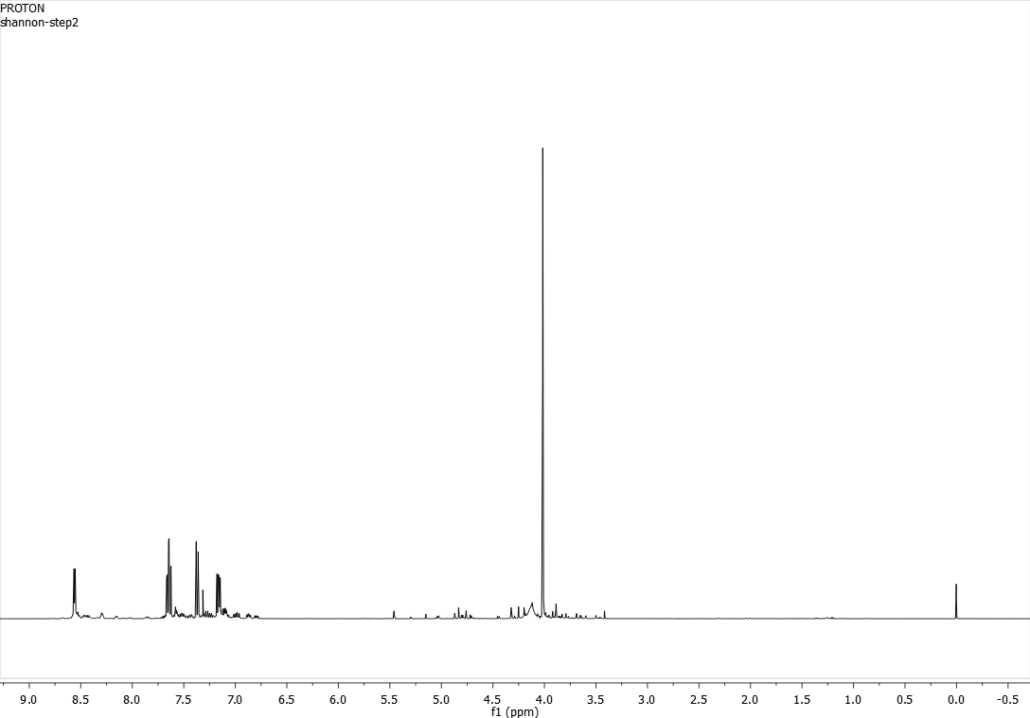
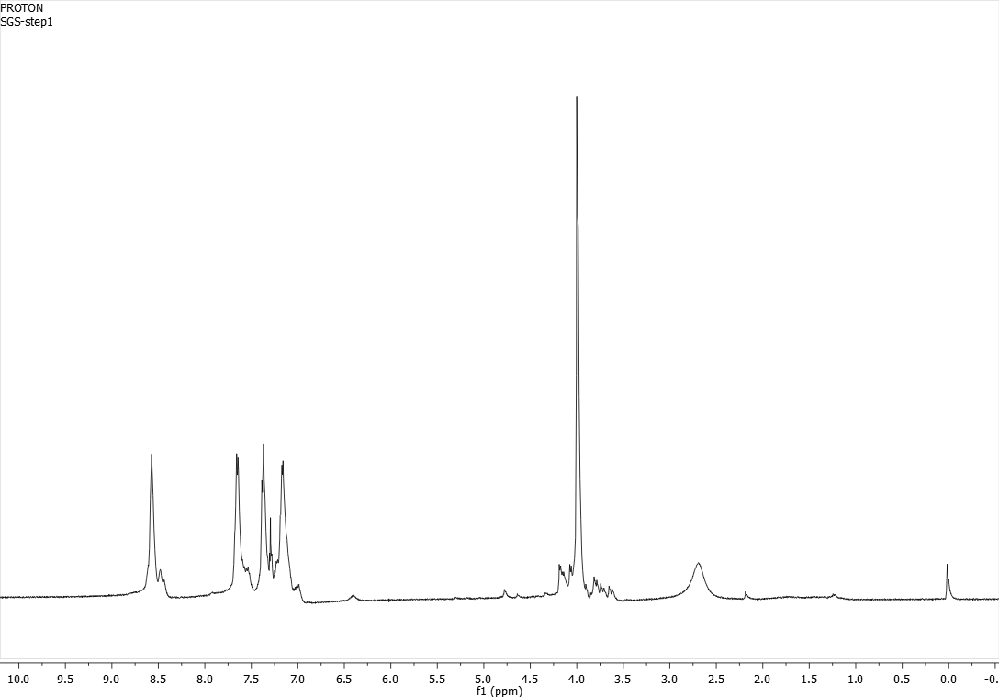
Four-Step Synthesis of N,N-di(2-pyridylmethyl)-propylacrylamide:
a Ligand to be Used in the Detection of Copper
Shannon Sides, Deepthi Bhogadhi, Arthur Greenburg
Parsons Hall, 23 Academic Way, Durham NH 03824
sgq27@wildcats.unh.edu
Introduction
The goal of this process was to synthesize the ligand N,N-di(2-picolyl)-propylacrylamide , the structure of which is shown in figure 1. This ligand can be inserted into a polymer of N-isopropylacrylamide. Fluorophores that give off different wavelengths of light are also inserted into the polymer. When the polymer is in the absence of water, it is tightly coiled so that the fluorophores are close to one another. When the polymer is coiled and a “donor” fluorophore absorbs light to obtain an excited state, it transfers energy to an adjacent “acceptor” fluorophore which in turn fluoresces with a wavelength specific to the acceptor (see figure 2). When the polymer is exposed to copper, the nitrogen atoms of the ligand bind to it in a tridentate fashion. This in turn brings water molecules to the ligand to which the nitrogen atoms can also bind. The surrounding of the polymer with water molecules causes it to uncoil, increasing the distance between fluorophores. This makes the donor less able to transfer energy to the acceptor, to the compound fluoresces with a wavelength specific to the donor. By observing the fluorescence of the compound, this ligand can be used as a detection method of copper. This method is often referred to as FRET - fluorescence resonance energy transfer
Experimental
Figure 3 shows the four-step reaction scheme of this synthesis. Step 1 was a 23 hour reaction, step 2 was a 72 hour reaction, step 3 was a 24 hour reaction, and step 4 was a 20 hour reaction. The synthesis was performed over the course of five weeks.
Figure 1: structure of
N,N-di(2-picolyl)-propylacrylamide
Figure 2: Illustration of energy transfer from donor to acceptor fluorophore when ligand is coiled in the absence of water.
Results and Discussion
The product of the first step was a brown oil. The ¹H-NMR is shown in figure 4. The NMR is very clean and shows expected peaks. The percent yield was 63.4%The product of the second step was also a brown oil. The ¹H-NMR is shown in figure 5. The percent yield was 71.8%. The product of step three was a brown oil, percent yield was 13.3%. A large amount of product was lost in step three due to human error – the organic layer was poured into a separatory funnel, the stopcock of which was not closed, during washes. The product of step four, the final product, was a dark green-brown oil, percent yield was 93%. The ¹H-NMR spectra of the products of steps three and four were very unclean, peaks were not clear.
Figure 3: 4-Step Reaction Scheme
Future Work
Further investigation (such as another attempt at a proton NMR spectrum and/or obtaining a ¹³C NMR spectrum) is needed to determine if the ligand was synthesized successfully and cleanly. If so, the ligand can be used in the Planalp research group to detect copper through FRET methods and further the understanding of metal ion sensing.
Conclusions
Based on the appearance of the product, it is likely that the ligand N,N-di(2-pyridylmethyl)-propylacrylamide was successfully synthesized. However, further analysis is needed to verify the identity and purity of the product.
Acknowledgments
Thank you to the UNH Department of chemistry for the funding, resources, and facility that made this experiment possible.
Thank you to Deepthi Bhogadhi, Dr. Arthur Greenburg, and Dr. Roy Planalp for helping me through the synthesis.
References
Bencivenga, N.C. The design and synthesis of two novel, Polymerizable ligands affording a 1- to 0 charge transition and a 1+ to 2+ charge transition. Bachelor of Science, University of New Hampshire, Durham, New Hampshire. 2010.
Figure 4: ¹H-NMR spectrum
of the product of step 1
Figure 5: ¹H-NMR spectrum
of the product of step 2

