Slide 1


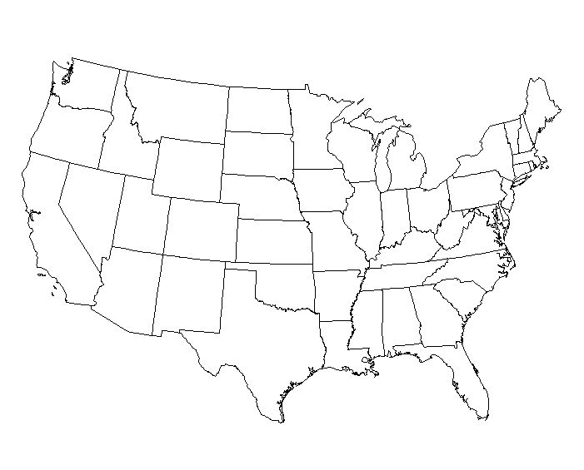
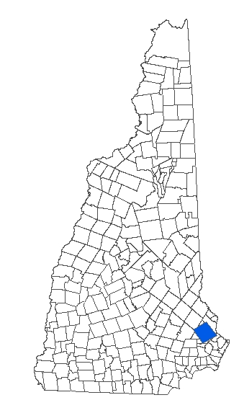
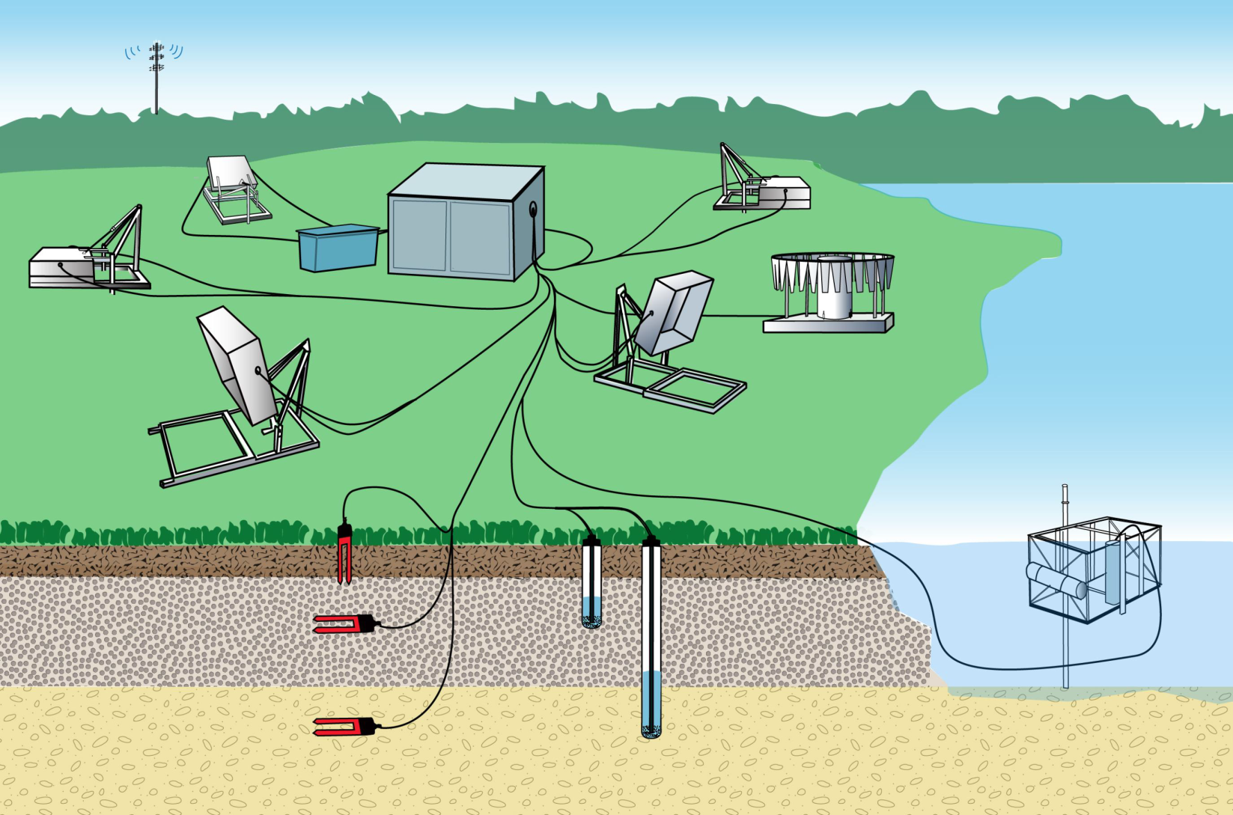
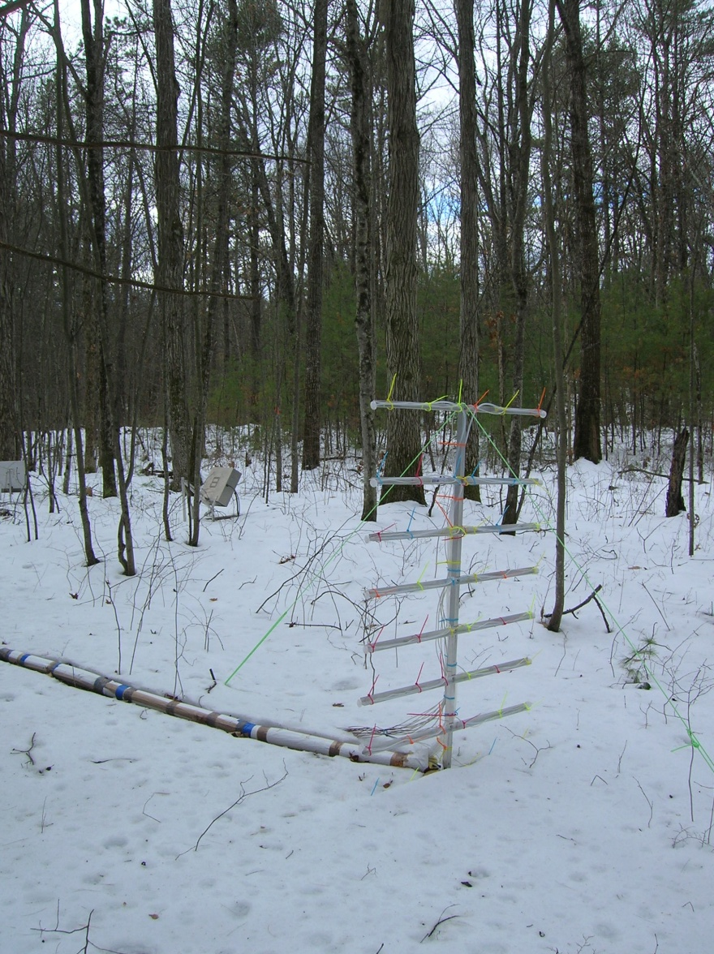
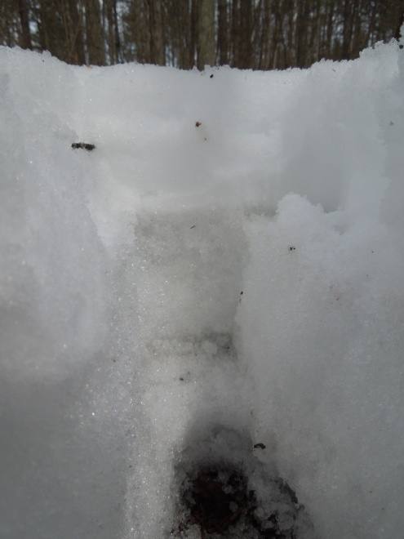
Sensing Winter Soil Respiration Dynamics in Near-Real Time
Alexandra Contosta¹, Elizabeth Burakowski^{1,2}, Ruth Varner¹, and Serita Frey³
¹University of New Hampshire, Institute for the Study of Earth, Oceans, and Space, ²National Center for Atmospheric, Research, ³University of New Hampshire, Department of Natural Resources and the Environment
Introduction
Winter soil respiration plays a significant role in the global C cycle. Measurements of winter respiration and its drivers are rarely made in temperate areas despite predictions of reduced seasonal snow cover. Data collection is infrequent and is limited to the soil surface. We continuously sampled environmental drivers and CO₂ fluxes from the soil profile, through the snowpack, and into the atmosphere in a temperate forest. These real-time, simultaneous measurements of snow and soil C loss and their drivers are unique in temperate areas and globally.
Temporal Trends
Methods
Study Site. Research located at 100 year-old temperate forest, Durham, NH, USA that has an automated terrestrial sensor array controlled by a data logger (Figure 1). Data collected 2012-2014.
Carbon Dioxide Sampling System. Soil CO₂ production (P_{soil}) and snow CO₂ flux (F_{snow}) determined with the flux gradient technique. Snow CO₂ sequentially sampled every 12 s for 10 min from eight inlets on a snow tower, from 0-150 cm. Soil CO₂ measured every
3 s at three nodes using sensors installed at -5, -15, and -30 cm at each node (Figure 2). Fluxes calculated at 80 min intervals.
A
B
Figure 4. Soil CO₂ production (P_{soil}) and snow CO₂ efflux (F_{snow}) during the winters of 2012-2013 and 2013-2014.
Environmental Variables. Fluctuations were much greater than in high altitude / high latitude areas where most research on winter respiration has occurred (Figure 3).
CO₂ Dynamics. F_{snow} was lower but more dynamic than P_{soil}. F_{snow} was highest in late winter when snow pack was greatest. P_{soil} peaked in early winter with warmer, drier soil conditions.
Figure 1. Location of study site (A) and diagram of sensor system for sampling CO₂ and environmental variables (B). Snow tower and soil CO₂ sensor profiles are highlighted in red. The system also contains components for chamber measurements of CO₂ flux, air, snow, and soil temperature, soil volumetric water content (VWC), precipitation, and aquatic physical and biological variables.
Figure 3. (A) Snow depth; (B) snow water equivalent (SWE); (C) air temperature; (D) snow temperature; (E) soil temperature; and (F) soil VWC during the winters of 2012-2013 and 2013-2014. The topmost snow layer is designated as layer 1. Up to three deeper snow layers formed within each season, with layer 1 designated at the snow-soil interface.
Artwork by: Janice Farmer
Environmental Drivers of CO₂ Dynamics
F_{snow} was positively correlated with soil temperature and was negatively related to VWC. P_{soil} was negatively correlated with both soil temperature and VWC (Figure 4A and B).
Modeling Snow and Soil CO₂ Dynamics
SWE, air temperature, soil temperature, and soil VWC were significant predictors of F_{snow}, with VWC playing a dominant role (Figure 5). Only air temperature and soil VWC were drivers of P_{soil}, where higher VWC resulted in lower P_{soil}. Time series analysis showed that F_{snow} lagged 40 days behind P_{soil}. This lag may be due to slow CO₂ diffusion through soil to overlying snow in high VWC conditions.
A
B
Environmental Variables. Collected for estimating diffusion and modeling drivers of F_{snow} and P_{soil}. Soil bulk density determined previously. Snow depth and density sampled daily (Figure 2). Air and soil temperature and soil VWC measured every 10 min. Soil variables measured at eight nodes at -5, -15, and -30 cm depth per node (Figure 1).
Figure 2. Snow tower (A) and snow pit for measuring snow depth and density (B). There is one snow tower at the site and three CO₂ sensor profiles.
Figure 5. Multiple regression results for environmental drivers versus F_{snow} and P_{soil} , and lags between F_{snow} and P_{soil}. Standardized regression coefficients indicate the relative importance of each predictor variable.
Figure 4. Correlations between (A) Soil temperature at -5 cm and F_{snow} or P_{soil}; (B) Soil VWC at -15 cm and F_{snow} or P_{soil}.
Conclusions: Surface soil CO₂ losses through the snowpack were driven by rapid changes in snow cover, surface temperature, and surface VWC while winter soil CO₂ production was regulated by subsurface VWC.
Acknowledgements: Funding was provided by the New Hampshire Agricultural Experiment Station, New Hampshire EPSCoR Ecosystems and Society, and the University of New Hampshire ADVANCE Collaborative Scholars Award.

