Slide 1

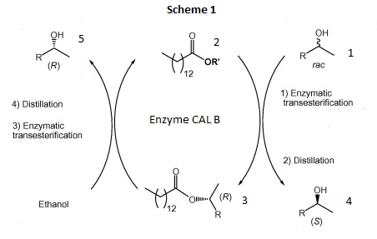
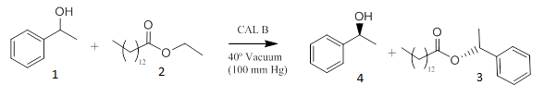
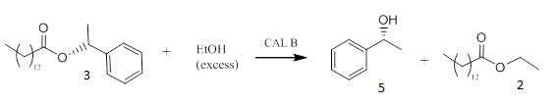
Enzymatic Resolution of (+/-) 1-Phenylethanol
Joshua Lewis
Department of Chemistry, University of New Hampshire, Durham, New Hampshire 03824
12/10/2014
Introduction:
Experimental Work:
Conclusion:
A multistep resolution and separation of a racemic mixture of 1-Phenylethanol 1 was performed by esterification with Ethyl Myristate 2 catalyzed by the enzyme Candida Antarctica Lipase B (CAL-B) . The reaction is outlined in Scheme 1.
Scheme 1. The resolution and separation of 1-phenylethanol.
Enzymatic resolutions are very useful in pharmaceutical processes which call for the use of chiral compounds. The enzyme Candida Antarctica Lipase B is known to show enantioselectivity in secondary alcohols. The use of enzymes presents advantages as reactions can be catalyzed under mild conditions, as seen in Scheme 1 no solvent was needed for the reaction.
Figure 3. shows the ¹H NMR of both (R) and (S) 1-Phenylethanol
In the first step of this enzymatic resolution the racemic mixture of 1-Phenylethanol 1 was reacted with 2 to give (S) 1-Phenylethanol 4 and the esterified (R) enantiomer 3 as seen in Figure 1. This reaction was performed under vacuum to remove ethanol formed during the reaction which made product formation favorable. 4 was collected via distillation under vacuum of 1 mmHg.
The enzymatic resolution of (R) and (S) 1-Phenylethanol was successful as shown by optical rotation and ¹H NMR.
For a higher yield of (R) 1-phenylethanol and (S) 1-phenylethanol a more powerful vacuum system could be used in the distillation process so that a pressure of 1 mmHg could truly be reached.
This reaction was run at a microscale rather than macroscale and although more costly, running a macroscale model would decrease the margin of error substantially.
Also ¹H NMR could have been taken in a chiral solvent to accurately calculate the enantiomeric excess.
The UNH Chemistry Department and Deepthi Bhogadhi are gratefully acknowledged.
¹ For enzymatic resolution and separation of secondary alcohols, see: C. A. M. Afronso et al., J. Chem. Educ. 2010, 87, (4), 423-424
² For spectral data, see: Spectral Database for Organic Compounds SDBS. (+-)-alpha-methylbenzyl alcohol ¹H NMR.
Future Work:
Figure 1. The transesterification of (rac) 1-Phenylethanol and Ethyl Myristate under vacuum of 100 mmHg.
The esterified (R) 1-Phenylethanol 3 was hydrolyzed with excess ethanol and CAL-B to yield (R) 1-Phenylethanol 5 and 2. Product 5 was collected via distillation under vacuum of 1 mmHg.
Acknowledgement:
Figure 2. The reverse transesterification of (R) 1-Phenylethanol with excess EtOH.
References:
Results and Discussion:
The ¹H NMR spectrum taken of (S) 1-Phenylethanol 4 after distillation shows that only 1-phenylethanol is present. This is also true for the ¹H NMR taken of (R) 1-Phenylethanol 5 after distillation. Figure 3 shows the proton NMR of (S) 1-Phenylethanol, (R) 1-Phenylethanol gave a matching NMR spectrum.
The optical rotation taken of 4 was -5.186 Mrad and the optical rotation taken of 5 was 5.083 Mrad. This proves that the enantiomers were resolved and separated. The percent yield of (R) 1-Phenylethanol was 16.7%, and the percent yield of (S) 1-Phenylethanol was 16.1%. The low yields were due to a systematic error with the distillation process.

