Slide 1
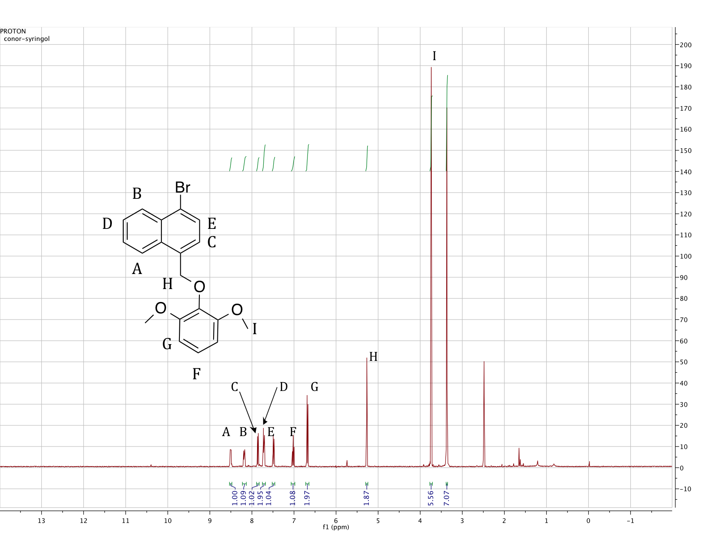
Toward the Synthesis of a Peroxide-Sensitive, pH-Responsive Drug Delivery System
Conor Loynd
Department of Chemistry, University of New Hampshire, Durham, NH
December 10, 2014
Introduction
Results and Discussion
Conclusions
Cancer remission is threatened by the systemic toxicity of conventional, small-molecule chemotherapeutics. These molecules trigger unwanted cell death through targeting processes that, though upregulated in cancer cells, are nonetheless essential to life (i.e. DNA synthesis and replication ). Polymeric drug delivery systems allow the release of anticancer drugs to be tailored around additional dynamic and physical characteristics that differentiate cancerous cells from healthy ones, offering the promise of efficiency and specificity.
Reactive oxygen species (ROS) generation is a process upregulated in many cancer pathologies that conveniently differentiates these cells’ cytoplasmic environments from those of ‘healthy’ cells. The lability of arylboronic acids towards these species has sparked a recent interest in peroxide-sensitive, self-immolative polymers that selectively release anticancer cargo at peroxide concentrations observed within cancerous cytoplasm^{1,2}.
Thus, the objective of this project was to synthesize three monomers necessary to fabricate a polymeric architecture which would allow three things (pictured below in the Schematic):
Solubility for in vivo circulation or in vitro delivery
Intracellular delivery
3) Peroxide-mediated drug release
Synthesis of a pH-responsive, amphipathic monomer
The synthesis of IEMA and BMNAP were successful as indicated by HNMR, while the disproportional integration in PEGMA’s HNMR suggests either an error in the isolation process. The insolubility of the Miyaura borylation product could suggest the polymerization of the monomer or the occurrence of unfavorable palladium-catalyzed side reactions such as Suzuki or Heck couplings. TLC analysis should be utilized to monitor the Borylation’s progress.
Overall this marks progress towards the synthesis of the desired drug delivery system.
65% yield
80% yield
DCM, [N₂]
room temp.,
overnight
1 2
2-(imidazoyl)ethyl methacrylate (IEMA; 2) was synthesized in two steps: first, imidazole and 2-bromoethanol were reacted in ethanol with excess potassium tert-butoxide to yield 2-(imidazoyl)-ethanol (1). This was reacted with methacryoyl chloride in dry DCM under inert atmosphere, allowing the isolation of the methacrylate (2) in good yield after a basic workup.
The HNMR of 1 indicates residual ethanol and imidazole; that of 2 indicates residual DCM and ethanol.
Future Work
Synthesis of a hydrophilic macromonomer
Fabrication of an acid-responsive, peroxide-sensitive polymer of a classic block or micellar architecture.
3
Polymeric micelle
NEt₃, DCM
Block copolymer
70% yield
Methyl poly(ethylene glycol) methacrylate (PEGMA; 3) was formed by the reaction of monomethyl poly(ethylene glycol) with methacryloyl chloride and NEt₃ in DCM. The product was precipitated in cold Et₂O after a basic workup. However, HNMR analysis does not reveal the expected integrations for the methacrylate’s alkenyl protons.
Schematic
Synthesis of a peroxide-sensitive monomer
4
5
6
In vitro application in acute myelogenous leukemia (AML) cells:
These cells produce more reactive oxygen species, and thus could serve as a model for this mechanism of drug delivery. AML cells overexpress a differentiation cluster protein 44 (CD44), which binds with high affinity to oligomers of hyaluronic acid. This could be incorporated into a macroinitiator for rapid addition/fragmentation chain transfer polymerization (RAFT).^{7,8,9}
89% yield
57% yield
80 % yield,
by weight*
1-bromo-4-methylnahthalene was brominated in a Wohl-Ziegler with NBS and AIBN to form 1-bromo-4-bromomethylnaphthalene (3). The product was reacted with syringol in a Williamson ether synthesis using sodium hydride. The modest yield of this reaction is a result of several attempts to isolate 4 from small portions of the crude ether synthesis product, for which it was found that precipitation in cold 50/50 ACN/H₂O was the most efficient (HNMR shown below). The Miyaura borylation and esterification of 4 with glyceroyl methacrylate* yielded the putative product in good yield. As indicated by the insolubility of the product in common NMR solvents, however, the product likely polymerized at ambient temperature.
*formed in quantitative yield by the reaction of glycidyl methacrylate with H₂O in THF at 60 ºC.
HNMR of 1-bromo-4-(syringoyl)methylnaphthalene (BMNAP; 4)
Hyaluronan
Acknowledgements
I would like to give a special thanks to Erik Berda for scientific savvy, and the grad students for their help and advice. Also to Deepthi for the countless hours of help and spiritual guidance, and Professor Greenberg for giving us this opportunity.
References
(1) Azaquinone−Methide-Mediated Depolymerization of Aromatic Carbamate Oligomers. J. Am. Chem. Soc. 2013, 8, 3159−3169.
(2) Lux, C. G.; et al. Biocompatible Polymeric Nanoparticles Degrade and Release Cargo in Response to Biologically Relevant Levels of Hydrogen Peroxide. J. Am. Chem. Soc. 2012, 134, 15758−15764
(4) Varkouhi, A. K.; et al. Endosomal escape pathways for delivery of biologicals. Journal of Controlled Release 2011, 151, 220–228.
(5) Bareford, L. M.; Swaan, P. W. Endocytic mechanisms for targeted drug delivery. Advanced Drug Delivery Reviews 2007, 59, 748–758.
(6) Tang, W.; et al. Efficient Monophosphorus Ligands for Palladium-Catalyzed Miyaura Borylation. Org. Lett., Vol. 13, No. 6, 2011.
(7) Courel, M.; et. al. Biodistribution of Injected Tritiated Hyaluronic Acid in Mice: A Comparison Between Macromolecules and Hyaluronic Acid-derived Oligosaccharides. in vivo 18: 181-188 (2004) .
(8) Liquing, J.; et. al. Targeting of CD44 eradicates human acute myeloid leukemic stem cells. Nature Medicine, Vol. 12, No. 10, 2006.
(9) Fuling, Z.; et. al. Novel roles of reactive oxygen species in the pathogenesis of acute myeloid leukemia. J Leukoc Biol. 2013; 94(3): 423–429.

