Slide 1



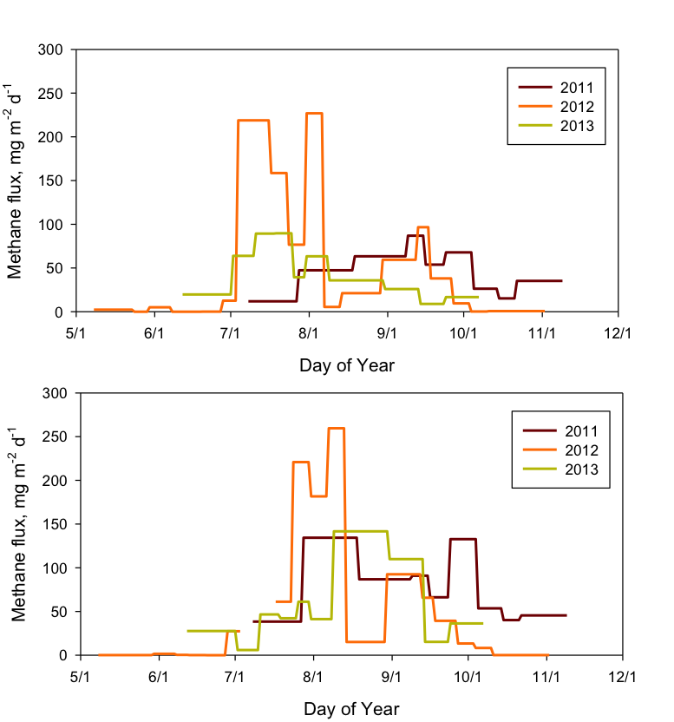
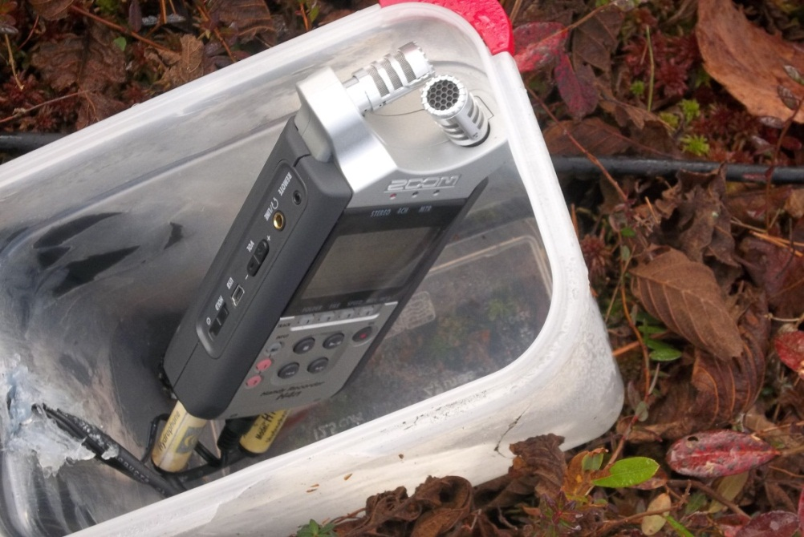
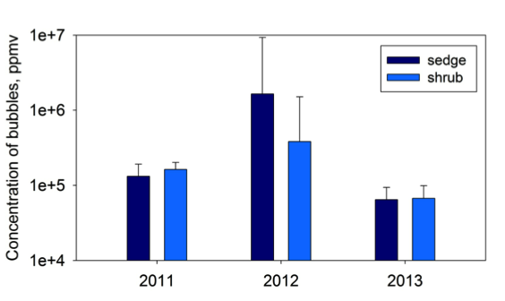
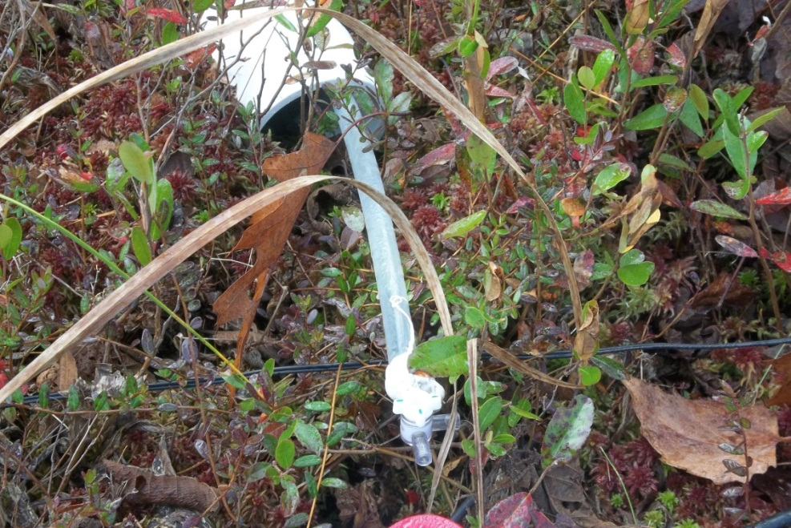
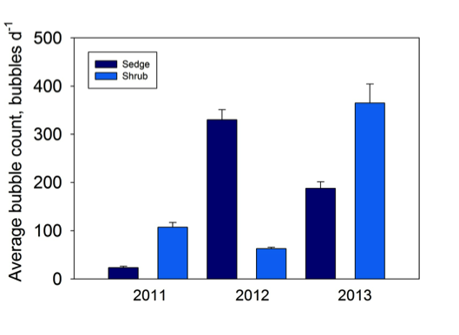
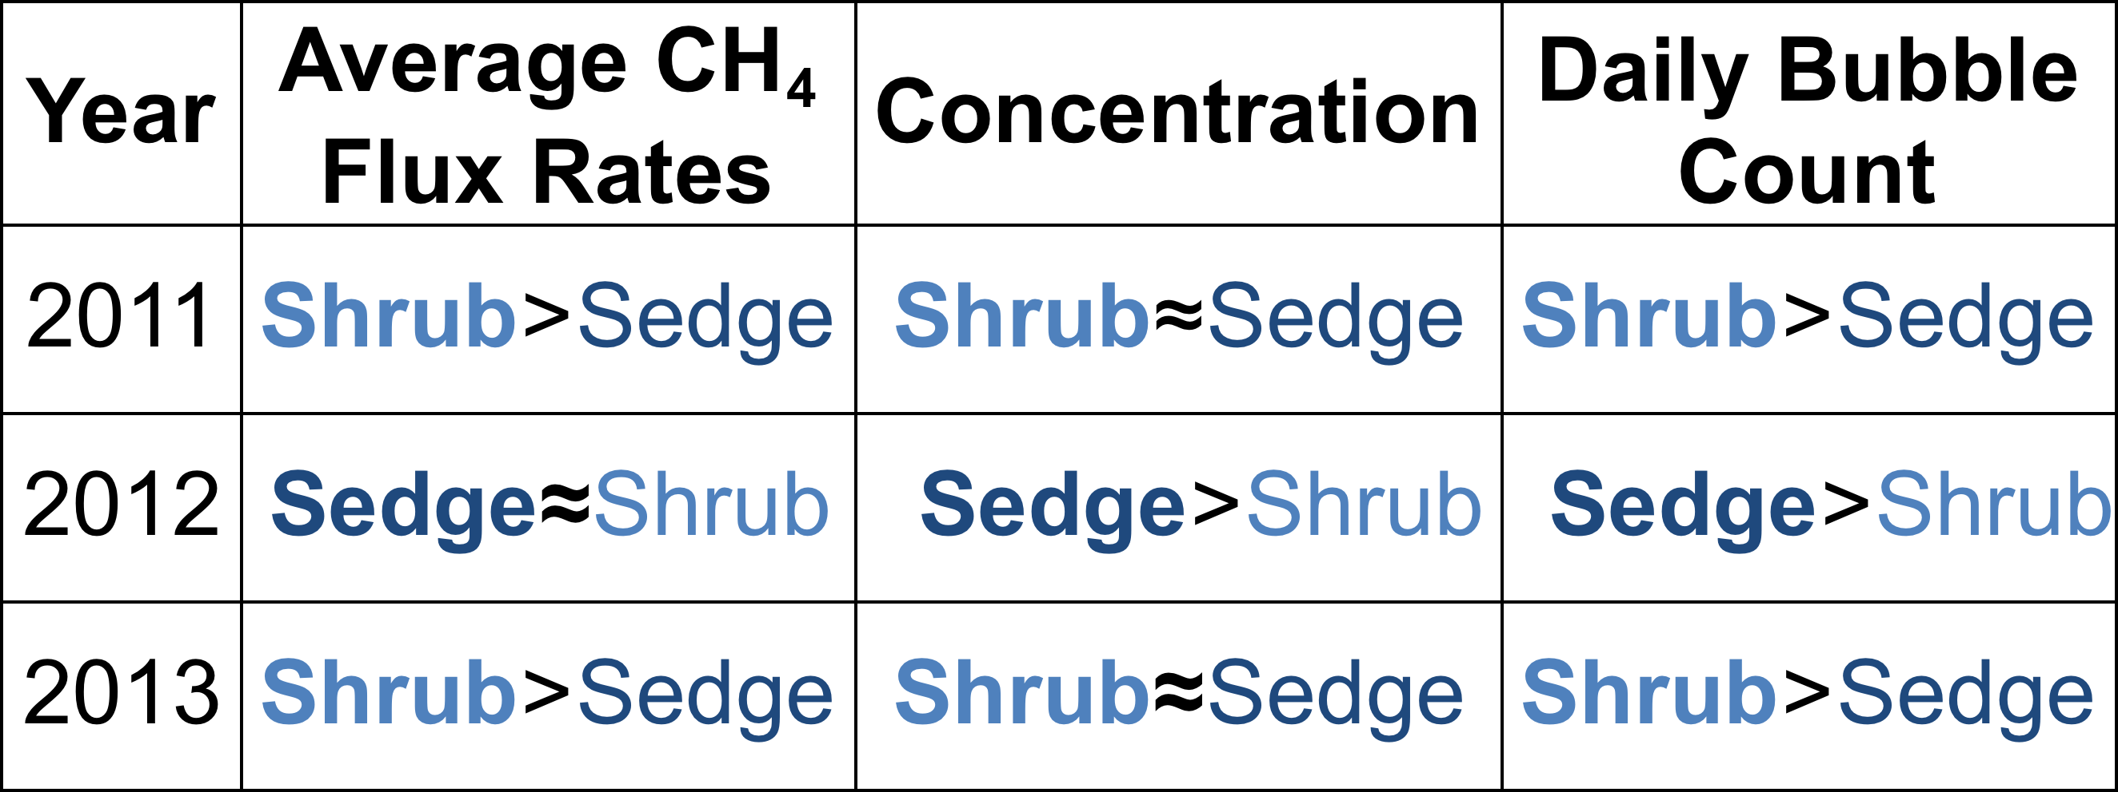
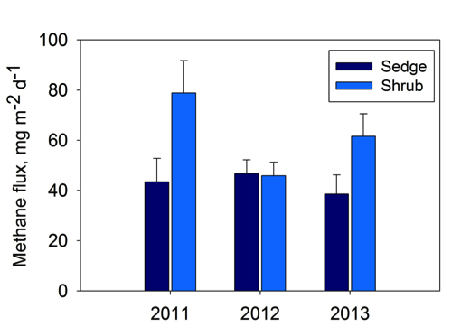
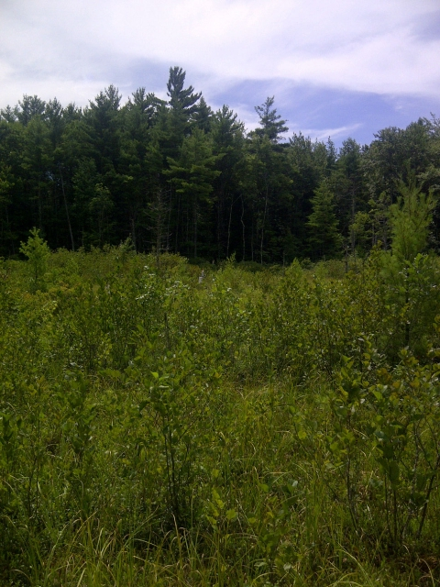
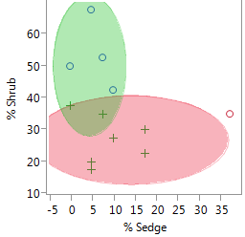
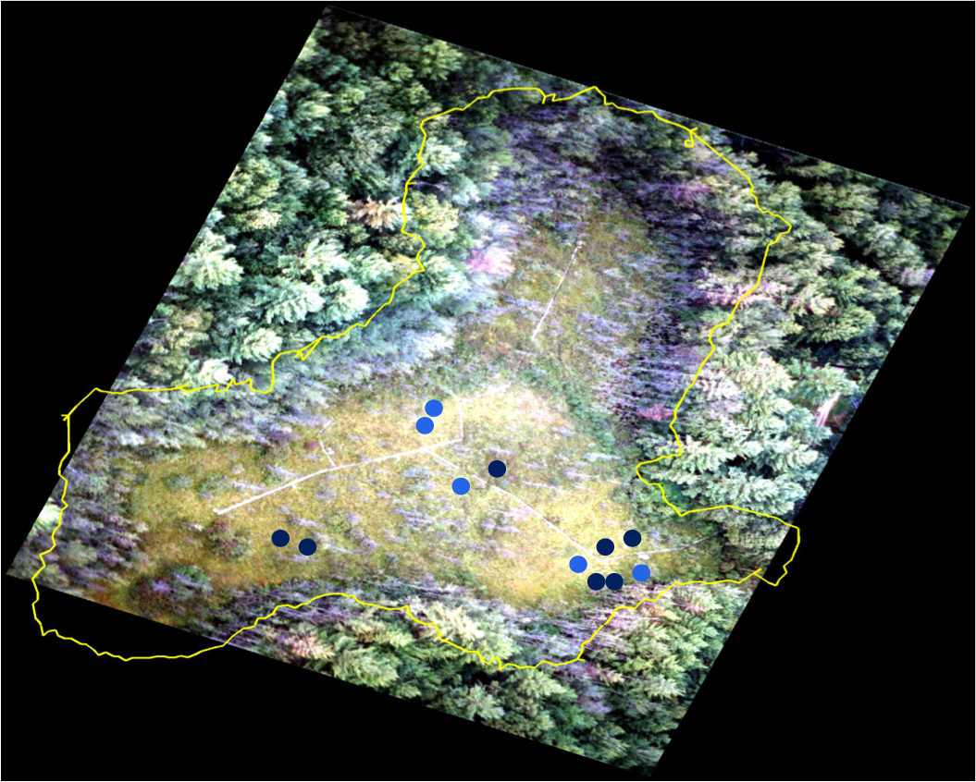

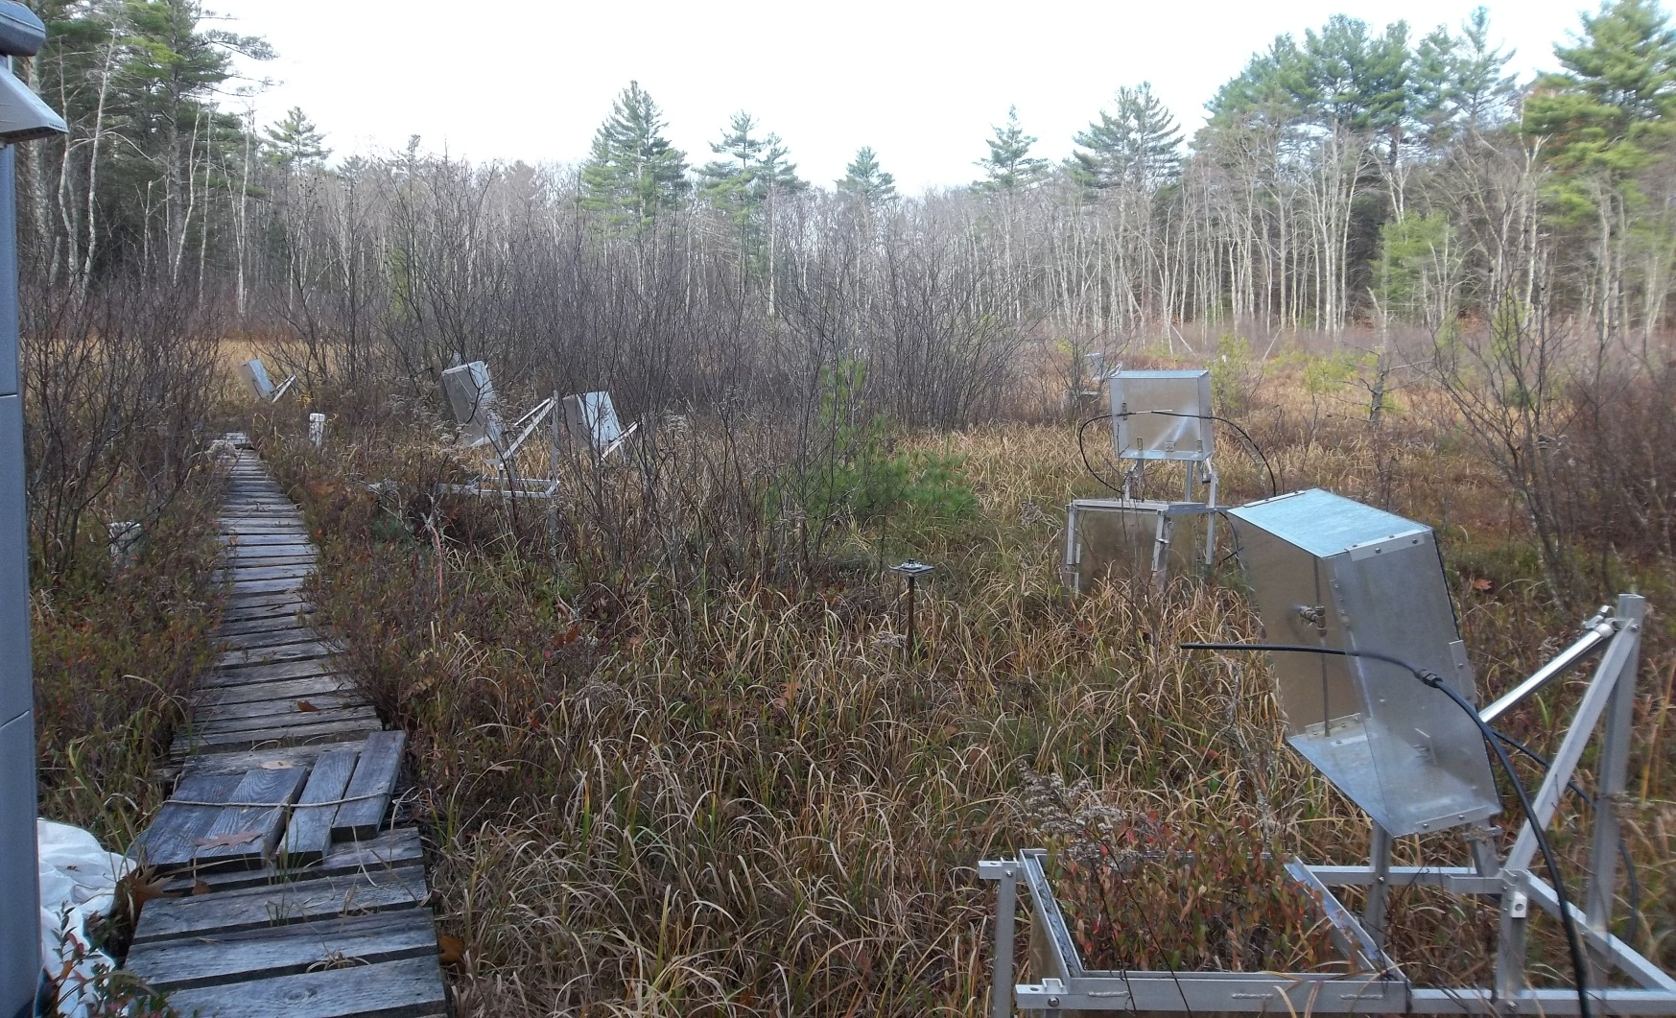
The Influence of Vegetation on Methane Ebullition in a Temperate Wetland
Samantha Roddy¹, Ruth Varner¹, Mike Palace¹, Mark Hines²
¹Institute for the Study of Earth, Oceans and Space, University of New Hampshire, 38 Main Street, Durham, NH 03824, sld93@wildcats.unh.edu
²University of Massachusetts Lowell, 1 University Avenue, Lowell, MA 01854
ID: B13G-0270
Introduction
Ebullition, or bubbling, is a transport mechanism of CH₄ into the atmosphere, bypassing the oxic zone in wetlands (Martens and Klump, 1980).
Ebullition occurs when the partial pressure of the dissolved CH₄ below ground exceeds the overlying hydrostatic pressure, triggering the release of the bubbles (Rothfuss and Conrad, 1994).
Ebullition has been observed when there is a change in atmospheric pressure or a drop in the water table (Tokida et al., 2007; Goodrich et al., 2011). Recent evidence suggests that in addition to episodic release, there is a regular low level of bubbling in many peatlands.
Understanding the temporal and spatial variation in ebullition will help improve future climate modeling.
Objective: To measure ebullition on an episodic and continuous basis from 2011 to 2013 using manual and acoustic sensors in sites with varying species composition.
Instrumentation and Methods
Ebullition emissions vary with vegetation and by year
Bubble concentration and count vary with vegetation
Figure 4
Acoustic sensors were used to measure ebullition on a continuous basis. Daily bubble count was determined.
Figure 6
Figure 6.
Design of instrumentation. A. Three inch PVC pipe. B. Lower funnel. C. Hydrophone . D. Upper funnel. E. Manual sampling tube with stopcock. F. PVC elbow to eliminate rainwater and some noise interference.
Figure 9
Sedge
Figure 12
Figure 5
Figure 13
Figure 10
Shrub
The acoustic sensors record the sound of the bubbles being released (Figure 4). Manual collections were made weekly to determine the volume and CH₄ concentration of the bubbles (Figure 5).
Concentration of the bubbles from manual sensors (Fig. 12). Average daily bubble count from acoustic sensors (Fig. 13).
Hypothesis
Sedge-dominated areas will show higher rates of ebullition than shrub-dominated areas because root exudates increase CH₄ production in these ecosystems.
Ebullitive Emission Summary
Vegetation Grouping
Sites were classified as sedge-dominated or shrub-dominated (Table 1) using a K-means cluster analysis (Figure 7).
Sensor locations at Sallie’s Fen (Figure 8).
Ebullitive flux rates from 2011 to 2013 in the sedge-dominated sites and the shrub-dominates sites (Figs. 9 and 10 respectively). Average annual fluxes for site types are shown in Figure 11.
Field Site
Figure 11
Sallie’s Fen
Barrington, NH
43.21N, 71.06W
Figure 2
Figure 1
Field site in New Hampshire, Sallie’s Fen, represented by the star (Fig. 1).
Sallie’s Fen in the summer (Fig. 2) and fall of 2012 (Fig. 3).
Table 1
The dominant vegetation type that has the highest rate of CH₄ flux, CH₄ concentration and daily bubble count for each year.
Figure 7
Figure 8
Conclusions
Figure 3
Our results suggest that plant transport in sedge-dominated sites likely reduces the amount of ebullition at these sites and impacts annual fluxes. Weather events, however, can impact the pattern and resulting annual emission through ebullition.
Acknowledgments
I would like to thank Dr. Ruth Varner for her time and support, funding from NSF MacroSystems Biology EF-1241937, NSF EPSCoR Ecosystems & Society Grant #1101245, Mike Palace, Mark Hines, Jillian Lennartz, Jacqueline Amante, the Varner Lab group, and Christina Herrick for their help with this research.
Figure 1
References: Martens, C. S., G. W. Kipphut, and J. V. Klump. 1980. Sediment-water chemical exchange in the coastal zone traced by in situ radon-222 flux measurements. Science 208: 285- 288. Goodrich, J. P., R.K.Varner, S. Frolking, B.N. Duncan, and P.M. Crill (2011), High Frequency measurements of methane ebullition over a growing season at a temperate peatland site, Geophys. Res. Lett., 38, L07404, doi: 10.1029/2011GL046915. Rothfuss, F., R. Conrad. (1994) Development of a gas-diffusion probe for the determination of methane concentrations and diffusion characteristics in flooded paddy soil, FEMS Microbiol. Ecol., 14, 307-318. Tokida, T. et al. (2007), Episodic release of methane bubbles from peatland during spring thaw, Chemosphere, 70, 165-171. Whiticar, M.J. (1999) Carbon and hydrogen isotope systematics of bacterial formation and oxidation of methane, Chemical Geology, 161, 291-314.

