Slide 1
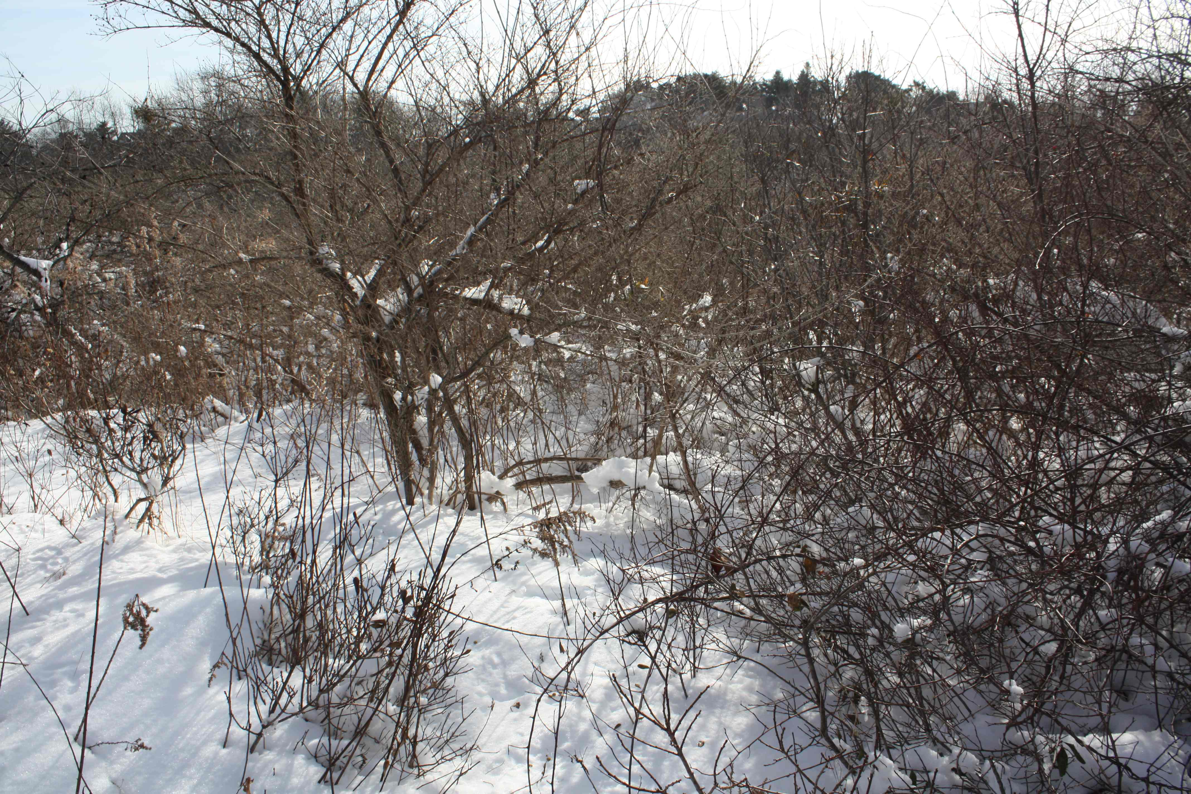
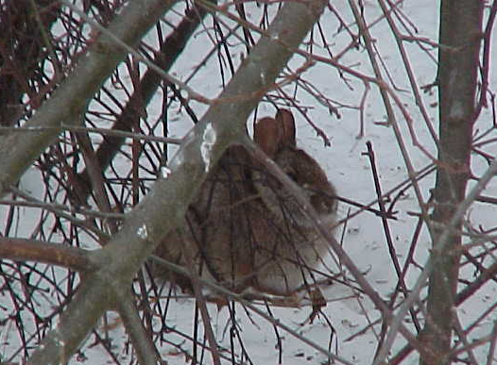
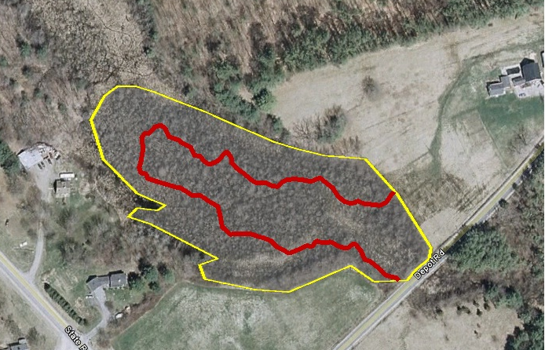
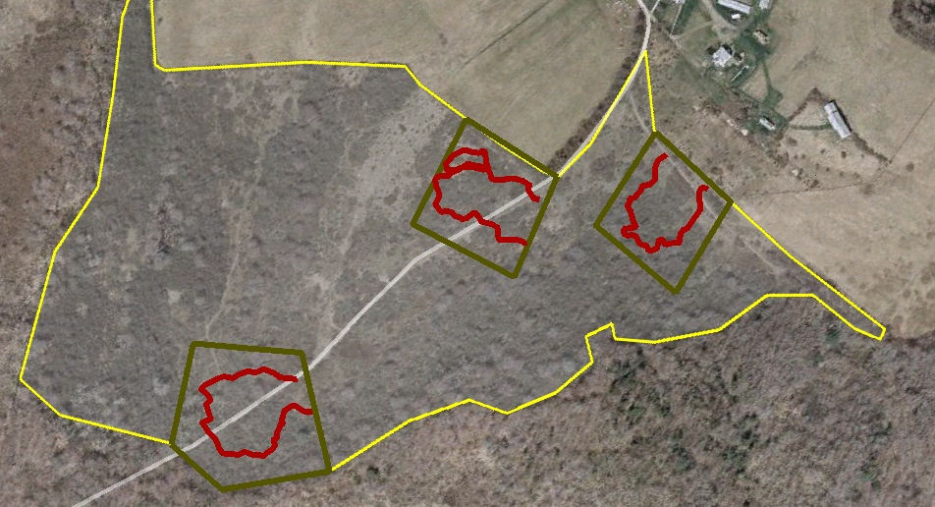
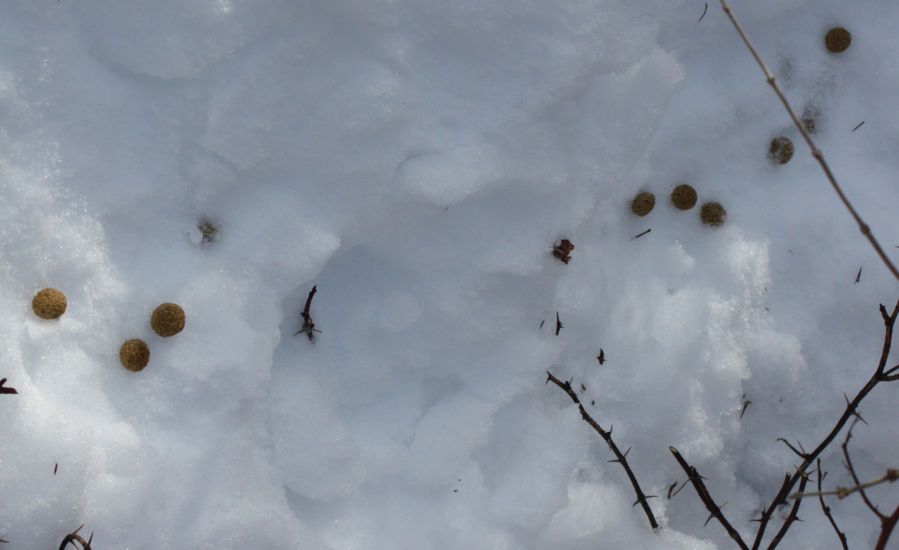
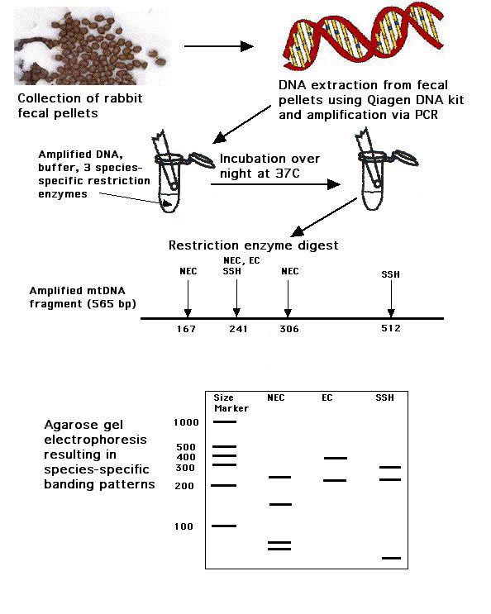
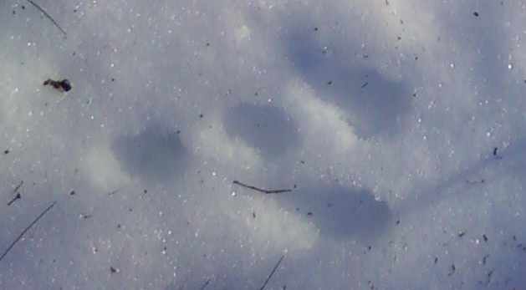
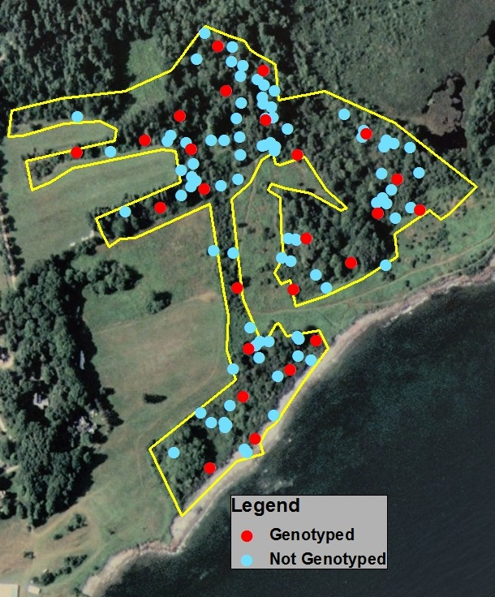
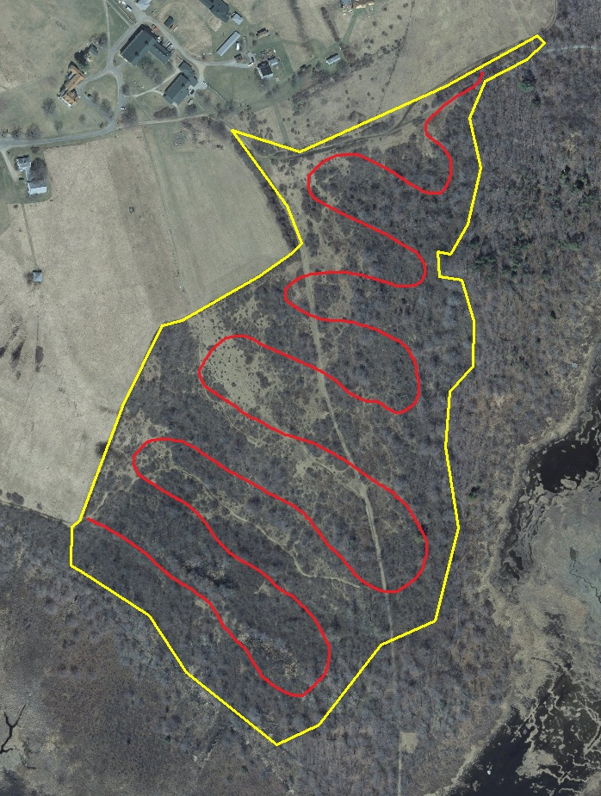
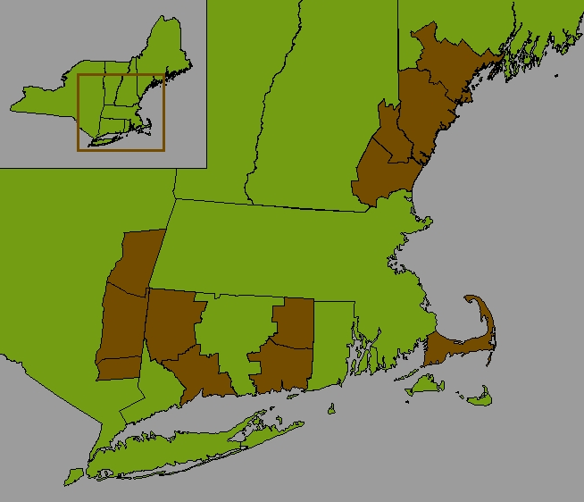








Range-wide Noninvasive Genetic Monitoring of New England Cottontails
Daniel Brubaker & Adrienne Kovach, University of New Hampshire
Objective 1: Detection
Preliminary Results: Detection
Patches (n=38) ranging in size from 2-55 acres were delineated by landscape boundaries and systematically searched for presence of lagomorph fecal pellets.
Top ranking models (ΔAIC<5) from program PRESENCE² for 22 detection sites in Maine and New Hampshire.
Mdl | Model Parameters | AIC | ΔAIC | AICwght | Par.
1 | Pdr+Depth+Knldge | 108.88 | 0.00 | 0.373 | 5
2 | Pdr+Depth+DaysStd+Knldge | 110.60 | 1.72 | 0.158 | 6
3 | Pdr+Depth+Days<2+Knldge | 110.70 | 1.82 | 0.150 | 6
4 | Srvy(1-3,4-6)+Pdr+Depth+Knldge | 110.86 | 1.98 | 0.372 | 6
5 | Srvy(1-3,4-6)+Pdr+Depth+DaysStd+Knldge | 112.58 | 3.70 | 0.157 | 7
6 | Svy(indv)+Powder+Depth+Knldge | 112.75 | 3.87 | 0.144 | 10
7 | Pdr+Depth+Knldge | 113.67 | 4.79 | 0.091 | 4
8 | Pdr+Depth+DaysStd+Knldge+Size+Obs | 113.84 | 4.96 | 0.084 | 8
INTRODUCTION
In the case of rare and threatened species, such as the New England cottontail, a Species of Greatest Conservation Need in the Northeast, population monitoring is a challenge and is best accomplished by noninvasive, genetic methods. Current monitoring efforts for New England cottontails rely on genetic analysis of fecal pellets collected noninvasively during winter surveys. Occupancy status is typically evaluated based on a single visit.
A critical issue with presence/absence-based surveys is the problem of detection¹. That is, if detection rates vary with environmental or other factors, then a seemingly unoccupied patch may not be truly vacant, but may appear so due to poor detection, i.e. a “false absence”. Monitoring New England cottontails within an adaptive management framework will require taking into account factors that influence detectability.
Patches ≤6 acres were surveyed intensively via loose transects (red line) with ~30 meter spacing.
Patches >6 acres were sureyed via multiple 2 acre subplots (green outline) for a search area of 6 acres or 20% of the total patch area.
Occupancy was determined by presence of cottontail sign.
Species identity was confirmed by a diagnostic mtDNA test of fecal pellets.
Covariates: Pdr (powdery snow), Depth (Snow Depth >12in.), Knldge (Prior knowledge of pellet locations), DaysStd (No. Days since snow event), Size (Patch Size), Srvy (Survey Period)
Preliminary results suggest that prior knowledge of cottontail activity increases detection probability, while the presence of powdery or deep snow (>12 in.) decreases detectability of New England cottontails.
Detection rates and sources of variation were determined using an occupancy modeling approach with covariates of:
  snow & other weather conditions
  observer effect & search effort
  patch size & vegetation cover
Parameters influencing detection may be either site specific (patch size) or survey specific (snow depth)
Future analyses will investigate the following additional covariates:
The goal of this project is to develop and implement noninvasive genetic monitoring tools for the estimation of occupancy and abundance of the New England cottontail throughout its range.
search effort (area searched)
temperature & weather events (rain, wind)
stem density
Objective 1: Evaluate the current presence/absence winter survey protocol through a systematic investigation of detection rates.
Cottontail fecal pellets and tracks.
Objective 2: Population Estimation
Objective 2: Develop a “genetic tagging” approach for estimating the numbers of cottontails occupying a habitat patch.
Population estimation surveys were conducted on 22 sites range-wide.
Sites were surveyed intensively during a single visit to collect pellets from multiple rabbits while also resampling a portion of the individuals.
Individual cottontails are identified by their unique genetic signatures obtained from 10 microsatellite loci.
As increasing numbers of pellets are sampled, the number of newly sampled individuals (unique genotypes) plateaus.
Rarefaction Curve
ME-15 (Det)
11 (Pop)
NH- 6 (Det)
5 (Pop)
# of Unique Genotypes
Abundance is estimated by the ratio of new/resampled genotypes.
diminishing returns
This approach will provide the first patch-specific population estimates of New England cottontails range-wide.
Number of Samples
Locations of samples collected during a population survey of in Cape Elizabeth, ME. Red dots indicate selected samples ~50 m apart that will be genotyped for population estimation. We will evaluate whether genotyping additional samples (blue dots) will increase the precision of the estimates.
MA- 4 (Det)
1 (Pop)
Population estimation surveys are exhaustive; pellets are collected every 50-75 meters following loose transects (red line).
NY- 7 (Det)
6 (Pop)
CT-10 (Det)
1 (Pop)
ACKNOWLEDGEMENTS
Funding for this project is provided by a NEAFWA Northeast Regional Conservation Needs Grant, Wildlife Management Institute, US Fish & Wildlife Service, and Maine Division of Inland Fisheries & Wildlife. Mark Ducey provided statistical advice and Kathleen O’Brien and Walter Jakubas assisted with sampling design. Thanks to Anthony Tur, Kelly Boland, Steven Fuller, Paul Novak, Georgette Walters, Eileen McGourty, Dave Scarpitti, Howard Kilpatrick and Travis Goodie for surveys and logistical support. Special thanks to all the technicians and volunteers who helped complete surveys.
Number and location of range-wide detection (det) and population estimation (pop) sites by county.
MacKenzie, D.I., J.D. Nichols, G.B. Lachman, et al. 2002. Ecology 83: 2248-2255.
Hines, J.E., 2006. PRESENCE2. <http://www.mbr-pwrc.usgs.gov/software/presence.html.

