Slide 1
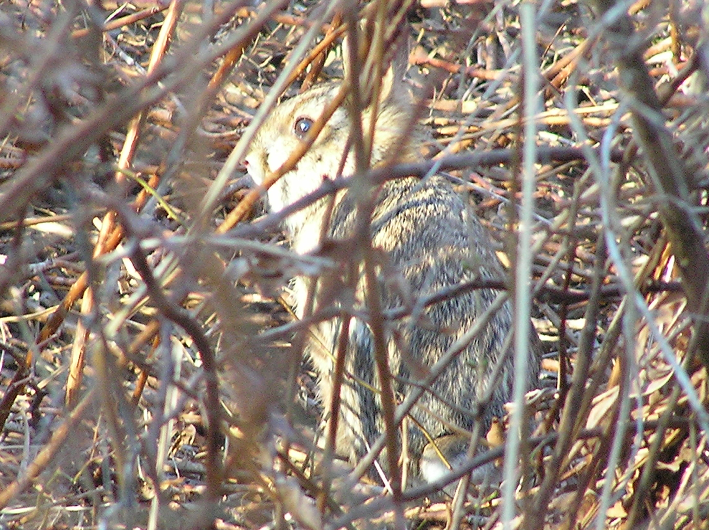


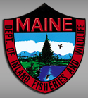
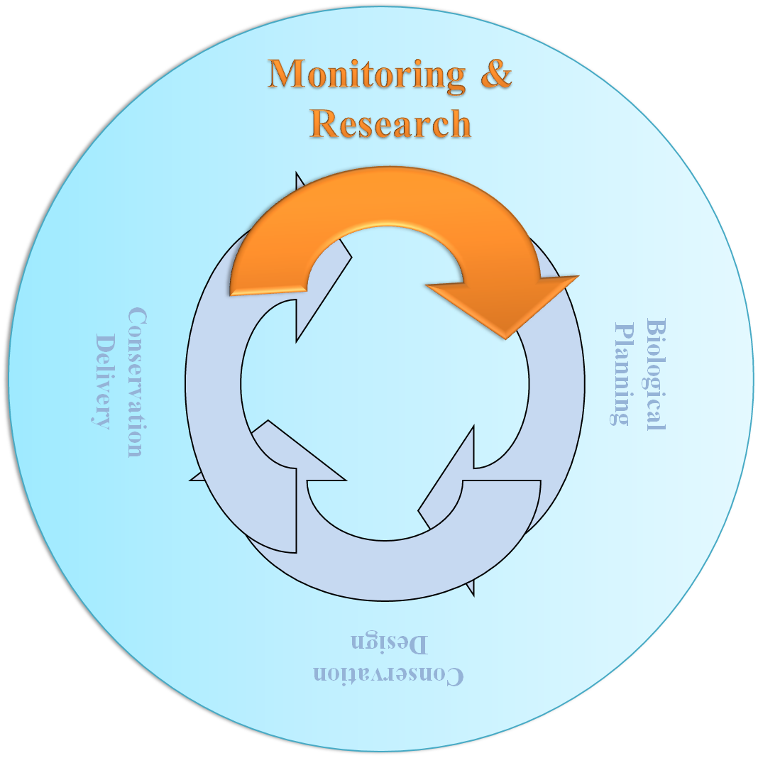
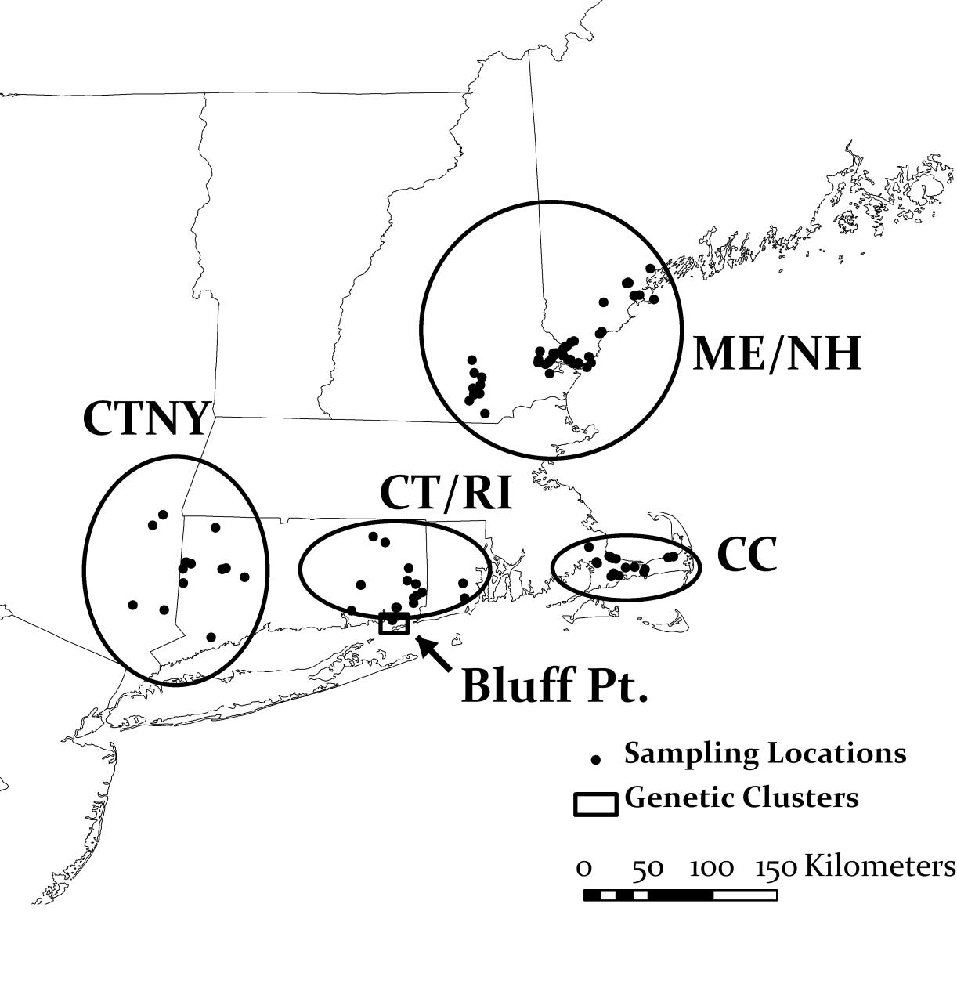
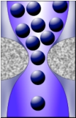
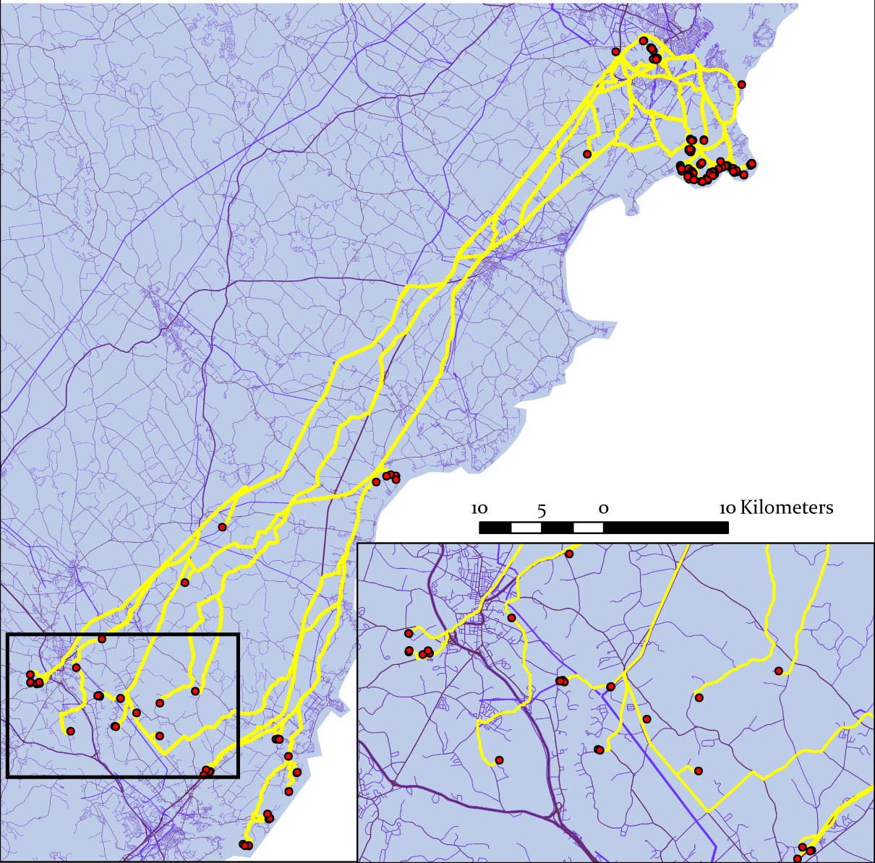
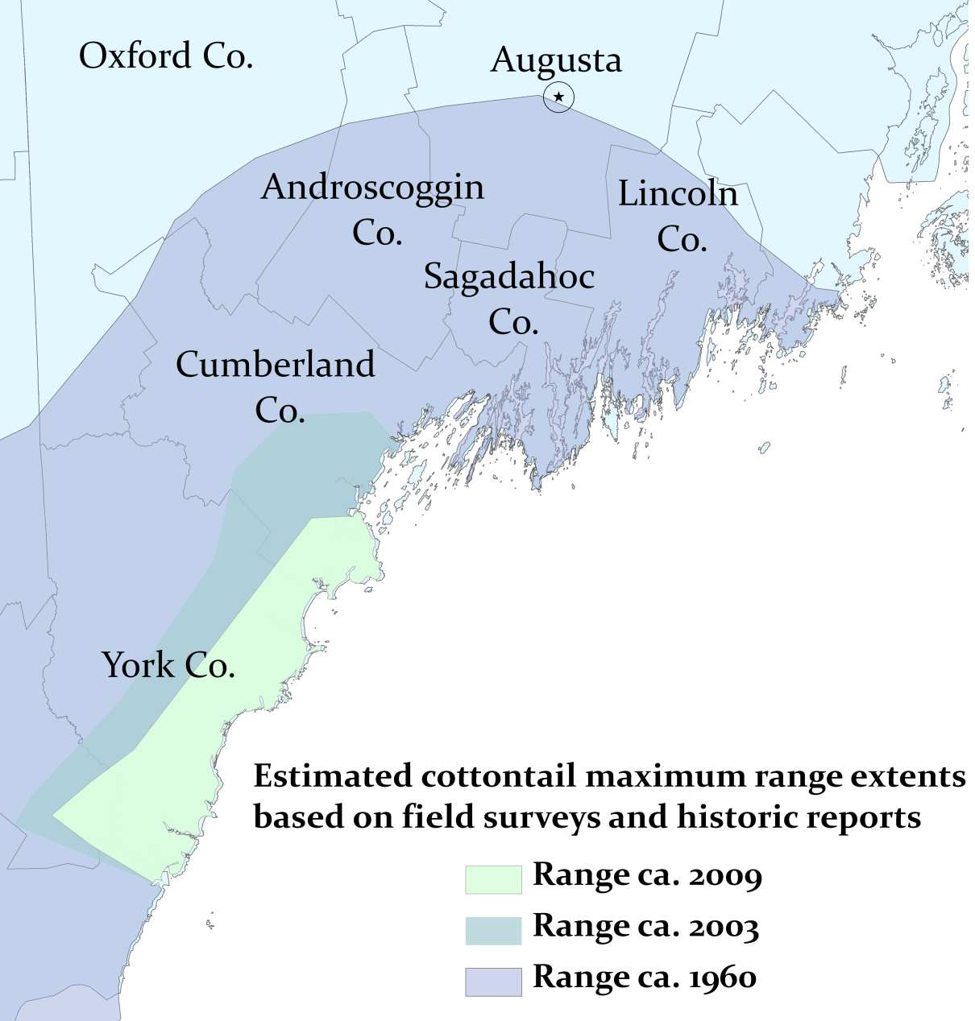
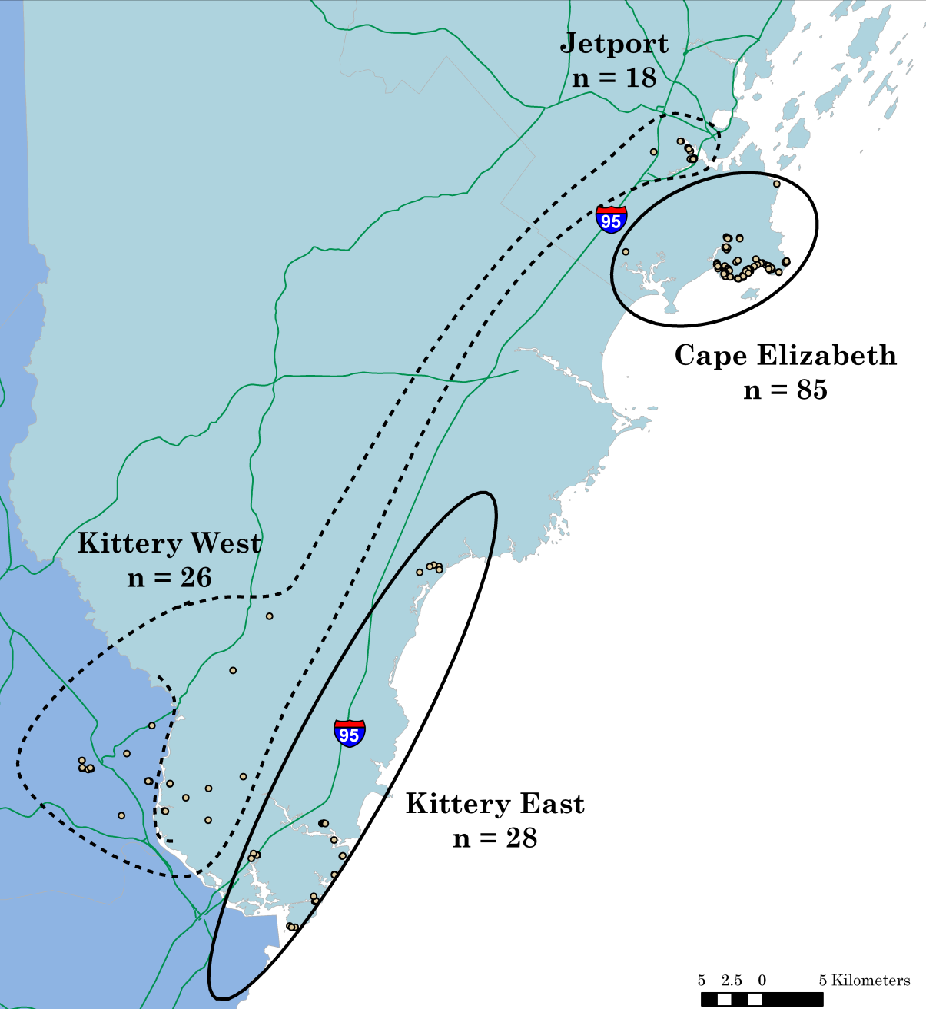
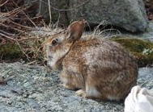
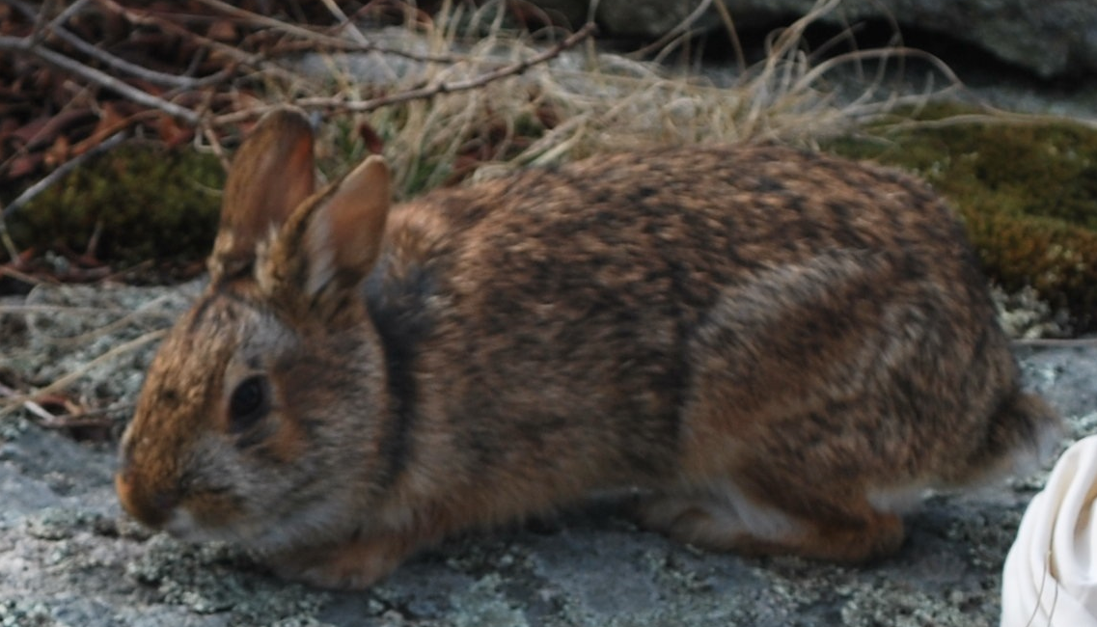
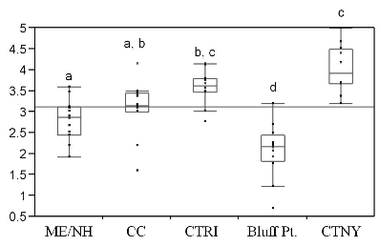
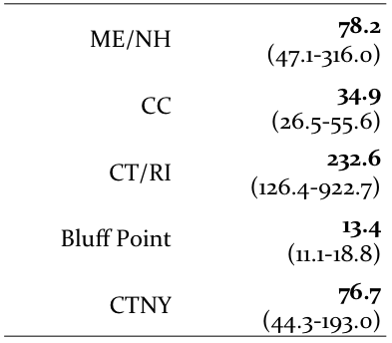
Conservation Genetics of New England cottontails:
Results of range-wide and local investigations
Lindsey E. Fenderson and Adrienne I. Kovach
University of New Hampshire, Durham, NH 03824
Partners: USFWS, Refuges (Rachel Carson, Eastern MA Complex, Rhode Island Complex),
Gulf of Maine Coastal Program, Maine Outdoor Heritage Fund,
NEFO, EDF, MDIFW, NHFG, NYSDEC, CTDEP, RIDEM
Broadscale Results
Effective Population Sizes
Ongoing Research
Five Genetically Distinct Populations
Genetic Diversity and Stochasticity
Population
N_{e}
We are developing several hypothetical raster cost models to test the influence of roads, rivers, and potential facilitating features (powerlines, road-side shrubby habitat and railroad corridors) on dispersal.
Allelic Richness
Introduction
The New England cottontail (Sylvilagus transitionalis) is a Candidate Species in the Northeast(1,3), and is considered endangered in Maine(4) and New Hampshire (5). Continued loss and fragmentation of the thicket habitat on which it depends has contributed to its ongoing decline (2).
Conservation of the New England cottontail will require a thorough understanding of current population structure and genetic diversity of remnant populations. Additionally, persistence of cottontail populations will be critically dependent upon maintaining and improving connectivity among remaining suitable habitat patches. By understanding current connectivity patterns, we can prioritize management actions and mitigate negative effects of population isolation.
To meet these needs, our objectives were to conduct population genetic investigations at two spatial scales: Range-wide (broadscale) and locally within the southern Maine and seacoast New Hampshire population (finescale). Specifically, we aimed to:
Broadscale
Evaluate population genetic structure and current levels of gene flow among populations range-wide
Assess genetic diversity and effective size of remnant populations
Finescale
Characterize the population genetic structure, diversity and gene flow at a local scale
Investigate patterns of dispersal in relation to landscape features and fragmentation
Methods
Analyses were conducted at two spatial scales:
1) range-wide, using 192 archived samples from surveys conducted between 1990-2009, and 2) locally, within Maine and seacoast New Hampshire, using 157 individuals collected during intensive winter surveys conducted 2007-2009.
We used Structure(6) and Tess(7), two Bayesian clustering programs, to delineate genetic units at both spatial scales.
Descriptive genetic diversity statistics were calculated using Genepop(8), Fstat(9) and HP-Rare(10). Tests for genetic bottlenecks were performed with Bottleneck(11), M_P_val.exe and Critical_M.exe(12) softwares.
We used two methods to estimate effective populations sizes of each genetic cluster: a linkage disequilibrium method performed in LDNe(13) and a Bayesian method performed in ONeSAMP (14).
Finescale dispersal measures and estimates of spatial genetic structure were calculated in Spagedi(15).
Cost distances are correlated with genetic distances to find the best fitting model.
The image depicts one hypothetical model, with the least costly dispersal route shown in yellow.
Sample Locations
Least Cost Path
(1) Facilitating features
(50) Background
Roads
Unique alleles
Effective population sizes are critically low for all populations, except eastern Connecticut.
Gene flow is negligible among the 5 broad-scale genetic groups.
o.17
o.62
o.2
o.77
A genetic bottleneck of long duration was detected in the Cape Cod population and a recent genetic bottleneck or founder event was detected in Bluff Point.
Genetic diversity in the ME/NH and CC populations is reduced relative to the Connecticut populations.
Finescale Results
Rapid and ongoing southeasterly
range contraction in southern Maine
Genetically distinct cottontail populations in Maine and New Hampshire (with sample sizes)
Effective Population Size, Parent –Offspring Dispersal Distance
and Spatial Genetic Structure
in Continuous (CE) and Fragmented (KE/KW) Habitat
Cottontails in Maine and seacoast New Hampshire occur in 3 genetically distinct populations with limited gene flow.
 | Mean Ne (95% CI) | Parent -Offspring Dispersal Distance (σ)² | Degree of Spatial Genetic Structure (Sp)
JET¹ | 3.2 (1.6 – 13.9)
CE | 36.7 (22.0 – 67.9) | 518 m | 0.052
KE² | 5.3 (2.5 – 10.9) | 2136 m | 0.085
KW | 16.8 (6.1 – 123.7) | 1093 m | 0.173
Jetport cottontails were most genetically similar to those from Kittery West.
Substructure was found within Kittery West following the boundary of the Piscataqua River.
The Cape Elizabeth population has experienced a recent genetic bottleneck, consistent with the pattern of rapid contraction of the northern range limit.
Effective population sizes are below that necessary for persistence, indicating cottontails in ME and NH are in need of immediate management action.
σ and Sp were not calculated for the Jetport due to small sample size
Standard deviations for σ range 100-400 m
Sp measures the association of genetically similar individuals over geographic space
Greater fragmentation in the Kittery populations has resulted in greater spatial genetic structure and larger dispersal distances to find suitable habitat.
Conclusions
Management Recommendations
Literature Cited
Fragmentation has caused population isolation and genetic differentiation as it has reduced gene flow range-wide and on a local scale.
USFWS (2009) New England Field Office, Concord, NH
http://www.fws.gov/northeast/endangered/pdf/NE Cottontail SSAP.pdf.
2. Litvaitis,JA, Johnson B, Jakubas W, Morris K (2003) Can J Zool 81:877-887
3. USFWS (2006) Federal Register 71:53755-53835
4. MDIFW (2007) http://www.maine.gov/ifw/wildlife/species/
pdfs/etlist_recommendations.pdf
5. NHFG (2008) http://www.wildlife.state.nh.us/Wildlife/Nongame/
Nongame_PDFs/Endangered_Threatened_Wildlife_NH_1108.pdf
6. Pritchard JK, Stephens M, Donnelly P (2000) Genetics 155:945-959
7. Chen C, Durand E, Forbes F, François O (2007) Mol Ecol Notes 7:747-756
8. Raymond M, Rousset F (1995) J Hered 86:248-249
9, Goudet J (1999) J Hered 86:485-486
10. Kalinowski ST (2005) Mol Ecol Notes 5:187-189
11. Piry S, Luikart G, Cornuet JM (1999) J Hered 90:502-503
12. Garza JC, Williamson EG (2001) Mol Ecol 10:305-318
13. Waples RS (2006) Conserv Genet 7:167-184
14. Tallmon DA, Koyuk A, Luikart G, et al. (2008) Mol Ecol Resour 8:299-301
15. Hardy OJ, Vekemans X (2002) Mol Ecol Notes 2: 618-620
Implement habitat restoration efforts immediately to increase available habitat and connectivity among patches within each geographic population.
Genetic diversity and effective population sizes are reduced for Maine/New Hampshire and Cape Cod relative to the Connecticut populations, suggesting that the former face the greatest threats to persistence.
Continue monitoring occupancy and population status of known populations to ensure that goals of population sustainability are being met.
Initiate fine-scale surveys within each geographic region to identify additional population subdivisions and to better estimate effective population sizes range-wide on a metapopulation level.
Fine-scale structure exists within ME and NH and likely within other geographic populations.
Fragmentation and isolation has shaped fine-scale population structure and altered dispersal patterns.
Conduct studies of reproductive fitness to assess whether there is evidence of inbreeding depression; knowledge of reproductive and demographic parameters will also be useful in constructing population viability models for the species.
Acknowledgements
Employ reintroductions to restored habitat, if necessary, to promote genetic exchange and population augmentation within geographic populations.
Collaborators: John A. Litvaits and Marian K. Litvaitis (UNH)
Additional Partners: Kathleen M. O’Brien, Anthony Tur (USFWS),
Walter Jakubas (MDIFW), Kelly Boland (EDF)
Funding provided by: MDIFW, Maine Outdoor Heritage Fund, USFWS
Additional support with sampling and other logistics provided by:
Avoid translocations between geographic populations unless it becomes justified by future findings of inbreeding depression; if translocations become warranted, use geographically proximate source populations.
John DePue & MDIFW
Margaret Arbuthnot & EDF
Steven Fuller & NHFG
Howard Kilpatrick & CTDEP
Paul Novak & NYDEC
Brian Tefft & RIDEM
Barbara Charry & Maine Audubon
David Tibbetts, Emma Carcagno
Notes:
517.5 ± 115.7
23.1 ± 13.6
0.052
2136.1
28.5
0.085
1093.1 ± 394.8
7.0 ± 5.0
0.173

