Slide 1
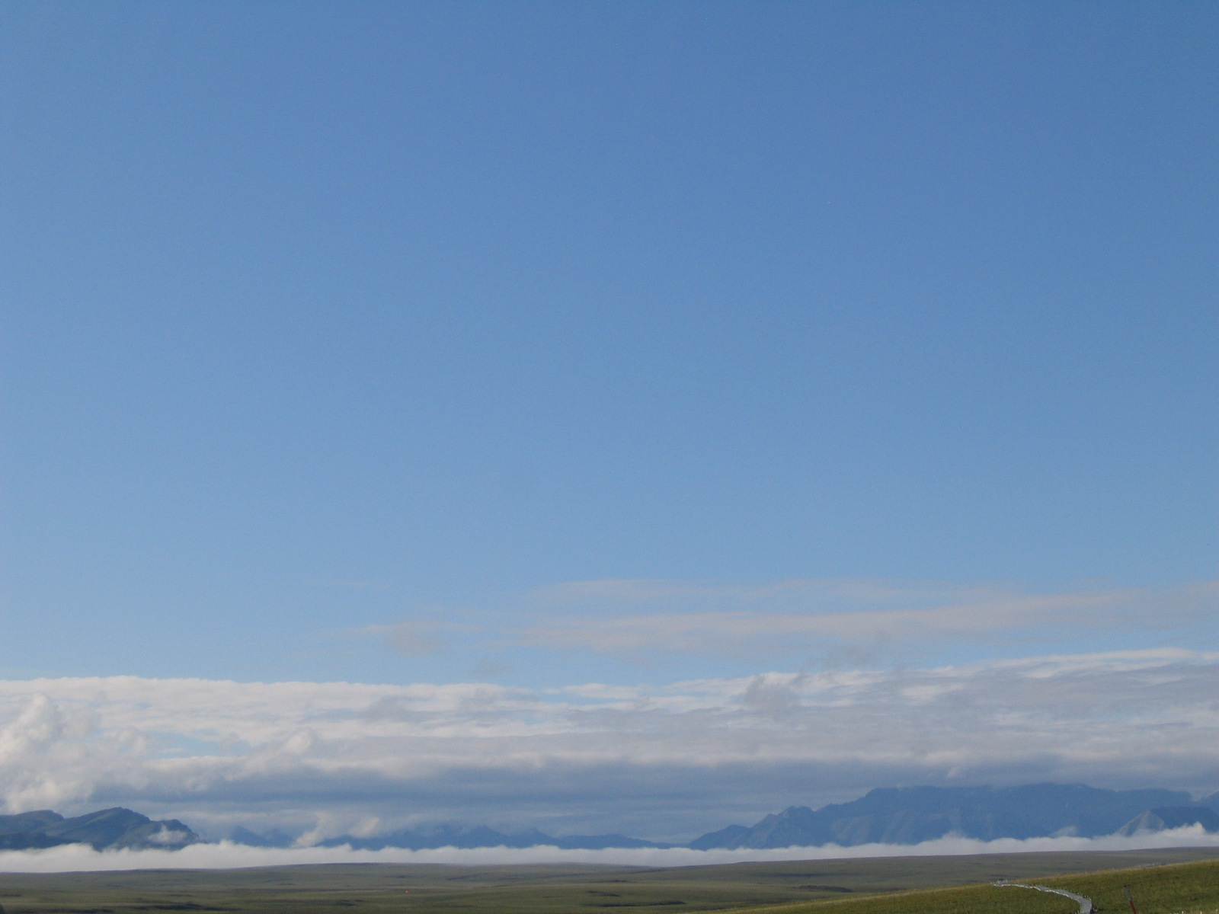
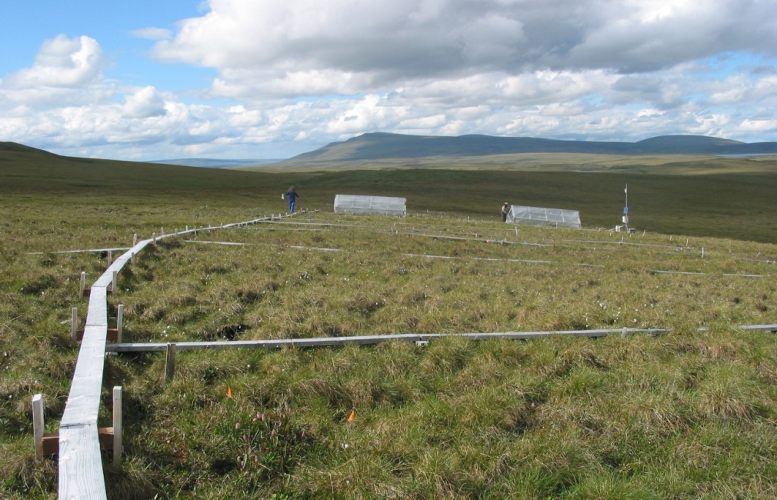
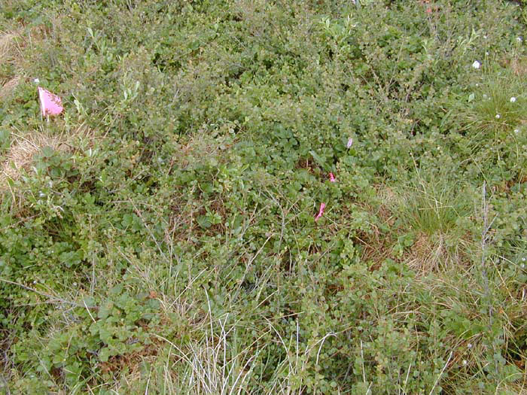
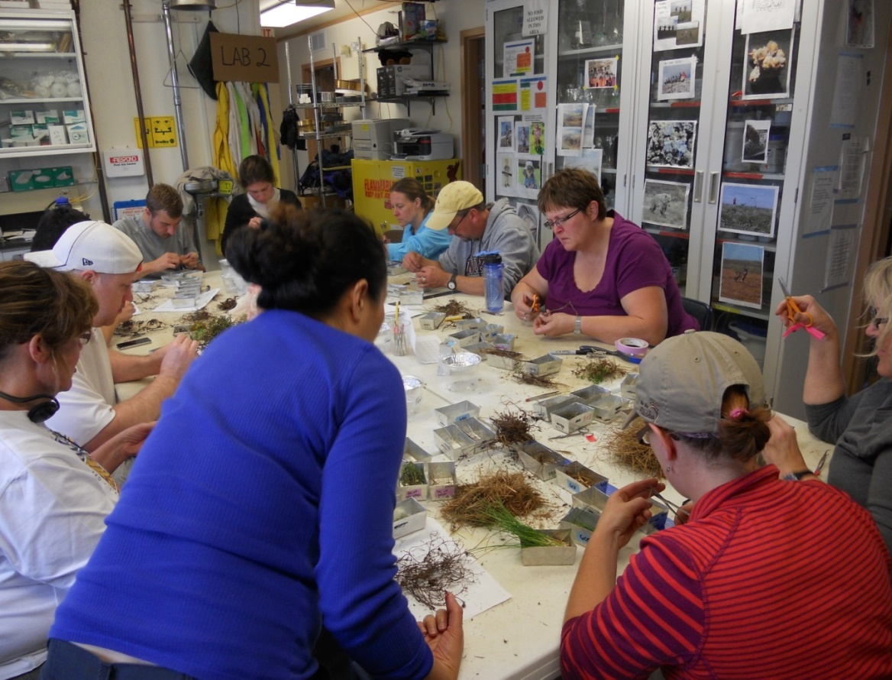
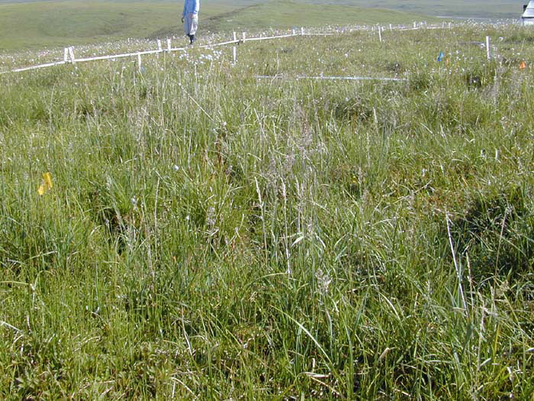
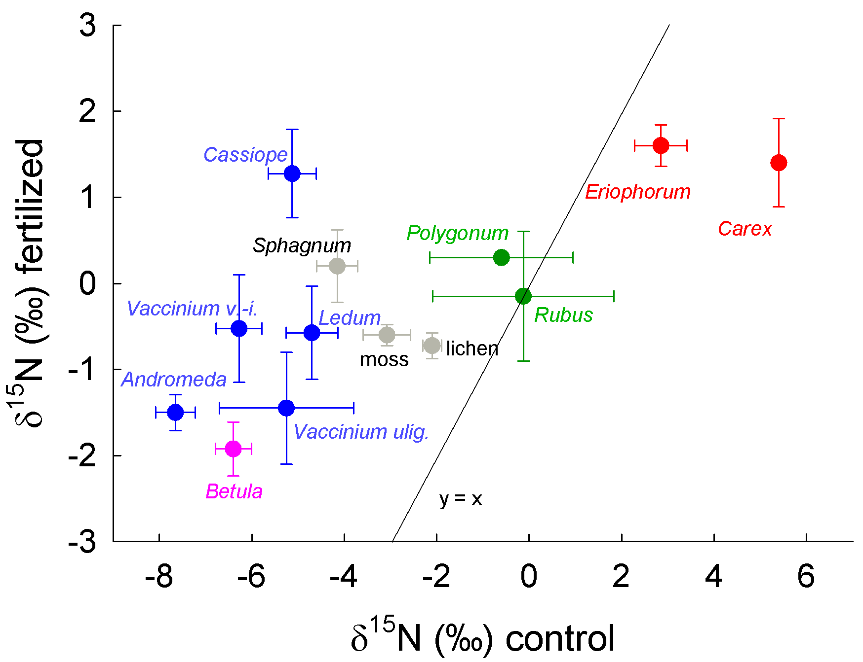
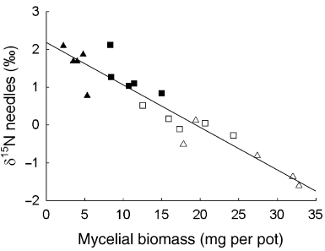


Mycorrhizal Type Influences C Allocation and N Acquisition in Moist Tundra in Response to N Fertilization, P Fertilization, and Warming
Erik Hobbie¹, Laura Gough², Sarah Hobbie³, Gaius Shaver⁴
¹University of New Hampshire, ²University of Texas at Arlington, ³University of Minnesota, ⁴Ecosystems Center, Marine Biological Laboratory
Introduction
∙ Responses to climate change in the Arctic may be mediated through shifts in nutrient dynamics of plants and the associated mycorrhizal fungi that supply plants with N and P.
∙ Mycorrhizal fungi vary in enzymatic abilities and extent of spatial exploration; accordingly, the nutrient resources available for uptake vary among nonmycorrhizal (NON), arbuscular mycorrhizal (AM), ectomycorrhizal (ECM), and ericoid mycorrhizal fungi (ERM).
∙ Fertilization changes C allocation patterns in plants and often N and P supply can control allocation to mycorrhizal fungi.
∙ N isotope patterns (expressed as δ¹⁵N) are influenced by plant N sources and the linked partitioning of C and N in mycorrhizal symbioses.
∙ Soil δ¹⁵N at Toolik increases with depth (unpublished data, Michelle Mack).
∙ Based on responses to N fertilization in temperate and boreal regions, we predicted:
δ¹⁵N differences between NON and AM plants versus ECM and ERM plants should diminish with fertilization. This reflects decreased C allocation to ECM/ERM fungi, decreased importance of recalcitrant organic matter as a nutrient source, and diminished transfer of ¹⁵N-depleted N by ECM and ERM fungi.
Warming should increase SOM turnover but nutrient availability may not increase.
δ¹⁵N in nonmycorrhizal plants should reflect bioavailable N and the depth of N acquisition.
∙ A warming (greenhouse, GH) and fertilization (N & P) experiment (Figure 2) in moist non-acidic tussock (MNT; Figure 3) and moist acidic tussock (MAT; Figure 4) tundra began in 1997; N and P were added at 10 g N/m²/yr (δ¹⁵N = 2.2‰) or 5 g P/m²/yr.
∙ A biomass harvest (pluck) in 2000 (Figure 5) was used to study plant responses to fertilization.
∙ Here, we report δ¹⁵N patterns across the treatments and species for insights into how warming and fertilization altered C and N dynamics.
Methods
∙ Treatments: control, N, P, NP, GH, GHxNP in MNT plots (n=3); control and NP in MAT plots (n=4).
∙ Samples classified by tissue type, species, and probable functional/mycorrhizal type (Table 1).
∙ After measurement at KSU, δ¹⁵N patterns were analyzed using multiple regression with functional type, species, tissue, and treatment (N, P, NP, or warming) as independent variables and interactive effects of functional type and treatment included.
Results
∙ Fertilization increased δ¹⁵N in ERM and ECM plants more than warming (Tables 2&3). In MNT tundra, ECM plants were more sensitive than ERM plants to P and NP whereas ERM plants were more sensitive to warming than ECM plants (Table 3).
∙ In MAT tundra, δ¹⁵N of ECM and ERM plants increased similarly with NP fertilization (Figure 6).
∙ Nonmycorrhizal plants declined in δ¹⁵N if N was added but not in P only or warming only treatments; nutrients, particularly N, decreased δ¹⁵N differences between ECM/ERM and AM/NON plants.
Discussion/Conclusions
∙ Increased δ¹⁵N with fertilization in ECM/ERM plants suggests that host plants reduce C flux to their symbionts (as demonstrated in prior culture studies, Figure 7). These fungi transfer less ¹⁵N-depleted N to host plants, and retain less ¹⁵N-enriched N as their biomass declines.
∙ Results imply that source δ¹⁵N controls δ¹⁵N more in ERM than in ECM plants. Based on declining δ¹⁵N with P fertilization, ECM plants decrease C flux to ECM fungi in response to P fertilization but ERM plants do not.
∙ ERM plants may use N as the regulating nutrient whereas ECM plants use both.
∙ Graminoid δ¹⁵N declined with fertilization, indicating parallel declines in the δ¹⁵N of available N.
∙ Warming probably increased the uptake of deeper, ¹⁵N-enriched N by both ECM and ERM fungi/plants but did not increase its bioavailability to nonmycorrhizal plants.
;
Figure 2. Study site, Toolik LTER.
Figure 4. MAT tundra, NP plot 1.
Figure 5. Happy days during the harvest of 2012.
Table 2. Mean δ¹⁵N values for foliage of plants from MNT tundra after four years of treatment. ulig. = uligonosum, ang. = angustifolium, and vag. = vaginatum. Treatments: GH, greenhouse; N, N fertilization; P, P fertilization; NP, fertilization with both. Values are ± SE (‰), n is usually 3. ¹appeared nonmycorrhizal in Denali (Treu et al. 1996).
Figure 3. MNT tundra, NP plot 1.
Table 1. Plants classified by probable functional/mycorrhizal type.
(A), in MAT tundra; (N), in MNT tundra; (B), in both tundra types.
Ericoid mycorrhizal: Andromeda polifolia (A), Cassiope tetragona (B), Ledum palustre (A), Vaccinium uligonosum (B), V. vitis-idaea (A)
Ectomycorrhizal: Betula nana (A), Salix pulchra (N), Dryas integrifolia (N)
Arbuscular mycorrhizal: Polygonum bistorta (B), Rubus chamaemorus (A)
Nonmycorrhizal: Carex bigelowii (B), Eriophorum angustifolium (B), Eriophorum angustifolium (A), Eriophorum vaginatum (B) (graminoids)
Moss: Tomenthypnum (N), Sphagnum (A), “other moss” (B)
Lichens: Mixed (B)
Table 3. δ¹⁵N shifts relative to control treatments in MNT tundra of NxP treatments, NPxGH (greenhouse) treatments, and in MAT tundra of NP fertilization. Calculations from multiple regression analyses. Units in ‰.
Figure 6. δ¹⁵N values for plant foliage from MAT tundra. Mycorrhizal type: blue, ERM; pink, ECM; green, AM; red, nonmycorrhizal.
Figure 7. δ¹⁵N values for plant foliage correlate with allocation to ECM fungi in culture (Hobbie EA, Colpaert JV. 2003. New Phytologist 157: 115-126).
Acknowledgements
This study was supported by NSF OPP-1108074, OPP-0909441, OPP-0909507, OPP-0312186, DRL-0832173, and the NSF LTER network. We thank all the volunteer teachers and technicians who participated in the plant harvest.

