Slide 1


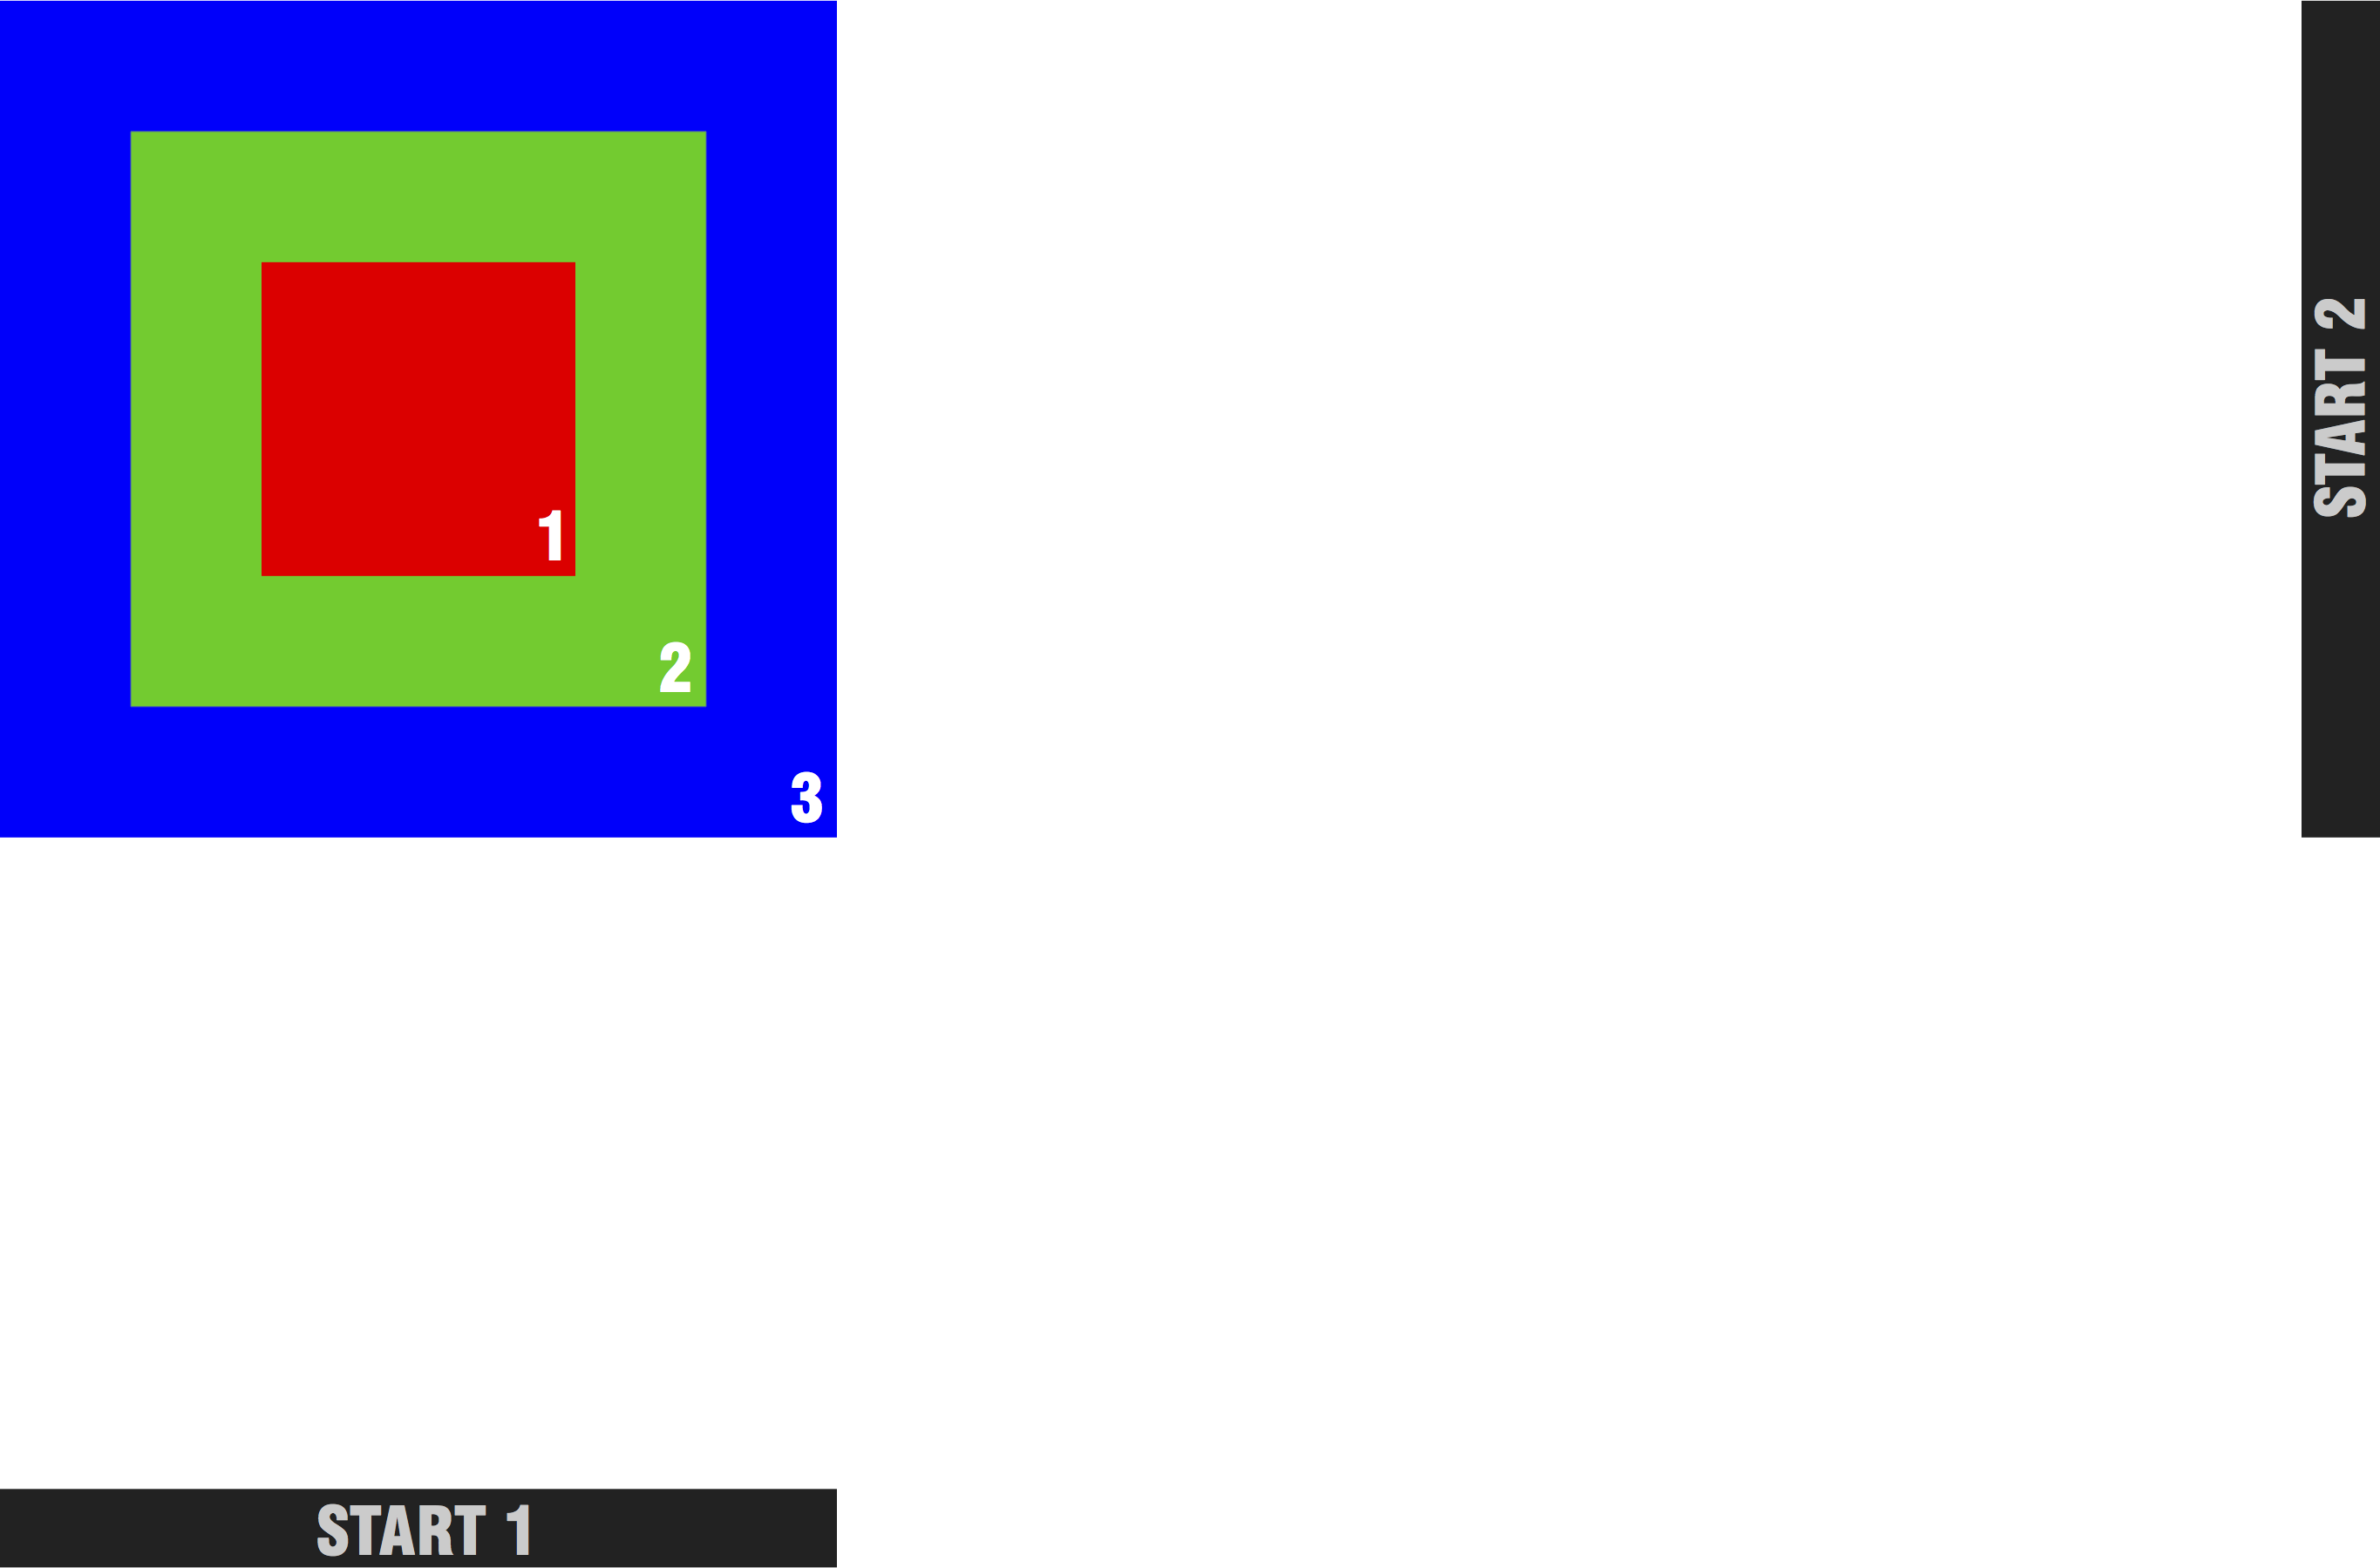
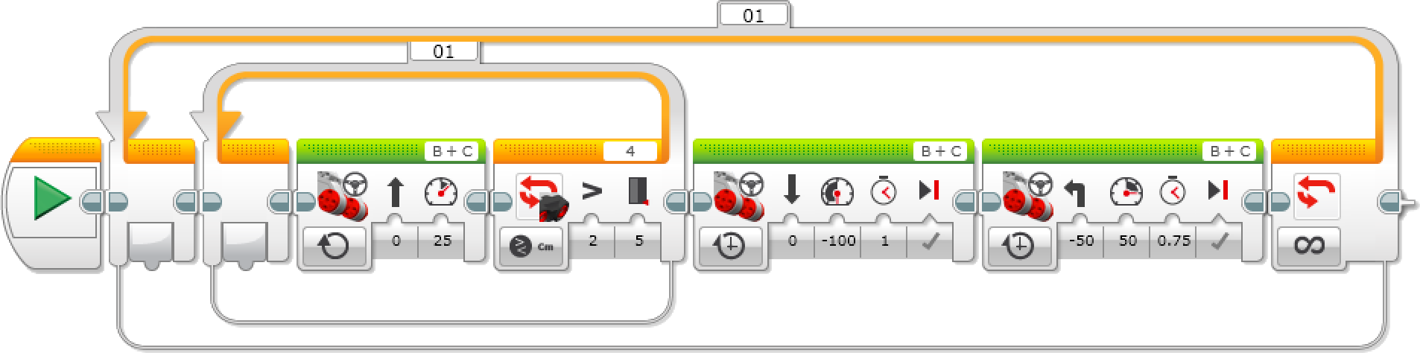
Just Enough Programming for Eight-Year Olds
Gavin Kearns
Paul Elementary School
Wakefield, New Hampshire
gavin.kearns@sau64.org
Karen H. Jin
Department of Computer Science
University of New Hampshire
Durham, New Hampshire
jin@cs.unh.edu
Abstract
The “Just Enough” Strategy
Programmable robots have become a very popular tool to introduce children to technology. However most curricula that emphasize actual programming typically target kids 10 years and older. This summer, the University of New Hampshire organized an Elementary Program Introducing Computing (EPIC) camp. Children 7-9 years old, with no prior programming experience, were introduced to problem solving and creative program design using Lego EV3 Mindstorms robotics. The program followed a “just enough” principle, such that just barely enough contents were presented to the children in spite of a wider ranger of available materials. For example, a simple robot model was prebuilt to help children focus on programming rather than construction; program control flow and sensor data processing were introduced early on, but only using a very limited set of visual programming blocks and sensors. These basic structure blocks provide enough functionality to construct a moderately complex program, and help students stay focused on problem solving in a non-overwhelming setting. In order to gauge the learning outcome, a test was given before and after the camp. The comparison of the results showed that our method helped the children retain the programming skills and knowledge of general concepts of computing.
The “just enough” strategy has shown successful results in several areas.
A simple base robot model was pre-built and given to the students; the only modification required from them was to add on sensors. This helped the children to focus on programming rather than construction, and help them grasp the real power of computing: what makes a robot “smart” is the program designed by the programmer rather than the robot itself.
A small set of visual programming blocks were introduced. For example, we presented one type of robot movement block, the moving steering block, and one type of loop block, the do-while loop. These basic structure blocks provide enough functionality to construct a moderately complex program, and help students stay focused on problem solving. See Figure 4.
Sensors are great additions to engage young children’s interest. We selected only the color sensor and the ultrasonic sensor as they are easy to understand and work well with young children. Nevertheless, this limited exposure to sensor data processing helped reinforce an important concept: it is the software that enables a robot to make use of the hardware, to sense and to react in its surrounding world.
A set of simple demo programs were explained to children daily, which gave them just enough preparation in creating their own solutions for more complex tasks. For example, we would first show a sample program to let the robot stop 5 inches from a wall, which gives enough basis for the children to design their own program that keeps the robot always 5 inches away from a moving object.
Children were very engaged throughout the camp; they showed great enthusiasm in working with robots that performed various tasks such as:
A “shadow bot” that follows moving objects.
A “never fall-off ” robot that always stays on the table without falling off the edges.
A “ranger bot” that navigates through an animal safari and make the right animal sounds when passing the different colored animal habitats.
An “orchard bot” that collects fruits from rows of trees.
A rotating “Team Captain” role was very effective in promoting leadership and team dynamics. The team captain, who is in charge of certain tasks, lead the other team members in programming design, testing and debugging. This team structure gave every child an equal chance to be in the driver’s seat and helped resolve common conflicts in team works. As a result, all teams finished at least 80% of the daily tasks and challenges.
Significance and Relevance of the Topic
Programming is an important skill that needs to be promoted among impressionable young minds. In current studies of teaching programming to elementary aged children, robots are a common theme. If children are working on something that is meaningful to them, they will be more motivated to learn from the experience [1]. By using robots, they see a tangible object that is being controlled by their programs. Additionally, using robots allows having games and competition to foster the entertainment value of learning to program [1]. When elementary aged students use robots for programming, those exposed early in childhood are more likely to be interested in a STEM career [2].
Robotic education curricula have gained popularity, especially ones that focus on creative problem solving and program design. Because of the complexity of working with robotics and sensors, most of these curricula have been geared towards children 10 years and older. In an effort to introduce programming at a younger age, organizations like code.org have started to promote computing skills through simple games. The UNH EPIC camp was planned for younger children and was designed based on a “just enough” principle. The content focused on basics of computing and was designed to not overwhelm young children. With the “just enough” classroom instruction and material, a simple pre-built base robot, two sensors and a small set of visual programming blocks, children were able to focus on creative program design. They wrote programs to control the robot to accomplish various game-like challenges; they were able to understand the real power of computing by making the basic robot a “smart” one that can “see” and “think”.
Evaluation of Results
Camp Structure
An anonymous test was given to students to gauge the effectiveness of our program. On the first day of camp, campers were given a pre-test on general computing concepts, vocabulary and actual visual program construction. They were told to answer to the best of their ability. Questions included a choice of “I don’t know.”, which allowed campers to either give us a correct answer, a guess, or truthfully say they did not know. On the last day of camp, the children took the same test again to measure what they learned since arriving at camp. There were no specific discussions on test prep throughout camp instructions.
The results showed that there was a remarkable improvement in the correctness for all test questions. In collecting data, specific campers were not tracked, so from the data we do not know how much any one camper improved, only as a whole. Figure 1 shows how much on average the campers learned. Six of the 11 questions were below 50% in the pre-test, but only two were in the post-test. Most notably, questions 10 and 11 involved reading a visual program to derive its function; post-test results showed between an 80%-100% correctness. Figure 2 shows the range of scores from pre- to post-test. Pre-test range was from 14%-78%, while post-test it was 64%-100%. Figure 3 shows the difference pre- and post-test between the low, median, and high scores. The lowest score achieved went from nearly 10% to 64% and the median went from 42% to 81%.
The result shows that the EPIC camp, designed with the “just enough” approach, was effective in introducing elementary age children to computing, and expanding their breadth of knowledge about general concepts of computing.
Enrolled 12 boys and 4 girls.
Monday to Friday from 1:30 pm – 4:00 pm
At the start of each day, children would learn important vocabulary words, such as loop, debug etc., that they would hear in the new concept discussions. Then the camp instructor would have a 10-15 minute presentation using visual blocks that detailed how to control the robot. Several demo programs were explained and then given to the children to play with on their own robot. Campers would next create their own programs to fulfill a set of tasks of increasing difficulty. We held a daily robotic competition in which campers then used the vocabulary and tools to accomplish a more complex challenge.
References
[1] S. Atmatzidou, I. Markelis, and S. Demetriadis. The use of Lego Mindstorms in elementary and secondary education: Game as a way of triggering learning. In Proceedings of International Conference on Simulation, Modeling, and Programming for Autonomous Robots, 2008.
[2] M. Varney, A. Janoudi, D. Aslam, and D. Graham. Building young engineers: Tasem for third graders in Woodcreek Magnet Elementary School. IEEE Transactions on Education, 55(1):78–82, 2012.
Figure 5. The final challenge campers were given.
Figure 4. A sample complex program written using simple to understand blocks.

