Slide 1
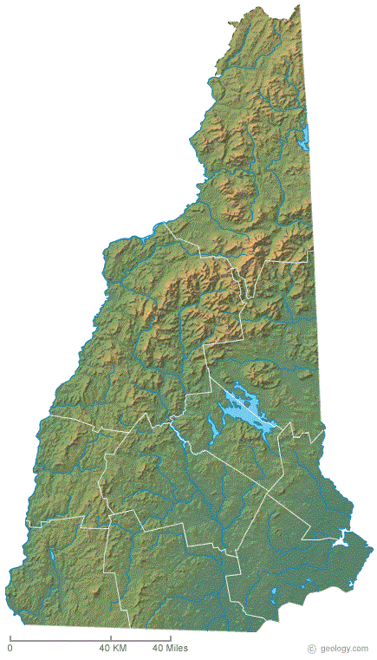
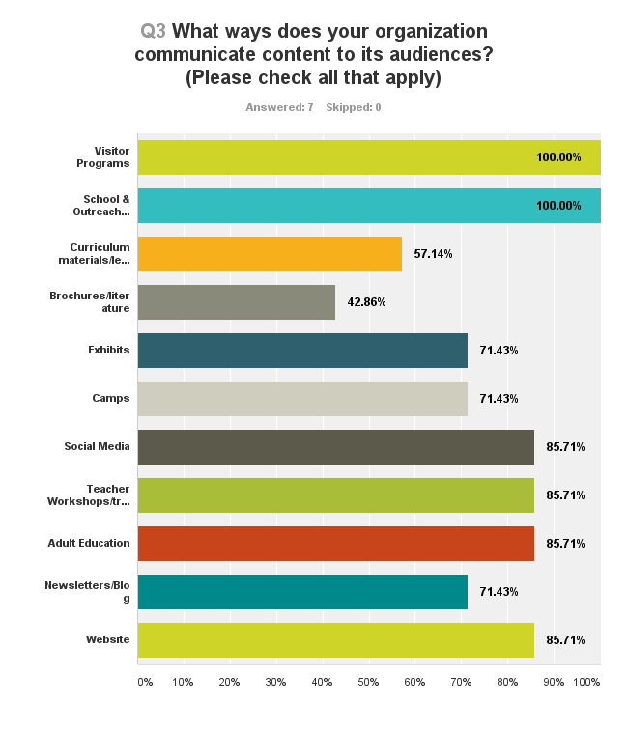
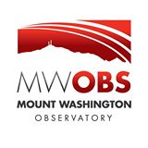

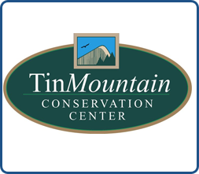

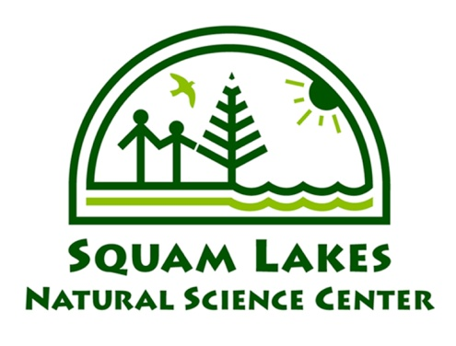

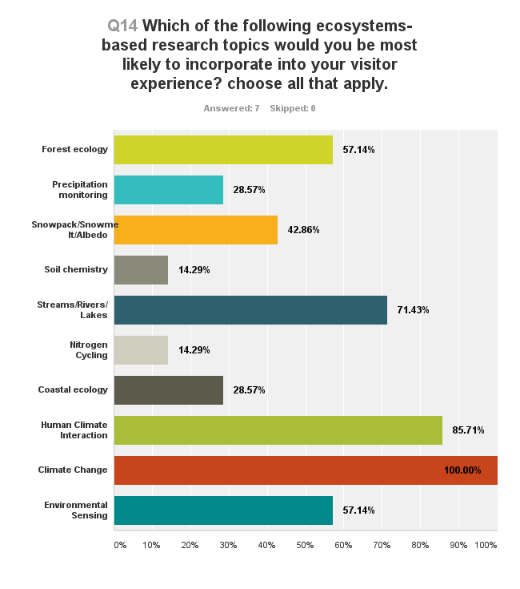




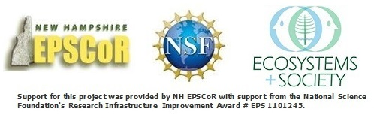
It’s “NHISE” to Connect: How do you communicate your science to a broader audience?
Kate Leavitt¹ and Will Broussard²
¹Seacoast Science Center, Rye, NH ²Mount Washington Observatory, North Conway, NH
NH EPSCoR’s Ecosystems and Society Project is a collaborative effort to study and broaden public understanding and appreciation for the complex interactions linking New Hampshire’s Climate, Land Use, Ecosystems and Society. Participating research scientists throughout the state are strengthening our understanding of the complex interactions among climate, land use, ecosystem function, and society through their projects and collaborations. Full realization of this work and its big-picture relevance requires public understanding of the research and an appreciation for its application in everyday lives. The New Hampshire Informal Science Educators (NHISE) Network attempts to bridge the gap between research scientists and the general public by better connecting scientists with informal educators who are themselves best equipped to engage large and diverse audiences statewide. The NHISE Network is comprised of ten non-academic, informal science education institutions of varying size, audience, and topic areas of interest with a common mission to advance environmental literacy throughout the state of New Hampshire. This Network builds informal educator capacity through the development of best practices for translating and disseminating ecosystems-based concepts and research. Facilitated match-making workshops provide opportunities for research scientists and educators to learn about each other’s work, target audiences, missions, project goals, and timelines to determine the best possible mutual benefit. Network member institutions work with scientists to explore a variety of public engagement strategies including visitor and outreach programs, social media, exhibits, newsletters and blogs.
Who is the Network, and What is the Scale of Impact?
Name | Focus | Visitation | Programming
Amoskeag Fishways | Rivers, Fish passage, River Ecology, Watershed Ecology, Urban Wildlife | 6,500 | 28,000
Appalachian Mountain Club | Alpine ecology, Weather, Place-based Environmental Education, Cultural History | 3,000,000 | 164,000
Great Bay National Estuarine Research Reserve | Estuarine Ecology, Ecosystem Services, Watershed Ecology, Place-based Environmental Education | 5,000 | 5,000
Harris Center for Conservation Education | Place-based Environmental Education, Wildlife Ecology, Watershed Ecology, Botany, Cultural History, Citizen Science | 2,200 | 7,000
Margret & H.A. Rey Center | Place-based Earth and Environmental Science; Experiential learning through Art, Science and Nature | 5,400 | 11,200
McAuliffe-Shepard Discovery Center | Astronomy, Earth Science, Aviation, Space Science | 50,000 | 60,000
Mount Washington Observatory | Mount Washington, Meteorology, Climate | 300,000 | 5,000
Seacoast Science Center | Rocky Shore Ecology, Saltmarsh Ecology, Ocean Acidification, STEM Careers Development, Place-based Environmental Education | 70,000 | 20,000
Squam Lake Natural Science Center | Lakes Ecology, Habitats, Scientific Data Collection, Place-based Environmental Education | 85,000 | 38,000
Tin Mountain Conservation Center | Solar/renewable energy, Avian Ecology, Forest Ecology, Wildlife Tracking, Mt Washington Valley Ecosystems, Watershed Ecology | 2,000 | 2,500
Literature Cited: Nisbet, J., K. Gardner, C. Wake, W. McDowell, R. Howarth. 2013. Partnerships for Research and Education. A Strategic Plan for: Interactions Among Climate, Land Use, Ecosystems Services and Society. NH EPSCoR Internal Document.

