Slide 1


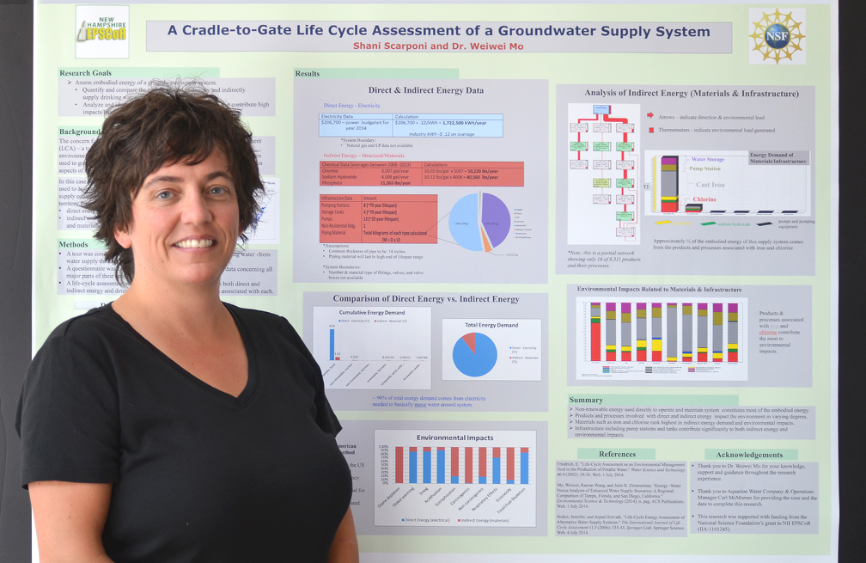
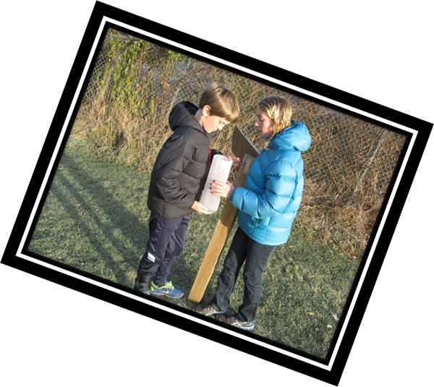
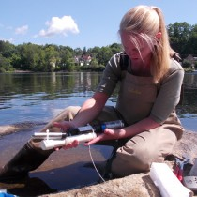
Formative Survey Results for NH EPSCoR Teacher Engagement Programs in Research and Citizen Science
Remiszewski, K.¹, A. Schloss^{2,3}, S. Hale², D. Earick⁴, S. Jean⁵, E. Froburg², S. Bradt⁶
¹UNH Dept. of Earth Science; ²UNH Leitzel Center; ³UNH Earth Systems Research Center; ⁴PSU Center for the Environment; ⁵KSC – Dept. of General Science; ⁶UNH Cooperative Extension
Abstract: NH EPSCoR workforce development programs have engaged NH educator’s over a wide range of formal grade-levels and in post-secondary education. In alignment with the NH EPSCoR Ecosystems & Society program’s strategic objective to “Strengthen and diversify the STEM workforce pipeline in NH” teachers have been engaged in science research and practice related to the project. Three specific NH EPSCoR workforce development programs were evaluated to determine, after two years of implementation, the impacts on teacher participants – Research Experience for Teachers (RET), CoCoRaHS, and LoVoTECS. The majority of participants were from K-12 formal settings and the grade-levels most represented were 9th – 11th grade. The CoCoRaHS program reached the youngest students (3rd and 5th grades). High numbers of teacher respondents in the RET (92%) and LoVoTECS (78%) programs reported utilizing their experience in their teaching, and 58% reported the same for CoCoRaHS. Across all three programs, and including only respondent teachers, in the past two years over 1,500 students have been reached by aspects of research and citizen science supported by the NH EPSCoR Ecosystems & Society Project.
RET
CoCoRaHS
LoVoTECS
Demographics: 75% from K12 formal setting
56% teach 9th/10th grade
89% teach physical science; 56% teach life science
Demographics: 89% from K12 formal setting
53% teach 9th/10th grade; 6% elementary-level
Balanced teaching across physical, earth, and life science
Demographics: 68% from K12 formal setting; 21% from post-secondary; over half taught 11th grade
Earth, and life science were most taught subjects
Reach: 330 male and 304 female students impacted by teachers’ RET experiences in 33 classes
Reach: 128 male and 152 female students impacted by CoCoRaHS teachers in 13 classes
Reach: 342 male and 372 female students impacted by LoVoTECS teachers in 70 classes
Successes: 76% of respondents have begun or completed integration of CoCoRaHS in teaching
Successes: 91% have utilized specific content from RET in their teaching; 91% would recommend program to peers
Successes: 58% of respondents have begun or completed integration of CoCoRaHS in teaching; 81% of observations made by students
Data Discovery Center: 53% of respondents have used the DDC outside of the workshop activity; No teacher was unfamiliar with the DDC
Challenges: Availability of research materials, tools, and supplies; appropriateness of content matter
Further Support: 73% would utilize professional development time for developing curriculum; 64% would benefit from more materials and supplies
Data Discovery Center: 38% of respondents have used the DDC outside of the workshop activity; 19% were not familiar with the DDC
Challenges: Time constraints; statistics
Further Support: 75% would utilize example activities or lesson plans; 56% would like more science content workshops with scientists
Challenges: Time requirements and lack of student interest
Further Support: 75% would utilize example activities or lesson plans; 69% would like to collaborate to develop a learning unit; 69% would like a CoCoRaHS pedagogy workshop
“… a very refreshing program to remind me of why I love my subject matter.”
“With changes in the river and weather, it was hard to include site visits in the class.”
This project evaluation was possible through NSF grant #1101245 to the NH EPSCoR program.

