Slide 1


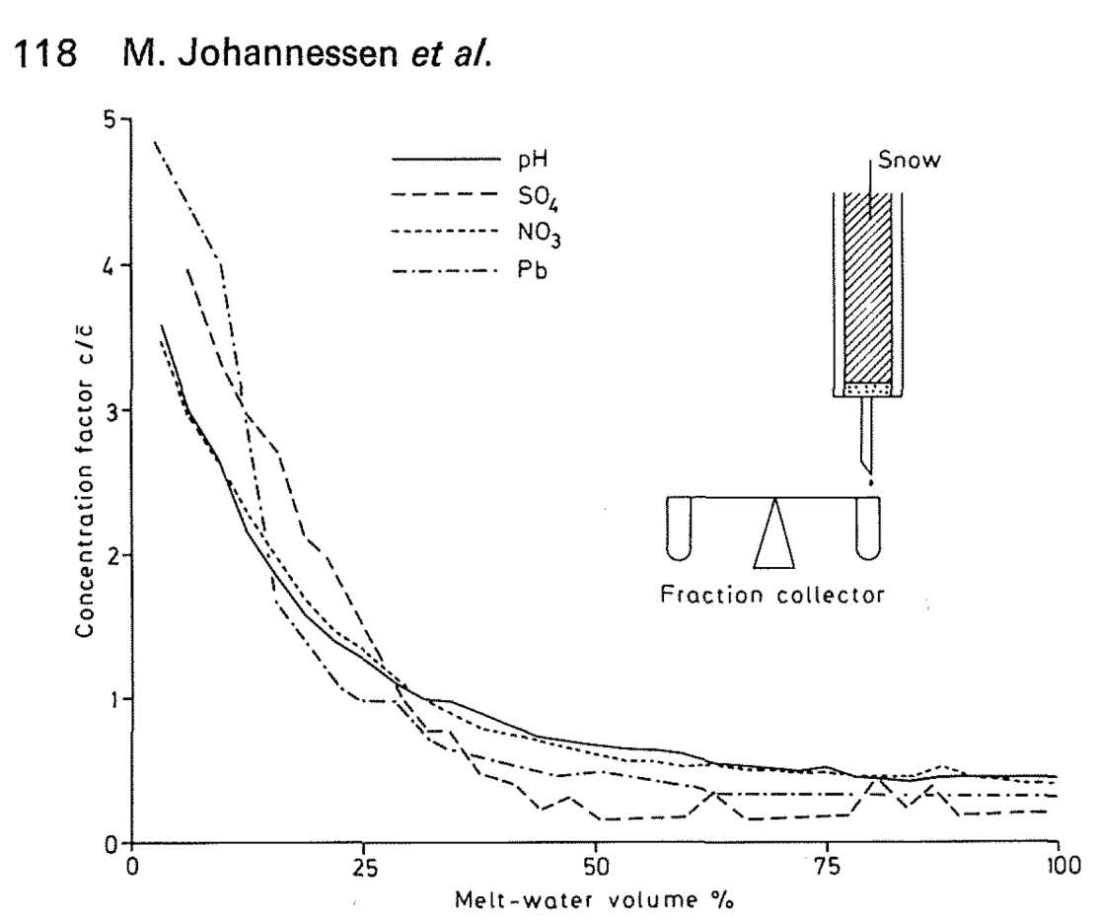
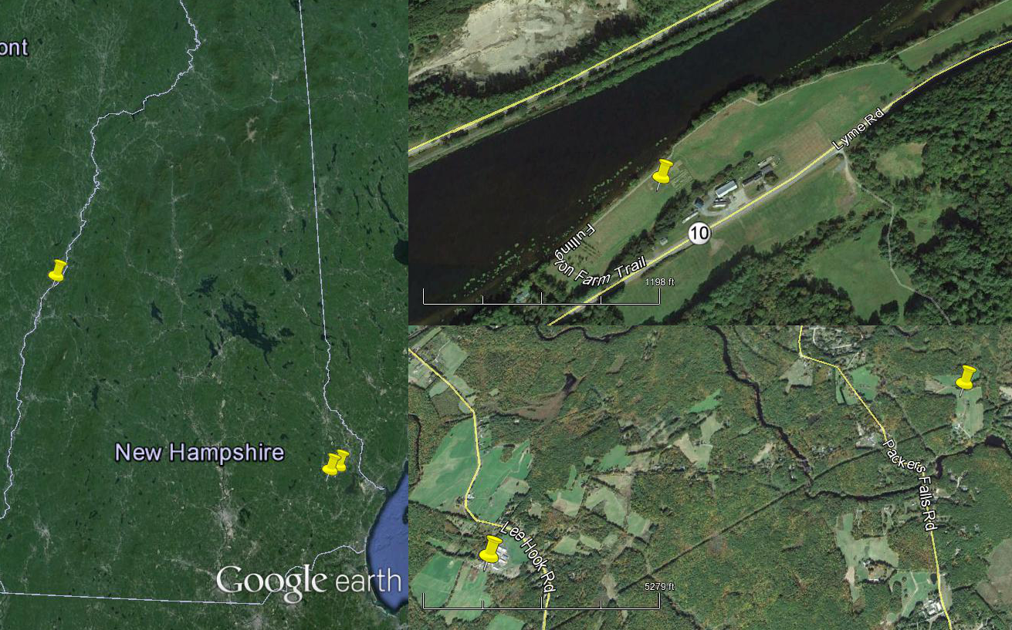
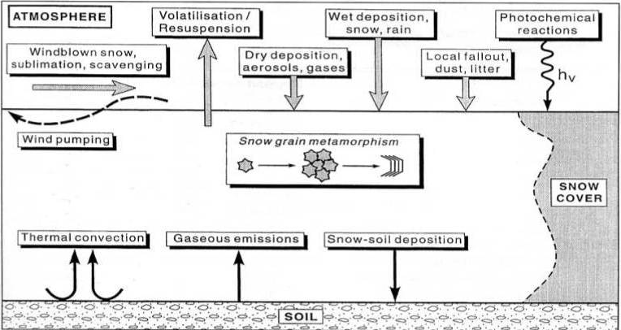
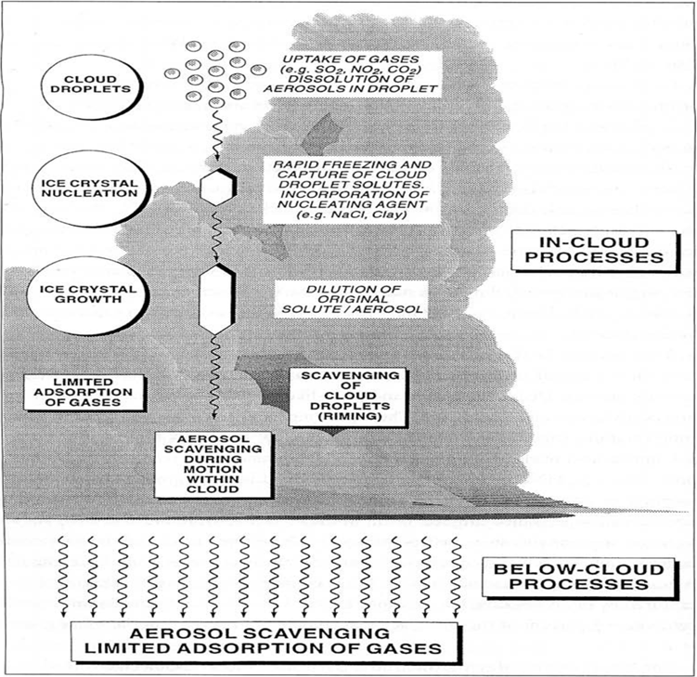
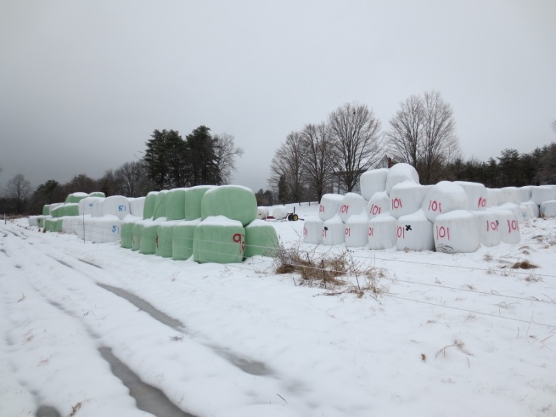
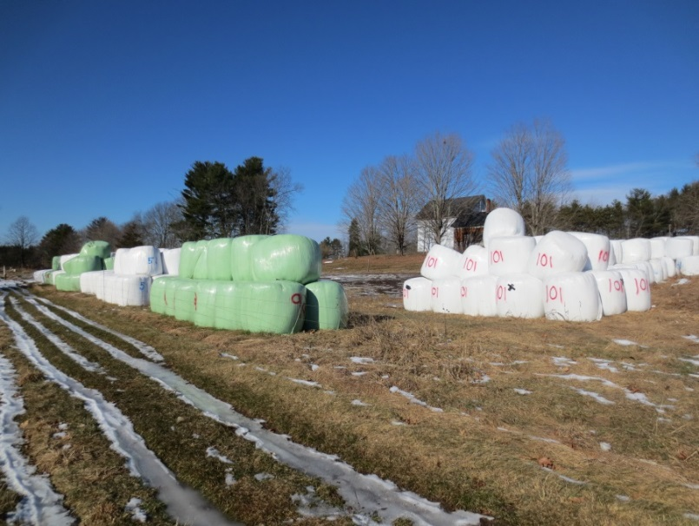
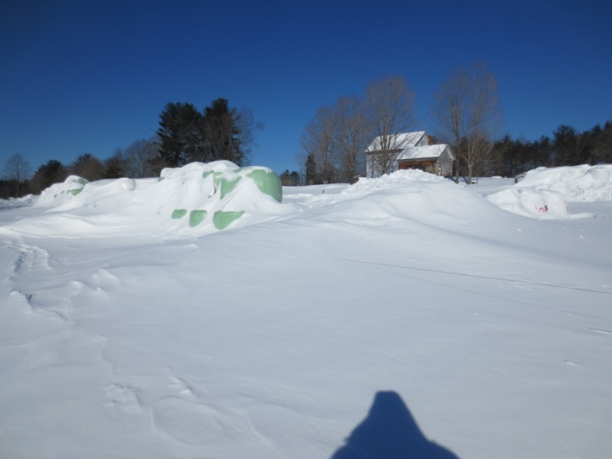
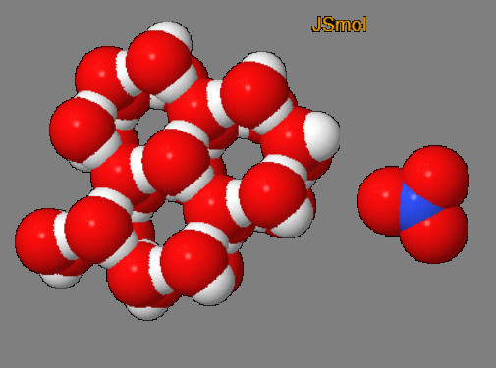


Characterizing the ionic pulse in New Hampshire
James Lazarcik
Department of Earth Science , University of New Hampshire, Durham, NH, USA
Advisor – Jack Dibb
Background
Expected Observation
Fig 2. From Johannessen et al., 1977: The ionic pulse as demonstrated by a lab experiment using doped artificial snow. The highest concentrations are observed at the very beginning of the melt fraction for all species. Different chemicals may elute before others in a process termed preferential elution.
Methods
Many field studies have shown that a melting snowpack may release up to 80% of the solutes in the first 20% of the melt in what is commonly termed an ‘ionic pulse’. The ionic pulse can include elevated levels of many chemical species during a melt period because these ions are thought to be preferentially excluded from the ice crystal lattice of metamorphosing snow grains.
Individual storm layers will be monitored throughout the snowpack and each layer will be sampled daily with 3-6cm resolution. Samples will be stored in a freezer and analyzed via ion chromatography at a later date. Calculated solute loss can than be compared to soil sensor data. In addition to contaminants, bulk snowpack properties will also be measured such as density, snow-water equivalent, temperature, and depth.
Proposal
If daily snow samples are taken and snow solute measurements are made, then it may be possible to identify and quantify an ionic pulse in New Hampshire’s seasonal snowpack. Furthermore, the pulse may be able to be traced from the snowpack to the soil in conjunction with high-intensity soil measurements such as nitrate levels.
A
A
Fig. 3 (left): Tranter and Jones 2001: Overview of processes affecting snow chemical composition after it has fallen to Earth. During melt, the runoff into the soil is expected to be the dominant process.
C
C
B
B
Fig. 5: Three sample sites across the state of New Hampshire. A is the site near Hanover, B and C are Burley-Demeritt Farm and Thompson Farm, respectively.
1/4/15
1/23/15
2/16/15
Fig. 4 (right): When snow grains metamorphose, the ice lattice excludes contaminants. Under normal conditions, ice (left) forms a hexagonal (D_{6h}) h-bond complex, where
Fig. 6: Time lapse series depicting a complicated winter season at Burley-Demeritt.
References:
Tranter, M., and H. G. Jones. 2001. The chemistry of snow: processes and nutrient cycling. Pages 127–167 in H. G. Jones, J. W. Pomoroy, D. A. Walker, and R. W. Hoham, editors. Snow ecology: an interdisciplinary examination of snow-covered ecosystems. Cambridge University Press, Cambridge, UK.
Johannessen, M., Dale, T., & Gjessing, E. (1977). Acid precipitation in Norway: the regional distribution of contaminants in snow and the chemical concentration processes during snowmelt. IAHS, 4, 116–120.
Fig. 1: From Tranter and Jones 2001: Overview of processes affecting snow chemical composition during formation and fall. Several processes happen after the snow has fallen as well (see Fig. 3).
contaminants such as nitrate (right) simply do not fit in. They accumulate on the outside of aged snow grains, and consequently leave the snowpack early in the melt stage. Red, blue, and white spheres are oxygen, nitrate, and hydrogen respectively. Atoms are depicted as space-filled to show steric hindrance.
Support for the New Hampshire EPSCoR Program is provided by the National Science Foundation’s Research Infrastructure Improvement Award # EPS 1101-245

