Slide 1



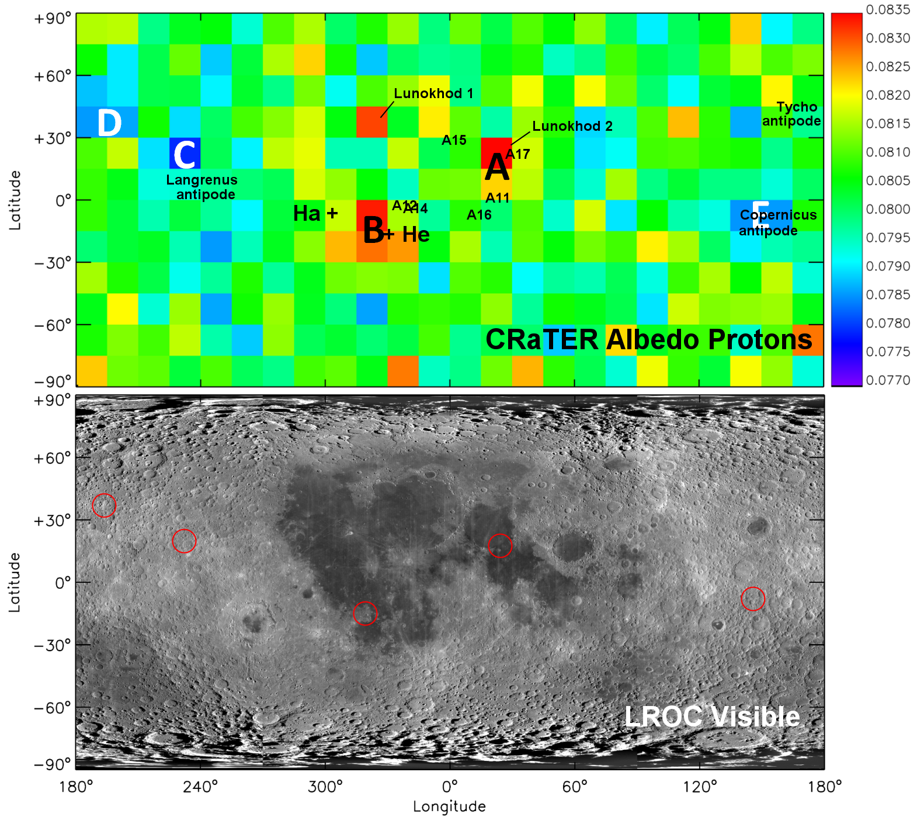
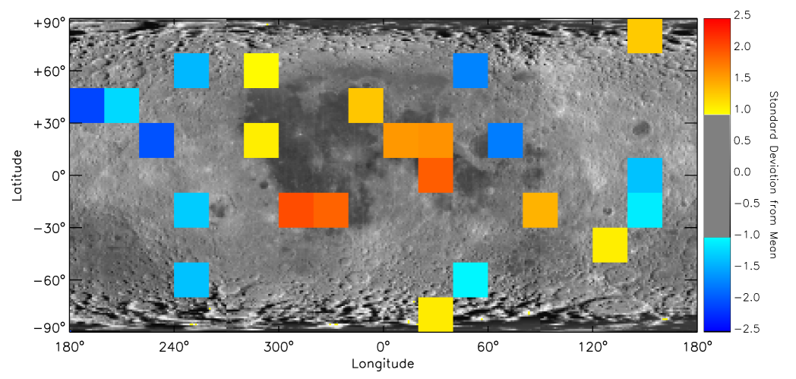
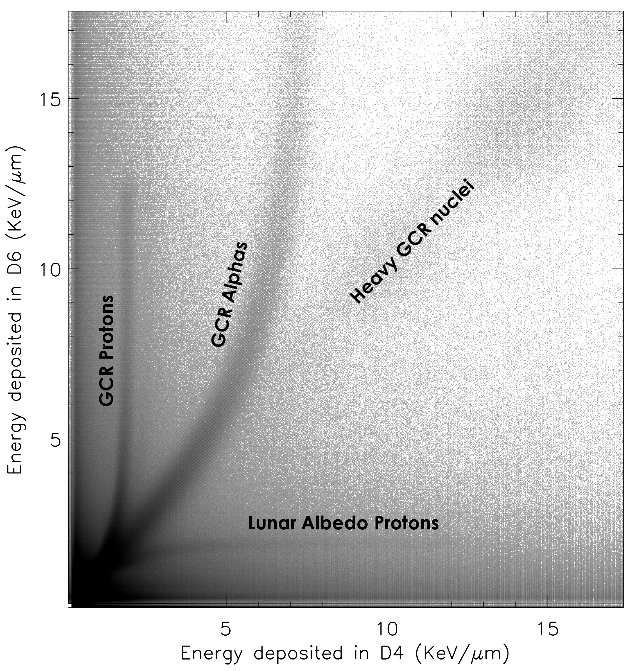
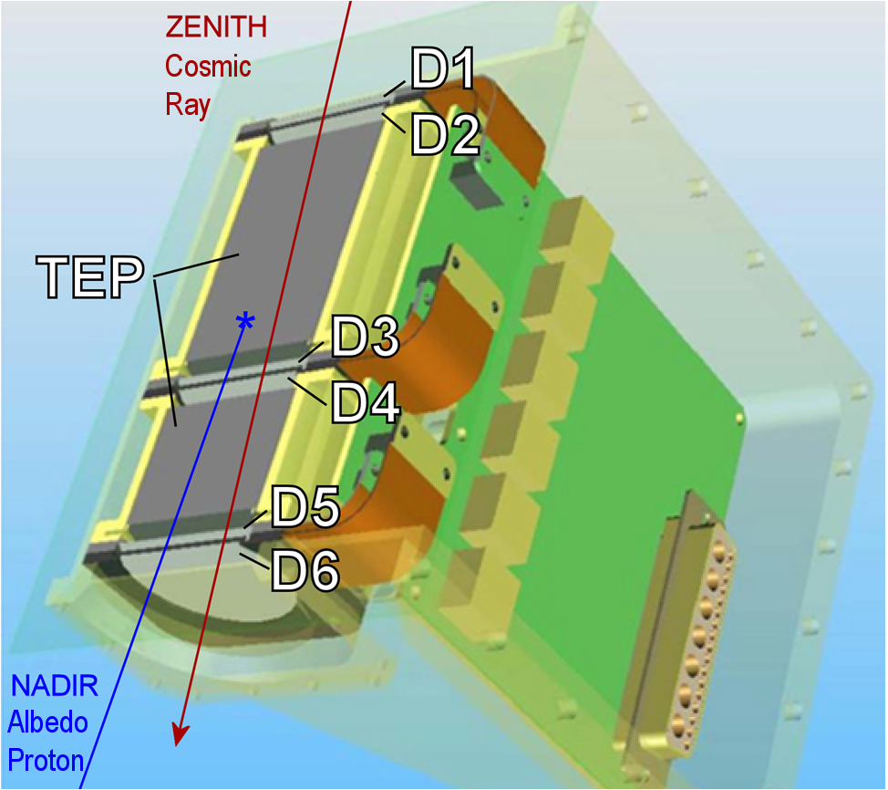
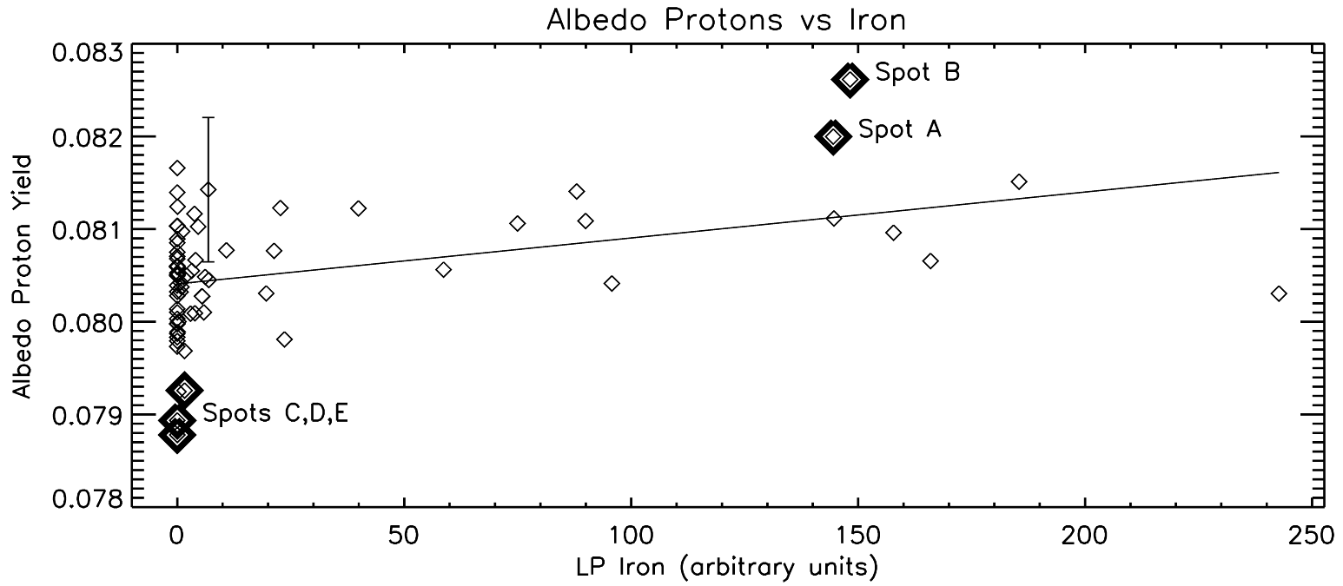
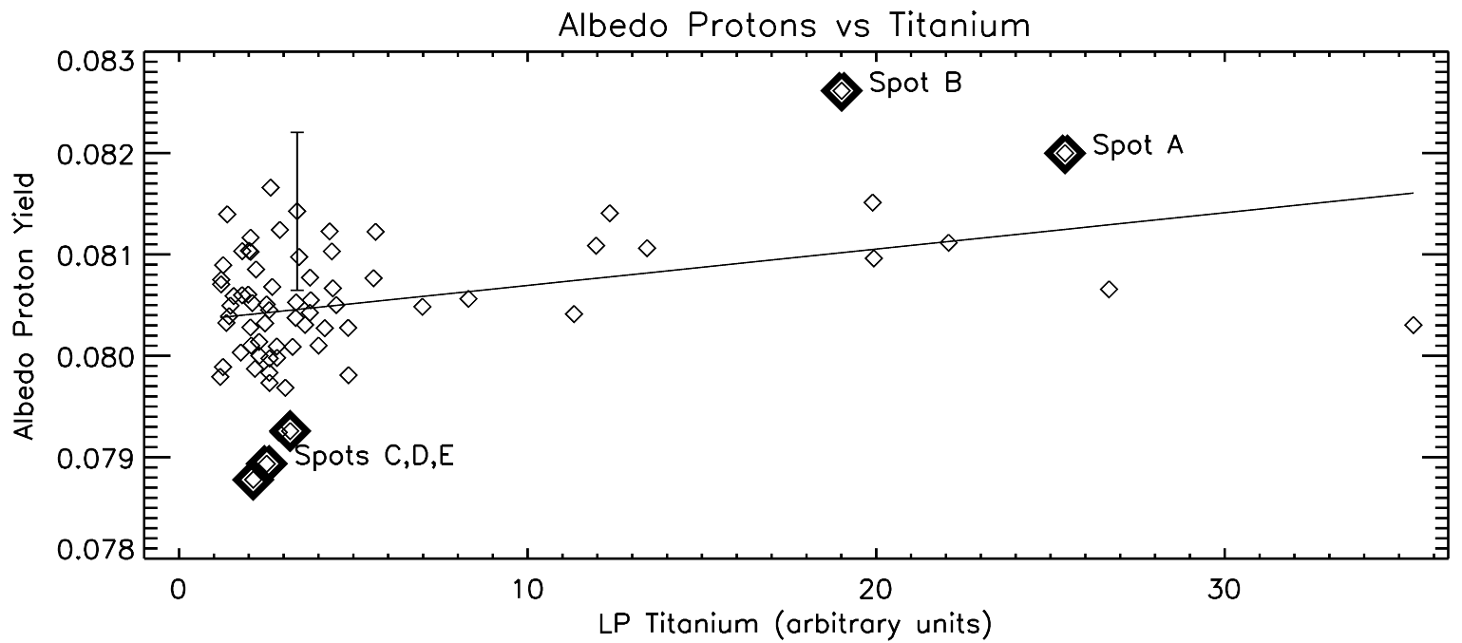
Lunar Proton Albedo Anomalies: Soil, Surveyors, and Statistics
Jody K. Wilson¹ (jody.wilson@unh.edu), N. Schwadron¹, H. E. Spence¹, A. W. Case^{2,7}, A. P. Jordan¹, J. B. Blake³,
J. Kasper^{2,7}, M. D. Looper³, J. E. Mazur³, N. E. Petro⁶, M.S. Robinson⁸, S. S. Smith¹, L. W. Townsend⁴, C. Zeitlin⁵, T. J. Stubbs⁶
(1) Space Science Center, University of New Hampshire, Durham, NH; (2) High Energy Astrophysics Division, Harvard CFA, Cambridge, MA; (3) The Aerospace Corporation, Los Angeles, CA; (4) Dept. of Nuclear Engineering, Univ. of Tennessee, Knoxville, TN; (5) Southwest Research Inst., Boulder, CO; (6) NASA Goddard Space Flight Center, Greenbelt, MD; (7) NASA Lunar Science Inst.; (8) School of Earth and Space Exploration, Arizona State University, Tempe, AZ
Summary
We use “albedo” or “splash” protons with energies between ~60 and 150 MeV to construct a galactic cosmic ray (GCR) albedo proton map of the Moon. The yield of albedo protons is:
Yield = (Lunar proton rate) / (GCR proton rate)
We detect a proton yield from the maria that is 0.9% ±0.3% higher than the lunar highlands, particularly at two localized spots which may be associated with specific elemental concentrations or geological features. We do not yet see any obvious small-scale features in the polar regions.
Albedo proton yield map & LROC
Standard deviations from mean
Proton map binned 20°×20° (162 pixels). Three pixels (2%) lie >2σ from the mean, but outlier pixels are clustered.
CRaTER's six detectors can discriminate different elements in the galactic cosmic ray (GCR) population above ~10 MeV/nucleon, and can also distinguish between GCRs arriving from deep space and secondary particles traveling up from the lunar surface. http://crater.sr.unh.edu/
Protons and Elements in Regolith
Map features are consistent with higher yields in maria vs. highlands, but the five named spots (A-E) are not exceptional in terms of elemental abundances.
Proton-bright spots “A” and “B”
Yield ~4% more protons than lunar average
Spot A near Taurus-Littrow, between Mare Serenitatis and Tranquillitatis; near strongest titanium concentration
Spot B centered between Maria Humorum & Procellarum
Pyroclastic flows: 3000 km² flow lies within Spot A, but Aristarchus flow (50,000 km²) has no proton feature.
Volcanic Dome “Red Spots”: Helmet (He) near center of B
Man-made landers/crash sites: Lunokhod 2 and Apollos 11 and 17 all lie within Spot A – otherwise the most massive vehicles (S-IVBs) are all in average areas
Proton-dim spots “C”, “D” and “E”
Yield ~3% fewer protons than lunar avg.
Far-side highlands
Close to antipodes of largest rayed craters: Copernicus, Langrenus, and Tycho
Acknowledgements: This work was supported by the NASA LRO project and the DREAM2 Project

