Slide 1
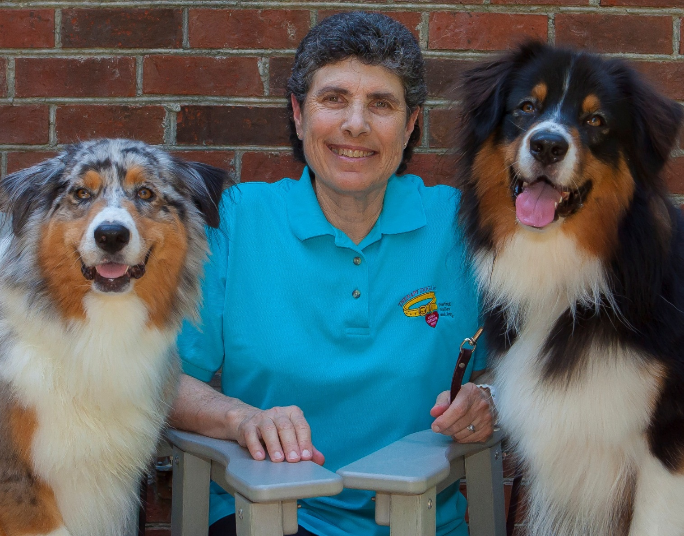
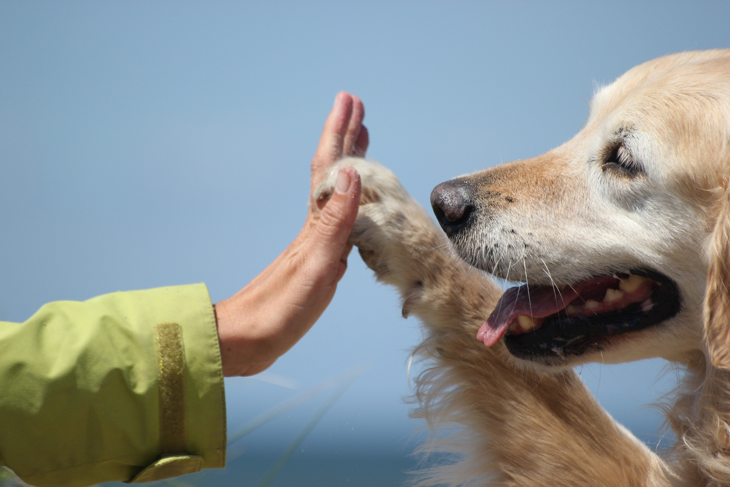
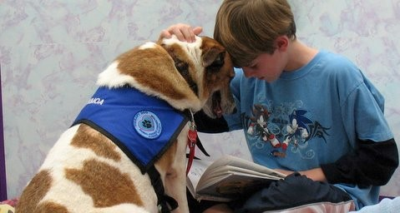

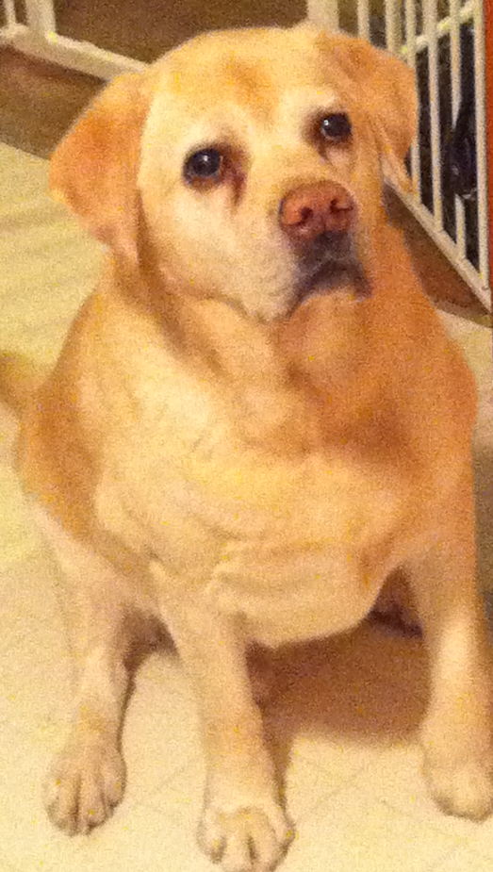

Animal-Assisted Therapy:
Motives and Rewards
Kailee Collins, OTS
Kerryellen Vroman PhD., OTR/L
University of New Hampshire, Durham, NH
Introduction
No Ordinary Dog
Motivation
Discussion
Animal-assisted therapy is utilized to provide goal-directed therapy with dogs. This study investigated what motivates individuals to become animal-assisted therapy volunteers and the rewards that encourage and sustain them.
Participants’ first topic, across interviews, was the “uniqueness” of their dogs, making the interviews “dog focused.” The dogs’ personality, abilities, and behavior were described. Common traits ascribed to the dogs included intuition and intelligence. Having trained their dogs, participants construed the dogs’ achievements were their achievements too. The achievements seemed to be internalized enhancing their positive sense of self.
The motive of giving back as well as being needed were compelling, and were integral in participants’ decisions to become animal-assisted therapy volunteers. The life stage of participants further influenced their decision to give back to the community and to occupy their leisure time constructively. However, it was important for participants to feel appreciated while giving back.
What emerges from the findings of this study is participants’ strong values and sense of responsibility to give back for their quality of life. Altruistic motivations, including a desire to help people and to adhere to one’s values, were core reasons participants gave for becoming and remaining animal-assisted therapy volunteers.
Animal-assisted therapy consistently demonstrates positive physiological, psychological, and social benefits for recipients.
Participants’ motives for engaging in animal-assisted therapy can not be fully explained by altruism or egotism¹. Participants’ sense of self-worth was derived from their belief that their volunteering activity made a significant contribution to clients’ health, more consistent with a health profession than a volunteer activity.
Animal-assisted therapy volunteers are similar to other volunteers, and have a sense of pride in and respect for the organization they are part of. Volunteering fulfills a desire to help people and to belong to a group, which in turn helps define their social identity.
There is an altruistic-egotistic duality (intrinsic vs. extrinsic motivation) that exists in volunteering. For those who volunteer in the domains of health and human services, such as animal-assisted therapy, there is evidence that this duality exists.
I’m giving something back as opposed to just being another person, getting my paycheck.
Derek and his lab Tommy (#1)
Based on the continuum that defines volunteerism², animal-assisted therapy volunteers appear to be pure volunteers. However, from the net cost versus perceived benefits equation, they cannot be considered “pure”. Their perceived amount of time and effort spent towards volunteering is high, influencing their perceived importance of volunteering. However, “net cost” for participants is relatively low, due to no income or socialization opportunities lost.
I never realized this, but when [my dog] is working, he knows he’s working.
Pat and his boxer Ralph (#3)
The Volunteer
Although there is extensive research on the benefits of animal assisted therapy, there is a lack of information about animal-assisted therapy volunteers themselves, and why they chose to volunteer.
A sense of responsibility and commitment were essential qualities participants emphasized for animal-assisted therapy volunteers. They believed animal-assisted therapy volunteers “should be” caring, empathetic, and genuinely invested in those they visit. In addition, they highlighted the time and patience required to train a dog to be part of the team and work with all clientele.
But I just felt I wasn’t needed enough there. So I searched to where I belonged.
Matilda and her terrier Buddy (#5)
I [was] like a parent with your kid when he gets a homerun, you just feel proud.
Derek and his lab Tommy (#1)
In contrast to the high value placed on socializations by most volunteers^{3,} animal-assisted therapy volunteers do not appear to place importance on socializing with peers. The dog replaces the shared companionship component that other volunteers derive from each other. Attributing human qualities (anthropomorphism) to their dog and the strength of the “partnership” appears to replace the need for social interaction with other volunteers.
Study Objectives
What are the reasons (motives) people become animal-assisted therapy volunteers?
What are the benefits (rewards) for people who engage and remain animal-assisted therapy volunteers?
[animal-assisted therapists] obviously want to help people, and [are] willing to do the work required.
Derek and his lab Tommy (#1)
Implications
Methods
Having a better understanding of what motivates individuals to volunteer allows organizations to identify and recruit volunteers.
Participants:
The Team
You have to commit yourself to it because you have to keep in mind that you develop a relationship between your dog and this other person
Pat and his boxer Ralph (#3)
Rewards
Occupational therapy practitioners, by understanding what motivates and rewards animal-assisted therapy volunteers, can more thoughtfully integrate these volunteers into interventions and therapeutic sessions. Animal-assisted therapy could be implemented in conjunction with occupational therapy as a way to make interventions more meaningful to clients, thereby increasing participation in therapy sessions.
Fifteen past or current animal-assisted therapy volunteers from Rhode Island and New Hampshire completed surveys; 13 were also interviewed. Participants’ ages ranged from 19 to 74 years; the majority were in their 50’s (46%, n=7). Sixty-six percent (n=10) of participants reported doing other voluntary activities.
The dog and the therapist were a team. The image of dog and partner instilled a sense of professionalism and confidence that distinguished them from people “just” visiting with their animals. The trust between dog and owner as a team strengthened their identity as animal-assisted therapy volunteers. Almost every participant believed that the bond they had with their dogs was stronger as a result of working together.
Volunteers are typically thought of as selfless who do not desire a reward, yet it was clear that the participants involved felt rewarded for their hard work and time spent. Participants spoke of the magical element of animal-assisted therapy. Almost every volunteer expressed there was something unique and “enchanting” about each session. This volunteering experience was different from other volunteer work they had experienced.
Instruments:
A semi-structured interview with 15 core questions pertaining to the participants and their dogs, as well as animal-assisted therapy in general, was used.
Conclusion
The Volunteer Motivation Index (VMI) measures participants’ motivations to volunteer. The VMI contains 44-item summative Likert-type rating scale from 1 (strongly disagree) to 5 (strongly agree). The VMI contains 10 categories of motivation.
The value of animal-assisted therapy is definitive. In examining the people who commit their time and resources to volunteering we gain insight into an essential ingredient in the therapeutic process of animal-assisted therapy. This unique group of volunteers falls into the gray area between the altruistic-egotistic duality that is common in other volunteers. Continuing to explore the dynamic interaction of volunteer, dog, and therapy recipient will permit more critical use of animal-assisted therapy to achieve measurable outcomes.
He’s my co-therapist, he’s my helper. I can’t imagine him not being with me.
Betty and her golden retriever Max (#11)
It’s probably been the greatest thing I’ve ever done. It’s probably been the most inspiring and the most fun, and out of all the things I’ve done in my life, probably the most interesting.
Patricia and her terrier Abby (#14)
Results:
Content analysis protocol was followed to analyze qualitative data. Five themes emerged from semi-structured interviews with animal-assisted therapy volunteers.
Resources
Once you go through all that training, you’ve got that bond, you know, they get so attached to you.
Doris and her lab Genie (#8)
Bussell, H. & Forbes, D. (2002). Understanding the volunteer market: The what, where, who and why of
volunteering. International Journal of Nonprofit and Voluntary Sector Marketing, 7(3), 244-257.
2. Cnaan, R. A., Handy, F. & Wadsworth, M. (1996). Defining who is a volunteer: Conceptual and empirical considerations. Nonprofit and Voluntary Sector Quarterly, 25, 364-383.
3. Omoto, A. M & Snyder, M. (2002). Considerations of community: The context and process of volunteerism. American Behavioral Scientist, 45, 846-867.
Statistically significant VMI variables included Values as participants’ highest rated motive for volunteering. Social was not considered to be an important motive for participants to volunteer.
…was like watching a miracle. That was the power of pet therapy.
Doris and her lab Genie (#8)
Acknowledgements
Contact Information
Summer Undergraduate Research Fellowship, Hamel Center for Undergraduate Research, University of New Hampshire
Kailee Collins kvy8@wildcats.unh.edu
Dr. Kerryellen Vroman
kerryellen.vroman@unh.edu

