Slide 1


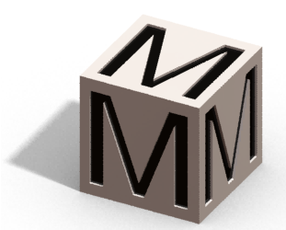
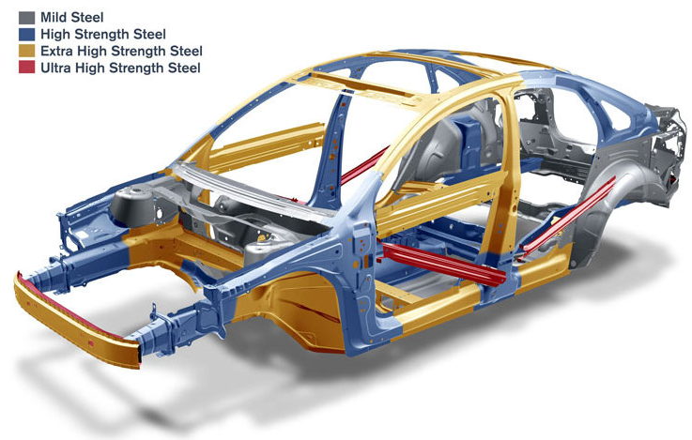
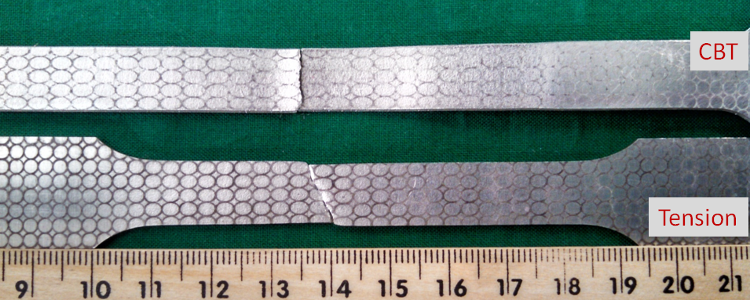
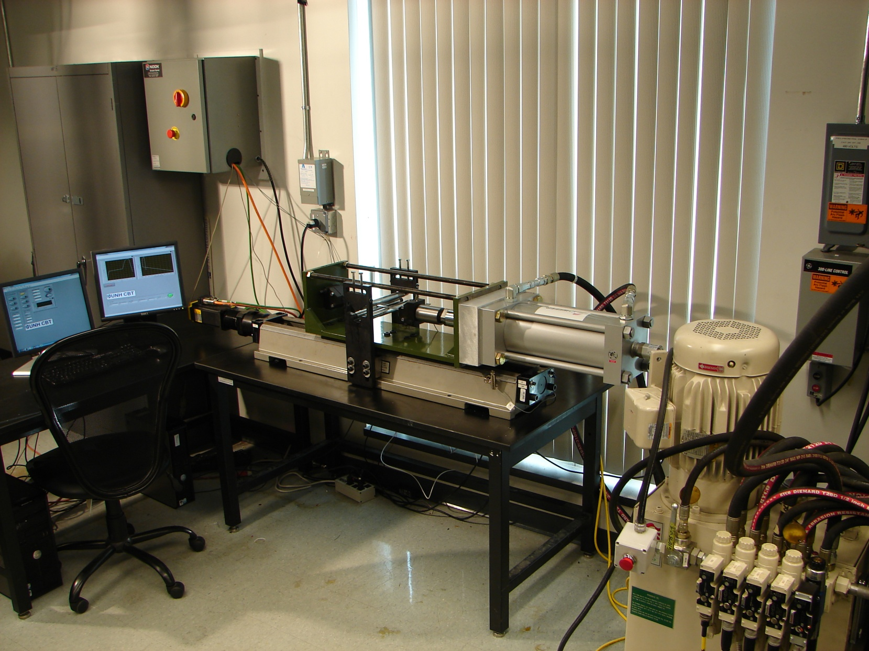
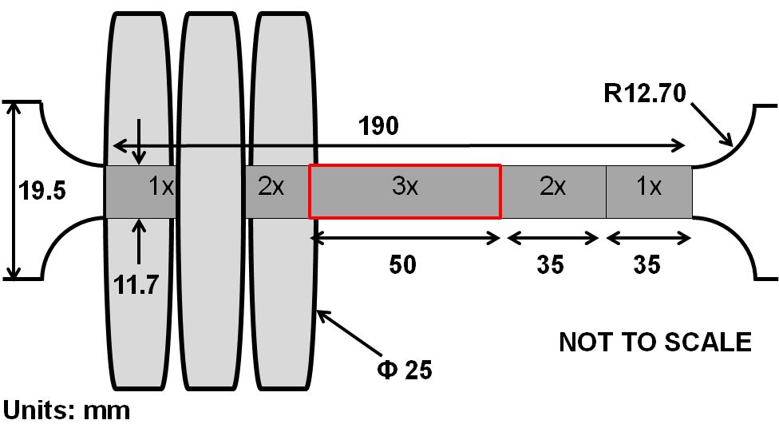
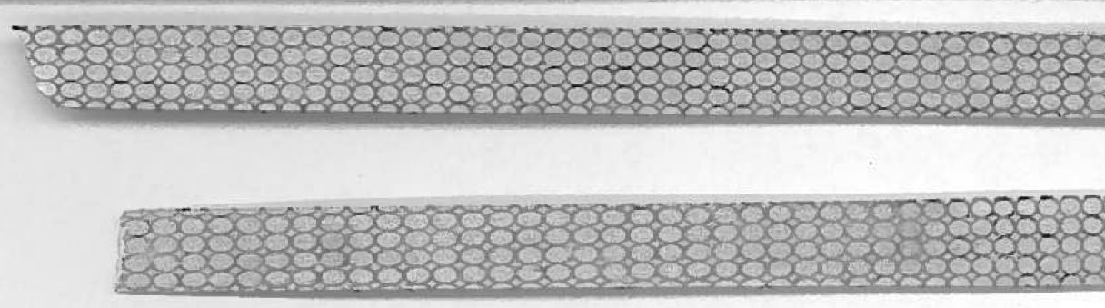
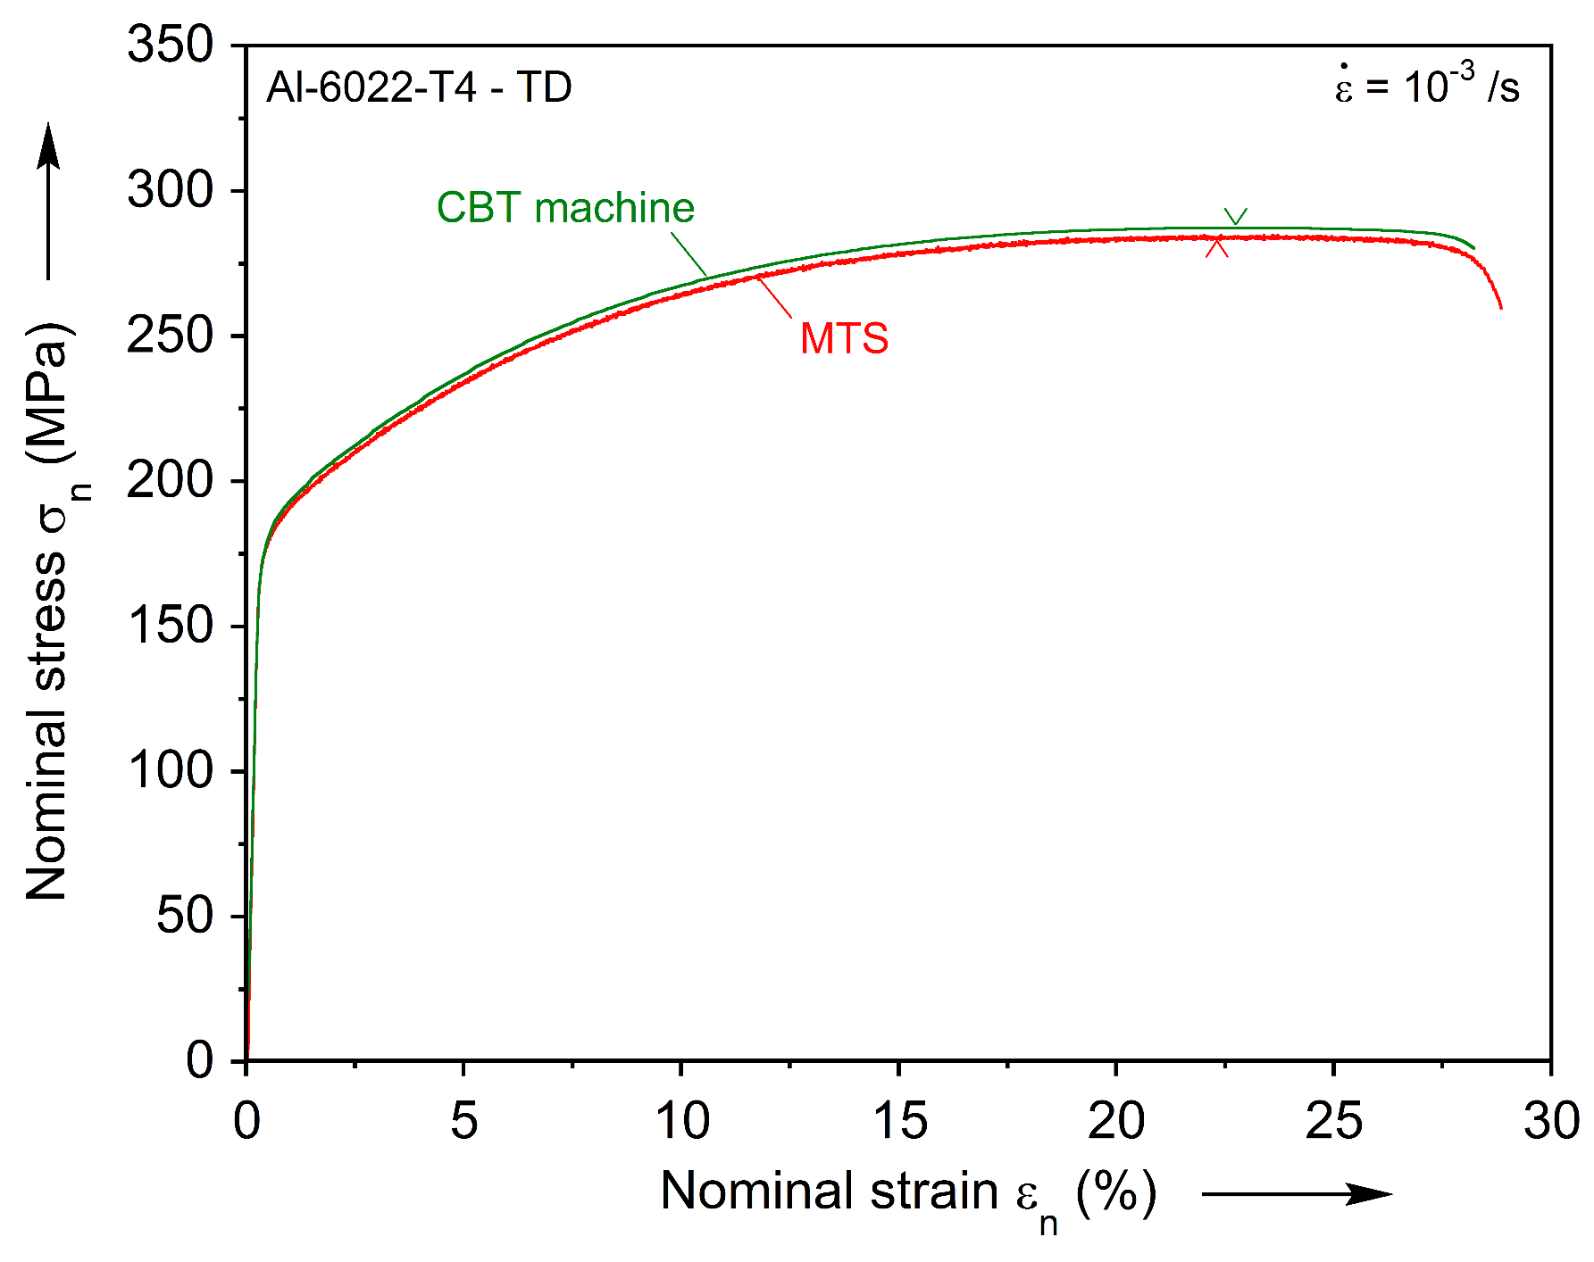
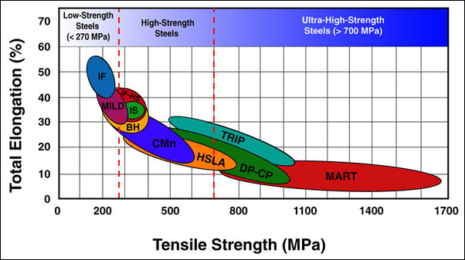
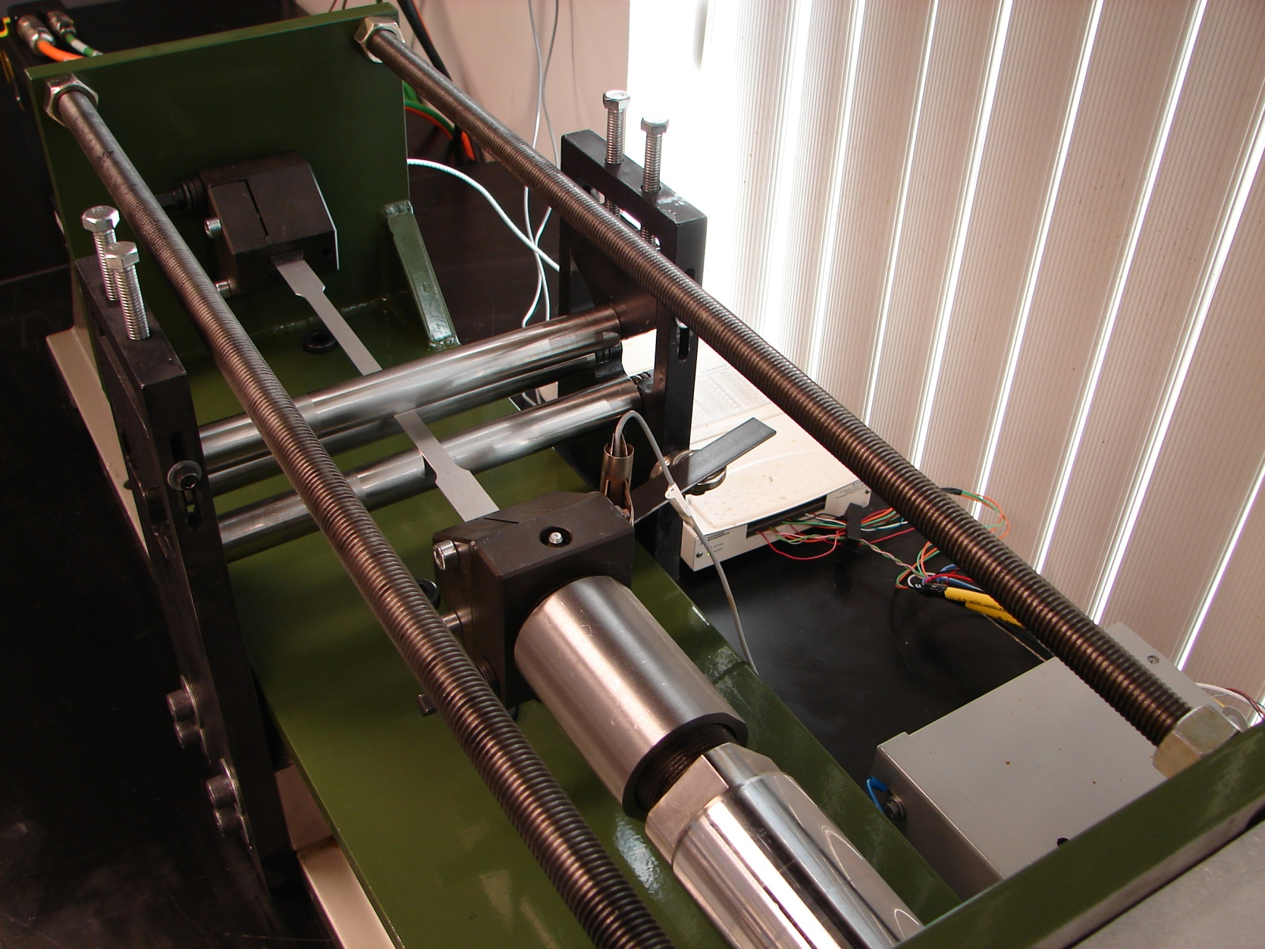
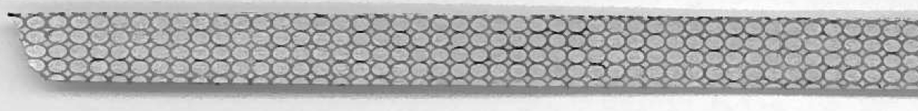
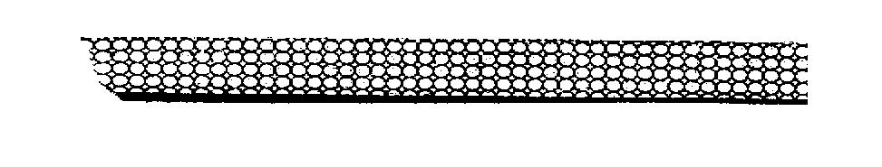
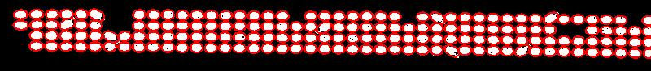
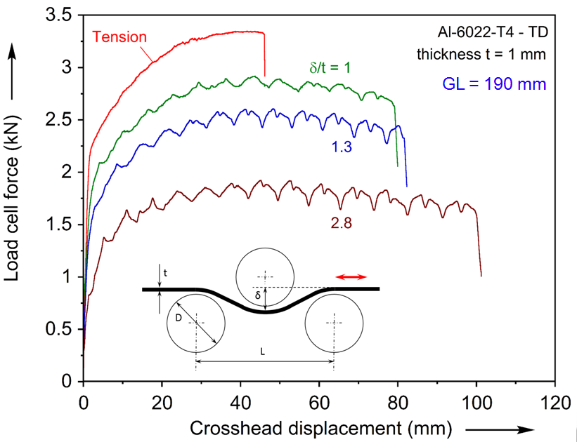
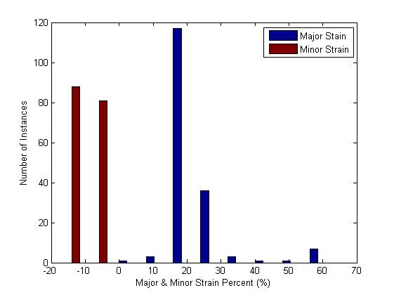
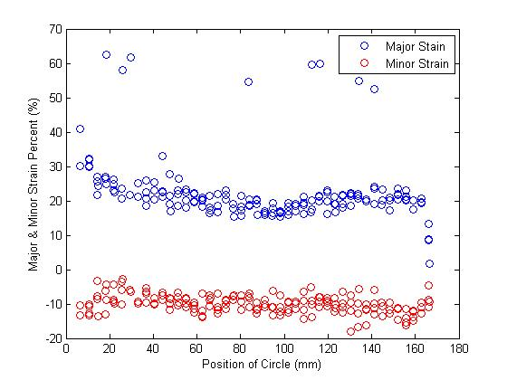
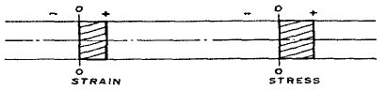
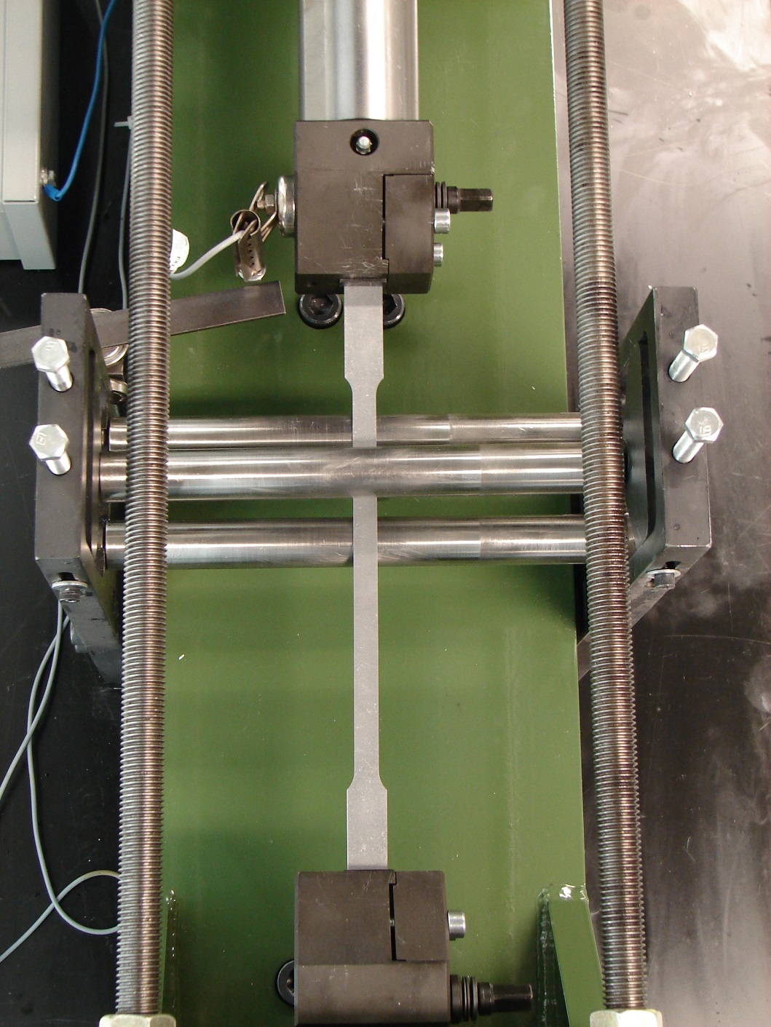
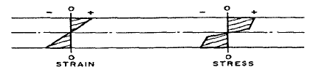
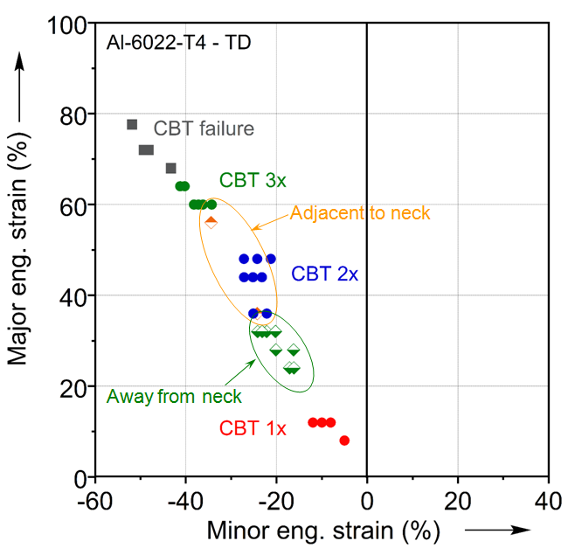
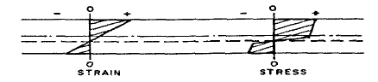
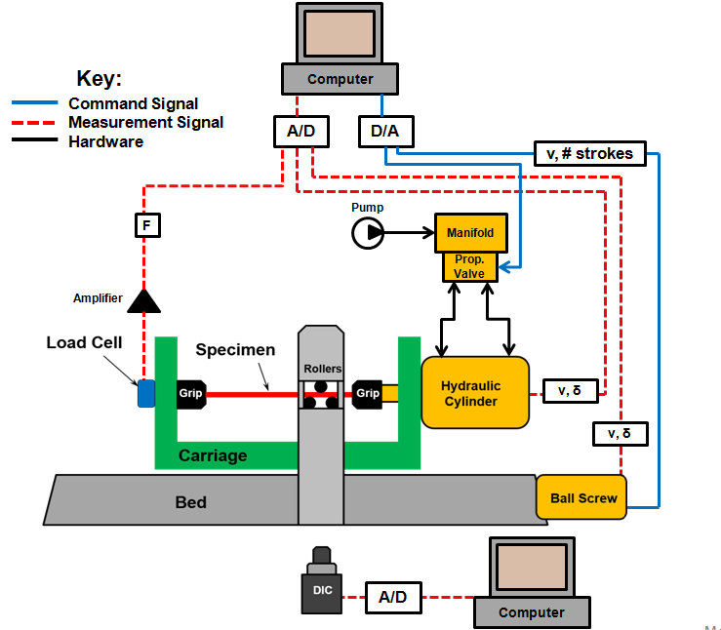
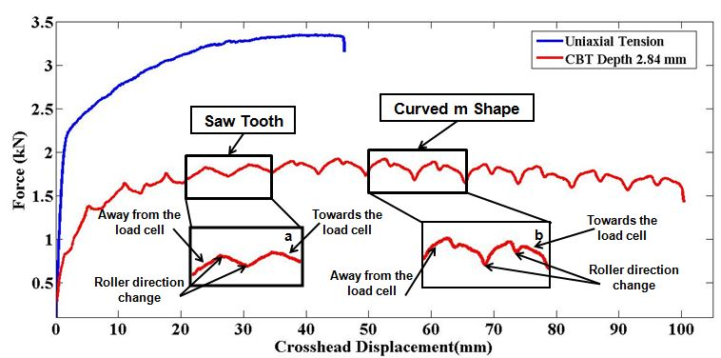
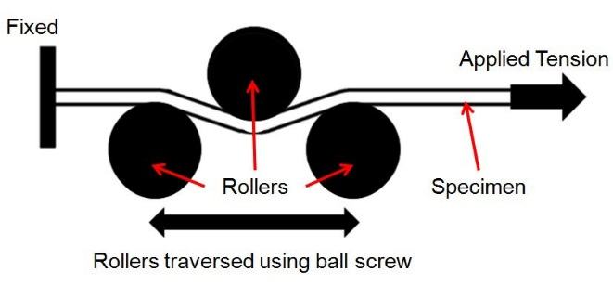



Continuous-Bending-under-Tension
Timothy J. Roemer - Mechanical Engineering Department
Project Objective: To understand the fundamental mechanisms behind Continuous-Bending-Under-Tension to implement in innovative manufacturing processes.
Motivation and Theory
Continuous-Bending-under-Tension Machine and Experimental Setup
Experimental Results
Result and Post-Processing
Ball Screw Motor
Roller Assembly
Hydraulic Cylinder
The Automotive Industry continues to face challenges as fuel consumption regulations increase. One of the major causes of poor fuel consumption is the weight of the vehicles. Using traditional metals, we cannot decrease the amount of material used without compromising the safety of the vehicles. By using high strength metals, we can use less material without sacrificing safety.
CBT and Tension Test Specimens
DAQ & C Computers
Bed
Carriage
Matlab Circle Grid Measurement
Hydraulic System
CBT Specimen: 1x, 2x, 3x Regions (Uniform)
CBT System: Hydraulics, Ball Screw, Computer
Grip
Rollers
Initial Specimen Image
Limit Switch
Analysis of First Specimen
Black & White Contrast Intensity Image
CBT Machine Tension Test Validation:
x is the ultimate tension strength
Ellipsoid Identification & Measurement Image
CBT Specimen
Grip
Continuous-Bending-Under-Tension (CBT) allows us to incrementally deform a specimen. This is achieved by only allowing deformation to occur at the rollers. This is due to the specimen being plastically bent, which decreases the required axial load needed to deform the specimen. This process is know as bending-under-tension.
Carriage
CBT Carriage: Rollers, Specimen, Grips, Limit Switch
Limit Switch
CBT Machine Specification
Grip
Machine Specifications | Value | Units
Cylinder speed | 33.5 | mm/s
Carriage speed | 66 | mm/s
Cylinder force (retraction) | 312 | kN
Specimen elongation | 400 | %
Major & Minor Engineering Strain Percent Distribution
Ordinary Tension
Rollers
Ordinary Plastic Bending
CBT Tests For Different Roller Depth (δ) Per Thickness (t)
Plastic Bending Under Tension
CBT Specimen
Grip
Top View of Carriage
CBT System Diagram
CBT Curve Analysis
Major & Minor Strain Percent
Advisors: Brad Kinsey, Yannis Korkolis, Marko Knezevic
Sponsors/ Partners: Ford Motor Company, Alcoa, U.S. Steel, National Science Foundation
Special Thanks: Vojta Kubec, Sheldon Parent, Madhav Baral, Peter Ripley, Chris Dick, Nengxiu Deng, Steve Racca, Joseph Wilson

