Slide 1


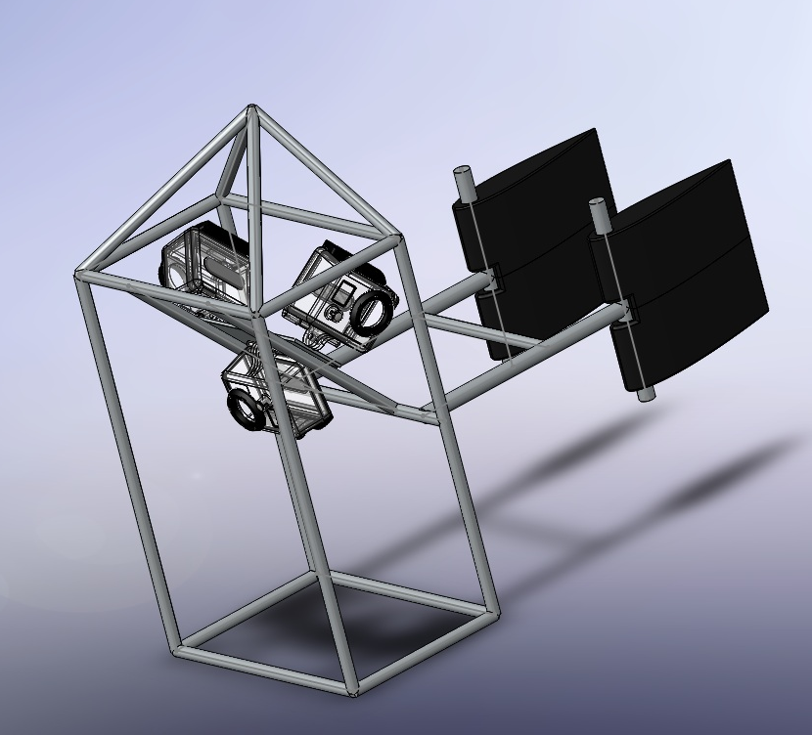
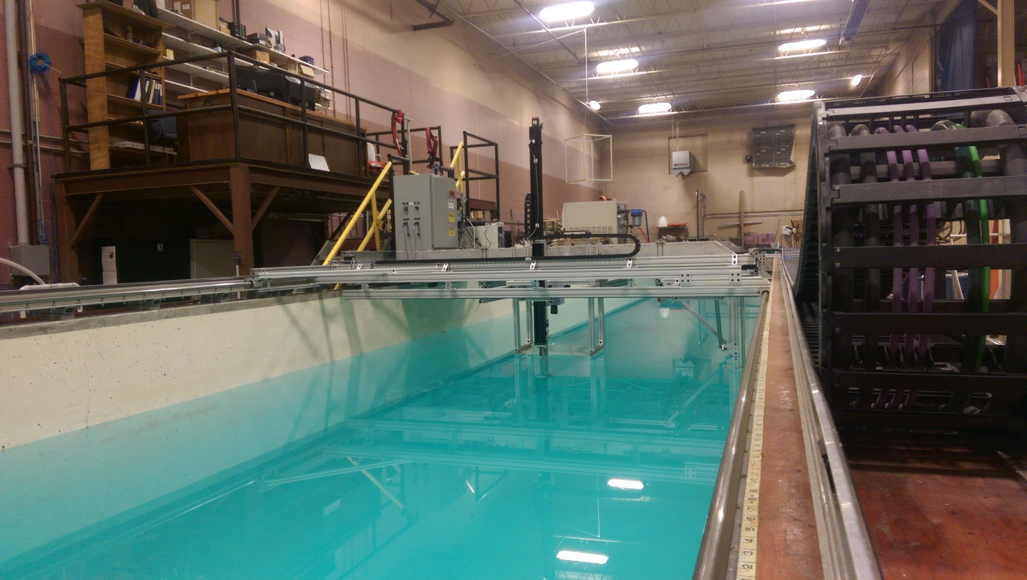
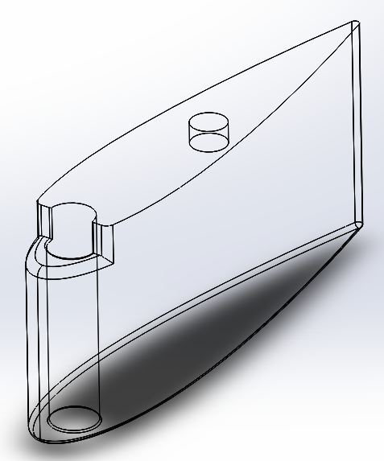
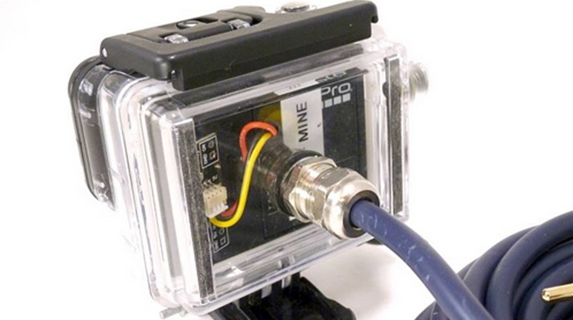
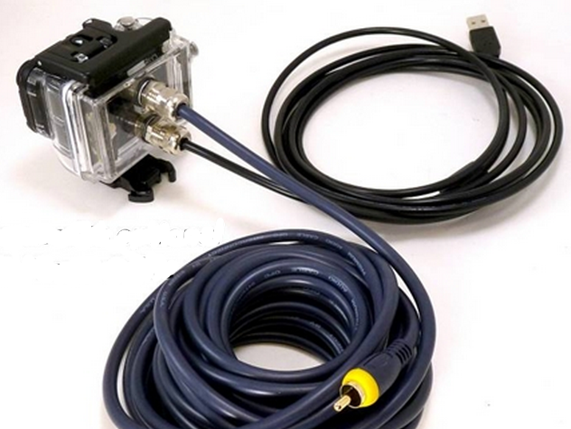
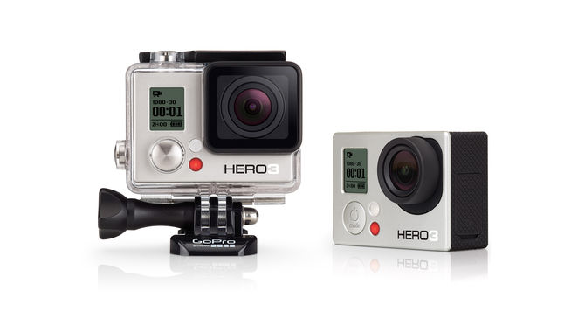
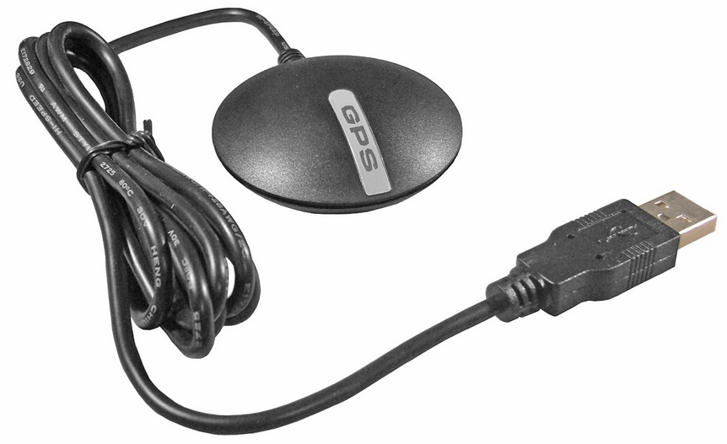
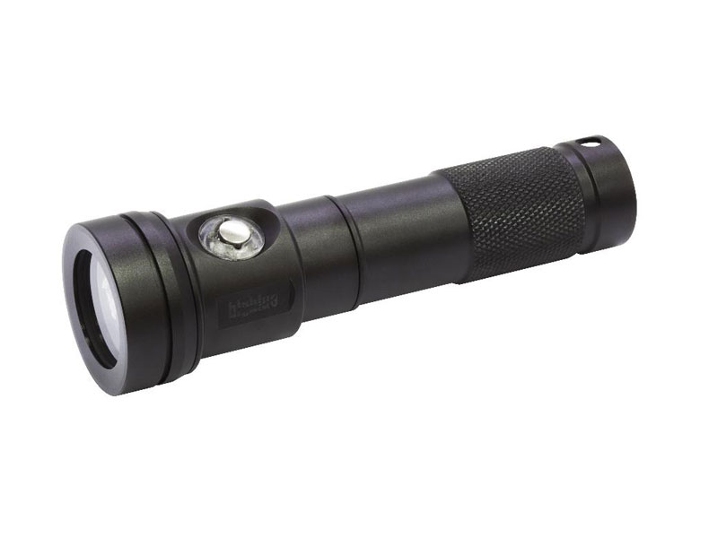
Drop Camera: In Search of the Lost Whaling Fleet
Grace Cardarelli || Devon Snell || Myles Riddell
Advisor: Bradley Barr
Prudhoe Bay, Alaska:
In September of 1871, 32 whaling ships were suddenly and unexpectedly trapped between ice and shore in a constantly and quickly diminishing stretch of open water with no chance to escape. One ship was hauled across the rugged ice and rowed 90 miles back to shore. The remaining 31 ships were sunk or burned after they were abandoned.
Design and Construction:
Testing:
Top Level Assembly
316 series stainless steel round bar to minimize drag effects and maximize corrosion resistance in harsh ocean environment
Designed for robustness to protect cameras and lighting
Designed for cost effective shipping
Flat Bar used to provide mounting for cameras
Testing Facility
Jere A. Chase Ocean Engineering Laboratory Tow Tank
Tow tank used for pressure sensor testing and fin design testing
Tested speed range: .25kts-2kts
Purpose:
Design and research a drop camera system to tow behind 60’ vessel
Collect live footage of ocean floor for navigation
Implement pressure sensor for live depth recording up to 150ft
Collect GPS data of drop camera location relative to vessel
Maximize efficiency of available low-cost technologies
Initial Testing
Tested using a pressure sensor to record depth while varying speed and tow cable length
Found that the tow angle is dependent on tow speed and cable length
Tow stability was poor at slow speeds (<1kt) and short cable lengths
Fin Design
NACA 0012 Airfoil design to avoid any effects from camber
2 piece construction designed to assemble quickly over fixed threaded rod pivot. Male/Female joint permits accurate assembly utilizing minimum hardware
Independently adjustable airfoils allow for precise adjustments to be made quickly
FDM printed PC-ABS plastic remains light and buoyant to ensure proper tow geometry
Live Feedback System:
Video Recording Hardware
Send live feed to research vessel for navigation
EyeofMine waterproof GoPro housings provide 12V external USB power source
USB booster needed to reach full 150ft depth
EyeofMine live SD video cable covers the full 150ft with RCA adapter
2 side-shooting GoPro cameras capture footage on Micro SD card only
USB, video cable, and winch cable are tethered together
Re-Design Testing
With no fins: the camera would not correct viewing direction to direction of travel when given 180 degree turn
After comparison testing between one fin and two, it was found that though directional response improved dramatically for both assemblies, the twin finned cage was more stable and required less adjustments
http://www.eyeofmineactioncameras.com/GoPro_Hero3_SMALLER_Underwater_Wired_SD_Live_Video_p/euvh32d.htm
GoPro
3x GoPro Hero3 capable of 1080p recording at 30 fps
1 GoPro dedicated for live feed navigation footage at 720p
2 side shooting cameras at full high definition for data collection
Tethered case designed by EyeofMine allows for charging and synchronized live feed output
The maximum recording time on battery life < 2 hours. Micro SD capable of 8 hours of footage storage
http://shop.gopro.com/cameras/hero3-white/CHDHE-302-master.html
Dive Light
Light Output: 90-900 Lumens
120° Extra Wide Beam
D 1.5in x L 5.25in
330ft max depth
Two light design (one light per data collection camera)
Lighting used for deeper, low light filming conditions
FDM printed PC-ABS brackets allow for clamping and securing in an adjustable position
Light filtering can be used to increase the visual quality of the video
http://www.eyeofmineactioncameras.com/GoPro_Hero3_SMALLER_Underwater_Wired_SD_Live_Video_p/euvh32d.htm
Location Hardware
Globalstat USB GPS receiver provides real-time navigation
Installed driver uses DropCam mapping software to record position of laptop
August 2015 Design Recommendations:
In the process of designing a cost effective pressure sensor, we were able to effectively construct a working sensor using an Arduino microprocessor. However due to remote operation location we recommend a more thoroughly tested and reliable pressure sensor. The GoPro cameras will capture better color definition with the addition of lens filters. The addition of more lights coupled with higher pressure deep water camera housings will allow for operation at greater depths. A final design will be utilized at the operation site.
http://www.thegpsstore.com/USGlobalSat-BU353-S4-USB-GPS-Receiver-P3219.aspx
Software
Single LabView user interface to view live navigational video
GPS software installed on research laptop
Available information aboard research vessel: GPS location of camera underwater, live video footage, depth of camera off ocean floor
http://www.bigbluedivelights.com/products-detail.asp?REC_ID=119

