Slide 1


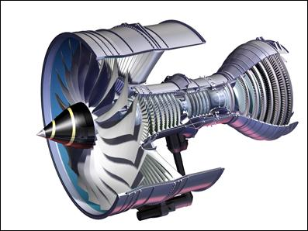

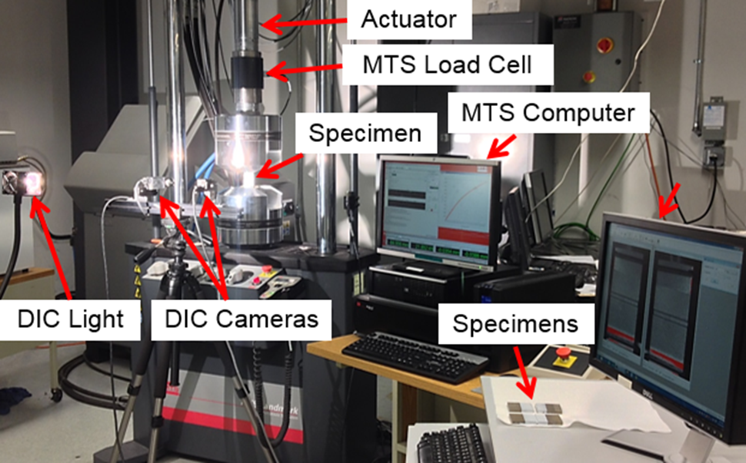
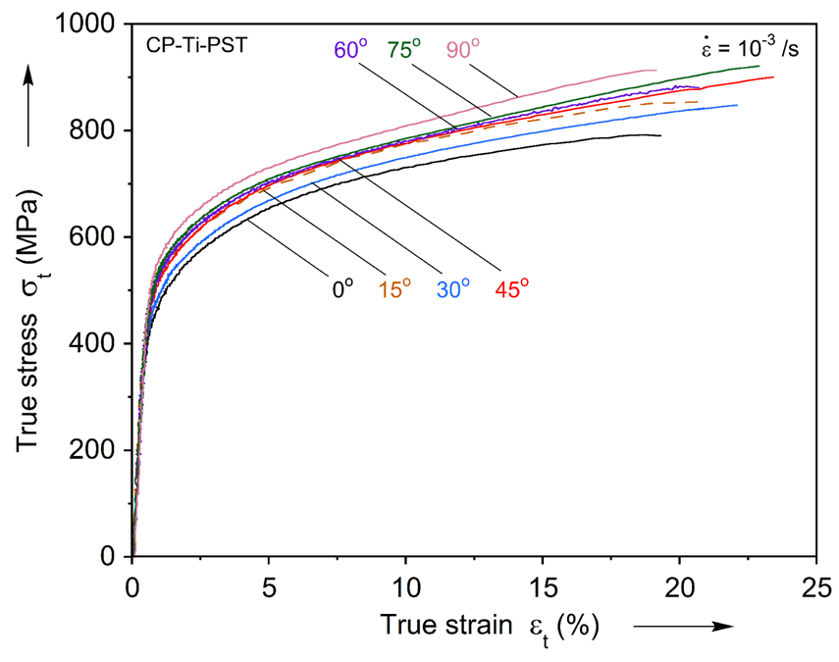
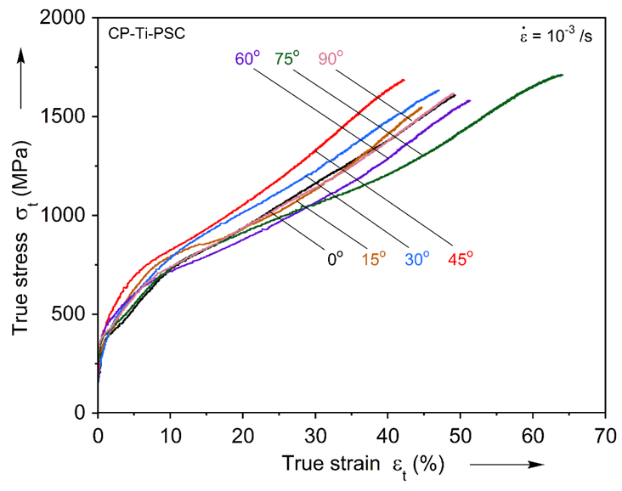
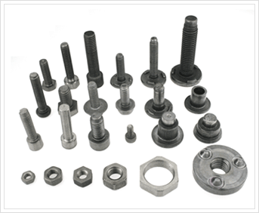

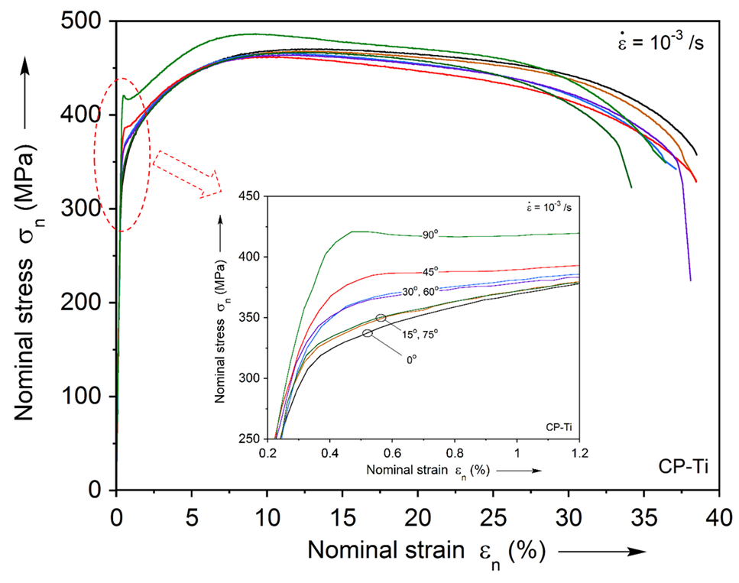
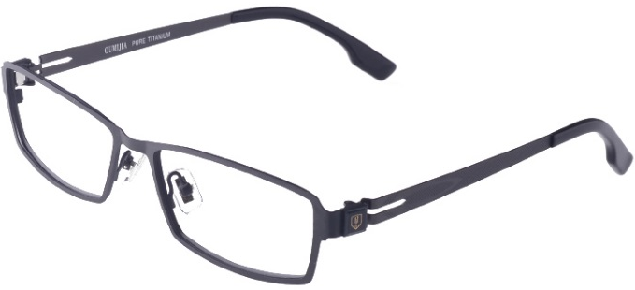
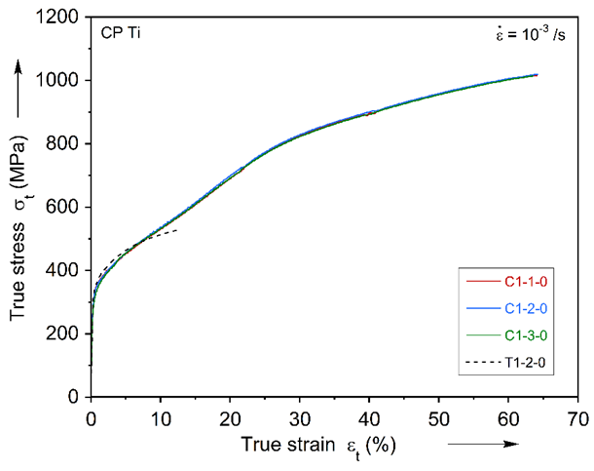
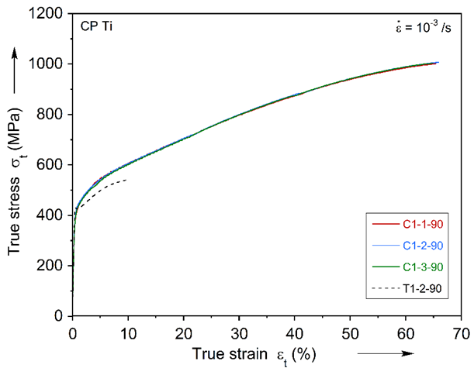
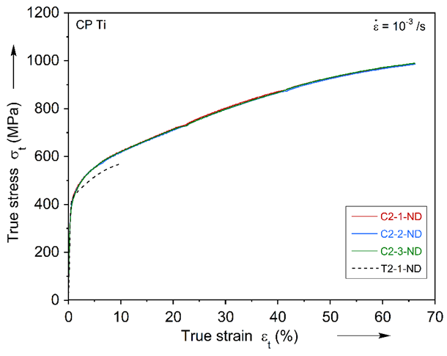
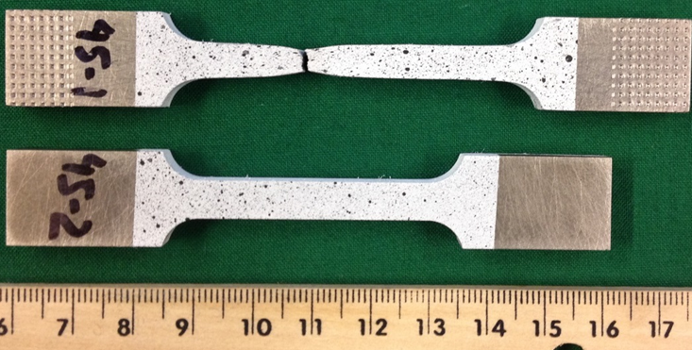
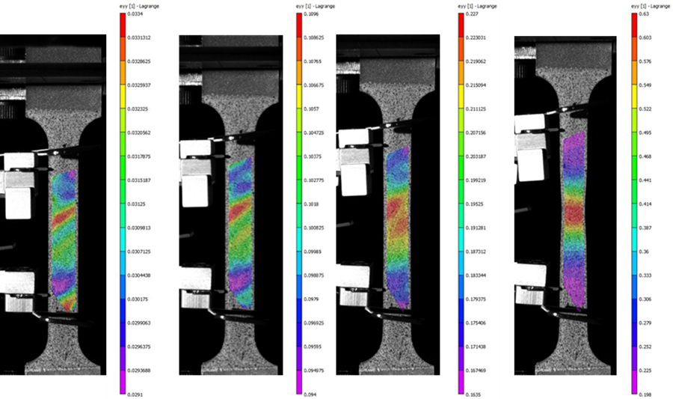
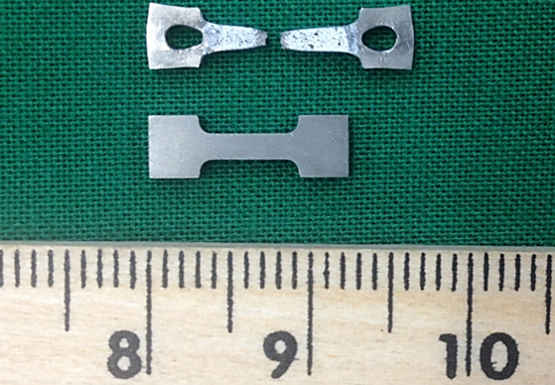
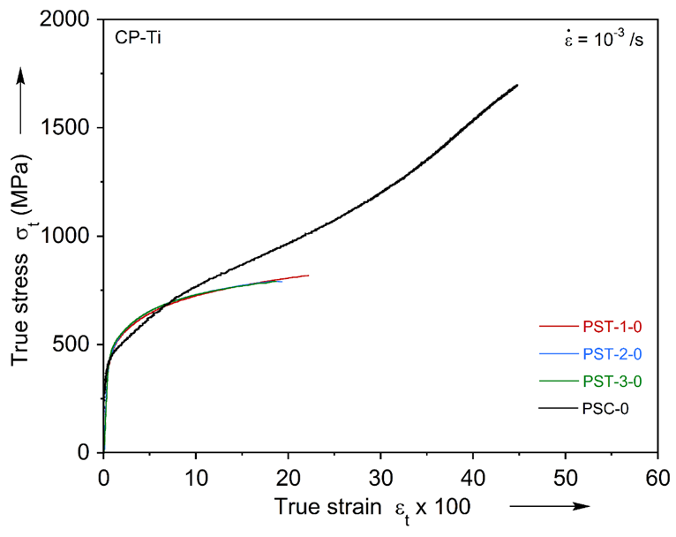
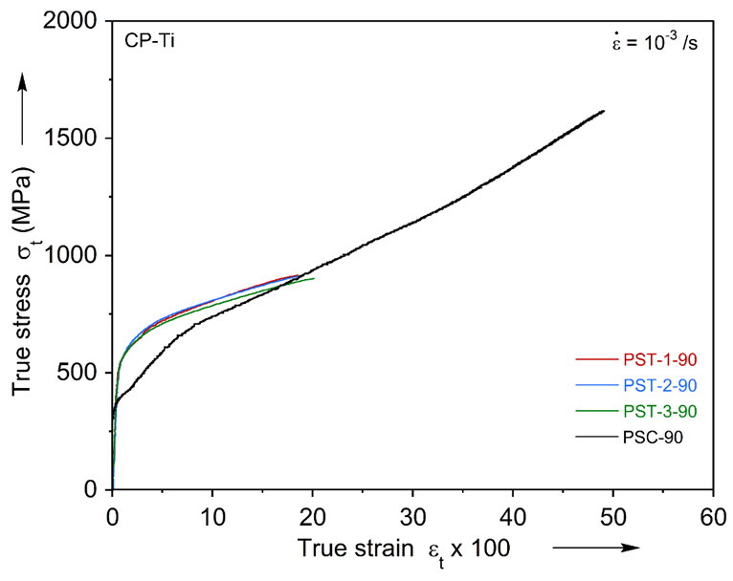
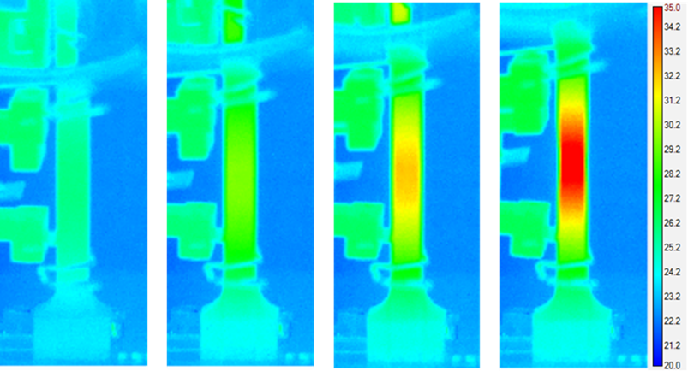
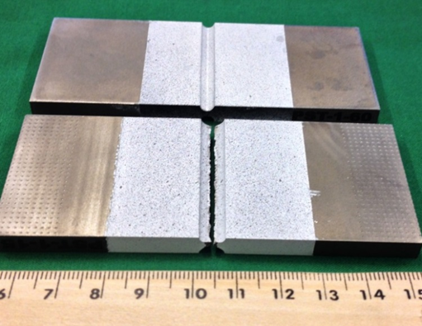
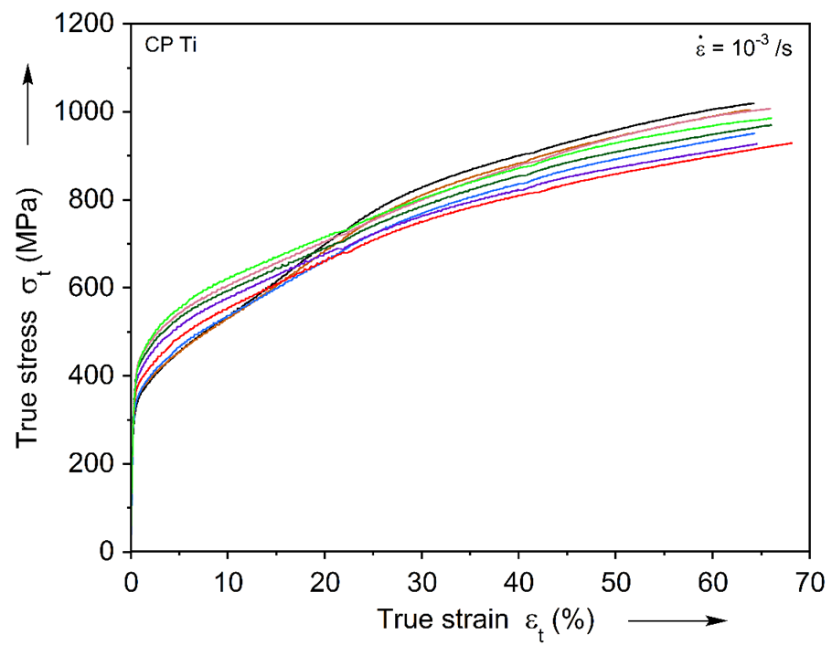
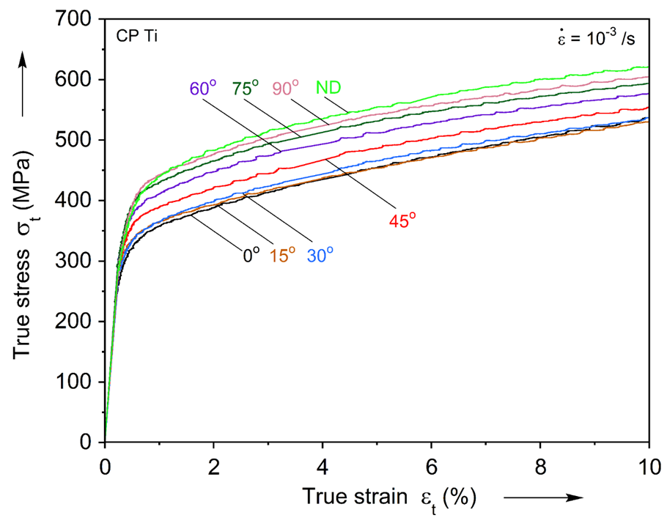
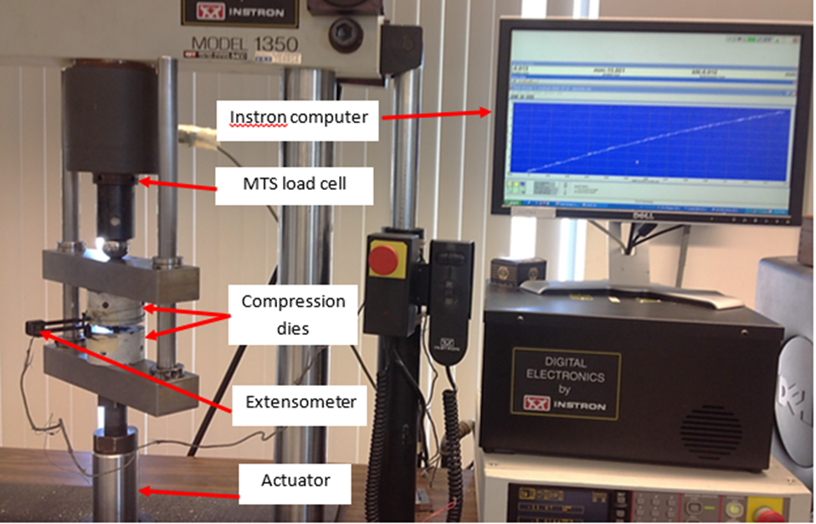
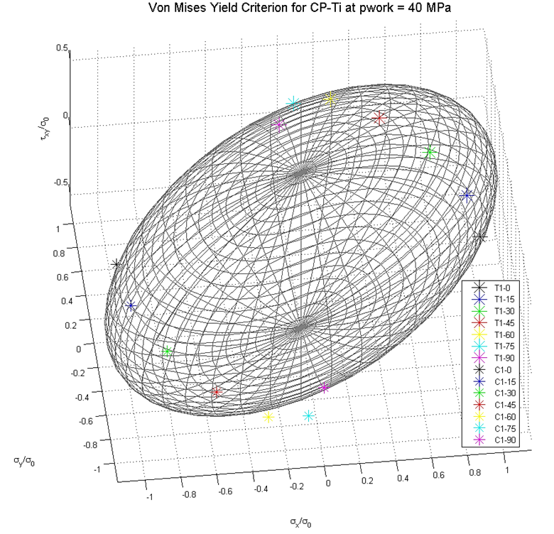
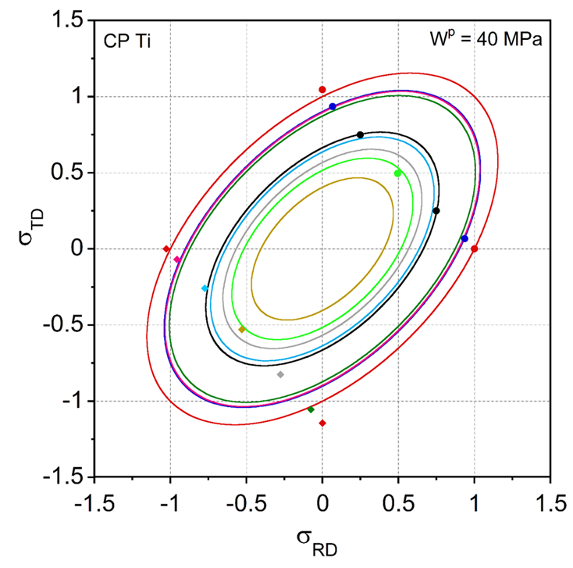
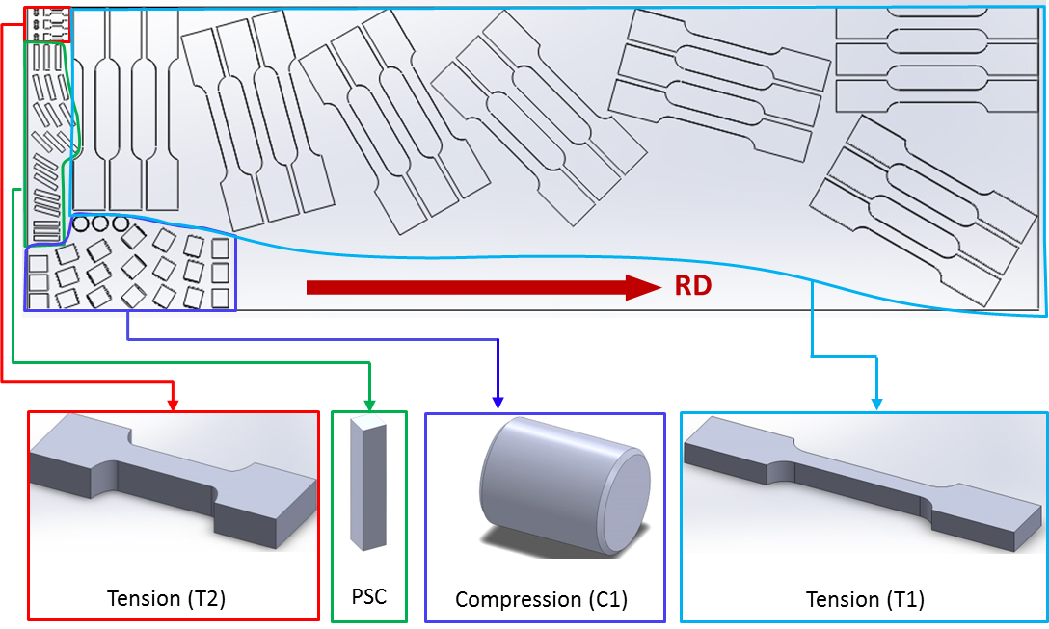
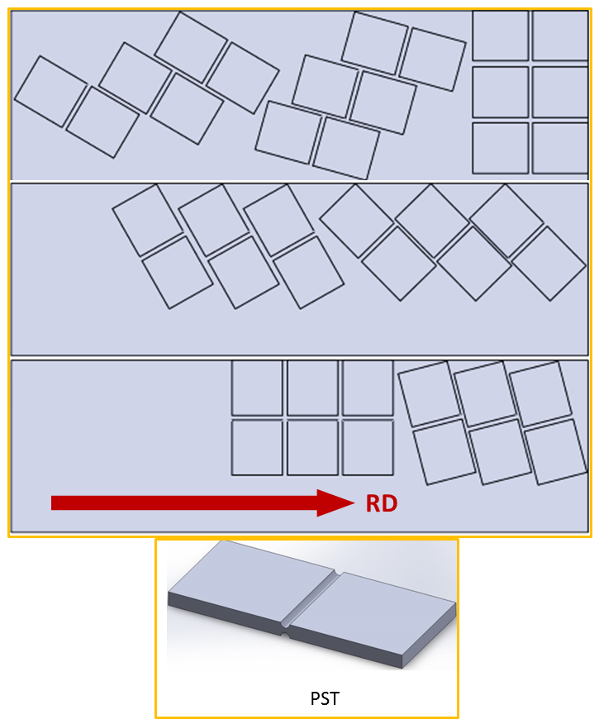
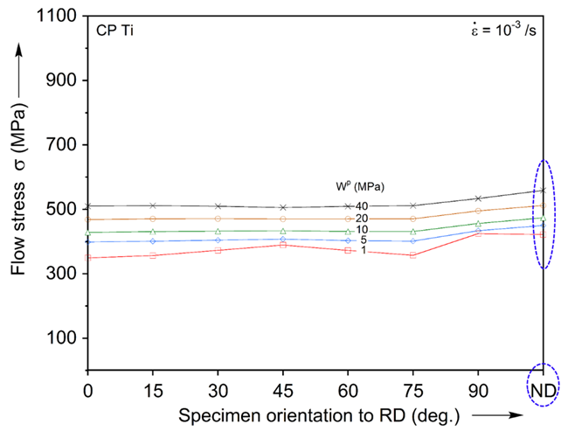
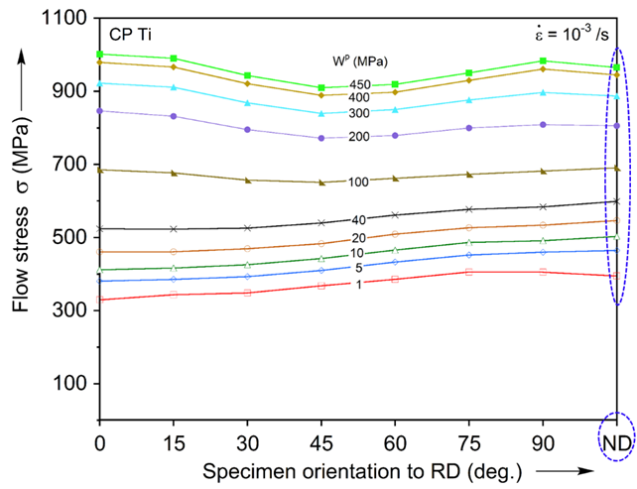
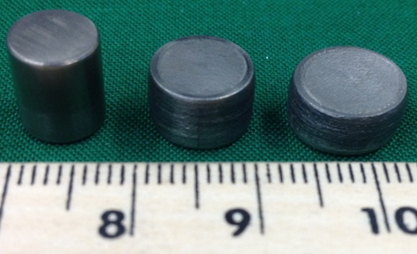
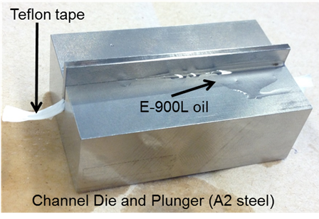
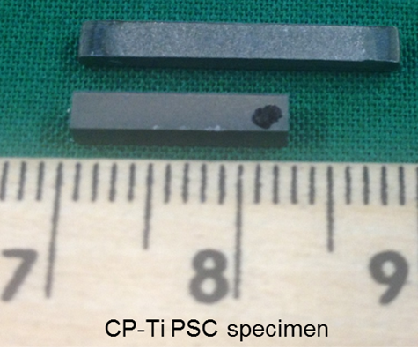




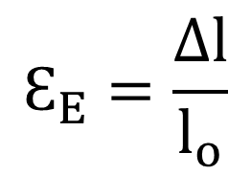
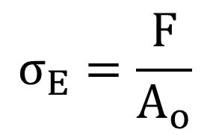
Anisotropy of Commercially Pure Titanium (CP-Ti)
Presenter: Madhav Baral Advisor: Prof. Yannis P. Korkolis
Project Objective: To assess the anisotropy of Commercially Pure Titanium using extensive material testing at various in-plane and through-thickness orientations with respect to rolling direction (RD) of a plate.
Motivation and Background
Experimental Setup and Procedures
Experimental Results
Results and Conclusions
Results: The load and displacement from the experiments can be reduced to obtain stress and strain relationship as shown:
$$σ_{E}=\frac{F}{A_{o}}$$
$$Ԑ_{E}=\frac{∆l}{l_{o}}$$
$$\left.σ_{T}= σ_{E}(Ԑ_{E}+1\right)$$
$$\left.Ԑ_{T}= ln(Ԑ_{E}+1\right)$$
True Stress-Strain Curves at orientations wrt to RD in plane strain tension (PST) and plane strain compression (PSC)
Standard tension experiments using MTS and 3D DIC system
Titanium parts and components used in various commercial products
Motivation: Titanium has higher strength to weight ratio, excellent corrosion resistance, and higher temperature resistance than conventional steel alloys. Today, the need of such material in the aerospace, nuclear, automobile, medical, sports, and fashion industries is increasing. For example, the strict CAFE regulation requires the auto manufacturers to drastically increase the fuel efficiency of their vehicles in near future. One of the promising ways to resolve this issue while maintaining the safety standard is by using higher strength and lighter weight materials like Titanium.
CP-Ti Asymmetry in uniaxial tension-compression in RD, TD, and ND
Engineering Stress-Strain Curves at orientations wrt to RD in tension
Introduction: Anisotropy in materials is induced due to certain texture patterns that are produced during the manufacturing process. This leads to inconsistency in material properties in the rolling, transverse, and normal directions.
Tested tension specimens, Digital Image Correlation Images and Infra-red thermal Images of specimens
CP-Ti Asymmetry in plane strain tension (PST)-compression (PSC) in RD and TD
True Stress-Strain Curves at orientations wrt to RD in compression
Layout of CP-Ti specimens on a rolled plate with respect to the rolling direction
Yield Surface and Plastic Work Contour predicted with von-Mises Yield Criteria revealing a need for an appropriate yield function
Objective: To assess (quantify) the anisotropy of CP-Ti using Uniaxial and Plane Strain Tension and Compression tests at different orientations with respect to RD. To generate enough experimental data points (stress tensors) at different deformation levels in order to calibrate an appropriate yield function that can be implemented in commercial Finite Element Analysis (FEA) packages to model the material.
Conclusions: The anisotropy and asymmetry of CP-Ti in tension and compression is established by performing different types of uniaxial, through-thickness, and plane strain tension and compression tests at various orientations with respect to rolling direction of a plate. The obtained results will be used to calibrate an appropriate anisotropic yield function that can be implemented in FEA for simulation and modeling purposes.
Uniaxial compression and plane strain compression specimens
Flow Stress evolution in Tension and Compression revealing Anisotropy and Asymmetry
University of New Hampshire, Department of Mechanical Engineering
Presented at the Annual Graduate Research Conference (GRC); April 14, 2015

