Slide 1


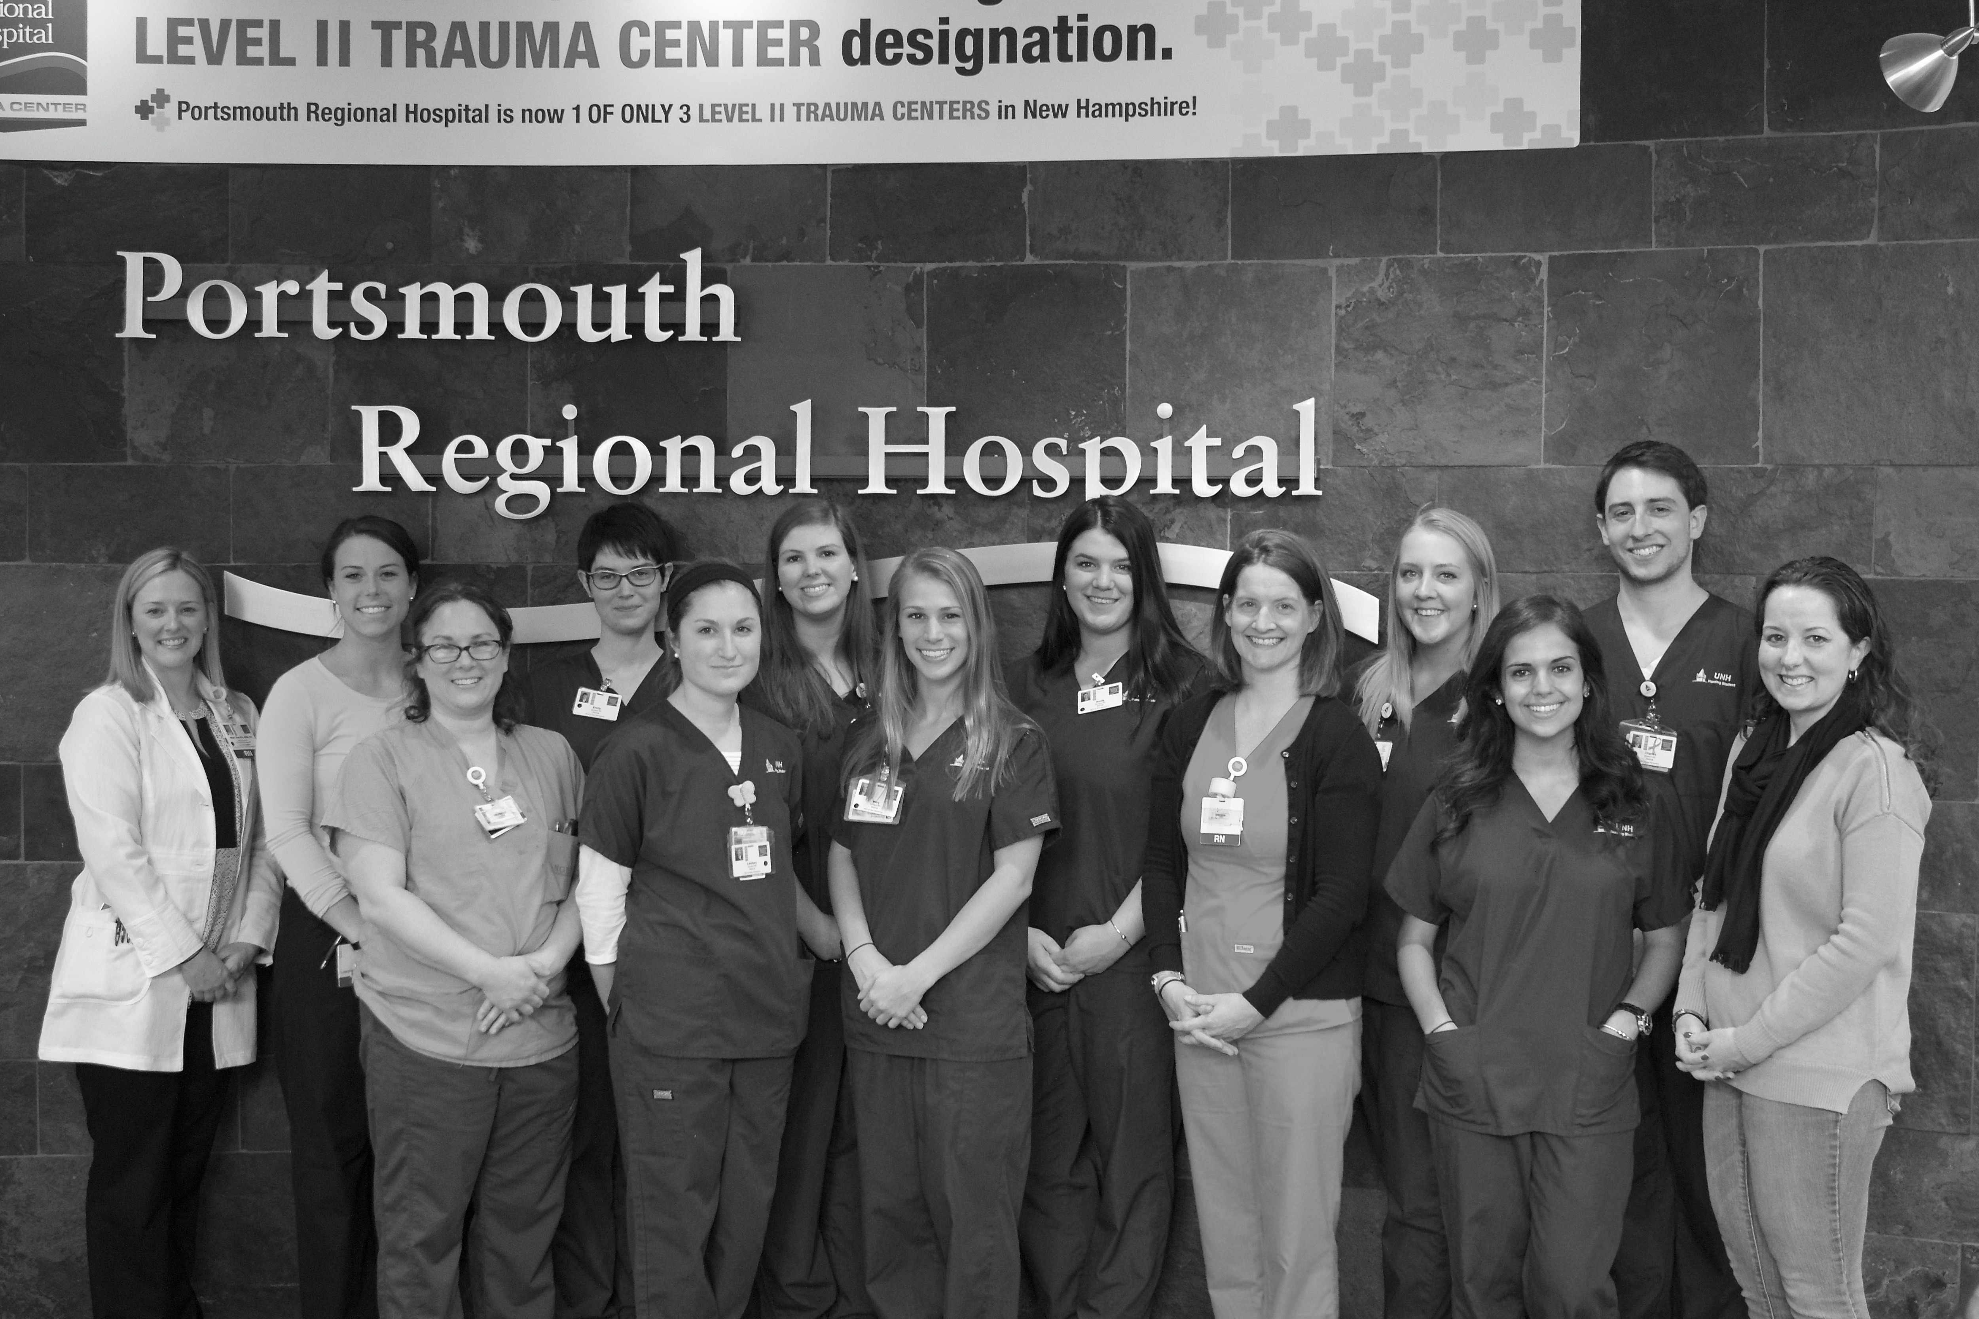
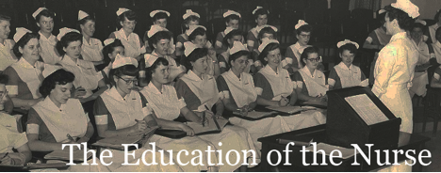
Evaluation of a New Dedicated Education Unit
Megan Gray, MS, APRN, FNP-BC, CNL
University of New Hampshire and Portsmouth Regional Hospital
Introduction
Improving healthcare quality and safety through the translation of evidence into practice is intricately tied to the education of nurses, both at the pre-professional and practice levels (Future of Nursing, 2011). To achieve the requisite knowledge, skills and expertise required of nurses for today’s complex clinical arena, new models of pre-licensure clinical education and professional development in nursing are needed. One such model is a dedicated education unit (DEU). The DEU is believed to enhance the learning of pre-licensure students through an immersive experience in clinical practice as well as enhance the adoption of evidence-based practices (EBP) by forging partnerships between clinical agencies and nursing schools. In the DEU, students work directly with experienced nurses, and this learner-nurse dyad is then provided support and guidance through strong role modeling in evidence based practice from knowledgeable faculty.
Methods
A longitudinal descriptive study design was utilized to evaluate the DEU implementation and it’s impact on nurses and students self-efficacy and patient satisfaction. After receiving university and hospital institutional review board approval, formative evaluative strategies were initiated to explore the following objectives:
The influence a DEU has on staff nurses’ self-efficacy related to evidence-based practice.
The influence a DEU has on student general self-efficacy
The experience of patients who were cared for by DEU students and nurses via patient questionnaire surveys.
The student perception of the clinical learning environment, the role of the clinical instructor, and clinical teacher.
Conclusion
Overall, the findings from this implementation project support the continuation of the DEU and begins to describe the difference between DEU and non-DEU on key variables considered to be important to promote safe and effective nursing practice.
Results
RNs
Patients
= Responsiveness of staff, NH State average 70%*
= Communication with nurses, NH State average 80%*
Theme #1: Unintended benefits Theme #2: Breath of Fresh Air
“Very helpful, good listener, helped with all of my care, overall very pleasant” Pt. 1
“Very engaging, professional, they will be very good” Pt. 2
“Did well explaining things, nurse was hands off, let her (student) do things herself” Pt. 3
“Great to see teamwork which is important in healthcare, student was ambitious, seems to be enjoying what they are doing, very important” Pt. 4
UNH Nursing Students

