Slide 1
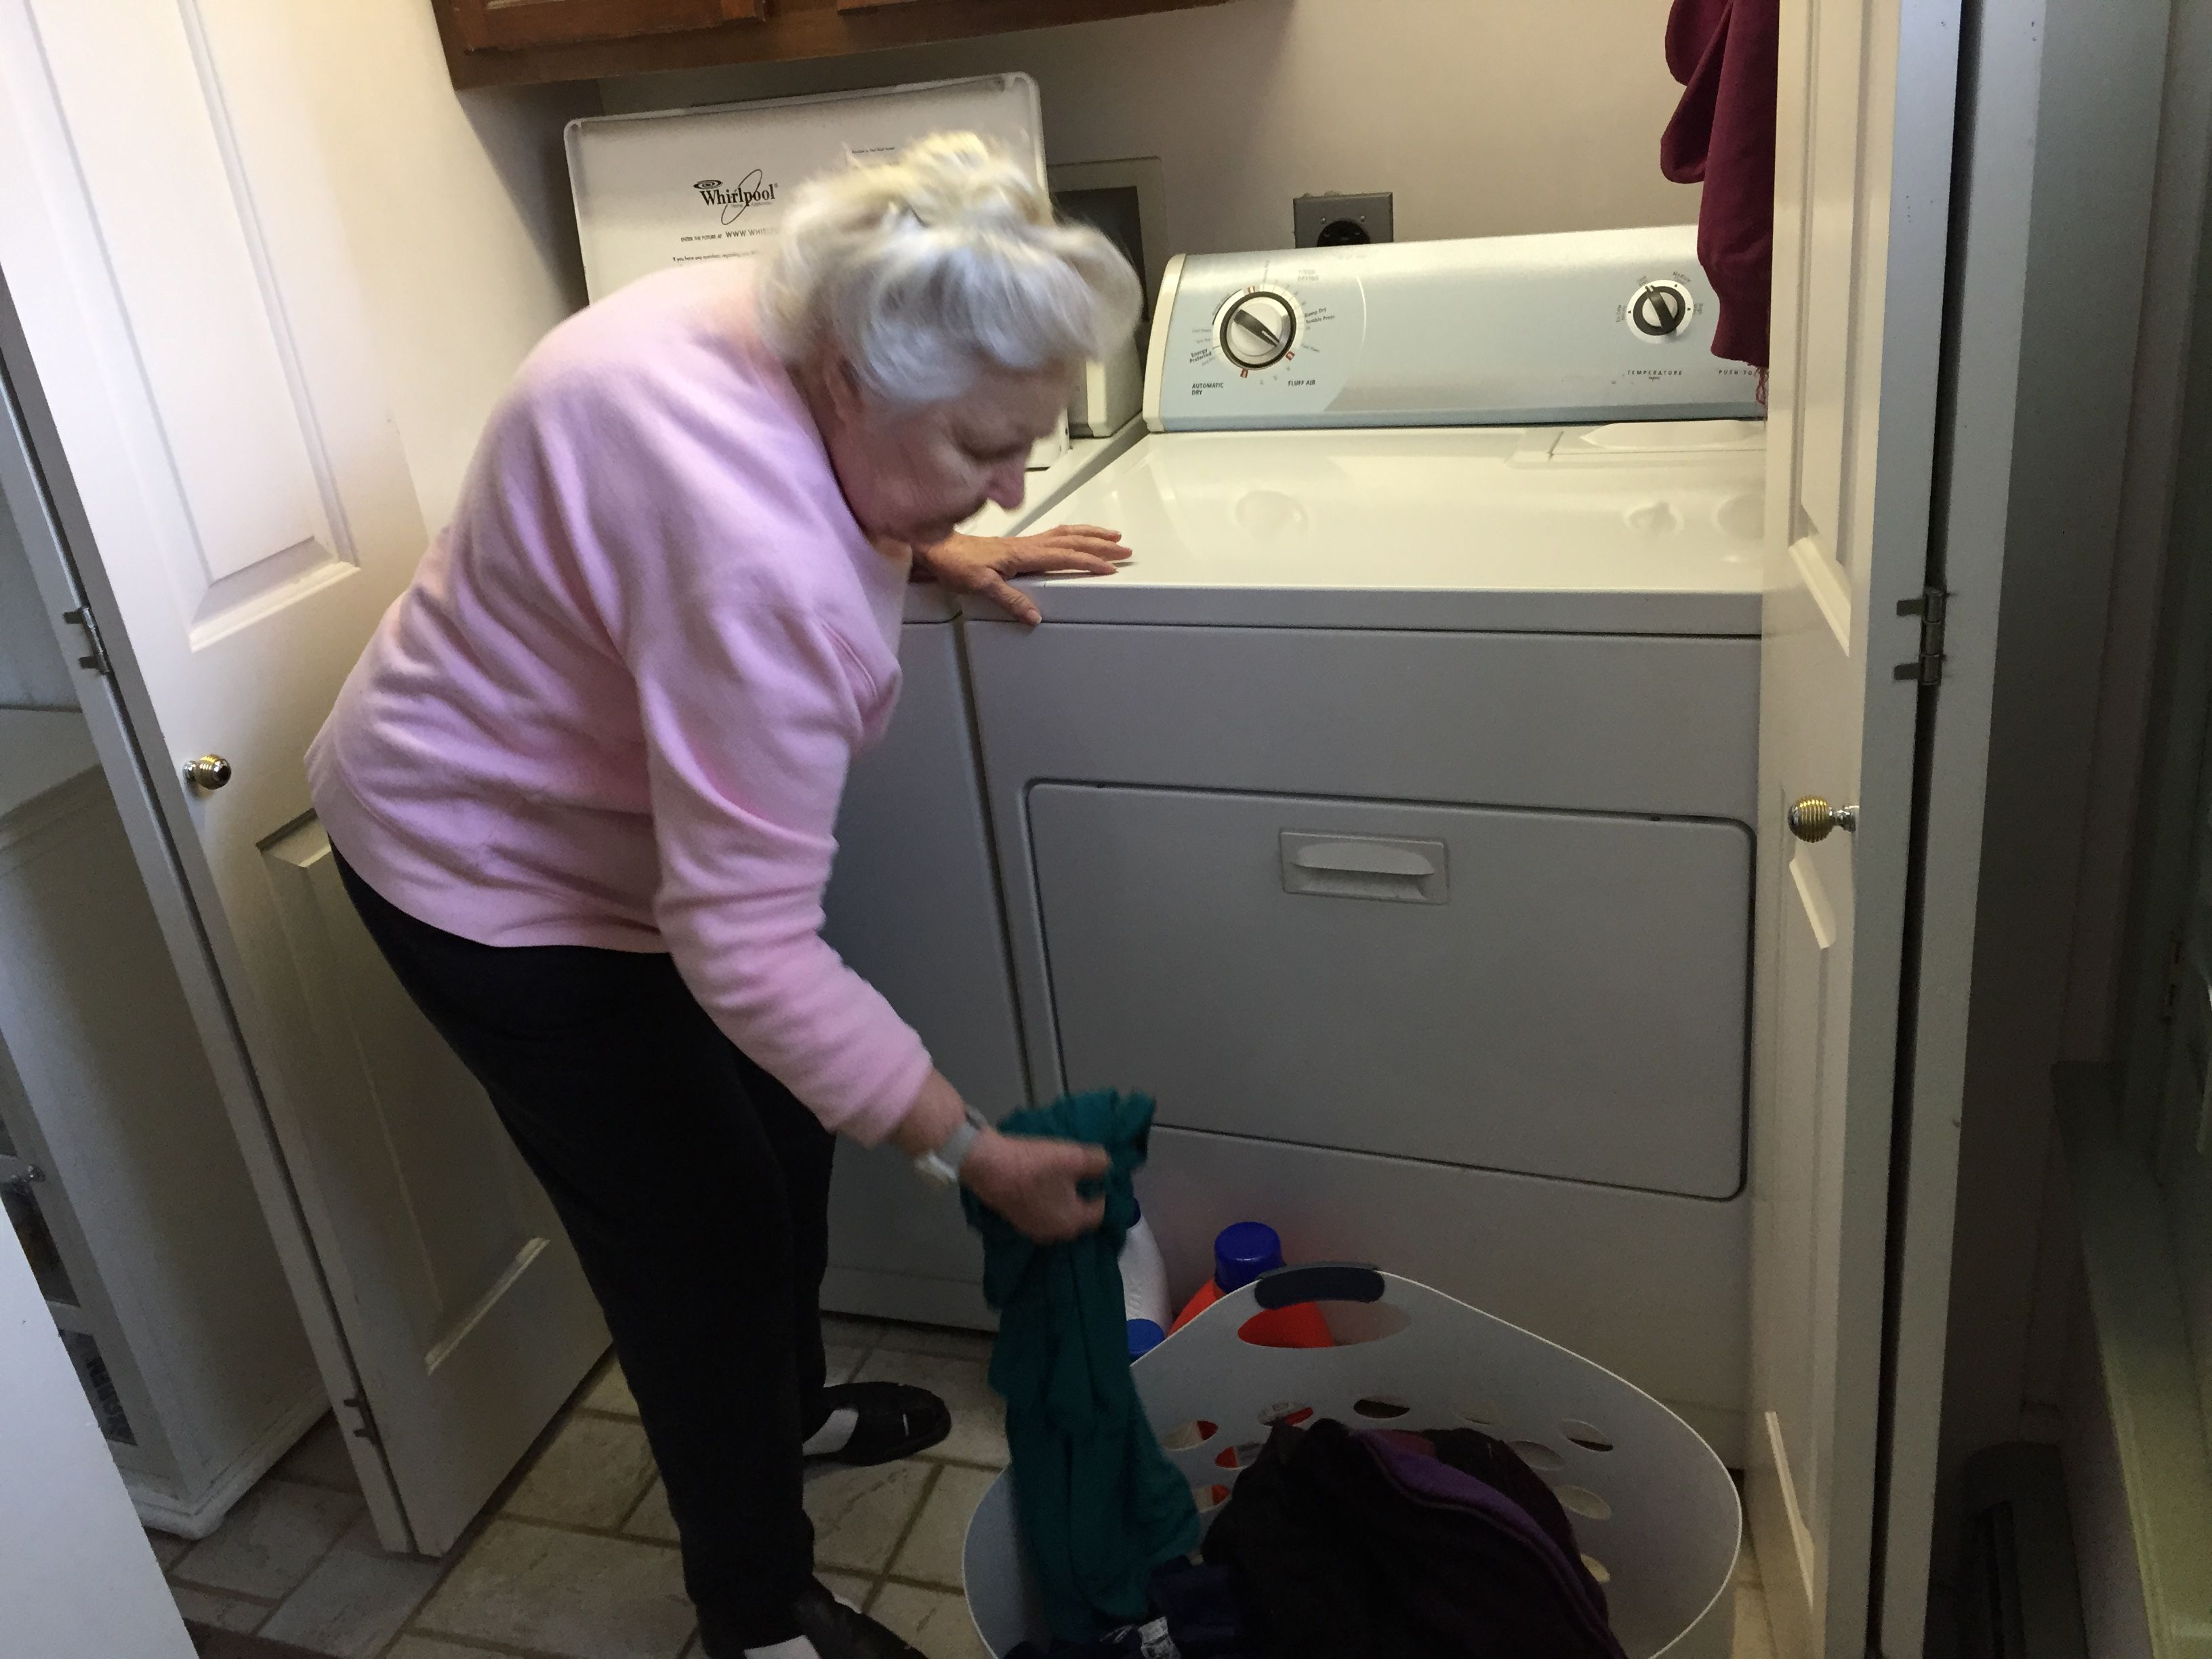
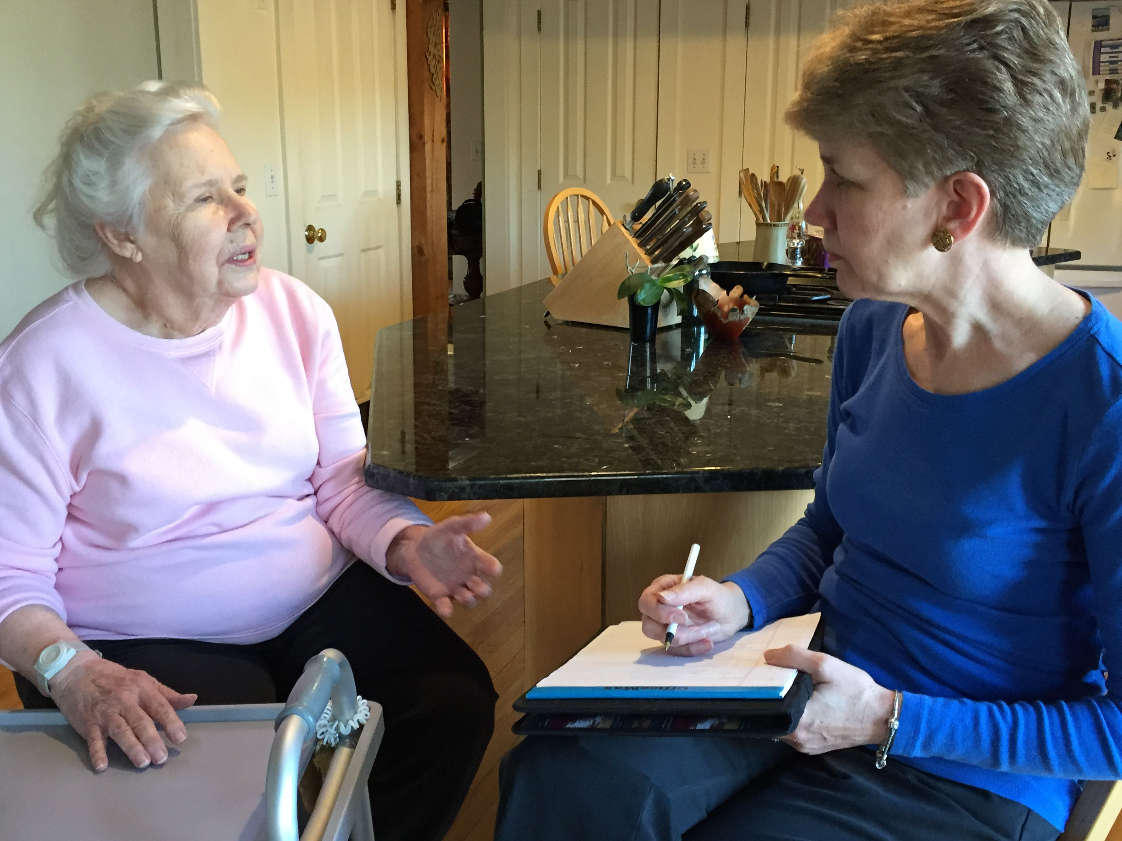
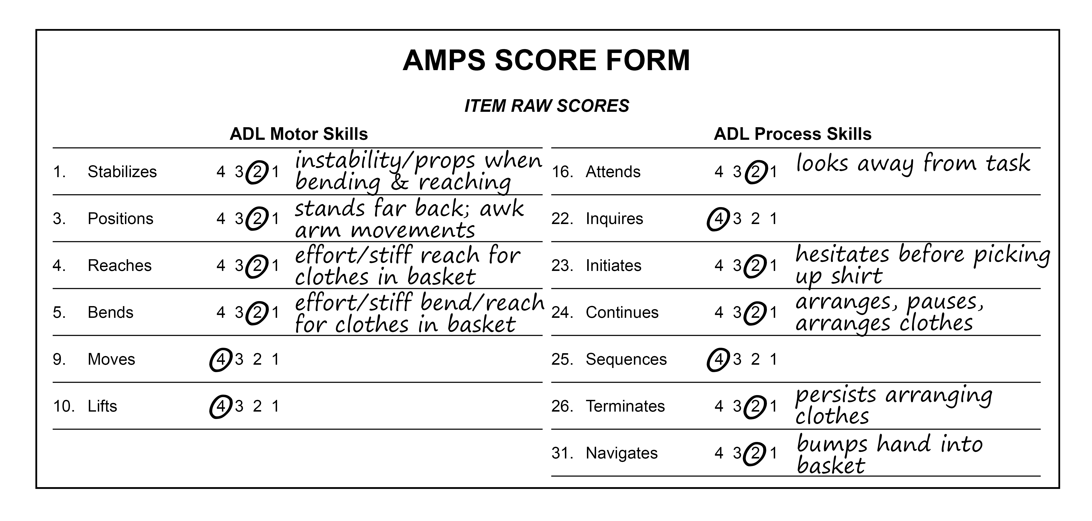
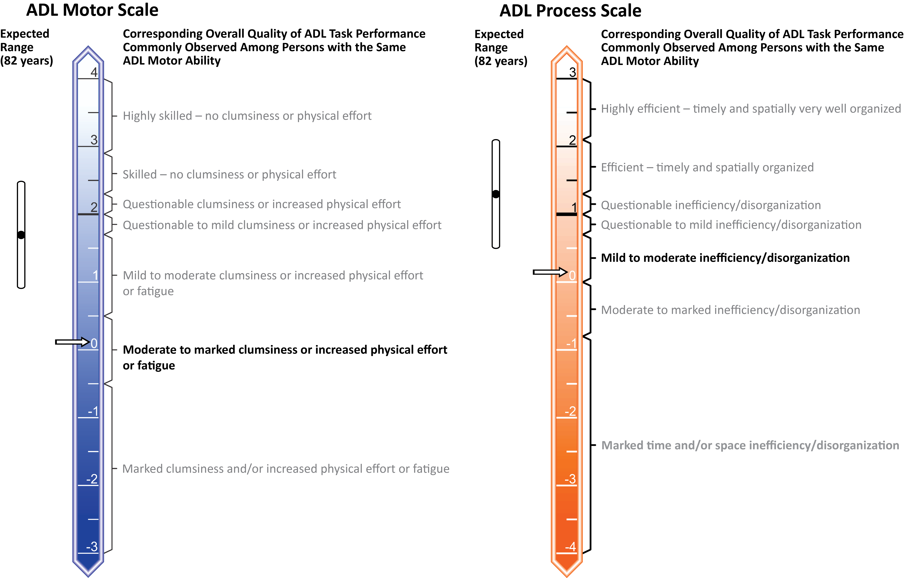
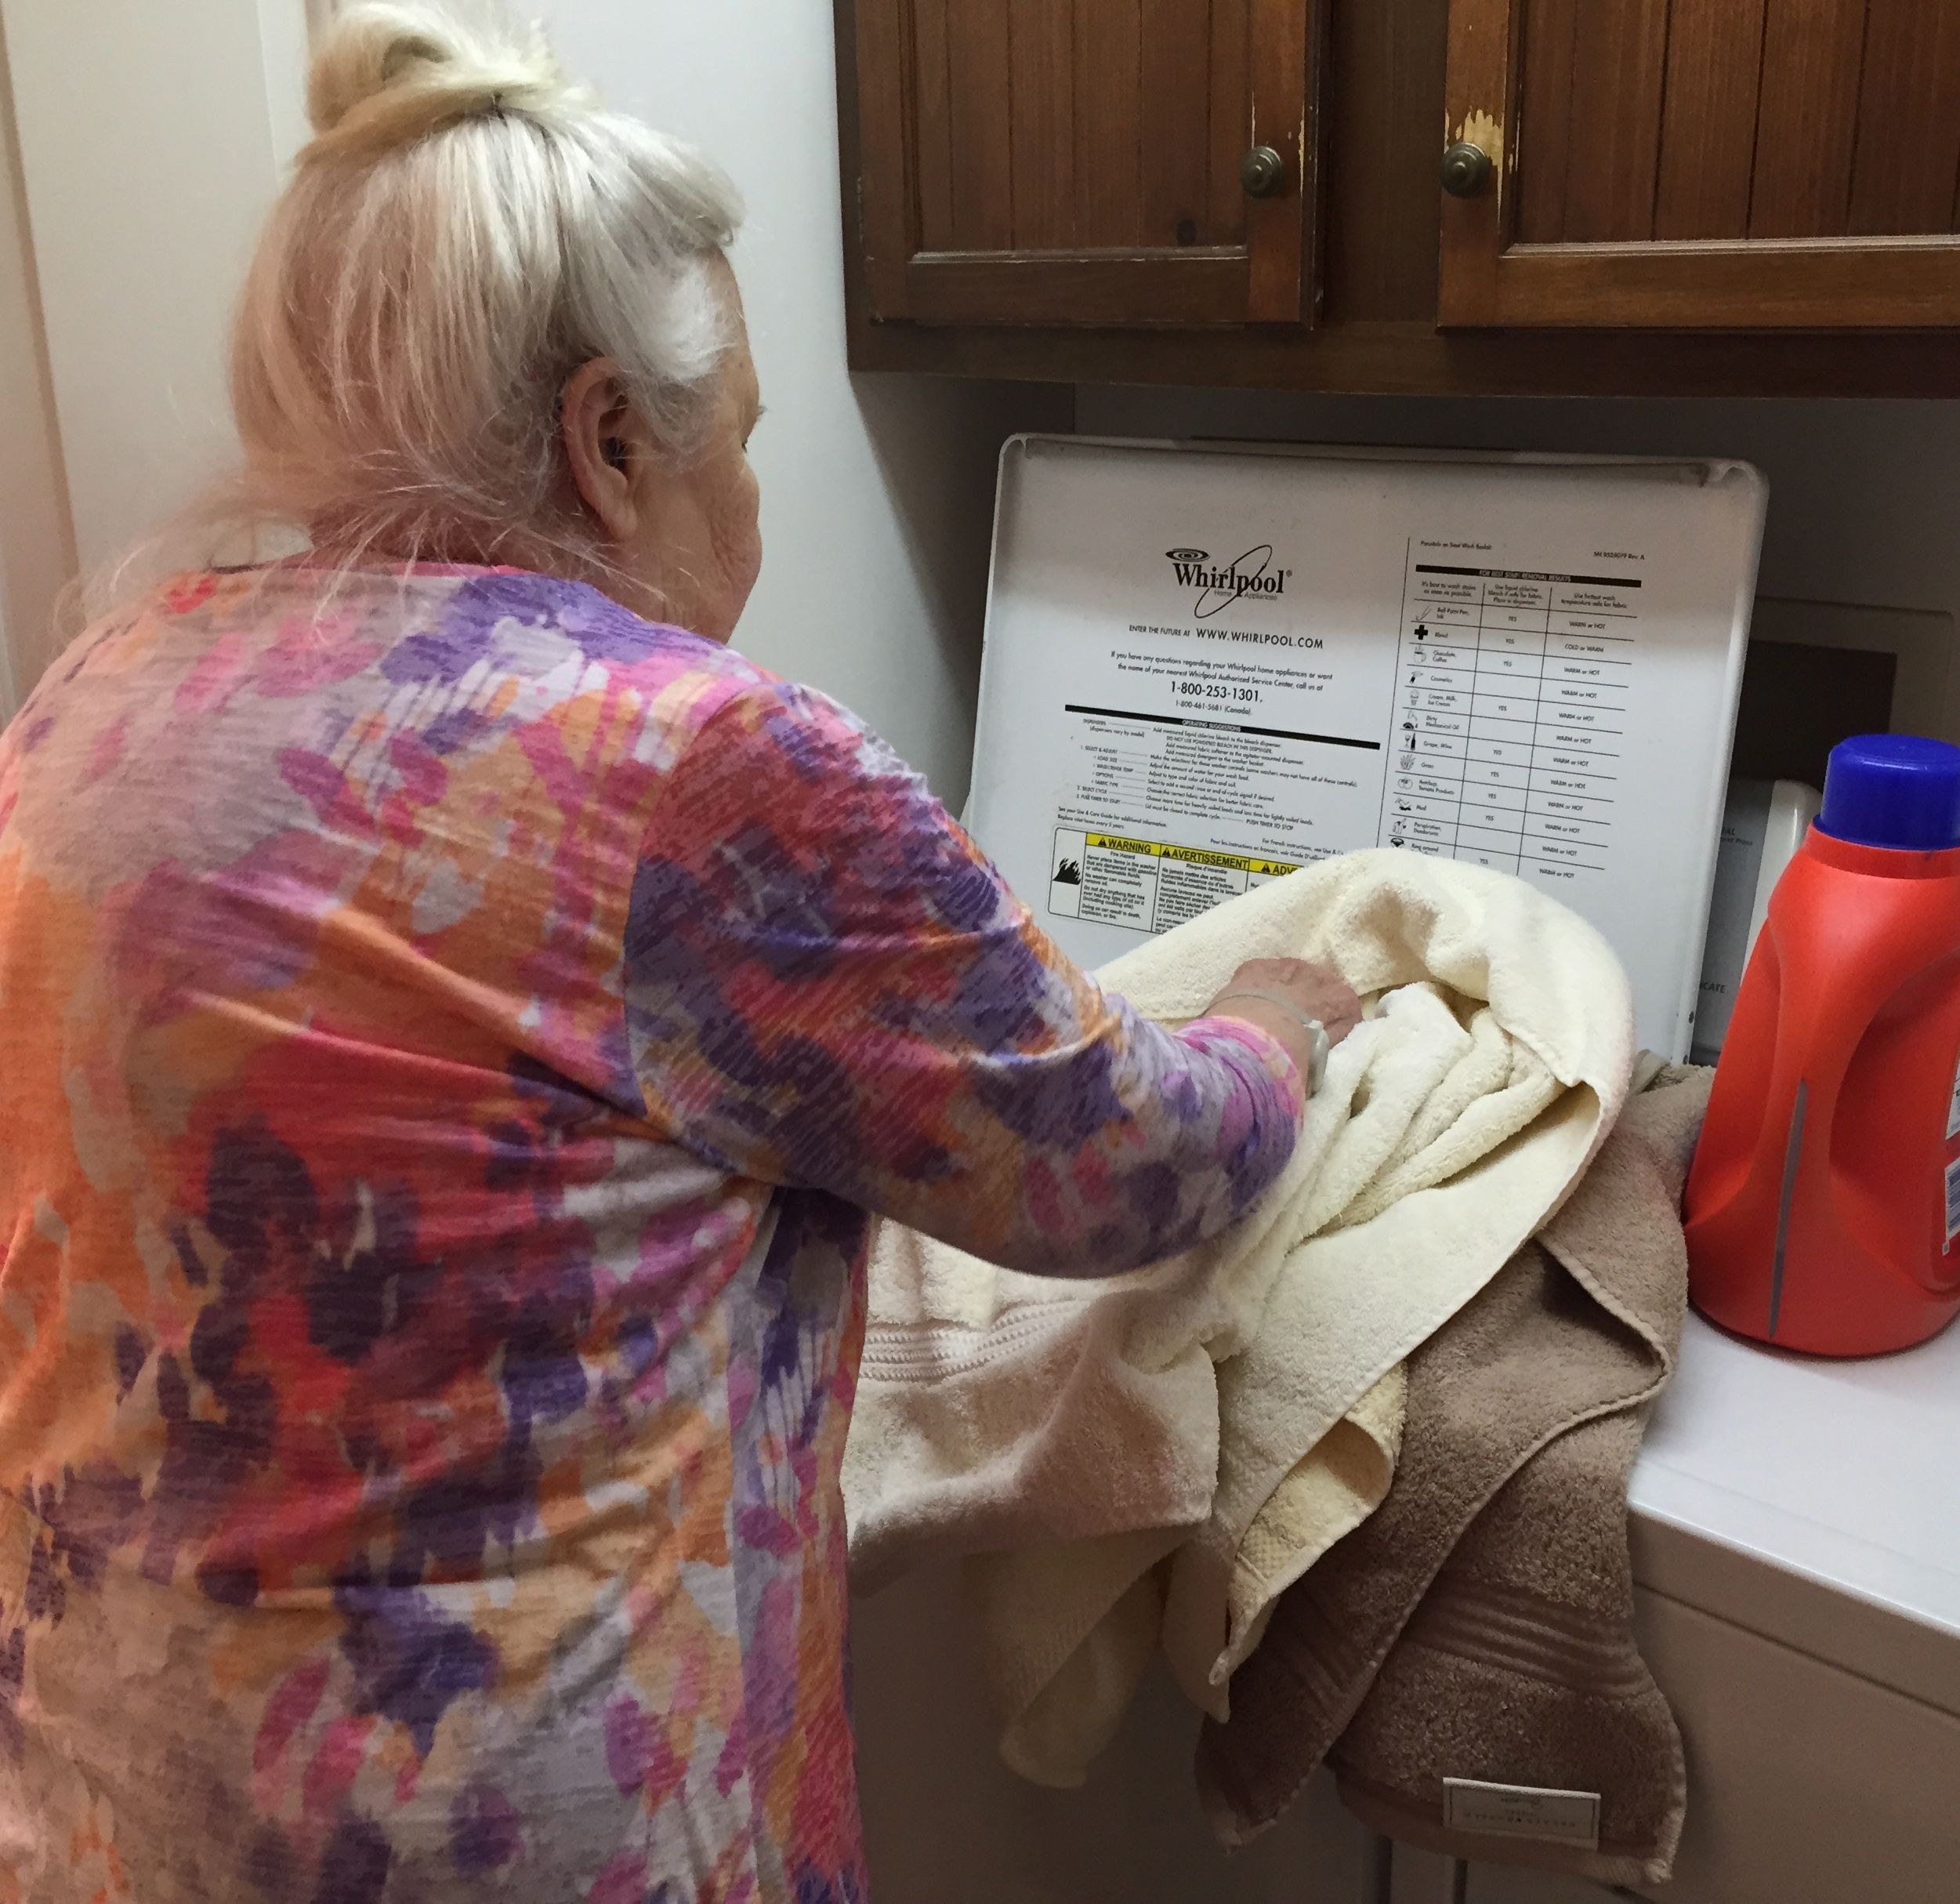
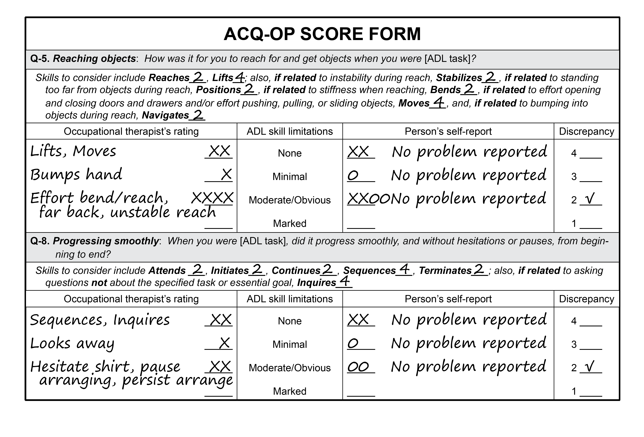
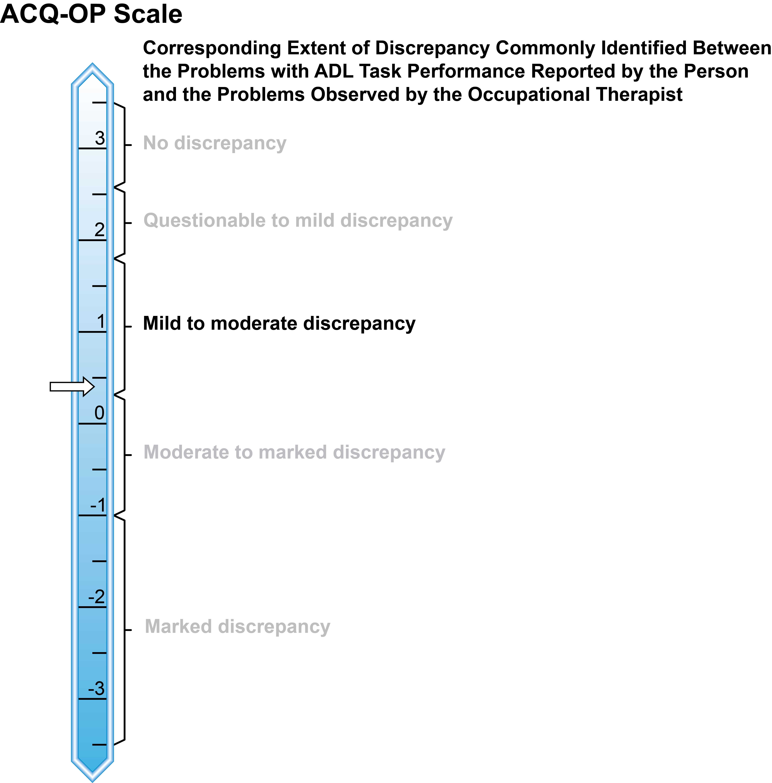
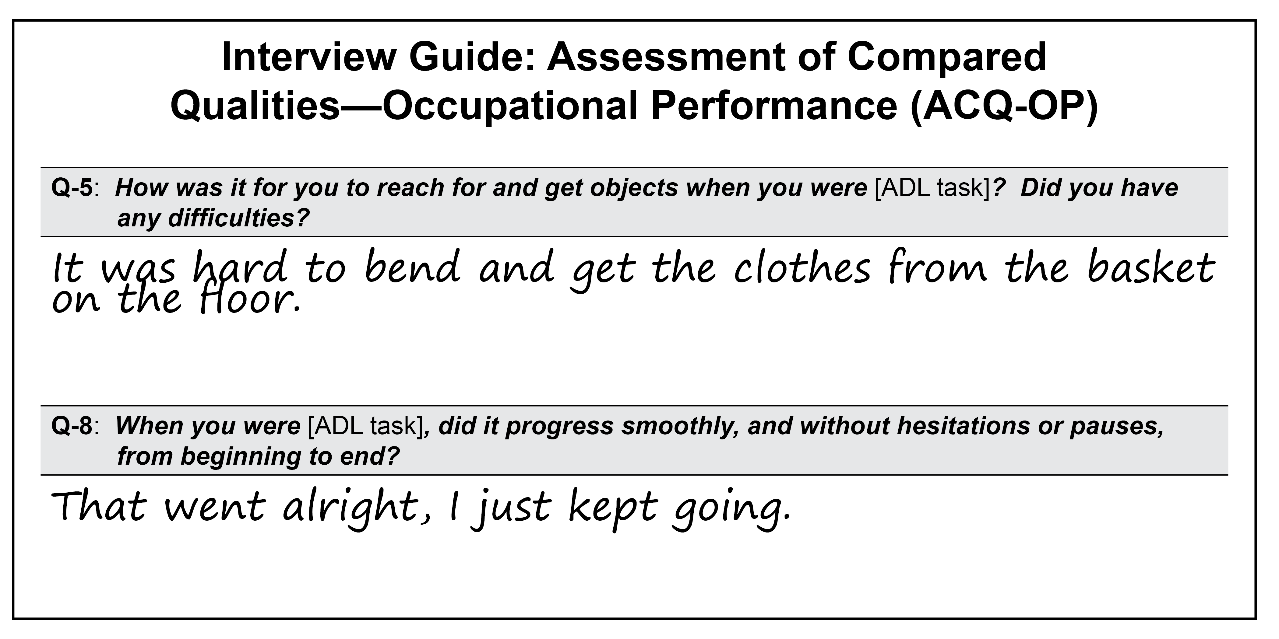
Assessing the Discrepancy Between Observed and Self-Reported Occupational Performance:
Implications for Intervention
Lou Ann Griswold, PhD, OTR/L, FAOTA, University of New Hampshire
Anne G. Fisher, ScD, OT, FAOTA, Division of Occupational Therapy, Umeå University, Sweden
Anders Kottorp, PhD, LegOT, Division of Occupational Therapy, Karolinska Institutet, Sweden
Observe Performance
Gather Person’s Perspective
Score Assessments
Interpret Results
Plan & Provide Intervention
Assessment of Motor and
Process Skills (AMPS)
Assessment of Compared Qualities—
Occupational Performance (ACQ-OP)
AMPS and ACQ-OP
AMPS and ACQ-OP
Compensatory model and
adaptive occupation
Moderate discrepancy indicates
need for compensatory strategies
focused on modifying the physical environment
Place laundry on dryer
Store laundry soap on dryer
Cue card on cupboard specifying steps of task
Observe the person performing
two familiar, relevant tasks
  Client-centered
  Occupation-based and -focused
  Criteria-referenced scoring
  Standardized measure of
  ADL task performance
Occupational therapy interview:
Global occupation-focused self-report
AMPS: Occupation-based, occupation-focused evaluation of task performance
ACQ-OP: Specific occupation-focused self-report
Supports collaborative and client-centered practice
Provides information on desired occupation and perceived general strengths and challenges
Affirms the person’s insider viewpoint
Provides initial information to guide further evaluation
Lacks detail needed to plan intervention
Provides specific information on strengths and problems
with occupational performance
Provides detailed outsider’s observed viewpoint
Supports specific client-centered and occupation-focused goals
Guides intervention planning to address specific performance problems
Provides detailed insider’s viewpoint
Allows direct comparison of the person’s perspective with that of the occupational therapist
Supports collaborating with person to select appropriate
intervention strategies that reflect person’s needed support
- Larger discrepancies (i.e., lack of a shared perspective)
Can hinder collaborative goal-setting and intervention planning
May indicate the need to implement compensatory strategies
For more information: http://www.innovativeOTsolutions.com

